Slide 1
CR-GR-HSE-405 Industrial hygiene
M&S: which differences between CR-GR-HSE-405 and CR-MS-HSEQ-501 ?

Slide 2
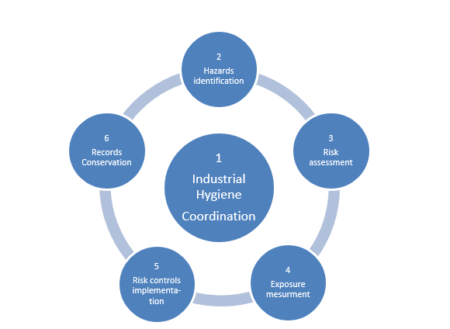
INDUSTRIAL HYGIENE
The chronic risks prevention approach is based on 6 main steps

Slide 3
REQUIREMENT OVERVIEW
Requirement 3.1.1 : Industrial Hygiene Coordinator
An Industrial Hygiene Coordinator is identified at the appropriate level in the entity or affiliate and has the competencies adapted to manage chronic risks associated with the workplace.
The competencies are acquired via a qualifying experience or a Group internal training.
No change
Requirement 3.2.1 : Hazard Identification, Assessment and Control of Chronic Risks at the Workplace
Chemical, biological, physical, ergonomic and psychosocial hazards are systematically identified and their related short, medium and long-term risks at the workplace are assessed and controlled.
The risk assessment covers all the workplace tasks, according to three criteria: hazard severity, task frequency, and exposure probability.
No change

Slide 4
REQUIREMENT OVERVIEW
Requirement 3.2.2 : Availability of Material Safety Data Sheets (MSDS)
An up-to-date MSDS, compliant with the current legislation, is available for every hazardous chemical present at the workplace.
No change
Requirement 3.2.3 : Update of the Chronic Risks Assessment
The workplace chronic risk assessment is regularly updated and is recorded in a dated document.
No change
Requirement 3.2.4 : Measurement of Occupational Exposures
Measurements of potential occupational exposures (quantitative evaluation) are conducted when the outcomes of the qualitative risk evaluation do not allow for a precise determination of the risk level.
No change
Requirement 3.2.5 : Chronic Risks Reduction Measures
An action plan is developed prioritizing first hazards elimination, then collective and organizational protections, and finally personal protective equipment. It is reviewed yearly.
No change

Slide 5
REQUIREMENT OVERVIEW
Requirement 3.3.1 : Document Retention
Information related to workplace risk assessments, in particular the following, are preserved in a secured manner in line with the Group’s document retention policy or in line with local regulations if they are more stringent:
Risk assessment documents;
Task analysis documents;
Action plans;
Results of occupational exposure measurements;
Incident reports related to accidental exposures;
Any other document providing information on the work positions (job description, HSE trainings received, HSE competencies acquired, etc.);
Any other information related to the technical progressions that contributed to the improvement of work conditions.
No change

Slide 6
REQUIREMENT OVERVIEW
Requirement 3.4.1 : Information Provided to Personnel
Permanent or temporary personnel that have a potential of exposure are informed about the present workplace hazards and the preventive measures implemented.
No change
Requirement 3.4.2 : Communication to the Medical Surveillance Team
In order to ensure that the medical surveillance is appropriate to the occupational risks of the position, the following are communicated to the medical surveillance team of the entity or affiliate:
Results of the risk assessment including the occupational exposure measurement results when available;
Known past occupational exposures, if applicable.
No change
Requirement 3.4.3 : Notification to Medical Personnel
Personnel under medical treatment (prescribed or not) are to notify the on-board medical personnel.
Not applicable for M&S

Slide 7
REQUIREMENT OVERVIEW
No specific requirements for performance measurement
Industrial hygiene performance indicators are defined and monitored.
Industrial hygiene related subjects are addressed as part of the HSE performance reviews where the effectiveness of the action plans is evaluated and improvement actions are decided.
Guide GM-GR-HSE-406: Self-Assessment in Industrial Hygiene is a tool for industrial hygiene self-assessment.

Slide 8
REQUIREMENT OVERVIEW: SPECIFIC REQUIREMENTS
Requirement 3.6.1 : Incident-Inducing Substances
A program to provide information on incident-inducing substances and ways to prevent their addiction is implemented.
Alcohol and drug testing is conducted as a minimum for people performing critical tasks.
New requirement for M&S
Requirement 3.6.2 : Asbestos and Refractory Ceramic Fibers Classified Carcinogen
Materials containing asbestos or refractory ceramic fibres classified as carcinogenic are not used for the construction of new buildings and installations.
If these materials are present in existing buildings or installations:
They are located by a person trained in their identification;
Their state is regularly monitored by a person trained in their hazards and in the risk controls to implement.
New requirement for M&S
Requirement 3.6.3 : Competent Person in Radioprotection
A competent person in radioprotection is designated as soon as NORM (Naturally Occurring Radioactive Materials) or artificial source of ionizing radiation are identified.
New requirement for M&S

