Slide 1
CR GR HSE 501 – HSE Requirements for Contractors

Slide 2
HSE Requirements for Contractors
Replaces existing Group & branches rules and defines 21 requirements
HSE requirements for:
Planning and Contract Preparation
Selection of Contractors
HSE management during mobilization, execution and demobilization
Closeout and performance evaluation
Contractor process monitoring and HSE performance improvment
Takes into account requirements from G70 – Zero fatality WG including:
New personnel (< 6 months in the business or on site)
Observation of high risk tasks
Actions in the event of fatal accident
Requirements adjusted according to the level of the HSE risk for the activity to be contracted (high, medium, low) and the type of contractual relationship (similar with IOGP 423 – e.g Mode 1: work in refinery, FPSO / Mode 2: drilling rig, closed construction site / Mode 3: construction yard).
Compatible with Purchasing process.
Does not apply to maritime, river and air transport services.
Applies to any new contract or renewal.
Effective date: within 6 months following publication
Group Dir Sec 5
RC CR RC HSE 133 & 149
MS CR MS HSEQ 204
EP CR EP HSE 071
GRP CR GP HSE 070
Notes:
The rule does not concern:
- The purchase of goods, equipment or materials manufactured or maintained outside the sites of the Group's operated domain;
- Financial or administrative services (such as banking, postal services, courier services, translation);
- Intellectual services (consulting / studies with staff not exposed to industrial risks)
- Transportation services by taxi and mailing services;
- Maritime, river and air transport services, which are already covered by directives:
Mode 1 : common one, works on site (maintenance, modifications of equipments, construction in site…)
Mode 2 : Drilling Rig typical case or closed construction site (fenced). The work is done by a company with its device and it applies the rules of its own HSE management system. There is a need for a bridging document to ensure the compatibility of the HSE management system of the entity and that of the contractor.
Mode 3 : construction yard typical case, spot transport or maintenance in client site for Lampiris or MS.

Slide 3
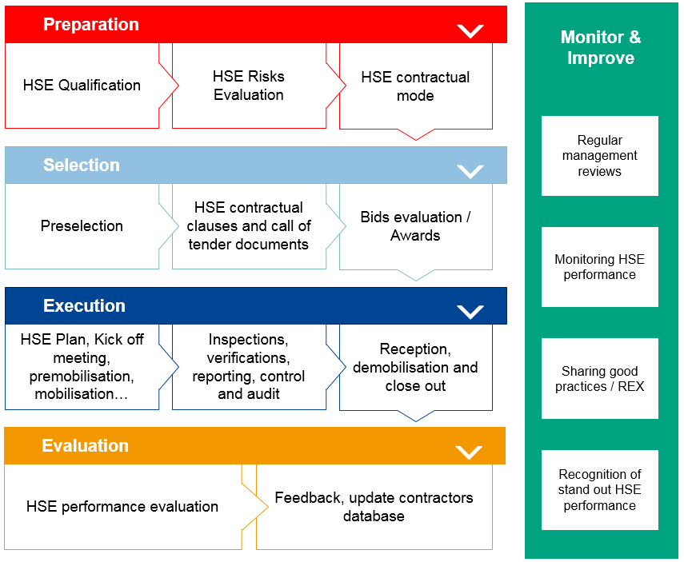
Rule structure : 4 phase process and monitoring
Notes:
Monitoring applies to all actors in the process, including EE

Slide 4
CR GR HSE 501 HSE Requirements for Contractors
Preparation – Contractors qualification
Minimum HSE criteria (Requirement 3.2.1)
Written commitment from the contractor to comply with all applicable local regulations and entity/affiliate HSE rules
Commitment from the contractor to provide competent and qualified personnel
For all high risk activities, a conformity inspection of the contractor is conducted. Will not be necessary if the contractor has a recognized certification of its HSE management system
Modifications:
Already exists in RC, MS, and GRP Company Rules
EP Company Rule only considers prior HSE performance. These criteria are detailled in GM-EP-HSE-071
Tracking and updating of contractors’ HSE qualification (Requirement 3.2.2)
Contractors HSE information is regularly updated (using the feedback following executed services) and a mechanism is in place to suspend/withdrawal from the list of qualified contractors in the event of breach of applicable HSE laws and/or regulations or the defined HSE contractual obligations.
Modifications:
Already exists in branch Company Rules and connected to TGP Sequana project (suppliers data base)
Notes:
ICC of MS answers to 3.2.1

Slide 5
CR GR HSE 501 HSE Requirements for Contractors
Preparation – Scope definition and decision to contract
HSE competency of the Technical Representative (Requirement 3.2.3)
Appointement of a Technical Representative with HSE competencies (including this rule, technical competence, general and specific HSE training)
Modifications:
Already exists in previous EP and RC Company Rules
New for MS and GRP because previous Company Rules did not specify. No major impact as the requirements are already in practice
Preliminary assessment of HSE risks (Requirement 3.2.4) and HSE contractual mode selection (Requirement 3.2.5)
classification of the contracted works according to three levels of risk (High, Medium, Low)
3 contractual modes
Mode 1 : Work on Total sites
Mode 2 : Work dones using the HSE MS of the contractor + bridging document (eg. Drilling Rig, closed construction site, etc.)
Mode 3 : Construction yards, transport, client intervention
Modifications:
Preliminary assessment of HSE risks already exists in previous branches rules
Contractual mode is new for all branches (based on IOGP 423)
Notes:
Mode 1 : common one, works on site (maintenance, modifications of equipments, construction in site…)
Mode 2 : Drilling Rig typical case or closed construction site (fenced). The work is done by a company with its device and it applies the rules of its own HSE management system. There is a need for a bridging document to ensure the compatibility of the HSE management system of the entity and that of the contractor.
Mode 3 : construction yard typical case, spot transport or maintenance in client site for Lampiris or MS.

Slide 6
CR GR HSE 501 HSE Requirements for Contractors
Selection of contractors
Pre-selection of contractors (Requirement 3.3.1)
Contractors are pre-selected from a database of qualified contractors including:
The ability to safely perform the contracted activities while limiting as far as possible the number of sub-contractors
The ability to control risks associated with contracted activities (prior HSE performance)
The ability to respond to specific HSE criteria if applicable
Modifications:
Already exists in previous branches Company Rules
Preparation of call for tenders and contractual HSE clauses
Preparation of call for tenders (Requirement 3.3.2)
The entity provides any relevant HSE information to contractors
Competent HSE resources from the entity are sufficient to assure the transcription of the general and specific HSE requirements
HSE evaluation criteria are defined and communicated to the contractors
HSE performance objectives and indicators are defined and communicated to the contractors
Modifications:
Already exists in previous branches Company Rules

Slide 7
CR GR HSE 501 HSE Requirements for Contractors
Preparation of call for tenders and contractual HSE clauses
Minimum HSE contractual clauses (Requirements 3.3.3 and 3.3.4)
The obligation to specify, based on HSE criteria, the part or parts of the service that cannot be subcontracted
The contractor obligation to declare all the subcontractors it intends to use, and the nature and extent of the services that will be subcontracted to them
The possibility for the entity or affiliate to refuse subcontractors proposed by the contractor on the basis of HSE criteria
The obligation to inform the entity of the presence of new personnel (<6 months in the business or on site) and to have an HSE support plan
Stricter requirements for services with medium and high risks in mode 1 (Golden Rules training, medical fitness certificates, HSE qualifications/certifications, HSE plan, and safety observations)
The obligation to comply with applicable HSE laws and regulations
The conditions where the entity or affiliate to suspend or terminate the contract
Communicatione on HSE performance of contractors
Conduction of safety observations
Modifications:
Limitation of the subcontracting, based on the nature of the activity (and not based on the number of levels : CR MS 1 level with particular conditions, CR EP 2 levels, CR GRP 1 level, CR RC « limitation of the number of level »)
Induction program for newcomers/new arrivals
Safety observations principle in line with G70 – Zero fatality WG requirements

Slide 8
CR GR HSE 501 HSE Requirements for Contractors
Preparation of call for tenders and contractual HSE clauses
HSE evaluation of tenders (Requirement 3.3.6.)
HSE evaluation of tenders is required for services with medium and high risks
The HSE proposals are objectively evaluated against the previously established HSE selection criteria
During the tenders evaluation, two lists of contractors are established distinguishing between the "capable contractors" that fully meet the HSE selection criteria, and the "potentially capable contractors" that partially meet the selection criteria (corrective or compensatory measures are defined and evaluated). Contractors unable to meet HSE selection criteria cannot continue on to other stages of the tender.
Modifications
Already exists in previous branches Company Rules

Slide 9
CR GR HSE 501 HSE Requirements for Contractors
Execution
HSE plan, kick-off meeting, premobilization, mobilization (Requirements 3.4.1., 3.4.2. and 3.4.3.)
An HSE plan adapted to the risk level, is prepared jointly with the contractor
For services with medium and high risks, a kick-off meeting is organized, actions are realised for premobilization and mobilization
Modifications:
Kick-off meeting : new for RC and MS (but already done in prevention plan)
Premobilization, mobilization : new term for RC
HSE monitoring during execution and reporting (Requirements 3.4.4. and 3.4.5)
The effective implementation of the HSE plan is verified
Detection of any changes
HSE performance monitoring and completion of the safety observations and which results are to be communicated to the entity
Modifications:
Already exists in previous branches Company Rules

Slide 10
CR GR HSE 501 HSE Requirements for Contractors
Execution
Provisions in the event of a fatal work related accident (Requirement 3.4.6)
In the event of a fatal accident, top management of the contractor contacts the entity or affiliate general manager and a Codir member of the relevant branch, presents the analysis of the accident and the actions identified aimed at avoiding recurrence
Modifications:
Clarification for all branches
Joint HSE reviews (Requirement 3.4.7)
For services with medium and high risks, joint HSE reviews between the entity or affiliate and the contractor are performed at regular intervals
Modifications:
Formalisation of existing reviews

Slide 11
CR GR HSE 501 HSE Requirements for Contractors
Close Out and Performance Evaluation
Provisions at the end of the services (Requirements 3.5.1 and 3.5.2)
At the completion of the activities (high and medium risks) the overall HSE evaluation is carried out
There is no degradation to the level of risk management during demobilization of contractor’s staff and equipment
At the end of the performance of the contracted service, a local report on the HSE performance of the contractor is drawn up covering all the contractual phases
Modifications:
Already exists in previous branches Company Rules
HSE Performance Monitoring and Improvement (Requirement 3.6.1)
Follow-up and monitoring of contractors HSE performance is ensured in order to drive improvement
A Safety Contract Owner is designated by the entity (CODIR member) to establish/maintain a high-level dialogue with the contractors’ management of the most important contracts (between 3 and 10 safety contract owners, depending on man-hours of all contractors)
Modifications:
Safety Contract Owners and recognition for stand-out HSE performance of contractor companies are integrated in this Company Rule (safety challenge, awards…)

