Slide 1

The new Golden Rules
My Commitment, our Safety
Golden Rule 3
Body Mechanics & Tools
Rev.0 – December 2022

Slide 2
01.
The essentials

Slide 3
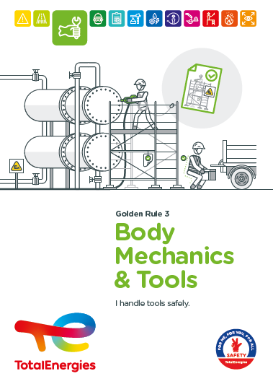
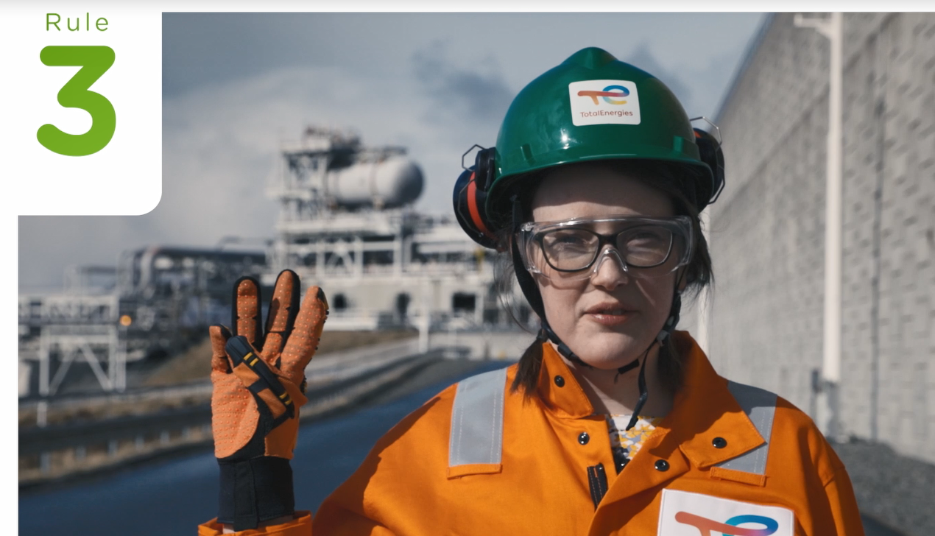
Poster & pictogram
The pictogram of the Golden Rule 3 “Body Mechanics & Tools" shows a hand protected by a glove and holding a spanner, symbolising the use of a tool.

Slide 4
Some definitions
TOOLS
GESTURE
All portable tools and equipment needed to perform a task.
Movement of all or part of the body.
POSTURE
Body position.
ERGONOMICS
Scientific study of working conditions and the relationship between human beings and their activity (tasks, tools, methods, working environment, etc.).
MUSCULOSKELETAL DISORDERS
Painful conditions that affect joints, muscles, tendons and nerves.

Slide 5
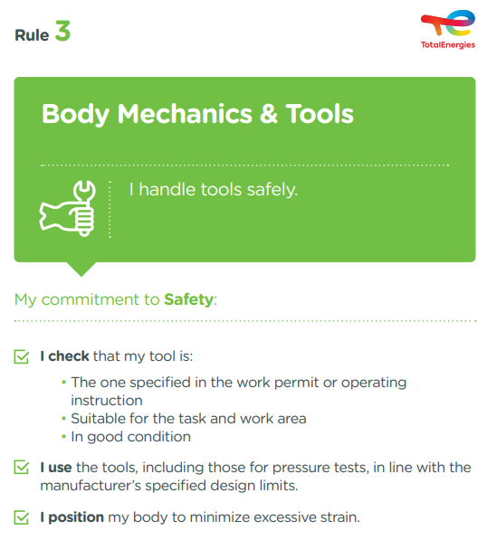
The essence of Golden Rule 3
What changes from the 2017 version of the Golden Rules:
    The requirements have been reformulated in the first person singular ("I").
    The content of the Golden Rule is unchanged.
The objectives of Golden Rule 3 include:
To raise awareness of the use of tools specified in the work permit and procedures.
To remind them of the importance of not using tools that are defective or not suitable for the task or area of use.
To raise awareness of the use of tools and their accessories within the limits set by the manufacturer.
To remind people of the importance of adapting their movements and working posture to the efforts and their repetition.

Slide 6
Body mechanics & Tools incidents
ACCIDENTS IN THE COMPANY WHERE A REQUIREMENT OF GOLDEN RULE 3 HAS BEEN BREACHED
MAIN RISKS
ASSOCIATED WITH BODY MECHANICS & TOOLS
In the short or long term
6
Cutting, crushing, puncturing
Low back pain and musculoskeletal disorders (MSD)
Fatalities*
93
Electrification, electrocution (non-insulated tools)
Falling tools
Lost time accidents**
20
Fire/explosion (non-ATEX equipment)
HIPO (High Potential)**
* 2012-2021
** 2017-2021

Slide 7
02.
REX

Slide 8
Illustration of requirements
REQUIREMENT | EVENT | SLIDE
1. I check that my tool is the one specified in the work permit or operating instruction. | FRACTURE WHILE HANDLING A MOULD PLATE | N°9
1. I check that my tool is suitable for the task. | FATAL ACCIDENT ON A DRILLING RIG | N°10
1. I check that my tool is suitable for the work area. | FLASH IN EXPLOSIVE ATMOSPHERE AREA | N°11
1. I check that my tool is in good condition. | FACIAL INJURY DURING GRINDING | N°12
2. I use the tools, including those for pressure tests, in line with the manufacturer’s specified design limits. | PRESSURE TESTING OF A JACK | N°13
3. I position my body to minimize excessive strain. | HOW TO MINIMISE OVEREXERTION | N°14
The descriptions of the circumstances and consequences have been simplified for a better understanding.
A link to each REX is available for more information.

Slide 9
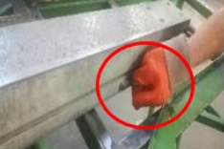
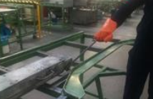
REX
1. I check that my tool is the one specified in the work permit or operating instruction.
> FRACTURE WHILE HANDLING A MOULD PLATE
CIRCUMSTANCES – FACTS
  The worker pulled the mould out of the press with the handle of the bottom plate of the mould.
  While pulling the mould with the handle, he hit the support structure with his right hand.
CONSEQUENCES
Fracture of the fingertip.
LESSONS TO BE LEARNED
  The tools to be used have been defined following a risk assessment.
  I ensure that I use the tool specified in the operating instructions or the work permit for the task to be performed.
CAUSES
  The operator did not use the tool provided for in the operating instructions.
Movement
Movement
Click here to access the REX

Slide 10
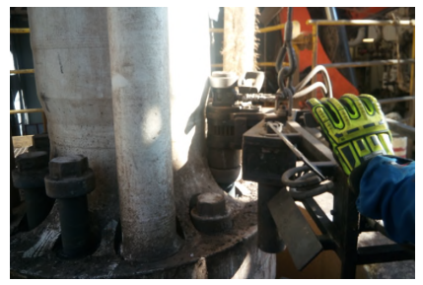
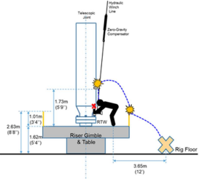
REX
1. I check that my tool is suitable for the task.
> FATAL ACCIDENT ON A DRILLING RIG
CIRCUMSTANCES – FACTS
  A hydraulic wrench was used to unscrew bolts.
  During the unbolting activity, the wrench got stuck.
  In order to free the wrench, the team decided to "pull upward" with the winch that was suspending it.
  This caused the cable to become taut, while the worker was above the tool.
  The wrench came loose and with the energy stored, hit the worker.
CONSEQUENCES
Death of the worker,
Several potential deaths
LESSONS TO BE LEARNED
I only use tools that are suitable and sized for my task.
If the work situation changes, I stop my task and participate in the re-evaluation of the operating procedure.
In general, I do not misuse a tool, and comply with the operating instructions where appropriate.
CAUSES
  Improper use of the winch to pull, lift or release a load.
  Operator positioned in the path of the wrench.
  Failure to stop work to reassess risks without taking into account previous difficulties.
Hydraulic wrench engaged
Click here to access the REX

Slide 11
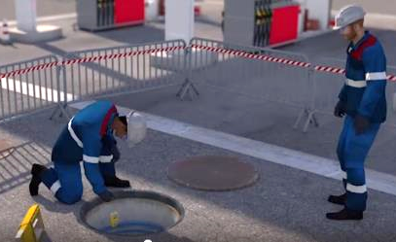
REX
1. I check that my tool is suitable for the work area.
> FLASH IN ATEX AREA
CIRCUMSTANCES – FACTS
  A worker came to fix “explosive atmosphere" signs in the chimney of a tank manhole.
  This tank still contained gasoline.
  An explosive test was carried out and confirmed the presence of hydrocarbon vapours.
  Despite this test, the worker used a non-explosion proof electric drill to fix the plate.
  A flash occurred.
CONSEQUENCES
Severe burns to the worker.
LESSONS TO BE LEARNED
When working in an explosive atmosphere area, I make sure that :
I use explosion proof equipment,
I position the explosimeter appropriately, depending on the type of gas (in this example, close to the ground as it is gasoline vapour).
CAUSES
  Non-compliance with procedures.
  Presence of gaseous hydrocarbons.
  Use of non explosion proof electrical equipment in an explosive atmosphere.

Slide 12
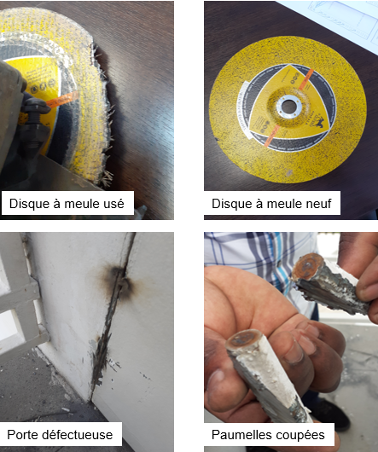
REX
1. I check that my tool is in good condition.
> FACIAL INJURY DURING GRINDING*
CIRCUMSTANCES – FACTS
  A worker carried out a grinding operation on a defective emergency door.
  During this operation, part of the grinding disc broke off and hit the worker's left cheek.
CONSEQUENCES
Injury to face - 5 stitches - 15 days off.
LESSONS TO BE LEARNED
I check the good condition of my tool and its accessories before use (integrity, wear, etc.).
If I notice that a tool or one of its accessories is defective:
I remove it immediately so that no one else uses it,
I formalise the information in writing and report it to my manager through the local process.
CAUSES
  Breakage of part of the disc.
  Poor tool quality.
  Lack of control of the tool before starting the work.
  Lack of specific PPE.
  Prevention plan not implemented.
Worn grinding disk
New grinding disk
*Event outside the scope of reporting

Slide 13
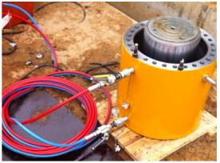
REX
2. I use the tools, including those for pressure tests, in line with the manufacturer’s specified design limits.
> PRESSURE TESTING OF A HYDRAULIC JACK
CIRCUMSTANCES – FACTS
  Pressure testing of a new hydraulic jack was in progress.
  2 workers pressurised the equipment 3 times to 500 bar.
  As the cylinder did not rise sufficiently, a 4th test was carried out.
  On the 4th test, the fastening bolts broke and the upper flange of the cylinder was thrown up in the air.
CONSEQUENCES
Death of one of the workers, who was leaning over the hydraoulic jack.
LESSONS TO BE LEARNED
I make sure :
I know the manufacturer's recommendations and the limits of use of the equipment,
I have the certificates and user manuals,
I use a hydraulic jack with a built-in safety device and protected against overpressure.
CAUSES
  Equipment without certification or marking.
  No user manual.
  No work permit, and therefore no risk analysis.
  Tests carried out at too high a pressure.
  Presence of workers in the immediate vicinity of the high-pressure equipment.
Click here to access the REX

Slide 14
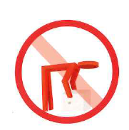
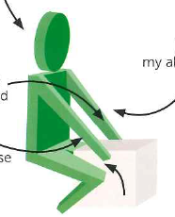
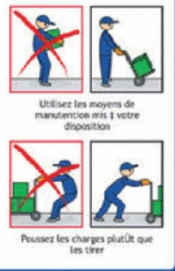
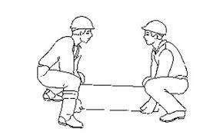
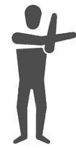
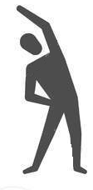
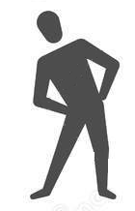

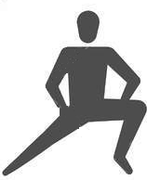

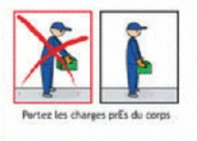
GOOD PRACTICE
3. I position my body to minimize excessive strain.
> HOW TO MINIMISE OVEREXERTION?
To lift a load, I keep my back straight and bend my knees
I use the handling equipment provided. If not, I don't hesitate to ask for help when I have to handle things manually.
I carry the load close to my body
I push the loads, rather than pull them
Before any intense or prolonged physical effort, I warm up, which reduces the risk of injury by preparing the body for the effort.

Slide 15
03.
Further information

Slide 16
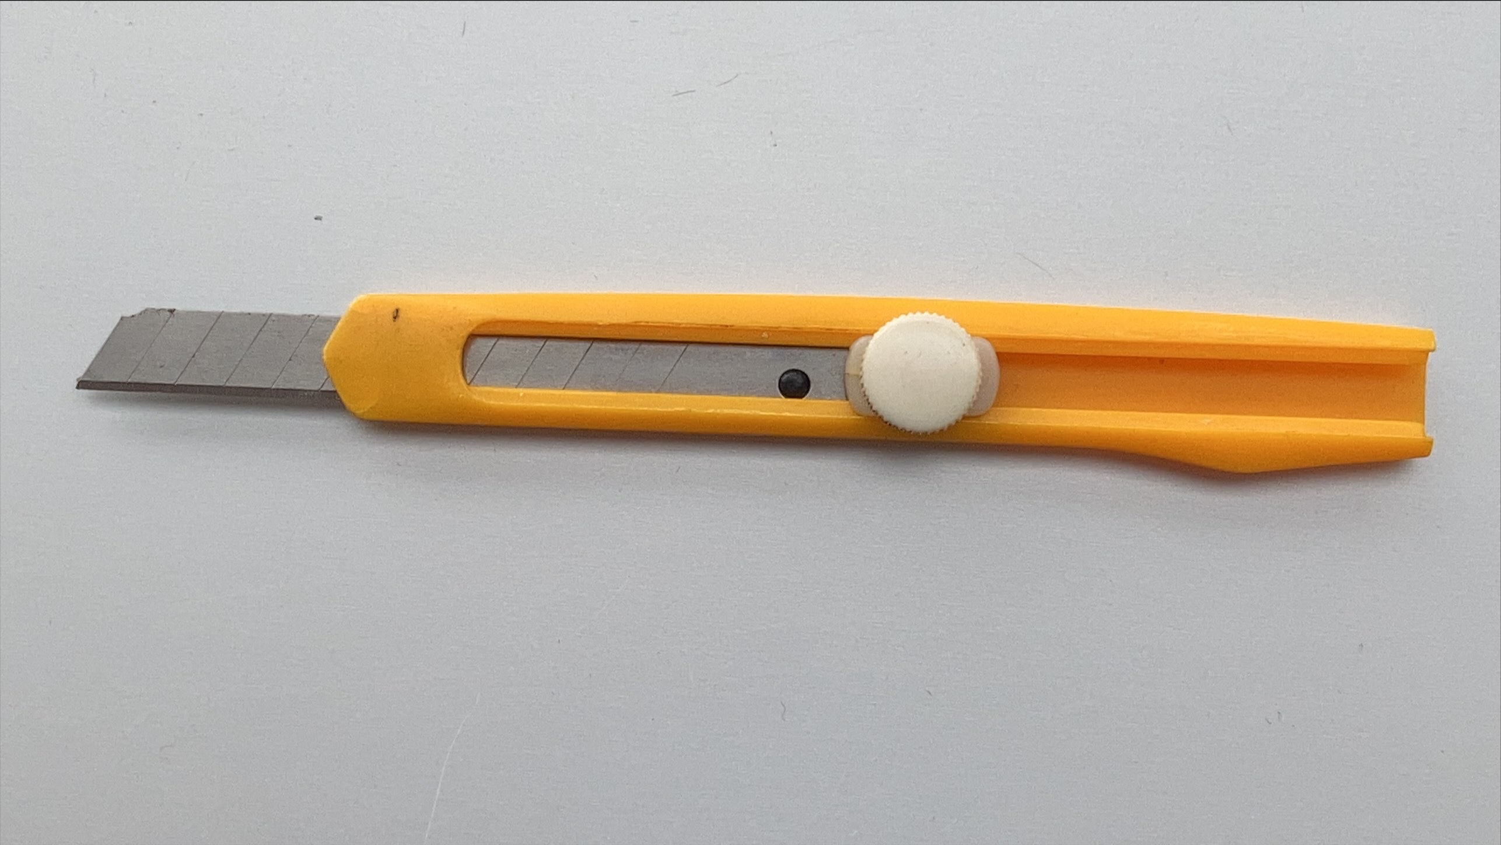
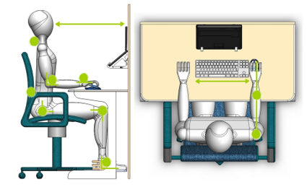
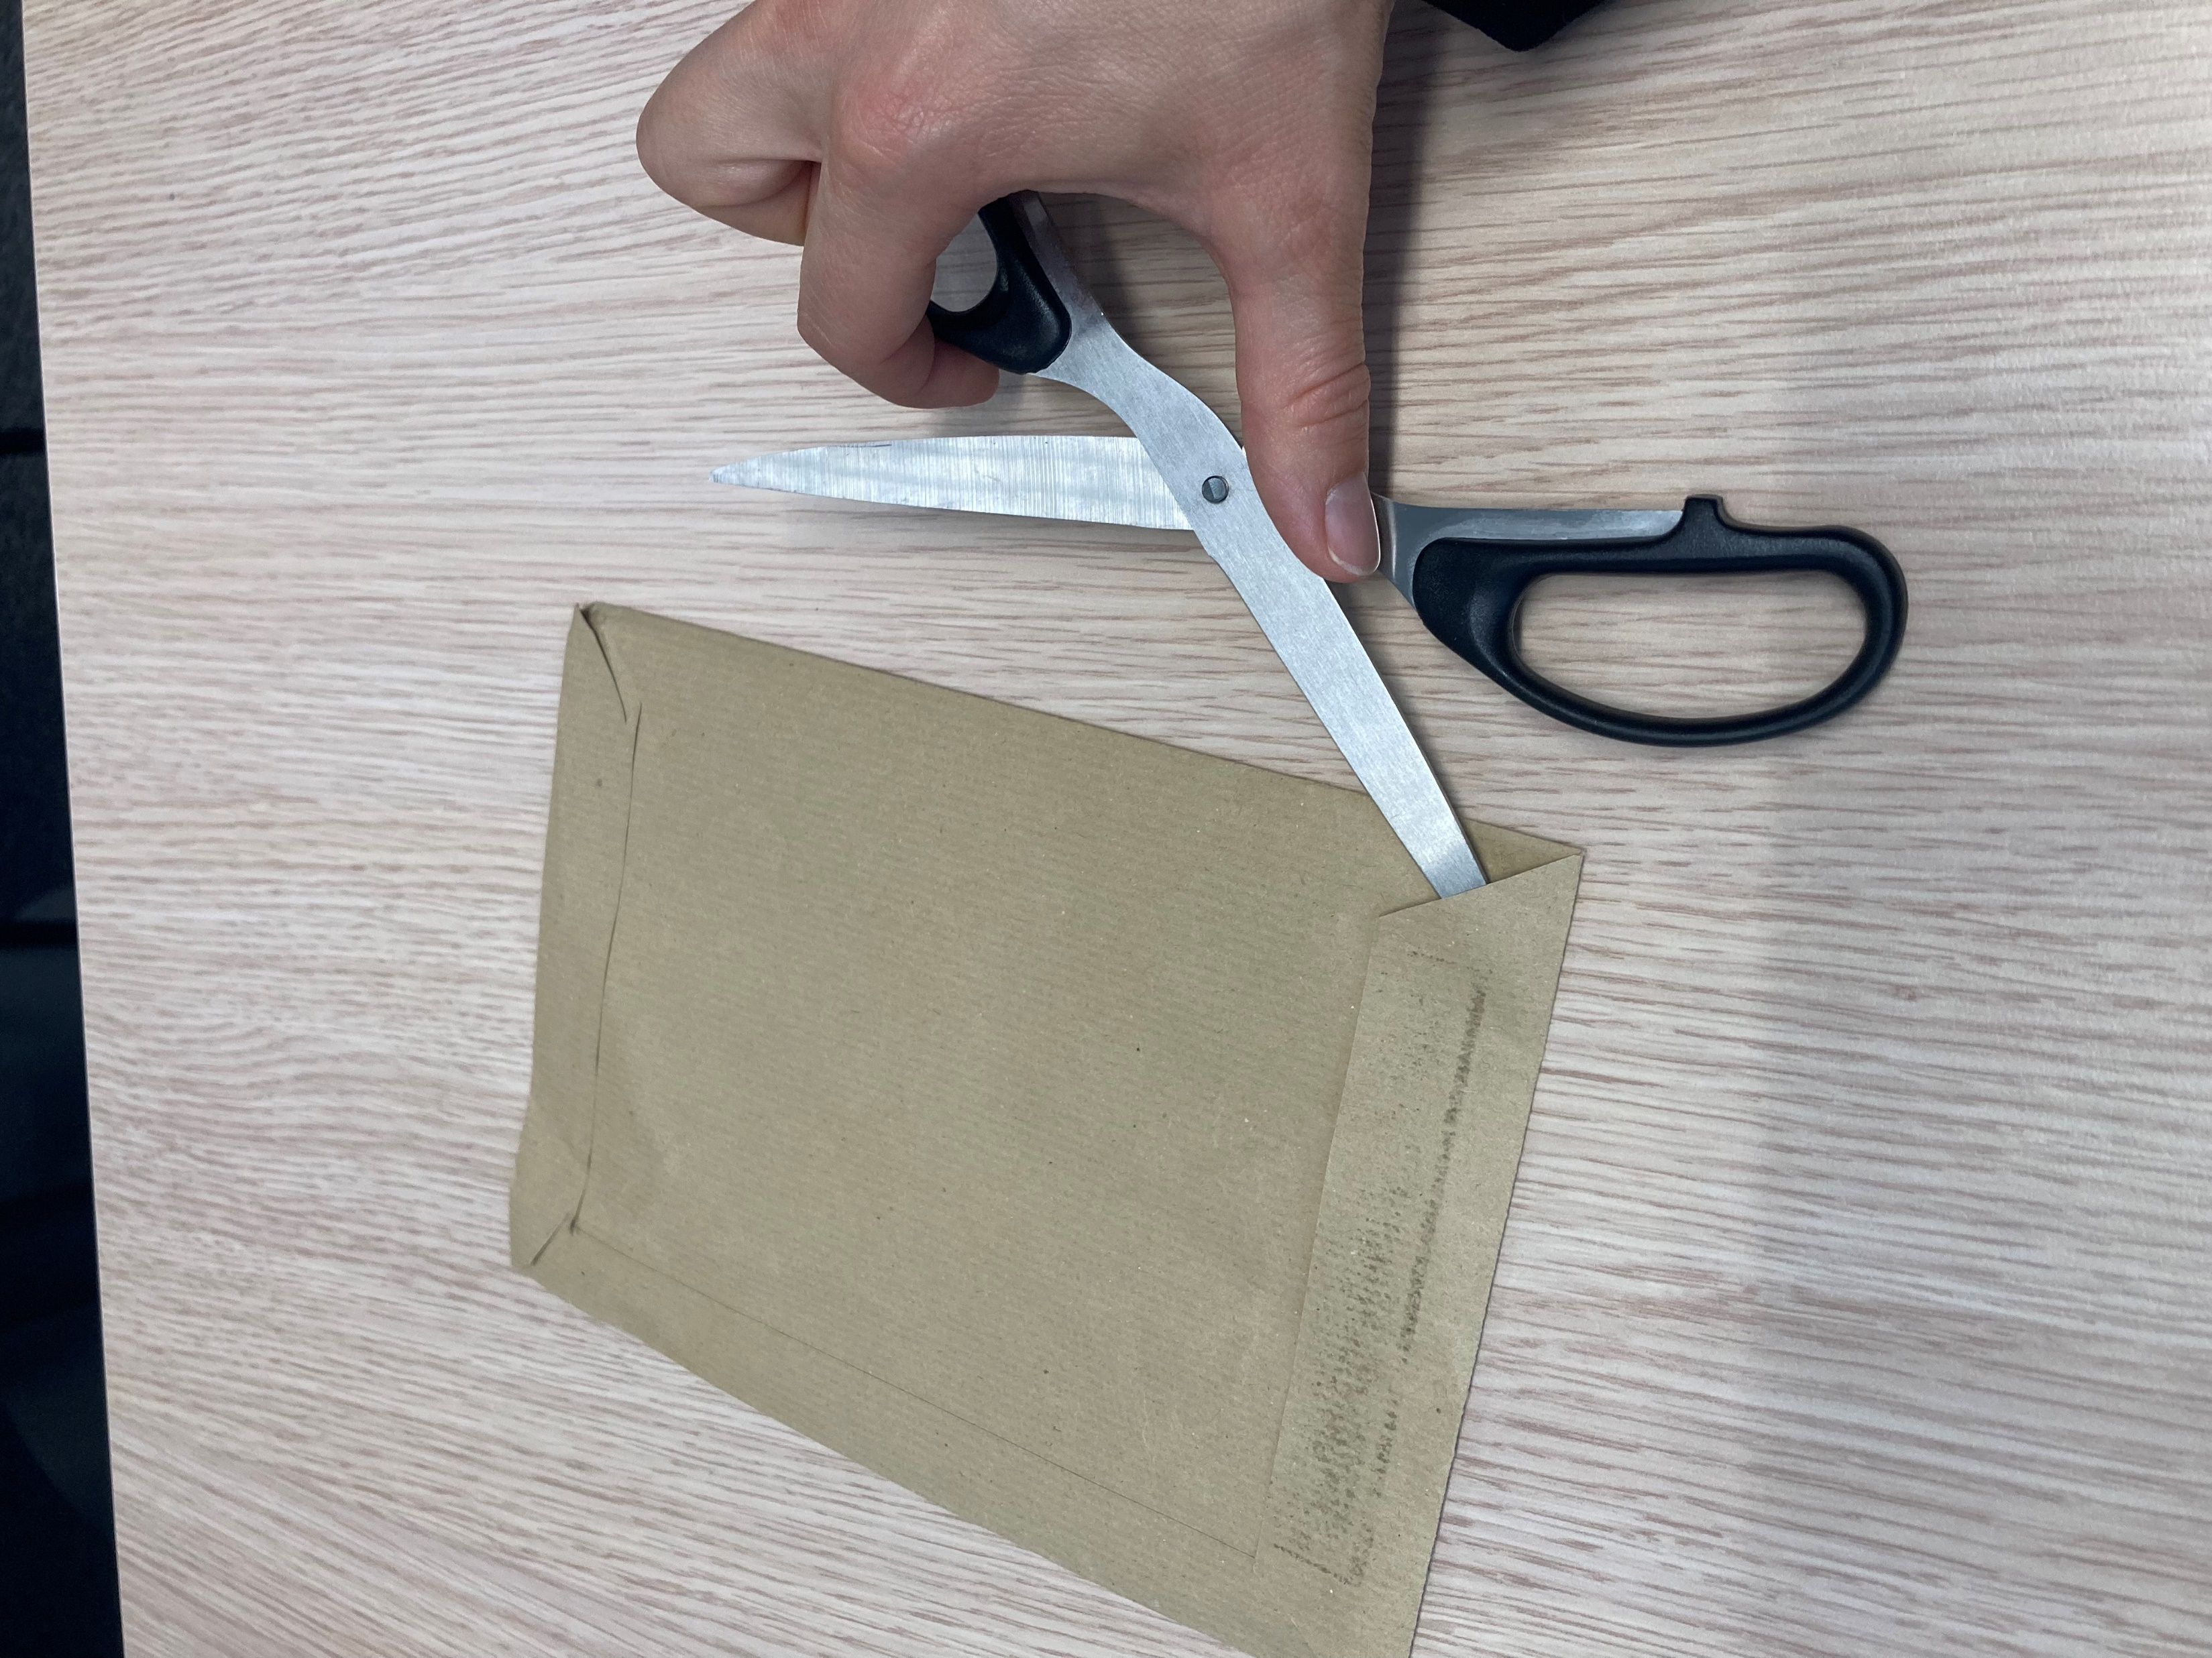
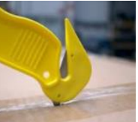
The Golden Rule 3 applied to offices
  Cuts, bruises:
  I use only safe office tools and equipment; unsecured cutters are prohibited.
  I use office tools and equipment for their intended purpose.
  I dispose of unsecured office equipment (unsecured cutters, etc.).
  Pain, lower back pain, musculoskeletal disorders:
  I adjust my workstation and position myself to limit postural constraints.
At the office,
I am also implicated!

Slide 17
The hand is a fragile tool!
ACCIDENTOLOGY
LESSONS TO BE LEARNED
In the Company, 191 TRIR events were caused by hand tools (2017-2021).
I select the most suitable tool for the task.
I check the compatibility of the accessories and spare parts to be used.
I inspect my tool before each use.
I set up my workstation (tidy work surface, working height, fixing the workpiece, etc.) before starting my task.
I wear suitable and approved PPE.
These events mainly occur when using sharp objects (cutters, knives, scissors: 28%), grinders (13%), drills (8%) or saws (6%).
CAUSES
The main causes of cuts by cutting tools are:
Unsuitable tools
Slipping of blades or use of worn discs
Projection of pieces of blade or disc
Unintentional contact when holding the tool

Slide 18
Our tools and documents
GM-GR-HSE-300 Assessment of the occupational risks in the workplace
GM-GR-HSE-404 Managing The Ergonomic Risks Associated With Work On Visual Display Units
Group guide and manual | TotalEnergies Toolbox HSE
E-learning on body mechanics: https://lizzy.totalenergies.com/
Toolbox HSE – new Golden Rules:
    General material: TotalEnergies Golden Rules – General material
    Roll-out material: TotalEnergies Golden Rules – Roll-out material
REX database: Company HSE REX DataBase
Safety+ (good practices per Golden Rule): https://safetyplus.totalenergies.com/en
    Some good practices:
          https://safetyplus.totalenergies.com/en/contribution/qkbngk?p_route=wall&p_qs=rules%3D2%26desc%3Dmanutention
          https://safetyplus.totalenergies.com/en/contribution/7jgi9g?p_route=wall&p_qs=rules%3D2%26desc%3Dmanutention
          https://safetyplus.totalenergies.com/en/contribution/rjzwpc?p_route=wall&p_qs=rules%3D2%26desc%3Dmeuleuse

Slide 19
Lexique
Hazard: An intrinsic property of a product, equipment, process, situation or action that can result in harm to people, the environment and/or assets.
Risk: The combination of the probability of occurrence of a hazardous event and the severity of the impact that may result from exposure to the hazard.
HSE events:
  Incident: Any sudden and undesirable HSE event on a given date, that causes injury or illness, damage to property or facilities, loss of production, environmental damage or damage to the Company's image.
  Near miss: Any sudden and undesirable HSE event on a given date which, in slightly different circumstances, could have had the same consequences as an incident. A near miss does not have an actual severity level but has a potential severity level.
  Anomaly: Any abnormal situation or behaviour, including deviations from a standard, specification, procedure or rule.
HIPO (High Potential) [slide 6]: Incident or near miss with an actual severity level ≤ 3* and a potential severity level ≥ 4** in one or more areas of the Company’s evaluation matrix of the actual and potential severity level of HSE events.
REX HSE: Document for sharing information on an internal or external HSE event, based on a detailed analysis and making recommendations.
* For example, physical consequences with an actual severity level = 3 correspond to a lost time accident.
** For example, physical consequences with a potential severity level of 4 correspond to a fatality.
Notes:
Définitions « risques » et « danger » (GM-GR-HSE-300 « Evaluation des risques professionnels au poste de travail »)
Définitions HIPO, Incident, presqu’accident, anomalie (CR-GR-HSE-100 « Reporting HSE »)

