Slide 1

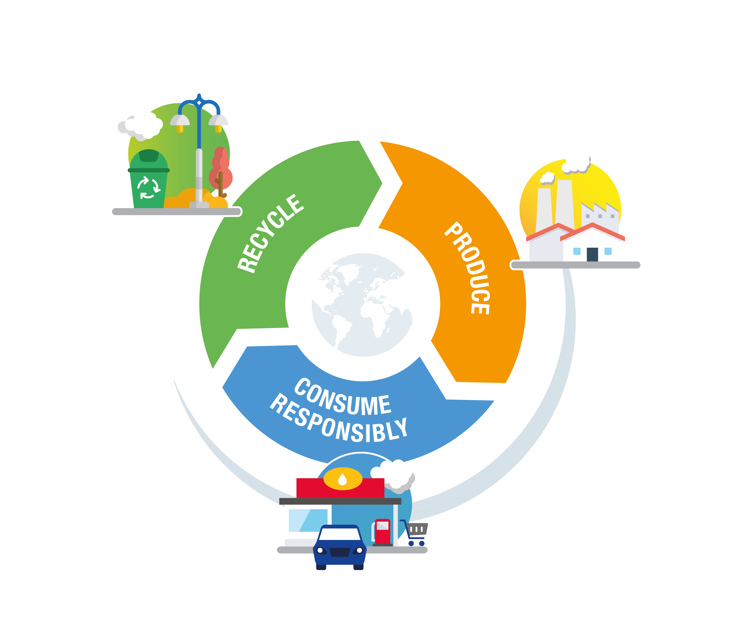
Environment Day
June 5, 2018
WE ALL MAKE
THE CIRCULAR ECONOMY
GO ROUND

Slide 2

BACKGROUND
In 2030, the world’s population will be around 9 billion.
The planet’s resources are not unlimited
and climate change is forcing us to reduce
greenhouse gas emissions.
At the same time, the world produces
4 billion tons of waste each year.
If we do nothing, the oceans will swim
with more plastic than fish in 2050.

Slide 3
CHALLENGES

Slide 4
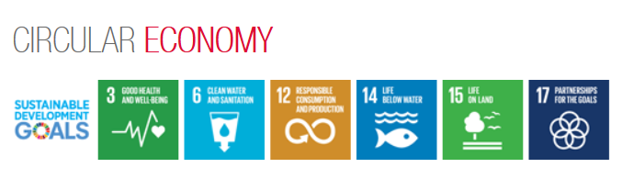
CHALLENGES
Technology and Know-How
Improve our environmental footprint:
Better manage natural resources
(water, raw materials)
Reduce the waste, greenhouse gas emissions and other impacts of our activities
Access
to raw materials
Legislation
Total sees the circular economy as an opportunity
to improve our environmental footprint and our competitiveness,
while providing as many people as possible with access to cleaner energy.

Slide 5
DEFINITION

Slide 6
THE PHILOSOPHY OF THE CIRCULAR ECONOMY
What if we repaired,
reused and recycled,
instead of throwing
things away?
That’s the
philosophy
of the circular
economy!

Slide 7
WHAT IS THE CIRCULAR ECONOMY?
Natural resources
Take
Make
Distribute
Linear economy
WASTE
Circular economy
The circular economy breaks with
the traditional linear model (produce, use, throw away), replacing it with a “loop”
that optimizes value creation throughout
the life cycle.
This new approach aims to curtail environmental and social impacts
by limiting resource waste. One example
is recycling waste and end-of-life products as sources of existing raw materials.
It is based on smart, responsible use
of materials and energy.

Slide 8
THE THREE ASPECTS OF THE CIRCULAR ECONOMY
RECYCLING
& RECOVERY
WASTE-TO-ENERGY
SUSTAINABLE SUPPLY
ECODESIGN & ECOSOLUTIONS
INDUSTRIAL
AND TERRITORIAL ECOLOGY
SERVICE ECONOMY
WASTE MANAGEMENT
COMPANY BUSINESS
OFFERING
CONSUMER
EXPECTATIONS
& BEHAVIOR
EXTENDING
THE PERIOD OF USE
Reuse - Repair
RESPONSIBLE CONSUMPTION
Sustainable procurement
Total’s sites and affiliates focus mainly on waste management and sustainable procurement.

Slide 9
TOWARD NEW BUSINESSES
Taking less out
Because resources are finite
The shift to a more circular economy could have advantages, notably improving environmental impacts (saving on resources and shrinking footprints), creating a more secure supply of raw materials and boosting competitiveness and innovation/differentiation.
Plus, in a circular economy things once considered waste can be turned into a valuable resource.
Producing smarter
Adding
Recycling & composting
Redesigning products to last or be recycled or composted
Using resources responsibly
Creating value
Repair & reuse

Slide 10
THE CIRCULAR ECONOMY AT TOTAL

Slide 11
TOTAL’S CIRCULAR ECONOMY COMMITMENTS:
AFEP* AND U.N. SUSTAINABLE DEVELOPMENT GOALS 7, 8 AND 13**
In 2017, 33 companies including Total took action to integrate this process into their activities.
1
Make the circular economy a criterion in the company’s procurement process.
  Consider energy efficiency, material efficiency and product durability when purchasing our goods and services.
Commit to recycling more than 50% of the company’s waste.
Set up waste reduction and zero-waste-to-landfill programs at company sites.
2
Limit waste production and promote waste recycling.
  Produce new polymer ranges using recycled polymer. Recycling one ton of polymer eliminates one ton of carbon emissions.
3
Develop polymers containing as much as 50% recycled plastic.
Solarize 5,000 service stations worldwide, including 800 in France (limit non-renewable energy consumption).
  Install 200 MW of power production capacity, equivalent to the amount consumed by a city of 200,000. This also enables us to cut carbon emissions by 100,000 tons a year.
4
Improve the energy efficiency of operated production facilities by an average of 1% a year between 2010 and 2020 (economizing non-renewable resources).
  This cuts down on the amount of oil and gas we use and our greenhouse gas emissions.
5
* A French business confederation
** Affordable and Clean Energy, Decent Work and Economic Growth, and Climate Action respectively.

Slide 12
SUSTAINABLE RESOURCE USE
EXAMPLE: FRESHWATER
The nature of our activities makes them likely to both impact and depend on water resources.
Principles:
Since 2016, we have assessed the water risk at 17 priority Total sites (11 in Refining & Chemicals, four in Exploration & Production and two in Gas, Renewables & Power).
1
Identification of priority sensitive sites for water use.
Comprehensive management of water risks and impacts in our environmental management system.
This assessment process will gradually be extended to all priority sites (another eight have been added to the list).
2
Monitoring and integration of changes in how water is managed, especially as they relate to climate change, through our stakeholders, partnerships and R&D.
Depending on risk type and impacts, we may introduce a plan in the future to optimize water use at priority sites.
3

Slide 13


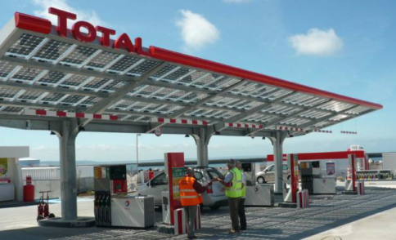


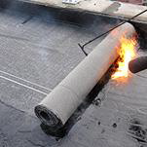
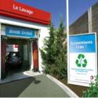

INITIATIVES ALREADY IN PLACE AT TOTAL
  Innovate to create low-carbon and environmentally responsible solutions,
  to keep up with our customers’ changing needs using eco-design principles.
  Explore new business activities
  for our industrial assets:
Refuse-derived fuels
Recycled plastics
Used oil recycled in a new range
of base oils: Osilub
Solarization of 5,000 service stations
Biorefinery
Recycle more than 50% of our waste
Bioplastics.
Energy efficiency improvement plans
Eco-efficient products
and services, to be a more
responsible consumer
Lubricant containers made of 15 to 30% recycled materials
Asphalt facilitating the recycling of
asphalt mixes
BioTfueL
Regenerated asphalt
(recycling)
Sustainable procurement
R&D program under way: Carbon capture, utilization and storage (CCUS) and water reuse

Slide 14
SPOTLIGHT ON WASTE MANAGEMENT

Slide 15
WASTE MANAGEMENT
  Linear economy
  Recycling economy
  Circular economy

Slide 16
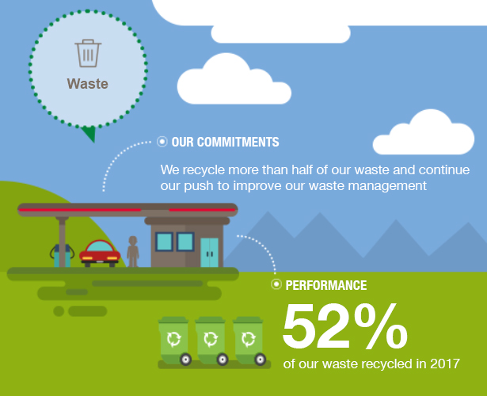
REDUCE OUR WASTE

Slide 17


OUR WASTE MANAGEMENT POLICY
Minimize our waste production
and adhere to the ranking of priorities.
  Prevent & avoid
  Designing products and systems
  for a longer and higher-quality life
  Minimize
  Using less material
  in design and manufacture
  Prepare for reuse
  Cleaning, repairing or refurbishing
  whole items or spare parts
  Environmental
  & Business Opportunities
  Recycle
  Turning unwanted items into new materials — includes composting
  if it meets quality protocols
  Recover
  Anaerobic digestion, incineration with recovery, gasification and pyrolysis, which produce energy/fuels,
  some backfilling
  Disposal
  Landfill and incineration
  without energy recovery

Slide 18
WASTE MANAGEMENT:
BASIC STEPS
Identify
Sort and store
Trace
Collect and transport
Treat
Waste
(category, amount).
Collect, sort,
store and ship waste.
From production to recycling or disposal.
Ensure that the waste’s movements can be traced on and off the site.
Arrange for controlled collection, sorting and temporary storage on site.
Plan the movement of waste at the site.
Recycle or dispose of waste.
Make sure that the waste is sent to the appropriate place based on type and characteristics. Choose processes suited to the waste and audit them.
Examples of best practice requirements
Sort (do not mix different types of waste).
Proper storage
(1 type of waste
= 1 container).
Archive the forms, logs, declarations, invoices and authorizations of the service providers who dispose of/treat the waste, along with the treatment certificates.
Get a transportation permit (for transporters).
Schedule an annual inspection at the site.
If no local waste treatment option is acceptable, the waste will have to be exported to another country, in compliance with its specific regulations and the Basel and Bamako Conventions.

Slide 19
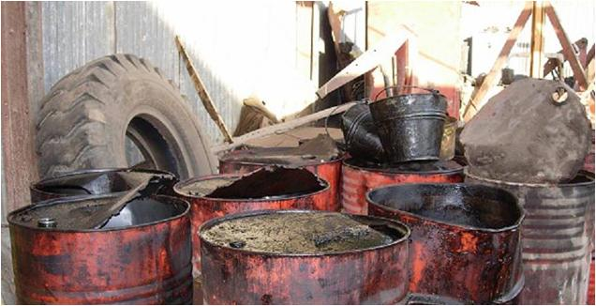
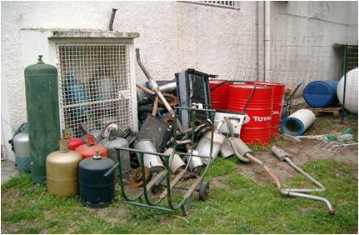
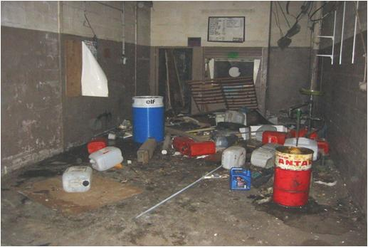
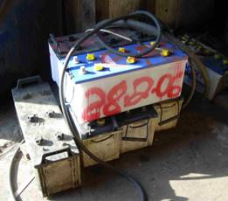
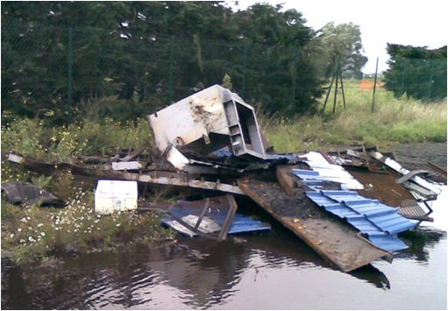
WASTE MANAGEMENT:
THINGS WE DON’T WANT TO SEE ANYMORE!

Slide 20
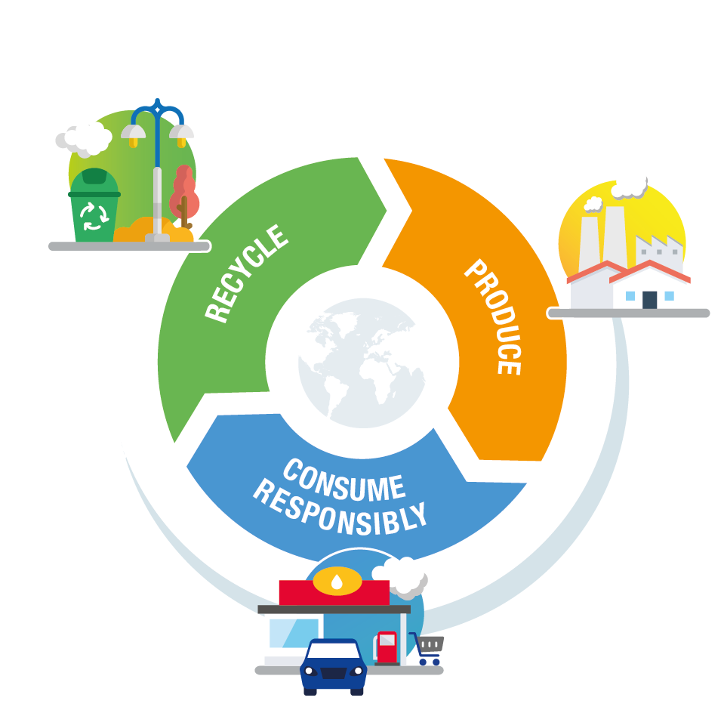
CONCLUSION
To move toward a circular economy
A pivotal initiative:
reducing and recycling our waste

Slide 21
APPENDIXES

Slide 22
BEST PRACTICES TOOLBOX FOR THE WED
  Site tour focusing on the environment/waste.
  Audits of waste service providers.
Looking for ideas for your WED?
  Workshops to share information about waste collection with employees, including hands-on exercises.
  Talks/lectures by a waste treatment partner.
  Quiz.
  Share what you did on WAT Waste Management community link

Slide 23
USEFUL LINKS
Waste Directive link
Reference Document (circular economy) link
Total Ecosolutions Internet link
WAT H3SEQ link
HSE Toolbox - WED link

