Slide 1

Safety moment
June 2022
Golden Rule 12
Line of Fire

Slide 2
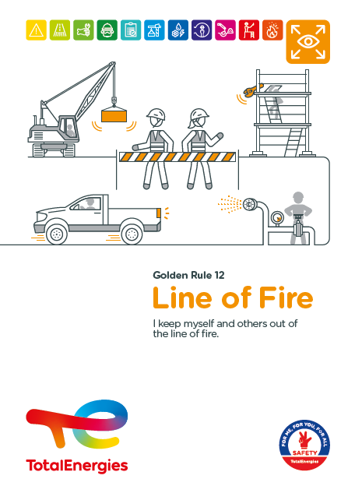
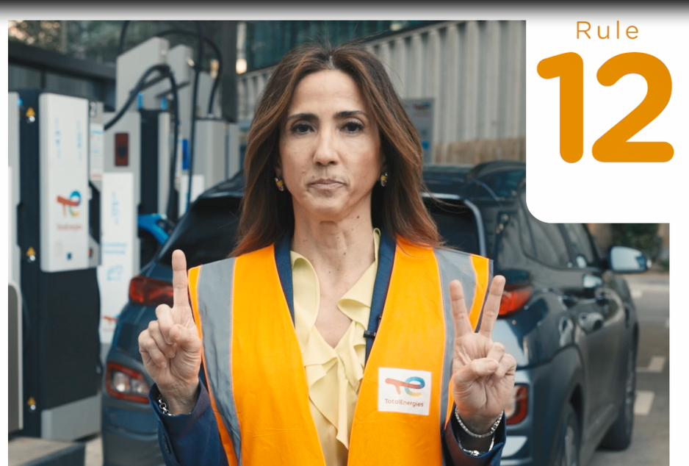


The Golden Rule 12 Line of fire
THE NEW GOLDEN RULES
Communication at the WDfS 2022
Evolution of Golden Rules 1 to 10 to strengthen personal commitment
→ Golden Rules written in "I "
2 new Golden Rules,
including Golden Rule 12 Line of fire

Slide 3
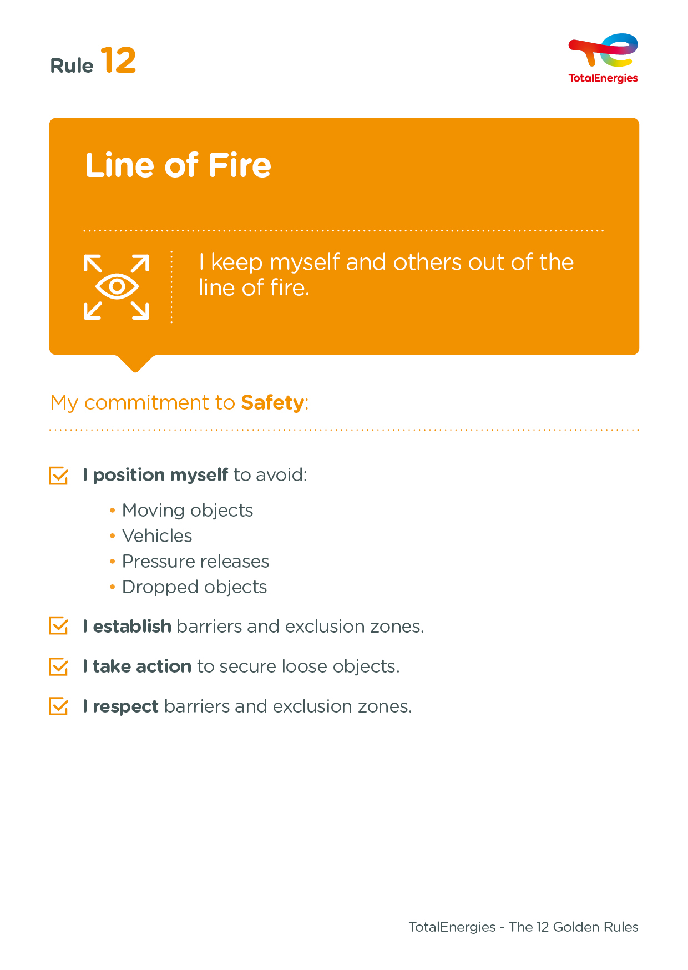
The essence of Golden Rule 12
CONCEPT OF « LINE OF FIRE »
Being in the line of fire means being positioned in the path of a moving object or energy discharge.
Lines of fire are not always visible or previously identified and can vary or be introduced by other activities.
2
Fatalities in the Compagny related to non-compliance with a requitement of the Golden Rule 12 (2012-2021)
On industrial sites, in the office and at home, we are all implicated!

Slide 4
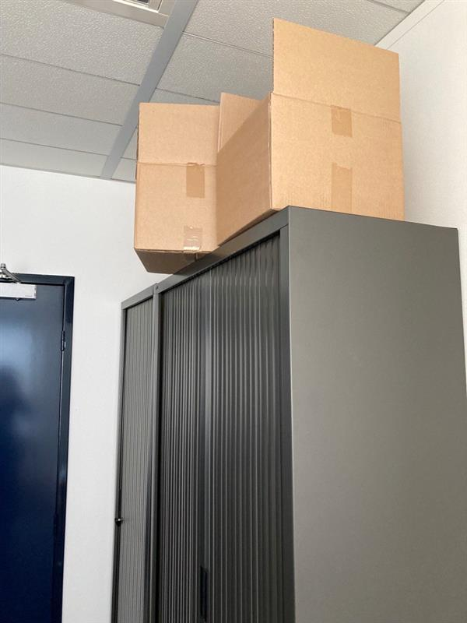
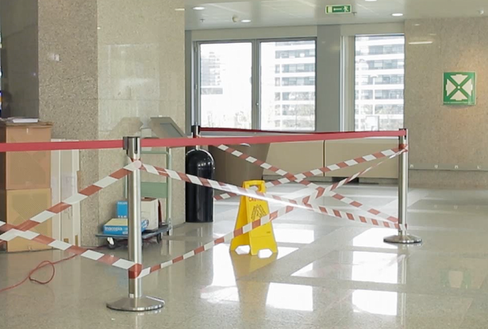

Examples of line of fire in the offices
Falling objects
I don't put things on top of cupboards, etc.
Moving objects
I am vigilant when opening doors or passing by doors.
I pay attention to the trajectories of scooters, bikes, etc. and to the vehicles maneuvering in car parks.
Engines or vehicles
Pressure releases
I am vigilant when using very hot liquids at fountains and/or coffee machines.
Barriers and exclusion zones
I respect the signs and safety barriers in place.

