Slide 1
HSE REPORTING revision 01 GROUP HSE RULE (CR -GR-HSE 100 rev 01) SYNTHESIS Rev01 of this rule introduces the Group's environmental reporting requirements and revises certain safety reporting requirements. This presentation includes the main changes and additions.

Slide 2
CR-GR-HSE-100
Context:
The Group's reporting is used to monitor our HSE performance;
The Group's reporting is published both internally and externally (for certain data, more and more of it is published);
The Group's reporting is subject to requirements outside the Group (regulations, extra-financial rating agencies) and is verified by an independent third party.
Scope: all subsidiaries and entities of the Group
6 new requirements for environmental reporting:
Annual environmental performance reporting;
Justification of significant deviations from the previous year;
Revision of previous years' reporting;
Other reporting (LTP, budget, monthly monitoring);
Local display of the Scope 1 and 2 GHG emissions indicator;
Verification and retention of documents.
Change in safety reporting requirements
Replacing or modifying Branch documents :
CR-EP-121 Improving HSE performance: key performance indicators and feedback;
CR-EP-124 Environmental Performance Reporting;
CR-MS-HSEQ-411 Environmental Performance Reporting.
Date of publication in REFLEX: 22nd of December, 2020
Application date: Immediate

Slide 3
Summary of changes
CR-GR-HSE-100
Reporting Scopes:
Safety reporting: No significant change. The requirements have been moved to a common chapter with the environment;
Environmental reporting: the practices of the Branches were taken over, the requirements already existed.
Environmental reporting
Addition of an appendix to help rate the environmental severity of HSE events;
Addition of environmental reporting requirements in terms of KPIs (annual, monthly, PLT, budget, local posting):
Transfer of existing requirements to the Branches ;
No additional reporting requirements.
Safety reporting
Updates in sight:
to clarify the text and certain classifications following feedback on the 2018 version;
to add new KPIs and deleting of those that are no longer needed;
to add a case of exclusion of statistics concerning accidents depending exclusively on third party factors in the road transport field;
to align the distinction between first aid and medical treatment with international standards (IOGP, OSHA)
NB: To be included in a future revision of the rule:
Societal reporting (objective 2021)
Hygiene reporting

Slide 4
Change concerning the REPORTING SCOPE

Slide 5
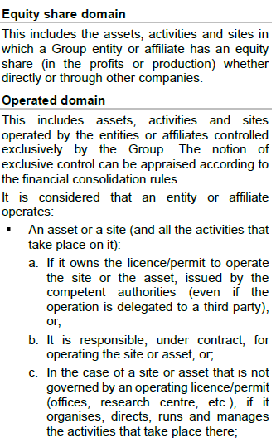
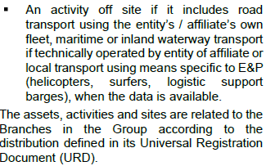
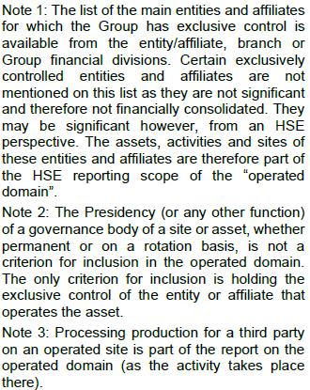
Reporting scope
CR-GR-HSE-100
Introduction “operated domain” definition:
The type of subsidiary to be considered as operator of a site in the operated domain defined: these are the subsidiaries over which the Group has exclusive control (to find out the status of your subsidiary contact the Finance Department of your subsidiary or Branch).
The notion of operation is defined (permit, delegation, etc.).The scope of reporting of safety KPIs and HSE events remains specified in Appendix 1.1.
The scope of reporting for environmental KPIs is specified in appendix 1.3.
These criteria were already in use previously, except for the notion of exclusive control, which stems from a requirement of the French Commercial Code and applies to reporting for the entire Group (including subsidiaries outside France).
Introduction of the “equity share domain” definition for greenhouse gas reporting only (environmental reporting).
Clarification on the minimum expectations of an environmental reporting process (refer to point 3.2 of CR-GR-HSE-100).
CHANGE OF REQUIREMENT AND DEFINITION
WHAT IS CHANGING

Slide 6
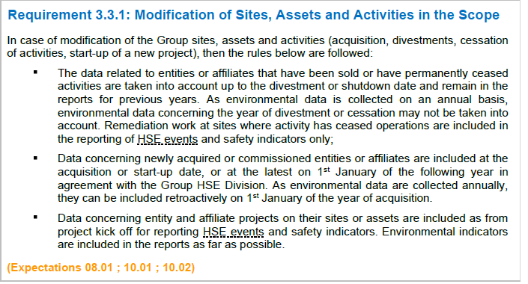
Reporting scope
CR-GR-HSE-100
Environmental reporting: Introduction of rules for changing the scope of environmental reporting. No change with the existing practice.
Safety reporting: No modification.
REQUIREMENT CHANGE
WHAT IS CHANGING

Slide 7
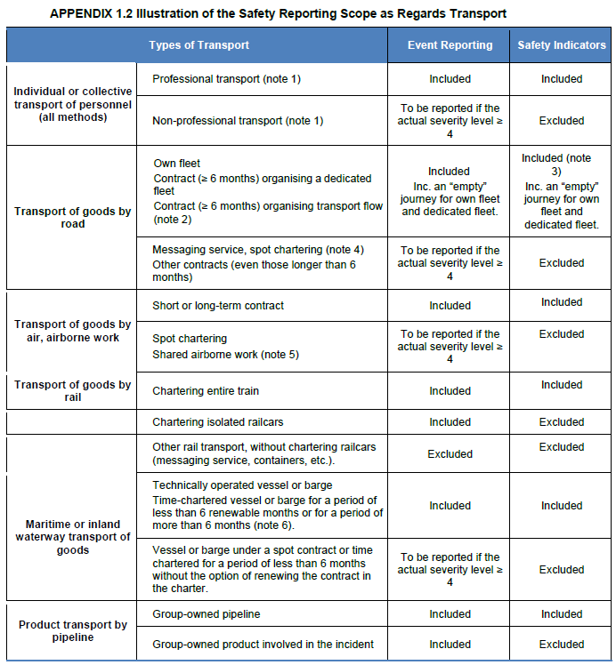
Reporting scope
CR-GR-HSE-100
Road freight transport under contract ≥ 6 months: only those organising a dedicated fleet or a transport flow are to be included in the Group's safety indicators (TRI, SVAR etc.).
Maritime or inland waterway transport of goods:
Vessels or barges technically operated by the Group are included in the reporting scope of the safety indicators;
Vessels or barges time-chartered are included in the scope of reporting of safety indicators only if the charter period is :
more than 6 months or;
less than 6 months but renewable.
APPENDIX CHANGE
WHAT IS CHANGING

Slide 8
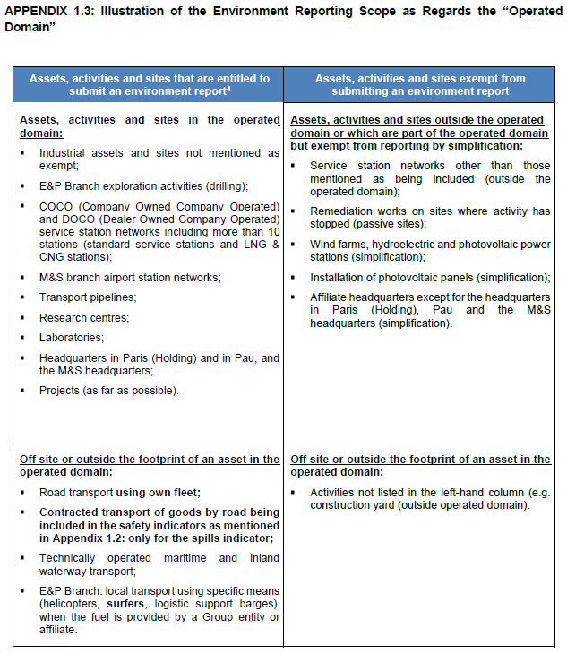
Reporting scope
CR-GR-HSE-100
The type of assets, activities or sites to be included or exempted from environmental reporting is specified.
Note: assets, activities or sites listed in this appendix as entitled to submit an environmental reporting may be exempted from reporting some indicators due to the materiality principle defined in points 5.1 and 7 of the rule.
NEW APPENDIX
WHAT IS CHANGING

Slide 9
Change concerning SAFETY REPORTING

Slide 10
Safety reporting
CR-GR-HSE-100
The term "local" has been added to clarify that a local tool may be suitable for recording HSE events if these events are not covered by requirement 4.1.2, i.e. if they are not:
HSE events with physical injury and of an actual severity level ≥ 2 (FAT, LTI, RWC, MT);
Other incidents with an actual severity level of ≥ 4;
HIPO;
Tier 1 and Tier 2 losses of containment.
If a Group tool is used to record the events covered by Requirement 4.1.1 (e.g. SYNERGI-EP, RAMSES-RC, RAMSES-MS, IMPACT, SHARE), the requirement is obviously met.
Under the requirement, it is specified that losses of containment are recorded as soon as they exceed the KPI 1 reporting thresholds defined in Annex 9.3b.
REQUIREMENT CHANGE
WHAT IS CHANGING

Slide 11
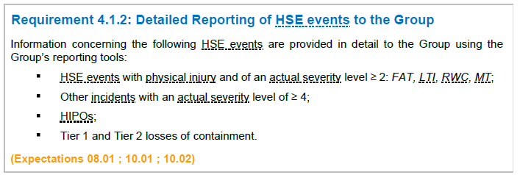
Safety reporting
CR-GR-HSE-100
Under the requirement, it is specified that, independent of any immediate alert process, HSE events covered by Requirement 4.1.2 are reported in the Group's reporting tools no later than 7 calendar days following the incident.
MODIFICATION UNDER THE REQUIREMENT
WHAT IS CHANGING

Slide 12
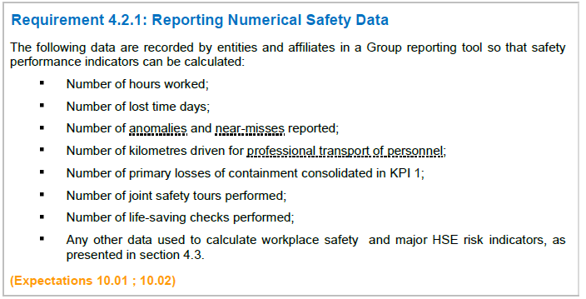
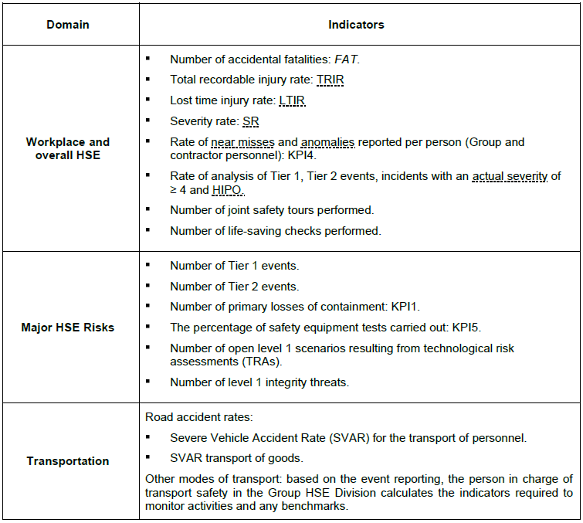
Safety reporting
CR-GR-HSE-100
The following indicators are removed from the safety reporting:
The number of restricted work days;
The number of fires and explosions (KPI2).
The following indicators are added to the safety reporting
the number of joint safety tours performed;
the number of life-saving checks performed;
The rate of analysis of Tier 1 and Tier 2 events, of incidents with an actual severity of ≥ 4 and of HIPOs.
Under Requirement 4.2.1, the reporting frequency is specified (no change compared to existing practices).
REQUIREMENT CHANGE
WHAT IS CHANGING

Slide 13
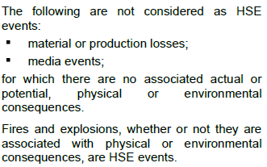
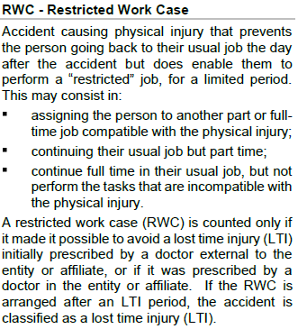
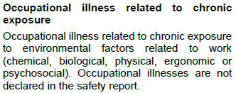
Safety reporting
CR-GR-HSE-100
"HSE event": the types of material or production losses and media events to be considered as HSE events to be reported under this rule are specified, and therefore those that are not.
“Restricted Work Case": it is specified that an RWC is accounted for only if it has been prescribed by a doctor of the entity or subsidiary or if it has prevented a Lost time Injury (LTI) initially prescribed by a doctor. If it is arranged after a period of time off work, the accident will be classified as an LTI.
It is clarified that occupational diseases are excluded from the statistics.
DEFINITION CHANGE
WHAT IS CHANGING

Slide 14
Safety reporting
CR-GR-HSE-100
Some examples were added.
APPENDIX CHANGE
WHAT IS CHANGING

Slide 15
Safety reporting
CR-GR-HSE-100
Some typical HIPO events have been added, modified or deleted:
“Undeclared excavation works performed by third parties close to or above a pipeline transporting gas, or a flammable (flash point ≤ 37.8 °C) or toxic liquid, or close to or above a buried medium or high-voltage (>500 V) power line.”
“Fire that cannot be immediately controlled following hot works (intervention of site or external fire-fighters – implementation of means exceeding those anticipated in the fire permit).”
“Heavy vehicle hitting or nearly hitting a facility containing a flammable or toxic product or a medium or high voltage (>500 V) electrical facility.”
“Spill over of liquid at the flare causing presence of liquid on the ground, except for low-key spill over related to the facility design, in particular during routine and well-identified operating phases.”
“Extinguishing of the flare except for when the flare is designed to operate securely as a vent (in particular if the distance between it and potential ignition sources is sufficient) and that it was rapidly relit (less than two hours).”
APPENDIX CHANGE
WHAT IS CHANGING

Slide 16
Safety reporting
CR-GR-HSE-100
“Railroad collision, derailing, rollover or wagon becoming unhooked in the middle of the track, irrespective of the product or goods transported.”
“During manoeuvres, rollover of a wagon of liquified product or containing a product with a flash point ≤ 37.8 °C or any other dangerous goods (to be assessed depending on the product and the environment in which the transport accident occurred).”
“Damage to a railcar tank (including during manoeuvres) full of liquefied gas or of a product with a flash point ≤ 37.8 °C or any other dangerous goods (to be assessed depending on the product transported and the environment in which the transport accident occurred).”
“Damage to the steering gear or main engine (barge/vessel not manoeuvring) with no possibility of active redundancy and the vessel is drifting near the coastline or in a high traffic area.”
“Fire onboard a vessel or barge transporting flammable or explosive products (other than in living quarters when it is immediately detected, controlled and extinguished).”
“Leak of a pollutant with significant impact on a surface water or the atmosphere (to be assessed according to the sensitivity of the area and the quantity - see Appendix 2.2)”
The examples concerning air transportation have been updated in line with the updated ICAO recommendations.
WHAT IS CHANGING (continued)
“Leak of flammable liquid or gas, where the presence of such substances is confirmed by several detectors and caused an emergency shutdown of the unit. For units or lines that do not have their own detectors, significant leak of flammable liquid or gas products causing a manually triggered emergency shutdown.”
“Massive projection of hot bitumen on loading (particularly in the presence of water) that could reach a person.”
“Ignition of a gas or vapour (from a flammable liquid) cloud, when the size of the cloud or its potential consequences are likely to cause a fatality.”
“Fire, flash or sparks (excl. Fire permit) in an ATEX zone type 1 and 2 (excluding service stations).”
“Large fire outside an ATEX type 1 or 2 zone, likely to cause significant worsening of the situation (e.g. fire in immediate vicinity of an equipment containing a flammable product, large fire in a building).”
“Transport incident near a sensitive area (protected area, numerous dwellings, etc.) – to be assessed according to the nature of the product transported and the sensitivity of the area.” → SUPPRESSED
APPENDIX CHANGE

Slide 17
Safety reporting
CR-GR-HSE-100
Reconciliation of classification criteria with international standards (OHSA, IOGP) and integration of feedbacks:
Deletion
of the notion of a “second visit to a practitioner or doctor” and thus of points 1., 12. and 13. of the list of the former rule on Medical Treatment.
Change
In the list of First Aid: “Administration of immunisation against tetanus or any other vaccine/serum”;
of the criterion on the prescription of medicines. The “Use of medication available on prescription only, or at a dose that requires a medical prescription (excludes use of preventive medication).” is to be considered as a Medical Treatment.
Adding in the list of Medical Treatments:
“Prescription of physiotherapy sessions following an accident, including sprains that do not require a rigid immobilization”;
« Pierced eardrum ».
APPENDIX CHANGE
WHAT IS CHANGING

Slide 18
Safety reporting
CR-GR-HSE-100
The following points have been added to the list of required information:
Copy of the formal analysis document (e.g. root cause analysis, investigation report) for HIPO, incidents with an actual severity ≥ 4 and Tier 1 and 2 losses of containment;
Total quantity of product lost, and the quantity of product having impacted the environment, if applicable.
APPENDIX CHANGE
WHAT IS CHANGING

Slide 19
Safety reporting
CR-GR-HSE-100
Incidents During an Assignment or Training Course (clause c) :
Accidents that occur during rest time while travelling for work (e.g. to and from restaurants) are no longer excluded from the statistics.
Incidents During Leisure Time (clause d) :
Coffee and cigarette breaks are henceforth considered as rest periods, so accidents occurring on these occasions are excluded from the statistics unless they result from a lack of control measures put in place by the employer. NB: These breaks are counted as hours worked to facilitate reporting (see Annex 8.1);
It is specified that accidents occurring during “journeys within the site to go to the canteen or to an activity classed as “leisure time” are still included in the statistics”.
It is specified that “time spent in the changing rooms (including showers) to prepare for work or when leaving work, is not considered as leisure time”. Accidents occurring during this time are therefore included in the statistics.
APPENDIX CHANGE
WHAT IS CHANGING

Slide 20
Safety reporting
CR-GR-HSE-100
Accident Depending Exclusively on Third Party Factors (Road Transport) (clause m) : this exclusion clause has been added. It concerns only road transport.
Allocation of Physical Incidents (clause 7.3) :
It is specified that “physical incidents affecting personnel on secondment to an entity not controlled by the Group are not included in safety statistics. They are included in the HSE event reporting if the actual severity is greater than or equal to 4.”
Allocation of incidents during services between two Group entities has been reversed.
WHAT IS CHANGING (suite)
Teleworking (clause f): the criteria for inclusion and exclusion of accidents occurring during teleworking are defined.
Psychological Disorder or Shock (clause i): psychological disorders and shocks are no longer included in the statistics whether or not they have led to a Lost Time Injury (LTI).
Death From Natural Causes - Dizziness and Incidents Subsequent to Dizzy Spells (clause k): it is specified that dizzy spells and injuries due to discomfort resulting from the performance of the task or exposure to the working environment remain included in the statistics.
APPENDIX CHANGE

Slide 21
Safety reporting
CR-GR-HSE-100
The number of lost time days preceding a death is no longer to be counted.
APPENDIX CHANGE
WHAT IS CHANGING

Slide 22
Safety reporting
CR-GR-HSE-100
The type of anomalies to be counted in the KPI4 has been specified.
The definition of the new indicators introduced by the rule (see slide 12) has been added.
The reporting methods of KPI1 and KPI5 have been modified to take into account the specific practices of the Branches.
The definition of the following indicators has been clarified:
Number of open level 1 scenarios resulting from the technological risk assessments (TRA);
Level 1 integrity threats (including failure of safety barriers, etc.).
APPENDIX CHANGE
WHAT IS CHANGING

Slide 23
Adding concerning ENVIRONNEMENTAL REPORTING

Slide 24
Environmental reporting
CR-GR-HSE-100
The requirements for annual reporting of environmental performances are specified: no changes from the Group's current practices.
The requirements for this reporting are specified in the updated guide, referenced GM-GR-HSE-100 "Annual Reporting on Environmental Performance and Displaying Indicators" published on REFLEX on 22/12/2020.
Reporting recommendations specific to the Branches are defined by the Branch Environmental reporting guides xxx (list to be provided by the Branches here).
The materiality principle in force in the Group since 2018 is defined in the rule :
It specifies how the PSR/HSE teams profile the annual environmental reporting questionnaires in the Group's tools (H@RPE, PL@NET) so that reporting entities with less emitting activities receive a lighter reporting questionnaire.
NEW REQUIREMENT
WHAT IS CHANGING

Slide 25
Environmental reporting
CR-GR-HSE-100
REQUIREMENT 5.1.2: No change from existing practices. In the event of a significant difference between the value of an indicator recorded in year N and year N-1, it is essential that a precise justification be recorded by the reporting entity. This enables the PSR/HSE teams to check the reporting and to answer questions from the third party body in charge of verifying the data before publication by the Group.
The rule specifies the percentage of variance for which justification is required.
REQUIREMENT 5.1.3 : No change from existing practices. As the annual reporting schedule is constrained by the publication of results in the Group's Universal Registration Document, certain data recorded by the reporting entity, corresponding in particular to the last month of the year, are estimated.
The rule specifies the difference between the estimated N-1 data and the actual N-1 data from which a revision of the N-1 data is necessary. The reporting campaign for the year N-1 is reopened during the reporting campaign for the year N to allow for this revision.
NEW REQUIREMENT
WHAT IS CHANGING

Slide 26
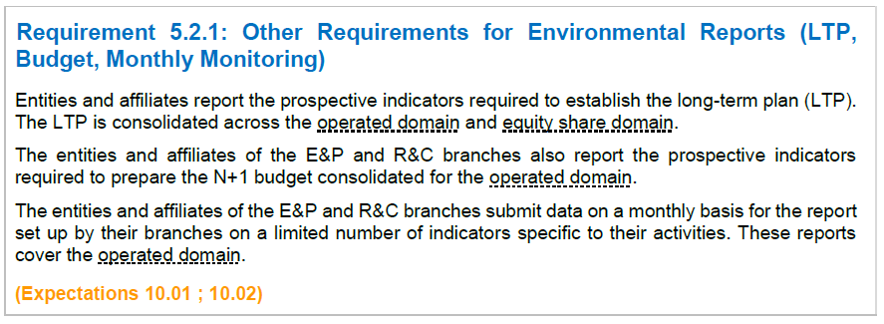
Environmental reporting
CR-GR-HSE-100
REQUIREMENT 5.2.1 : No change from existing practices. The rule incorporates them.
REQUIREMENT 5.3.1 : No change from existing practices. The requirement transmitted to the Branches in the form of a Memo (late 2019 / early 2020), and applied to the reporting entities, has been included in the rule.
REQUIREMENT 6.1 : The rule specifies that the reporting process must be auditable. Under the requirement, the documents that must be kept as a minimum are listed.
NEW REQUIREMENT
WHAT IS CHANGING

Slide 27
Environmental reporting
CR-GR-HSE-100
Appendix 2.2 : This appendix has been created to assist in the rating of environmental severity. It is advisable to contact the PSR/HSE environmental teams to validate an actual or potential severity 5 or 6.
Ecosystems Affected
Classification Factors (Hydrocarbons or Products Toxic for the Environment)
Sensitivity of the Sanitary Environment
Pollutants
Intervention Resources Implemented
NEW APPENDIX
WHAT IS CHANGING

Slide 28
Environmental reporting
CR-GR-HSE-100
The list of environmental indicators communicated/published by the Group is detailed:
It contains secondary indicators, calculated from the primary indicators provided by the reporting entities.
The list of environmental indicators reported monthly to the EP and RC divisions is defined.
NOTE (For RC): following the publication of the rule, the list of monthly reporting indicators was revised at the request of the CDRC. This revision is fully applicable as of now. Annex 10.2 of the Rule will be formally revised accordingly in the next edition of the Rule.
NEW APPENDIX
WHAT IS CHANGING

