Slide 1

Safety moment
Golden Rule 3
Body Mechanics & Tools
December 2022

Slide 2
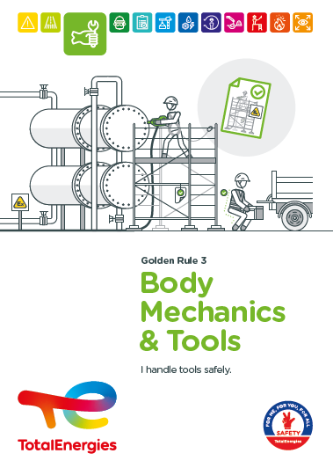
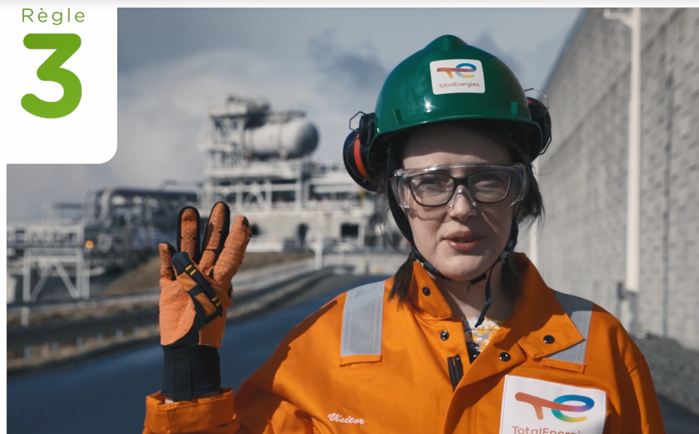


The Golden Rule Body Mechanics & Tools
THE NEW GOLDEN RULES
Communication at the WDfS 2022
Evolution of Golden Rules 1 to 10 to strengthen personal commitment
→ Golden Rules written in "I "
2 new Golden Rules

Slide 3
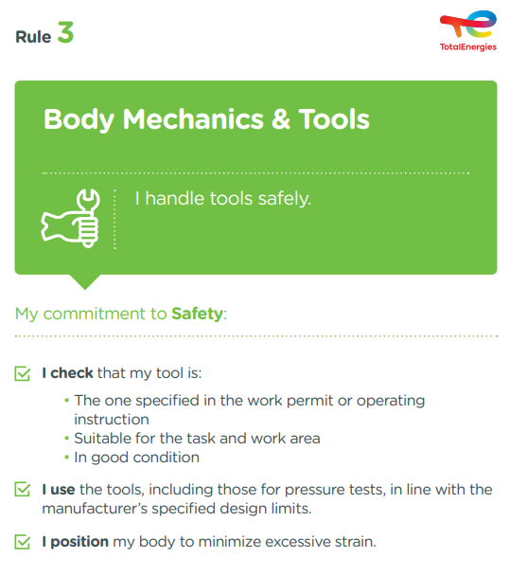
The essence of Golden Rule 3
TOOLS
GESTURE
POSTURE
All portable tools and equipment needed to perform a task.
Movement of all or part of the body.
Body position.
6
In the Company, where a requirement of Golden Rule 3 has been breached
Fatalities (2012-2021)
93
Lost time accidents
(2017-2021)
On industrial sites, in the office and at home, we are all implicated!

Slide 4
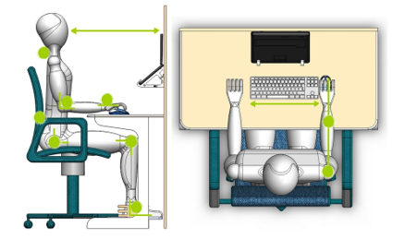
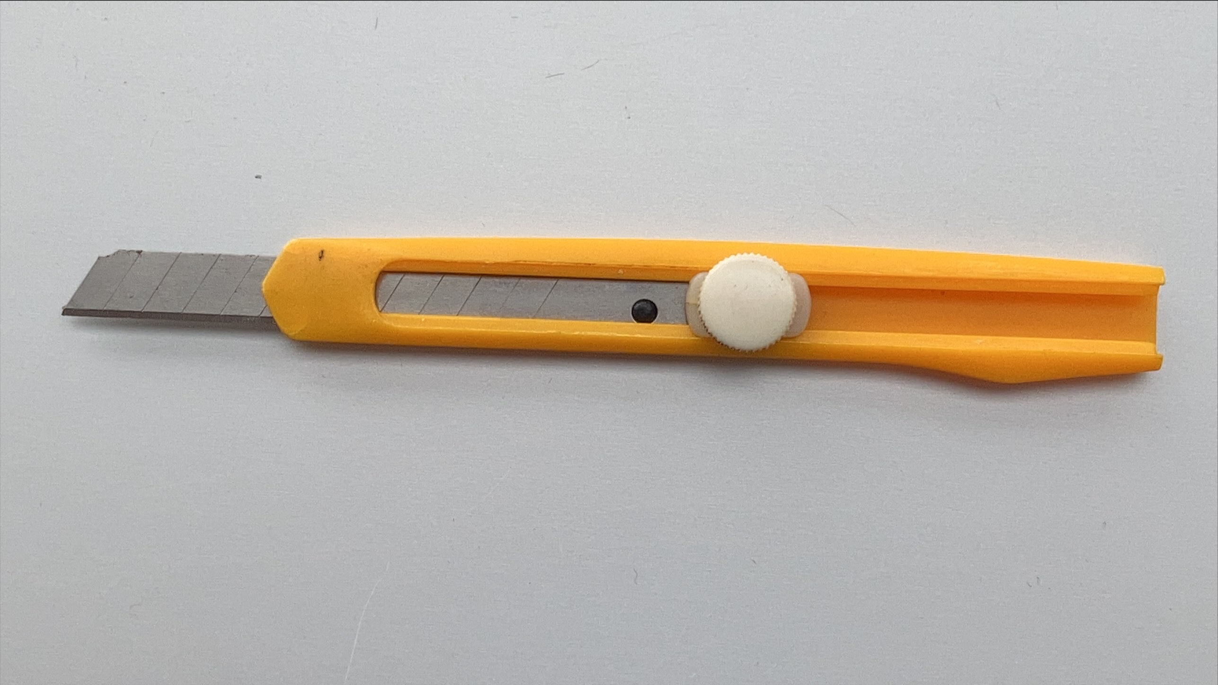
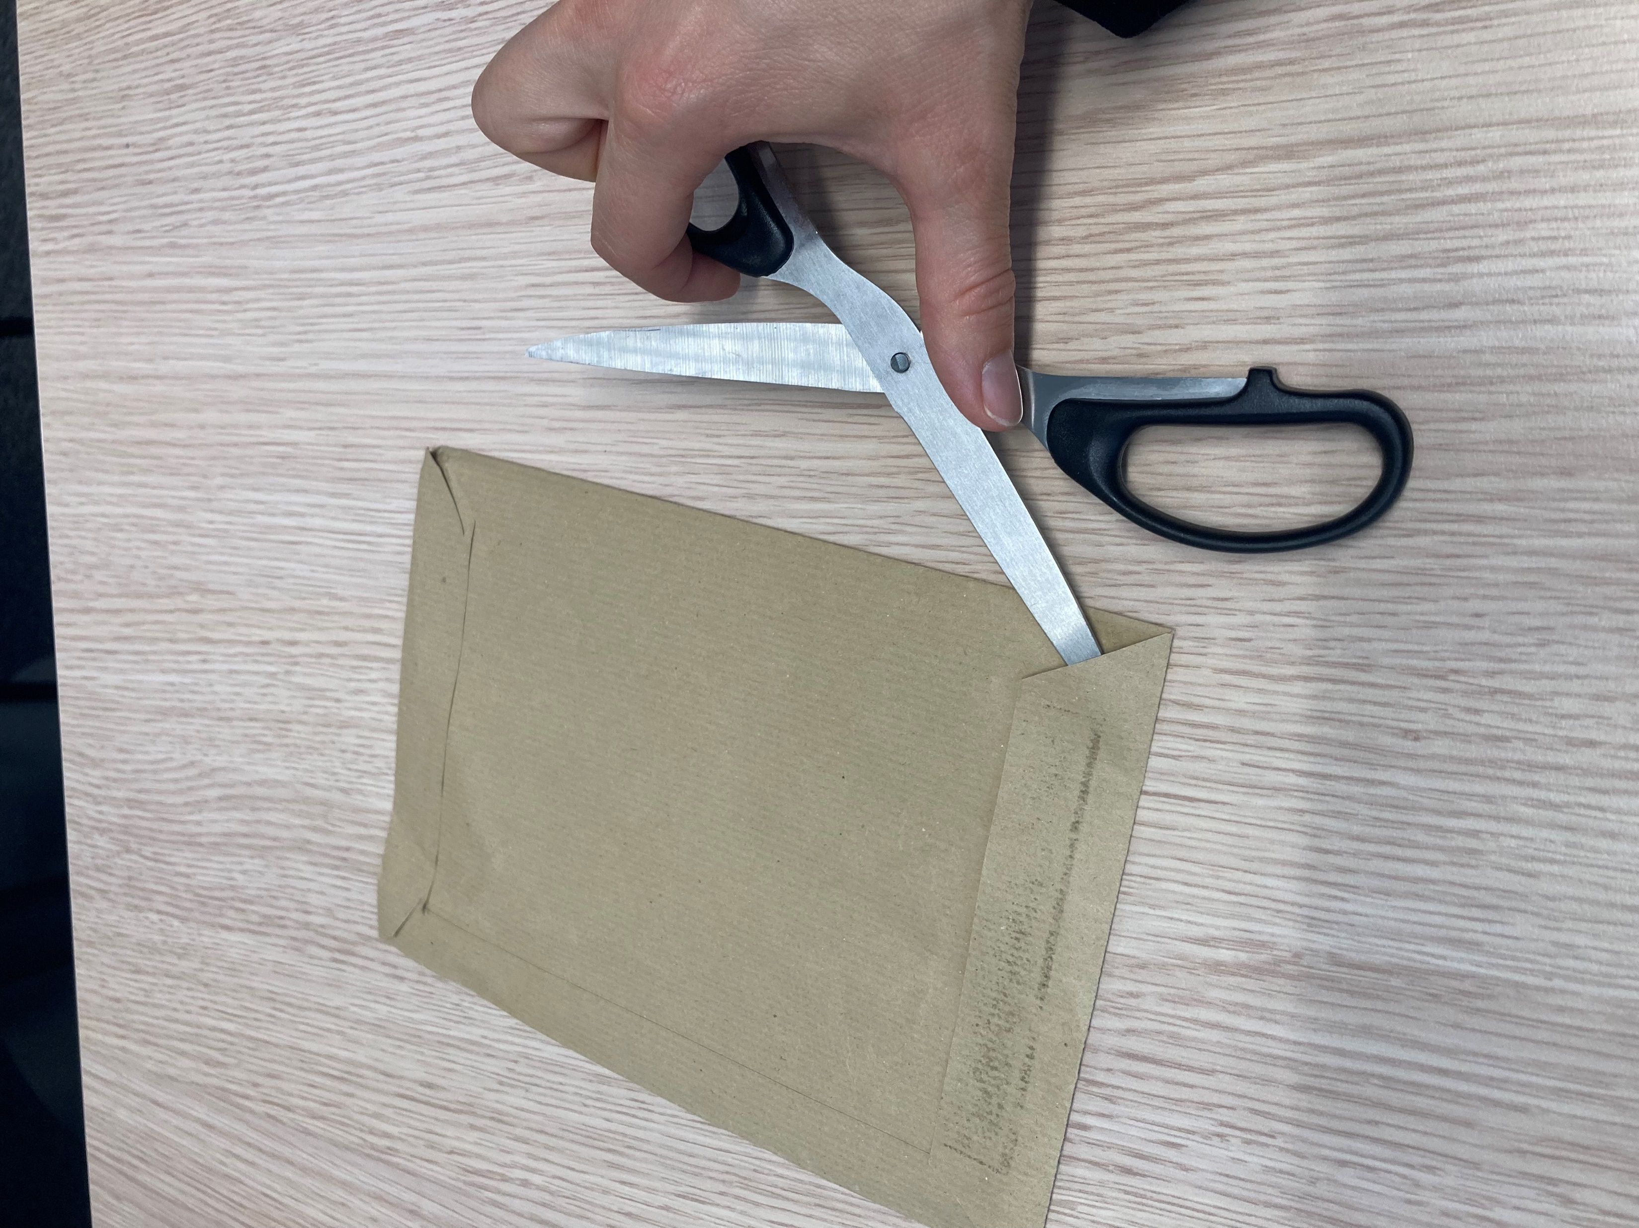
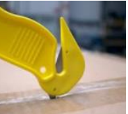
Examples of risks associated with body mechanics and tools in offices
  Cuts, bruises:
  I use only safe office tools and equipment; unsecured cutters are prohibited.
  I use office tools and equipment for their intended purpose.
  I dispose of unsecured office equipment (unsecured cutters, etc.).
  Pain, lower back pain, musculoskeletal disorders:
  I adjust my workstation and position myself to limit postural constraints.
At the office,
I am also implicated!

