Slide 1

The new Golden Rules
My Commitment, our Safety
Rev.0 – December 2022
Golden Rule2
Traffic

Slide 2
01.
The essentials

Slide 3
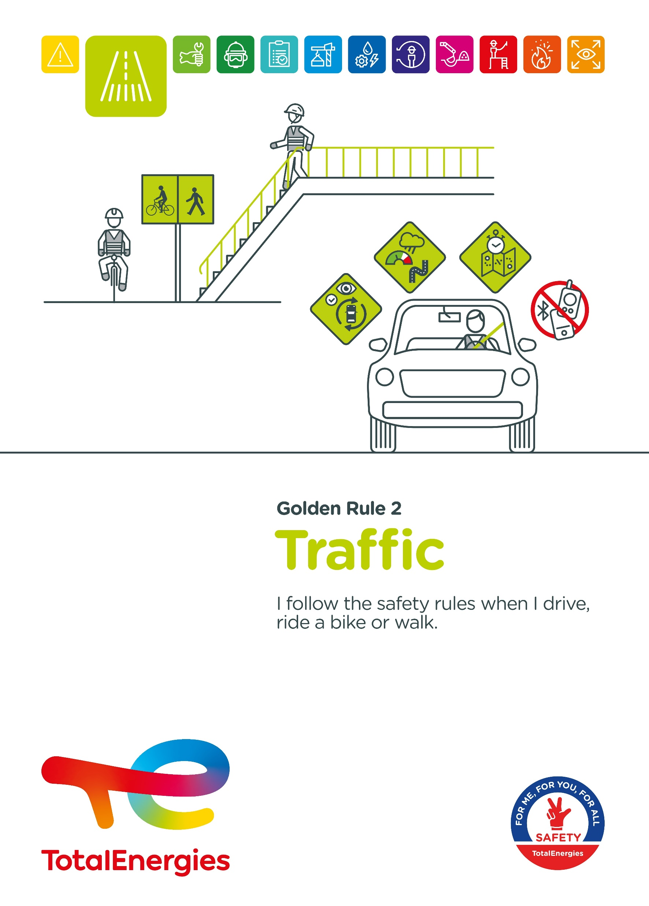
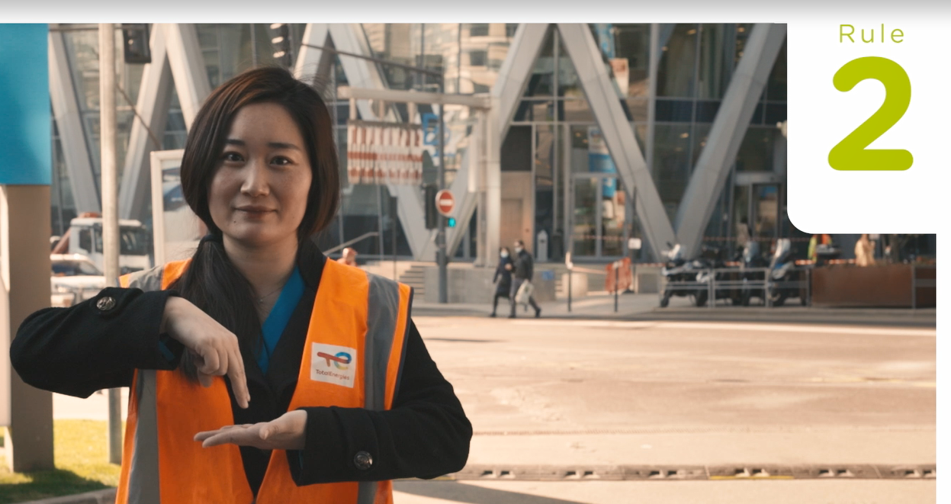
Poster & pictogram
The pictogram of the Golden Rule 2 "Traffic" is symbolized by a road and a pedestrian crossing. It thus represents all modes of transport: pedestrians, bicycles, vehicles and machines.
Affiche Règle d’or 2

Slide 4
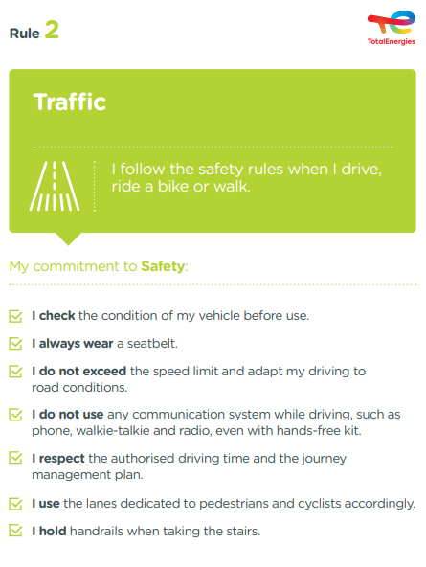
The essence of Golden Rule 2
What changes from the 2017 version of the Golden Rules:
    Prohibition of all communication system while driving: phone, walkie-talkie, radio.
    Addition of road conditions: driving is adapted to road conditions (traffic, weather conditions, road quality, etc.).
    Adding cycle paths: just as pedestrians must use the dedicated lanes, cyclists must use the cycle paths when they exist.
    Addition of the journey management plan: the journey** is managed by a journey management plan.
Traffic is covered by CR-GR-HSE-418 "HSE requirements for Site Traffic" and CR-GR-HSE-404 "Road Vehicle Driving Safety"*.
* Company Rules (CR) are limited to internal use.
** Concerns goods transport and collective transport, of more than 150 km or more than 3 hours, in high road risk countries.

Slide 5
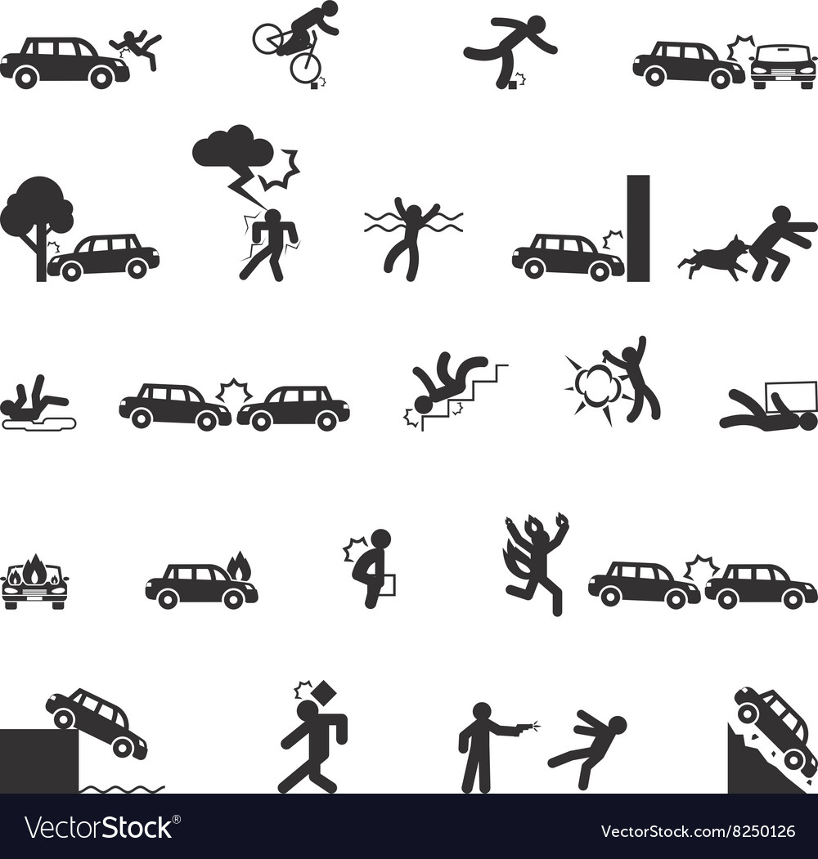


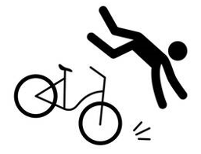
Traffic incidents
ACCIDENTS IN THE COMPANY WHERE A REQUIREMENT OF GOLDEN RULE 2 HAS BEEN BREACHED
MAIN RISKS
ASSOCIATED WITH TRAFFIC
5
Collision between a vehicle / machine and the environment (tree, animal, structure, ...)
Fatalities*
Rollover
36
Collision, crushing between a pedestrian and a vehicle / machine
Collision between vehicles / machines
Lost time accidents**
63
HIPO (High Potential)**
Slips, trips & falls
Bicycle fall
* 2012-2021
** 2017-2021

Slide 6
02.
REX

Slide 7
Illustration of requirements
REQUIREMENT | EVENT | SLIDE
1. I check the condition of my vehicle before use. | HOW DO I CHECK THE CONDITION OF MY LIGHT VEHICLE? | N°8
2. I always wear a seatbelt. | SHUTTLE ACCIDENT | N°9
3. I do not exceed the speed limit. | ROLLOVER OF A TRUCK ON A ROAD UNDER CONSTRUCTION | N°10
3. I adapt my driving to road conditions. | ROLLOVER OF A TANKER TRUCK ON A ROAD IN POOR CONDITION | N°11
4. I do not use any communication system while driving, such as phone, walkie-talkie and radio, even with hands-free kit. | DISTRACTION FROM DRIVING BY COMMUNICATION SYSTEMS | N°12
5. I respect the authorised driving time. | THE IMPORTANCE OF RESPECTING AUTHORISED DRIVING TIMES | N°13
5. I respect the journey management plan. | ROLLOVER OF A TANKER TRUCK ON A ROAD UNDER CONSTRUCTION | N°14
6. I use the lanes dedicated to pedestrians and cyclists accordingly. | PERSON HIT BY A VEHICLE WHEN LEAVING A CAR PARK | N°15
7. I hold handrails when taking the stairs. | FALLING DOWN THE STAIRS | N°16
The descriptions of the circumstances and consequences have been simplified for a better understanding.
A link to each REX is available for more information.

Slide 8
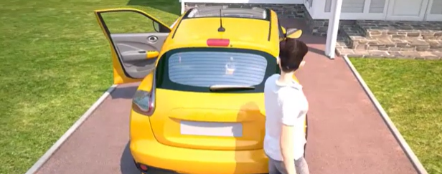
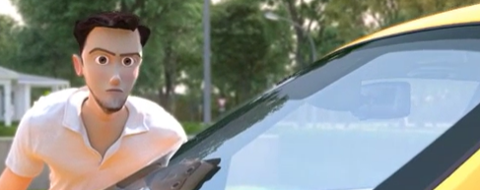
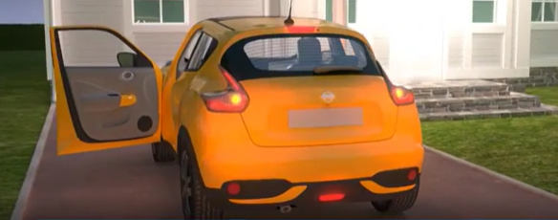
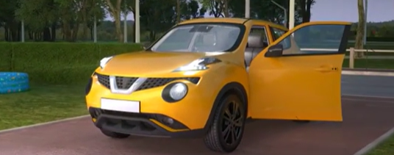
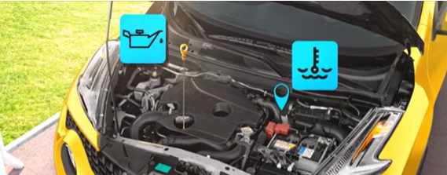
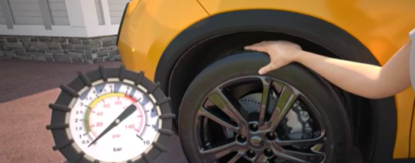
GOOD PRACTICE
I check the condition of my vehicule before use.
> HOW DO I CHECK THE CONDITION OF MY VEHICLE?
I walk around my vehicle to check that there are no obstacles and to check the condition of the bodywork.
I check the condition of the windshield to prevent it from cracking.
I check the condition of the rear lights to be seen by other road users.
I check the condition of the front lights to see/be seen by other road users.
I check the oil and coolant levels to protect the vehicle's engine.
I check the condition and pressure of my tyres to prevent the risk of bursting, aquaplaning, etc.
Notes:
https://wat.corp.local/sites/s276/fr-FR/Pages/vivre-sur-le-site/publications/actualites/2017/AVRIL/-campagne-de-sensibilisation-SafeDriver.aspx
https://acta-prevention.com/cgi-bin/HE/SF?P=1z1466z2z-1z-1z62DAA9D733
https://acta-prevention.com/cgi-bin/HE/SF?P=1z1457z2z-1z-1z54C80794D5
https://acta-prevention.com/cgi-bin/HE/SF?P=1z1459z2z-1z-1zD89EEFA0A2

Slide 9
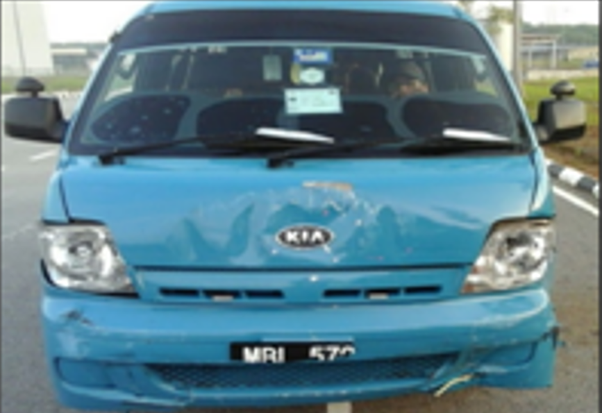
REX
2. I always wear a seatbelt.
> SHUTTLE ACCIDENT
CIRCUMSTANCES – FACTS
  A company minibus was transporting 8 employees to their workplace.
  A car overtook the minibus, swerved and then suddenly braked.
  The minibus driver could not avoid the car and hit the car from behind.
CONSEQUENCES
5 passengers were injured.
Potentially serious injury (HIPO).
LESSONS TO BE LEARNED
The seatbelt keeps the body securely attached to the seat and prevents potentially fatal injuries in the event of an accident.
CAUSES
  The driver of the car was trying to retrieve his mobile phone.
  Lack of defensive driving training for the minibus driver.
  Minibus equipped with seat belts, but not worn by all occupants.
Click here to access the REX
Cliquez ici pour accéder au REX
Notes:
https://totalworkplace.sharepoint.com/sites/GroupHSEREXDataBase/en-us/All_HSE_REX_Documents/ALERT-MS-AFR-TRANSPORT-2020-041%20Safety%20Stand%20Down%20Accidents%20Transport%2004-2020%20EN%20FR.pdf
https://wat.corp.local/sites/s215/fr-FR/Documents/Reporting-securite/PPT_MS%20HSE%2005%202020.pdf

Slide 10
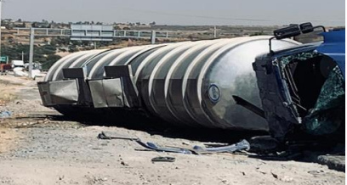
REX
3. I do not exceed the speed limit.
> ROLLOVER OF A TRUCK ON A ROAD UNDER CONSTRUCTION
CIRCUMSTANCES – FACTS
  A truck drove onto a motorway where road work was in progress.
  Traffic was diverted at the work area. The road was on a slight slope and at a reduced speed.
  On entering the curve, the speeding driver lost control of the vehicle.
  The truck then overturned on the side of the road.
CONSEQUENCES
Concussion and whiplash.
Potentially serious injury (HIPO).
LESSONS TO BE LEARNED
I respect speed limits when driving: speed limits are adapted to the road and its environment;
CAUSES
  Low visibility in the vicinity of the work area.
  Inappropriate driving in the work area, on a sloping curve.
  First time that the driver has used this road.
  Not wearing a seat belt (physical consequences).
Click here to access the REX

Slide 11
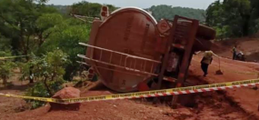
REX
3. I adapt my driving to road conditions.
> ROLLOVER OF A TANKER TRUCK ON A ROAD IN POOR CONDITION
CIRCUMSTANCES – FACTS
  A tanker truck overturned on an unpaved, winding, sloping and wet road.
  Its speed was 14km/h before the rollover.
CONSEQUENCES
No actual consequences.
Potentially serious injury (HIPO).
LESSONS TO BE LEARNED
I adapt my driving (speed, safety distance, maneuvering, etc.) to road conditions (roadworks, traffic, weather conditions, road conditions, bends, etc.).
If the conditions are very unfavourable, I stop in an appropriate area and contact the affiliate’s Transport Manager.
CAUSES
  Poor road conditions.
  Weather conditions.
Click here to access the REX

Slide 12
GOOD PRACTICE
4. I do not use any communication system while driving, such as phone, walkie-talkie and radio, even with hands-free kit.
> DISTRACTION FROM DRIVING BY COMMUNICATION SYSTEMS
DISTRACTED DRIVING
Distracted driving is the diversion of attention from the activities necessary for safe driving to another activity.
CONSEQUENCES
Slowing of reaction time.
Reduced field of vision.
Impaired judgment.
IN FIGURES
Using a phone while driving increases the risk of an accident by 4.
Reading a text message while driving increases the risk of an accident by 23 times.
Distractions while driving cause 25% of fatal road accidents.
GOOD PRACTICES
Before departure:
I make all my adjustments (mirrors, seat adjustment, ...),
I program my GPS,
I put my phone on "Do not disturb" mode and place it out of reach,
I make sure that the equipment and objects in the passenger compartment are stowed or secured.
When driving :
I keep my eyes on the road,
I do not reach for any device or object,
If necessary, I stop in a safe place, especially for :
  any emergency,
  making a call,
  changing the route on my GPS.
Click here to access the REX
Notes:
Distraction au volant : « La distraction au volant est le fait de détourner son attention des activités indispensables à une conduite en toute sécurité, au profit d’une autre activité. L’ attention du conducteur est divisée entre sa tâche prioritaire (la conduite) et les tâches secondaires (sans rapport avec la conduite) »
https://acta-prevention.com/cgi-bin/HE/SF?P=1z1481z2z-1z-1z8C8842861B
https://acta-prevention.com/cgi-bin/HE/SF?P=1z2831z2z-1z-1zF439AE04CF

Slide 13
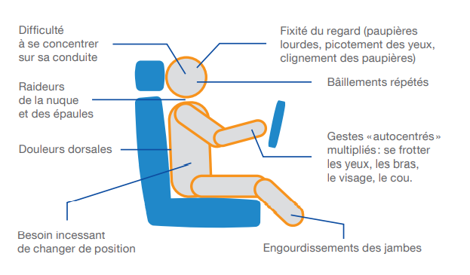


GOOD PRACTICE
5. I respect the authorised driving time.
> THE IMPORTANCE OF RESPECTING AUTHORISED DRIVING TIMES
IDENTIFY SIGNS OF FATIGUE
EXAMPLES OF THE EFFECTS OF FATIGUE ON DRIVING
Difficulty concentrating on driving
Staring (heavy eyelids, tinging eyes, blinking eyelids)
Stiffness in the neck and shoulders
Frequent yawning
Reduced vigilance
Back pain
Repetitive, “self-centered” gestures: rubbing your eyes, arms, face and neck
Difficulty driving in a straight line and at a constant speed
Constant need to change position
Numbness in legs
GOOD PRACTICES
Click here to access the REX
Microsleeps
Before leaving, I prepare my journey and identify rest areas to take breaks.
I leave rested and get enough sleep (7 to 8 hours per night).
I take a break at the first signs of fatigue.
I take a minimum break of:
  10 minutes every 2 hours of driving for light vehicles,
  30 minutes every 4.5 hours of driving for heavy vehicles.
Drowsiness
Notes:
Fatigue : « Diminution progressive de la vigilance physique et mentale qui conduit vers la somnolence et l’endormissement ».

Slide 14
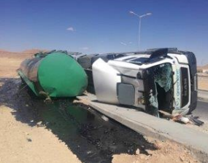
REX
5. I respect the journey management plan.
> ROLLOVER OF A TANKER TRUCK ON A ROAD UNDER CONSTRUCTION
CIRCUMSTANCES – FACTS
  The driver of a loaded tanker truck drove onto a road that was under construction and not included in the journey management plan.
  In a curve, he lost control of the truck, which overturned.
CONSEQUENCES
Scratch on the face.
Potentially serious injury (HIPO).
LESSONS TO BE LEARNED
I respect the journey management plan, particularly the predefined route, which takes into account the main known permanent and temporary road hazards.
In the event of a change of route, I stop and ask for validation from the affiliate's Transport Manager.
CAUSES
  Misjudgement on a succession of 2 curves.
  Traffic route not validated by the affiliate.
Click here to access the REX

Slide 15
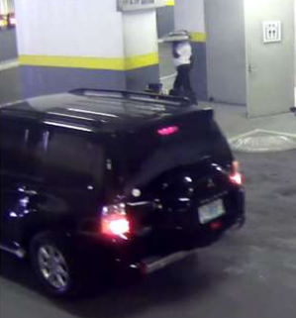
REX
6. I use the lanes dedicated to pedestrians and cyclists accordingly.
> PERSON HIT BY A VEHICLE WHEN LEAVING A CAR PARK
CIRCUMSTANCES – FACTS
  A worker was exiting the service lift carrying a snack tray on his shoulder.
  He crossed an access road to the car park which was prohibited to pedestrians.
  At the same time, a vehicle turned and hit him.
CONSEQUENCES
Fracture of the left leg at the level of the tibia – 3 months off work (HIPO).
LESSONS TO BE LEARNED
I use pedestrian and cycle lanes, where they exist, to minimise the risk of collision with vehicles.
These lanes separate motorised traffic from pedestrians and bicycles and minimise the number of crossings.
CAUSES
  The worker and the vehicle driver were distracted at the time of the accident.
  Failure to comply with the prohibition of crossing the vehicle access road (prohibition sign in place).
  No physical barrier at this point, preventing the worker from accessing the vehicle access road.
Click here to access the REX

Slide 16
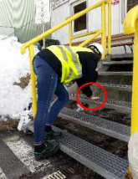
REX
7. I hold handrails when taking the stairs.
> FALLING DOWN THE STAIRS
CIRCUMSTANCES – FACTS
  A worker took the stairs.
  With only the tip of his foot on the step, he stumbled and injured his wrist while trying to break the fall.
CONSEQUENCES
Wrist injury.
LESSONS TO BE LEARNED
I hold the handrail when taking the stairs, both up and down, to reduce the risk of falling. These falls can be serious or even fatal.
CAUSES
  The worker did not hold the handrail.
Click here to access the REX

Slide 17
03.
Further information

Slide 18
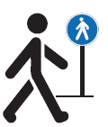
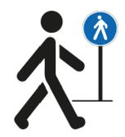

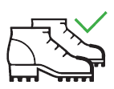

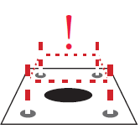




Some everyday essentials to prevent slips, trips & falls
I walk with caution, observing my surroundings, anticipating situations, and using pedestrian lanes.
I do not obstruct corridors (storage of boxes, cable runs, etc.).
I wear suitable shoes.
I don't check my smartphone while walking.
I wipe my shoes on the mats.
I report damaged floors and any dirt or spills.
I hold the handrail when taking the stairs.
I drain clothes and umbrella before entering a building.
At the office, I am also implicated!

Slide 19
Our tools and documents
CR-GR-HSE-404 - Road vehicle driving safety:
https://toolbox-hse.totalenergies.com/en/one-maestro/one-maestro-pyramid-documents/group-hse-rules
CR-GR-HSE-418 - HSE Requirements for Site Traffic :
https://toolbox-hse.totalenergies.com/en/one-maestro/one-maestro-pyramid-documents/group-hse-rules
E-learning sur la circulation :
https://lizzy.totalenergies.com/
2019-2021 SafeDriver Campaign:
https://toolbox-hse.totalenergies.com/en/safedriver-2019-2021
Toolbox HSE – new Golden Rules:
    General material: TotalEnergies Golden Rules – General material
    Roll-out material: TotalEnergies Golden Rules – Roll-out material
REX database:
https://totalworkplace.sharepoint.com/sites/GroupHSEREXDataBase/en-us/Pages/REX%20HSE%20Home.aspx
Safety + (good practices per Golden Rules): https://safetyplus.totalenergies.com/en
  Some good practices :
    https://safetyplus.totalenergies.com/en/contribution/jtdttr#
    https://safetyplus.totalenergies.com/en/contribution/3qrvgj?p_route=wall&p_qs=rules%3D1
    https://safetyplus.totalenergies.com/en/contribution/eoxt40?p_route=wall&p_qs=rules%3D1
    https://safetyplus.totalenergies.com/en/contribution/n78pne?p_route=wall&p_qs=rules%3D1

Slide 20
Lexicon
Hazard: An intrinsic property of a product, equipment, process, situation or action that can result in harm to people, the environment and/or assets.
Risk: The combination of the probability of occurrence of a hazardous event and the severity of the impact that may result from exposure to the hazard.
HSE events:
  Incident: Any sudden and undesirable HSE event on a given date, that causes injury or illness, damage to property or facilities, loss of production, environmental damage or damage to the Company's image.
  Near miss: Any sudden and undesirable HSE event on a given date which, in slightly different circumstances, could have had the same consequences as an incident. A near miss does not have an actual severity level but has a potential severity level.
  Anomaly: Any abnormal situation or behaviour, including deviations from a standard, specification, procedure or rule.
HIPO (High Potential) [slide 6]: Incident or near miss with an actual severity level ≤ 3* and a potential severity level ≥ 4** in one or more areas of the Company’s evaluation matrix of the actual and potential severity level of HSE events.
REX HSE: Document for sharing information on an internal or external HSE event, based on a detailed analysis and making recommendations.
* For example, physical consequences with an actual severity level = 3 correspond to a lost time accident.
** For example, physical consequences with a potential severity level of 4 correspond to a fatality.
Notes:
Définitions « risques » et « danger » (GM-GR-HSE-300 « Evaluation des risques professionnels au poste de travail »)
Définitions HIPO, Incident, presqu’accident, anomalie (CR-GR-HSE-100 « Reporting HSE »)

