Slide 1

Safety moment
December 2022
Golden Rule2
Traffic

Slide 2
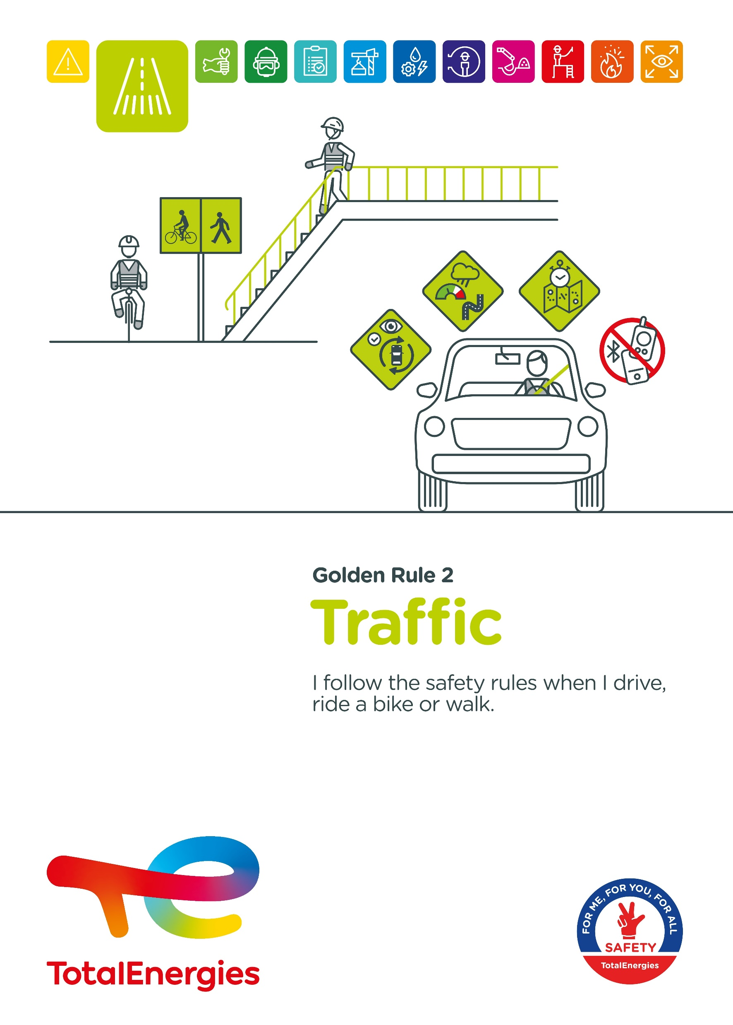
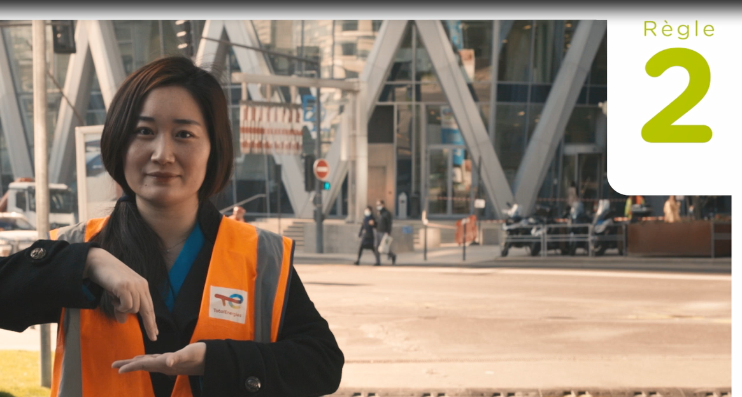
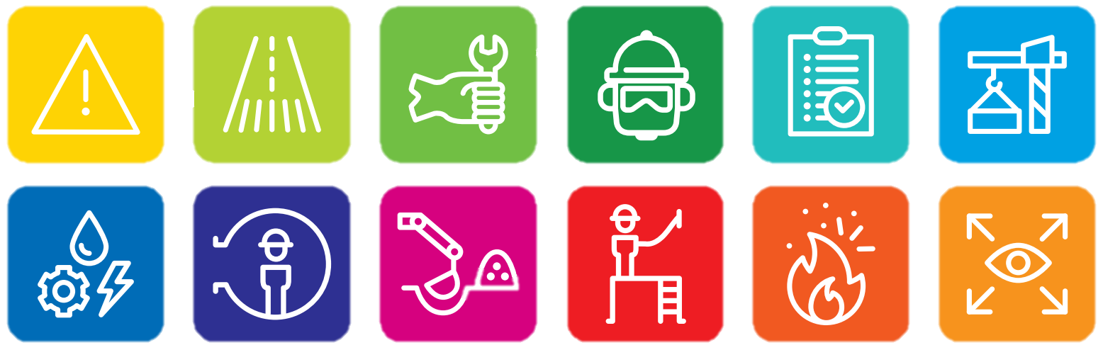
The Golden Rule Traffic
THE NEW GOLDEN RULES
    Communication at the WDfS 2022
    Evolution of Golden Rules 1 to 10 to strengthen personal commitment
    → Golden Rules written in “ I ”
    2 new Golden Rules

Slide 3
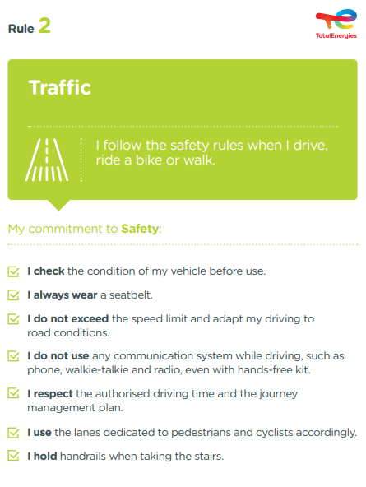
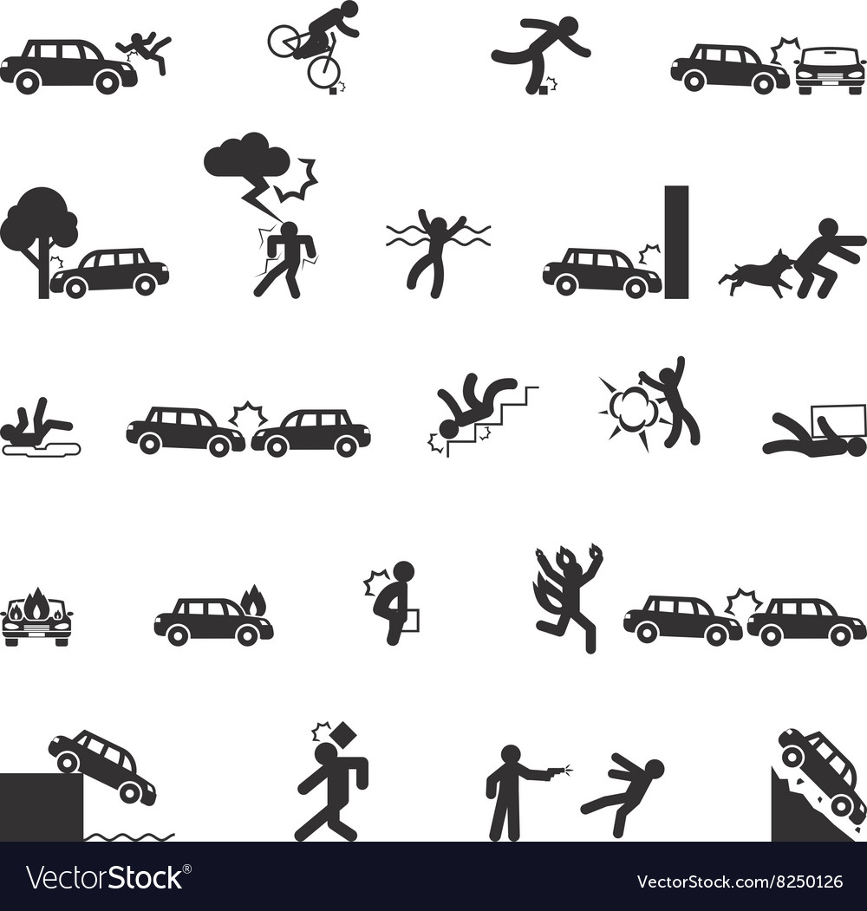

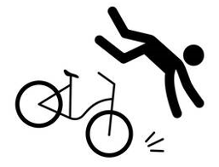
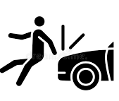
The essence of Golden Rule 2
MAIN RISKS ASSOCIATED WITH TRAFFIC
Collision :
    Between vehicles
    With the environment
    With a pedestrian or a cyclist
Slips, trips & falls
Bicycle fall
5
Fatalities (2012-2021)
In the Company, where a requirement of Golden Rule 2 has been breached
63
Events with a high severity potential (2017-2021)
On industrial sites, in the office and at home, we are all implicated!

Slide 4
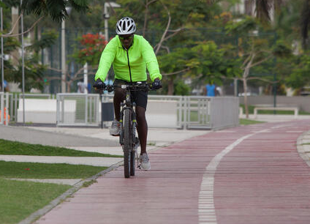
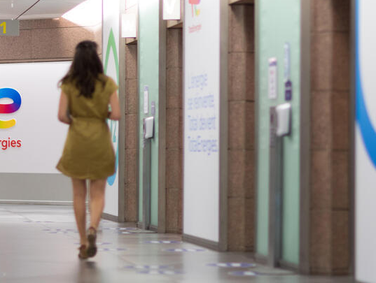
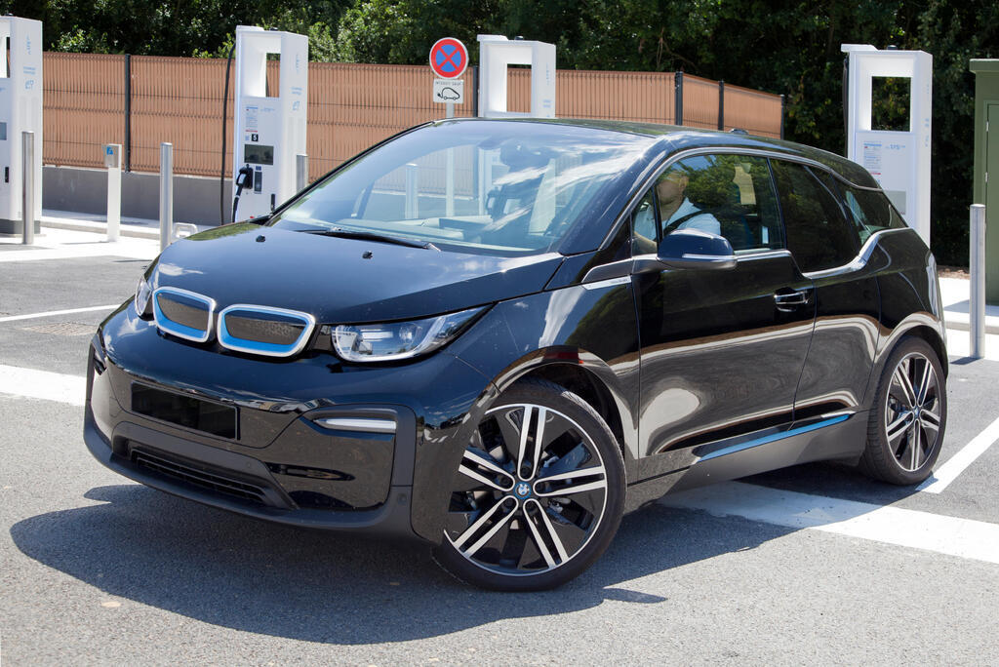
Prevention of falls and collisions
WHEN AM I CONCERNED?
WHEN I RIDE A BICYCLE
    In the office
    During assignments
    On trips between sites
    On the way to and from work
    I opt for a route with cycle paths, and use them.
    I check the condition of my bike: brakes, tyres, lighting and bell.
    I wear the appropriate equipment (helmet, fluorescent jacket).
    I am aware of blind spots.
    I indicate my changes of direction.
NOW IT IS YOUR TURN: HOW TO PREVENT FALLS AND COLLISIONS?
WHEN I WALK
WHEN I DRIVE A VEHICLE
    I hold handrails when taking the stairs
    I walk with caution, observing my surroundings, anticipating situations, and using pedestrian lanes.
    I do not check my smartphone while walking.
    I do not obstruct corridors (storage of boxes, cable runs, etc.).
    I respect the markings and signs in place.
    I check the condition of my vehicle before use.
    I program my GPS before departure.
    I always wear a seatbelt.
    I do not exceed the speed limit.
    I adapt my driving to road conditions.
    I do not use any communication system while driving, such as phone, walkie-talkie and radio, even with a hands-free kit.
    I respect the authorised driving times.
    I stay aware of my surroundings

