Slide 1
HSE Requirements for Loading and Unloading Road and Rail Vehicles GROUP HSE RULE (CR-GR-HSE-431)
SUMMARY
This rule defines the minimum HSE requirements to manage the risks during operations involving the loading and unloading of dangerous or non-dangerous goods, into or out of road and rail vehicles, at dedicated loading / unloading areas and bays.

Slide 2
CR-GR-HSE-431
Context:
4,3 Millions loadings/year; 12 Millions unloadings/year.
variety of goods or objects loaded.
13 requierements, grouped in 4 themes:
risk analysis & procedure;
information & training;
implementation;
audits.
Remplace documents:
DIR-SEC-14 - Road/Rail Loading and Unloading operations;
CR-RC-HSE-067 – Safety of Road/Rail Loading and Unloading operations;
CR-GP-HSE-122 - Road/Rail Loading and Unloading operations;
REG-GR-SEC-031 - Control procedure before loading tank trucks with liquid hydrocarbons and LPG ‟Safe to Load”;
GS-RC-HSE-050 – Filling rate of lorries with black products.
Date of publication in REFLEX : 02/10/2020
Date of application : 02/04/2021

Slide 3
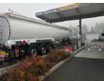
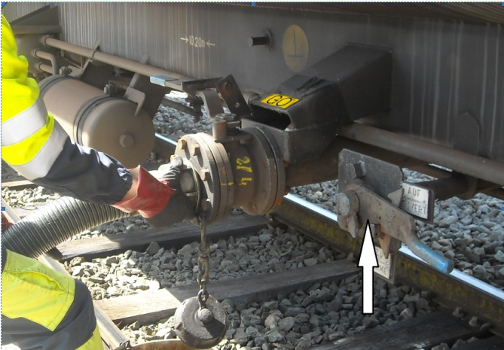
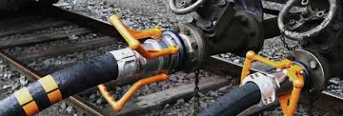
Scope of Application
Concerns loading/unloading operations on a permanent area or a dedicated station:
all types of trucks and rail cars (tipper, tanker, platform, etc...);
of all types of materials/goods, whether dangerous or not, objects (except goods such as mail or postal parcels);
carried out on operated sites (except construction sites);
of trucks operated and/or contracted for more than 6 months carried out on non-operated sites.
NEW

Slide 4
Scope of Application
The requirements in this rule are adjusted depending on the type of vehicle and the nature of the goods.
In addition to a written description, pictograms have been added for clarification:
Dangerous goods |  | Non-dangerous goods
Tankers |  | Other lorries
Rail Tank Cars (RTC) |  | Other rail cars
A requirement not preceded by a pictogram applies to all the operations targeted by the subject of this rule.

Slide 5
REQUIEREMENTS
Risk Analysis and Procedures
Information & Training
Implementation
Audits
Requirement 3.1.1: Risk Analysis
Any kind of loading / unloading operations are to undergo a risk analysis. The risk analysis is formalised and revised in the event of significant changes to the loading or unloading areas and bays, or to the operating instruction.
No change

Slide 6
REQUIEREMENTS
Risk Analysis and Procedures
Information & Training
Implementation
Audits
REQUIEREMENTS
Requirement 3.1.2: Risk Management Measures Specific to Loading / Unloading Bays for Dangerous Goods into/from Tanker Vehicles
During loading / unloading of dangerous goods from tanker vehicles: A minimum of two control measures are implemented at all times during loading/unloading operations; As a minimum, the risk control measures described in Appendix 1 are implemented.
Requirement already exists but specification of risk control measures required in Annex 1
Requirement 3.1.3: Loading / Unloading Procedures
A procedure or procedures incorporating at least the requirements of this rule and taking into account risk control measures are defined and implemented.
No change

Slide 7
REQUIEREMENTS
Risk Analysis and Procedures
Information & Training
Implementation
Audits
Requirement 3.2.1: Informing Crew Members
Crew members are informed of the safety instructions specific to the loading / unloading area or bay (including instructions for positioning the vehicle) before they are authorised to enter the site.
NEW
New requirement for all branches (formalisation of information on safety instructions to crew members)

Slide 8
REQUIEREMENTS
Risk Analysis and Procedures
Information & Training
Implementation
Audits
Requirement 3.2.2: Training and Authorisation
The persons involved (including the road driver) in the supervision, control or execution of loading / unloading operations of dangerous goods are trained as a minimum: In applicable procedures, in order to know the risks related to the operations and products handled, and the corresponding risk control measures; Action required in the event of an accident or emergency situation; A refresher course is completed every 5 years at maximum. In addition, on an industrial site and for personnel performing self-service loading / unloading operations: the courses include a practical part specific to the loading / unloading bay(s) and product types; a refresher is carried out after a significant change in the loading / unloading bay / station or operating instructions. For drivers operating self-service loading / unloading bays on an industrial site, training is validated by an authorisation. Training, refresher courses and authorisations are recorded.
NEW
NEW
Already existing requirement with a new precision on the periodicity of the training courses of 5 years

Slide 9
REQUIEREMENTS
Risk Analysis and Procedures
Information & Training
Implementation
Audits
Requirement 3.3.1: Control of Vehicles (Road and Rail) and Road Drivers
A control system, of which the frequency and check points are defined based on the risk analysis, return of experience (REX) and applicable local regulations is implemented. Particular attention is paid to ensure that no overloaded, over-pressurised or over-filled vehicles leave the site. The results of these checks are recorded and any corrective measures are implemented.
No change

Slide 10
REQUIEREMENTS
Risk Analysis and Procedures
Information & Training
Implementation
Audits
Requirement 3.3.2: Further Inspections for Tankers Fuelled by CNG or LNG Transporting Dangerous Goods
Tankers fuelled by Compressed Natural Gas (CNG) or Liquified Natural Gas (LNG) transporting dangerous goods are to undergo the following further inspections: On industrial sites, before they are allowed to access the loading / unloading bays: Presence of compliance certificate of the fuel supply system with one of the following two regulations: ECE-R110 or NFPA 52; Pressure in the LNG tank less than 13 bars; Absence of visible damage on the tank and fittings; Presence of two safety devices on CNG bottles: thermal fuse and rupture disc. At all other sites, before they are allowed to load / unload, the driver checks that the pressure in the LNG tank is below 13 bars.
NEW
New requirement for all branches

Slide 11
REQUIEREMENTS
Risk Analysis and Procedures
Information & Training
Implementation
Audits
Requirement 3.3.3: Specific Control for Lorries in Countries with High Road Risks - Safe to Load
An inspection is performed before authorising the loading of dangerous goods in countries with high road risks, according to the matrix defined in Appendix 2. The “blocking” check points are satisfied to authorise loading. Inspections are performed by trained and authorised personnel. Inspections performed and the decision to authorise loading are tracked and recorded.
NEW
New requirement for all branches, as Safe to Load now covers the entire transport of dangerous goods (tanks or packages) in countries with high road risks.

Slide 12
REQUIEREMENTS
Risk Analysis and Procedures
Information & Training
Implementation
Audits
Requirement 3.3.4: Vehicle Immobilisation at the Loading / Unloading Bay
One or more systems are installed to make sure that the road or rail vehicle is immobilised during the loading / unloading operation. In particular, chocks are used when discharging flammable liquids at service stations. During the loading / unloading of a rail car, measures are taken to prevent another rail car accessing the same bay.
No change

Slide 13
REQUIEREMENTS
Risk Analysis and Procedures
Information & Training
Implementation
Audits
Requirement 3.3.5: Load Distribution and Bracing
Before any lorry leaves the site, its personnel or the driver checks that the following provisions are met : The load is distributed to ensure its stability and that of the lorry during transport; All loads are braced (locking, fastening, blocking/bracing) to prevent them from moving suddenly during transport or if the lorry brakes suddenly; Removing the bracing device (e.g. for unloading) does not jeopardise load stability.
Already existing requirement with details of mandatory checkpoints.

Slide 14
REQUIEREMENTS
Risk Analysis and Procedures
Information & Training
Implementation
Audits
Requirement 3.3.6: Access to the Domes of Tanker Vehicles
The risk management measures described in Appendix 3 are applied when accessing the domes of tanker vehicles.
NEW
New requirement for all branches as minimum risk control measures for access to the tank dome are now defined according to the type of operation.
Type of Operation |  | Mesures minimales de maitrise des risques pour l’accès au dôme du véhicule citerne
Loading / unloading on industrial site | Dome filing (e.g. hose connection, handling the loading arm) | Access platform equipped with collective fall protection measures (handrail, intermediate rail, toe board) or Access platform + use of a personal fall-arrest system (including harness + anchor point)
 | Bottom filing requiring access to tanker dome (e.g. dome opening, opening a venting system) | Mobile platform equipped with collective fall protection measures (handrail, intermediate rail, toe board) or Use of a personal fall-arrest system (including harness + anchor point)
 | Bottom filing requiring access to rail tank car dome (e.g. dome opening, opening a venting system) | Mobile platform equipped with collective fall protection measures (handrail, intermediate rail, footguard) or Use of personal fall-arrest system (e.g. harness equipped with 2 lanyards, with one permanently attached to the side of the walkway)
Unloading of tanker except on industrial site |  | Use of one handrail all along the walkway

Slide 15
REQUIEREMENTS
Risk Analysis and Procedures
Information & Training
Implementation
Audits
Requierement 3.4.1 : Audits
Each entity or subsidiary periodically audits the adequacy of its loading / unloading procedure(s). Particular attention is paid to: Compliance with operating instructions; Maintenance programmes for loading / unloading bays, including testing of safety equipment on industrial sites; Vehicle checks. The frequency of these audits is defined according to the risk analysis. The period between two audits is a maximum of 5 years.
No change

Slide 16
REQUIEREMENTS
Risk Analysis and Procedures
Information & Training
Implementation
Audits
Requirement 3.5.1: HSE Assessment of Loading Third Party Sites
Third party sites where loading operations are carried out on operated lorries or contracted lorries are subject to an HSE assessment. This HSE assessment includes at least the criteria listed in Appendix 4 and is renewed at least every five years. When appropriate, the entity or affiliate ensures that a progress plan is put in place by the third party site operator to achieve compliance with the criteria listed in Appendix 4.
NEW
New requirement for all branches

