Slide 1
A tool to support the recognition of significant actions for safety
DG/STS/HSE – Update May 2023

Slide 2
Basics to improve safety performance
2020
2019
“Our lives first” program
Safety green lights, Life saving checks, Joint safety tours
2018
‘Zero fatal accidents’ Company objective
- Safety actions recognition program
- Safety+ launch
2017
12 Golden Rules for the workplace reformulated as ‘musts’ and ‘must nots’
2015
- Stop Card
- Safety Contract Owners
2013
Total Commitment
Safety for me, for you, for all
Safety is one of the TotalEnergies’ core value: it underpins our decisions and behaviors
Programs are deployed to ensure that all the Company’s employees and contractors are committed to work in this way
2012
Safety Moments
2010
12 Golden Rules for the workplace
2007
1st World Day for Safety

Slide 3
Encourage the development of actions for Safety
Initiatives in this area are undertaken and implemented daily at all the Company’s sites and subsidiaries
Recognition systems already exist at the Company’s sites and within the affiliates to recognize employee commitment
TotalEnergies tends to promote recognition at local, branch and Company level, while supporting the key role of local management

Slide 4
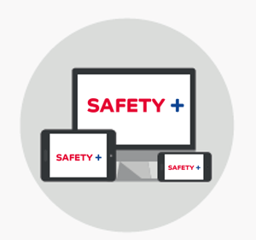
Safety+: a tool dedicated to Safety initiatives and best practices
Safety+ is an easy-access digital platform available for sites and affiliates to:
Give visibility to significant safety actions taken in your entity
Highlight and share these actions with all the Company’s sites and subsidiaries. Then promote them at different levels of the Company
Ensure the systematic and regular implementation of recognition at local level, then at branch or Company level
https://safetyplus.totalenergies.com
Contributors:
Individual or group: employee(s) of TotalEnergies or partner companies (only for recognition at site/subsidiary level)
Scope:
All Company’s sites and subsidiaries
What are the administration rules on Safety+?
The administration rules are to be organized by each site and affiliate that wants to use the digital platform to facilitate the recording and selection of significant actions for Safety Request the access by sending an email to: safetyplus-contact@totalenergies.com

Slide 5
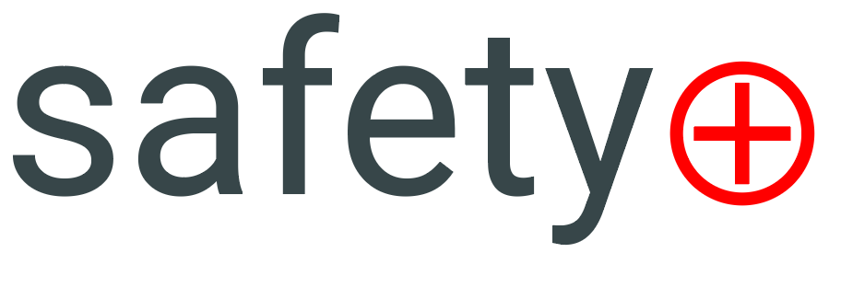
Selecting & recognizing
Collection of actions via Safety+ or any other reporting system
Decided by site/affiliate/entity
Decided by branches CODIR and EXCOM
★ Local prize 
★ Distinction 
★ Award 
Local action, selected and awarded.
Locally awarded action, branch/Group-worthy.
Branch (TOP) and Company (WOW) award.
or local recognition system
« Push »
• Employee or Stop Card
• Service or team
• Individual / As a group
• Individual / As a group
Every month
Regularly
Each quarter
Each year
Recommended recognition criteria:
Effective implementation | Transferability | Added value

Slide 6
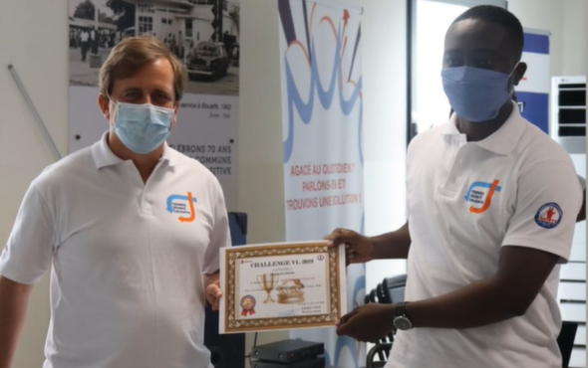
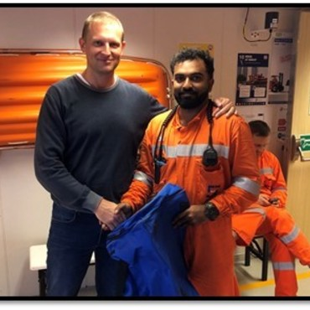
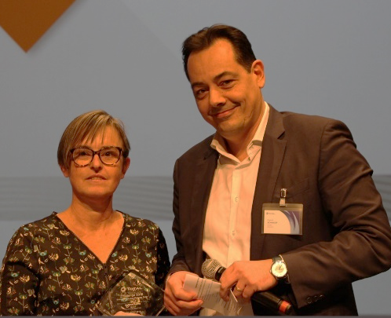
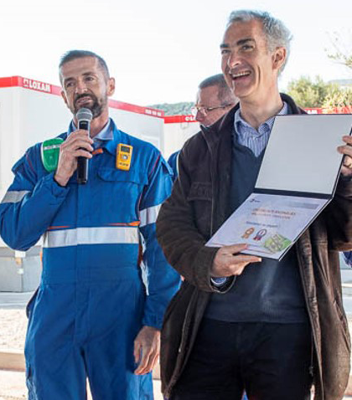
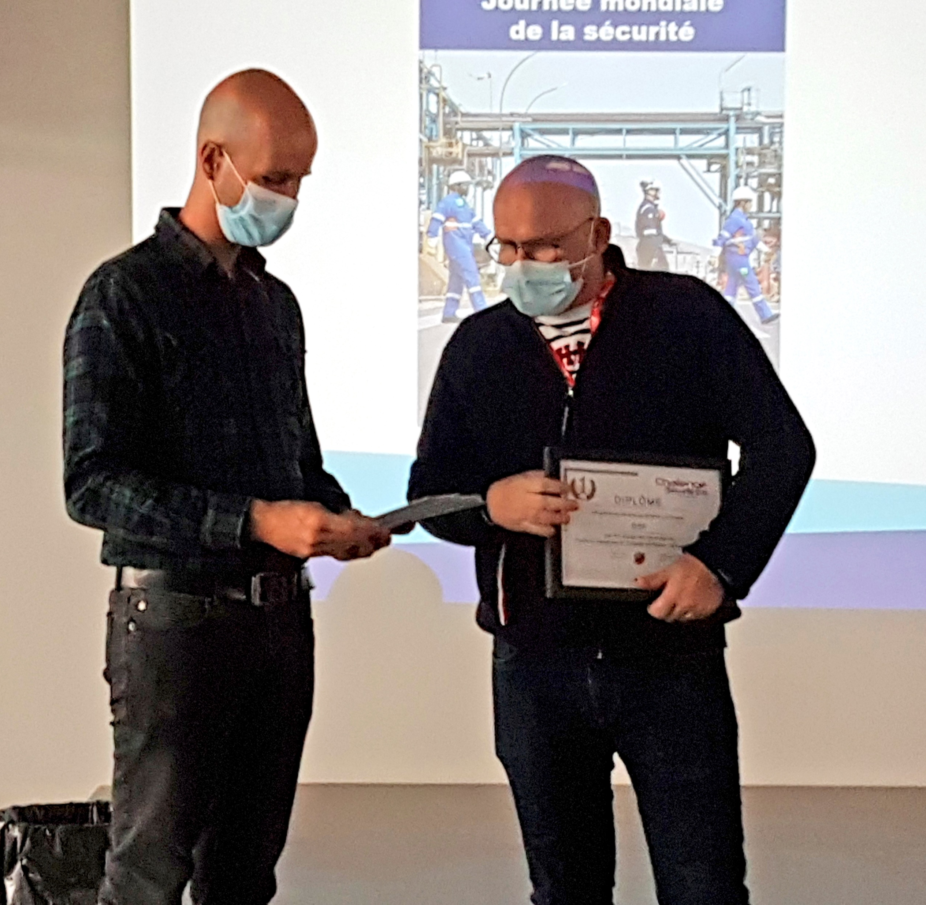
Types of recognition
Possible types of recognition: (to be adapted according to local customs and regulations)
Verbal congratulations and/or formal acknowledgement from the line manager, and from local management
Showcasing according to local custom (posters, intranet, meetings, etc.)
Introduction of prize-winners to management and top management staff when they conduct Safety Tours on site
Promotion of the significant safety action at different levels of the Company via the online platform
For more information on recognition, see the practical guide:
Recognition, a key lever for improving HSE performance

Slide 7
A tool to recognize the actions of those who work everyday to make sure that safety is shared and experienced as a positive value

Slide 8
Disclaimer - Intellectual Property
Definition TotalEnergies / Company
The entities in which TotalEnergies SE directly or indirectly holds an interest are distinct and autonomous legal entities. The terms "TotalEnergies", "TotalEnergies company" and "Company" used in this document are generic and are used for convenience to refer to TotalEnergies SE and the entities included in the scope of consolidation. Similarly, the terms "we", "us" and "our" may also be used to refer to these entities or their employees.
Disclaimer
This presentation may contain forward-looking statements within the meaning of the Private Securities Litigation Reform Act of 1995 relating to the financial condition, results of operations, business, strategy and plans of TotalEnergies that are subject to risk factors and uncertainties arising from changes in, among other things, technological development and innovation, supply sources, legal framework, market conditions, political or economic events. TotalEnergies undertakes no obligation to publicly update any forward-looking statement, whether as a result of new information, future events or otherwise. Further information on factors which could affect the Company's financial results is provided in documents filed by TotalEnergies with the Autorité des Marchés Financiers and the US Securities and Exchange Commission. Accordingly, no assurance can be given as to the accuracy or correctness of such statements.
Intellectual Property
Any reproduction, publication, transmission or more generally any use of the elements of this presentation is prohibited, except with the express written authorization of TotalEnergies.

