Slide 1

The new Golden Rules
My Commitment, our Safety
Rev.0 – December 2022
Golden Rule 5
Work Permits

Slide 2
01.
The essentials

Slide 3
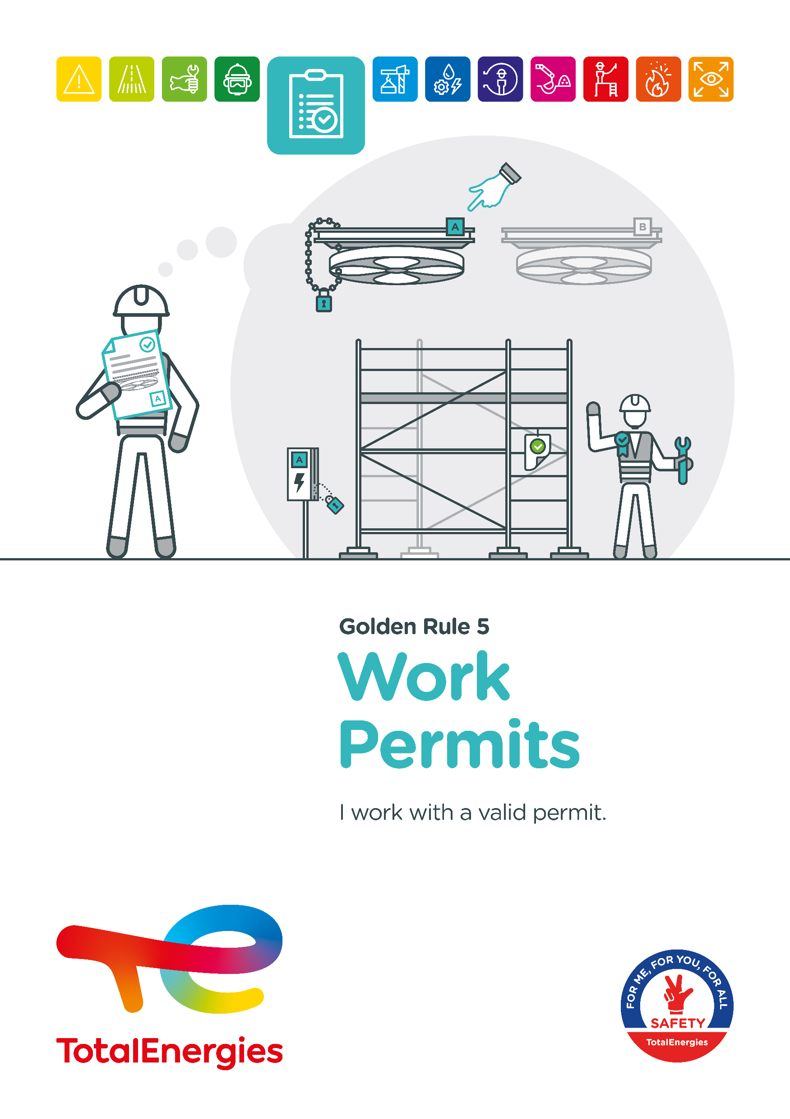
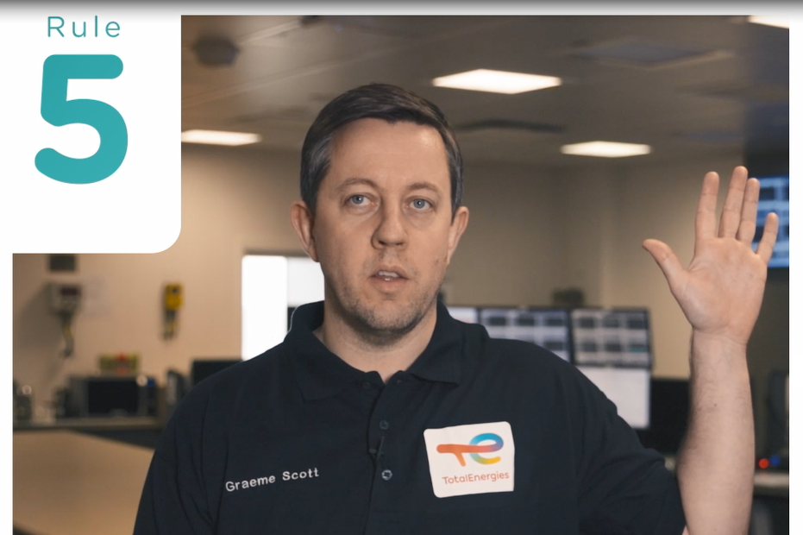
Poster & pictogram
Golden Rule 5 ʺWork Permits" is represented by a document with a validation sign, symbolising an approved work permit.

Slide 4
Some definitions
WORK PERMIT
A documented authorisation issued to carry out work and specifying the place, time and manner.
CERTIFICATE
Document independent from the permit to work, which after validation, certifies the safety of the installation or the equipment to be worked on or the place where the work is to be carried out.
It is sometimes referred to as a ʺcomplementary permit" or ʺsupplementary permitʺ but does not authorise the start of the work.
Examples of certificates:
Confined space entry certificate
Powered system isolation certificate
Excavation certificate
Radiation certificate
Diving certificate
Cleaning / degassing certificate
Cold work permit
For work that does not require the use of ignition sources.
Hot work permit
With a naked flame: for work with naked flame or producing sparks or heat
Without a naked flame: for work involving other potential ignition sources due to the temperatures created or internal arcing
If required, the permit to work is accompanied by all the necessary certificates.
A certificate is not a work permit and does not authorise the start of the work.

Slide 5
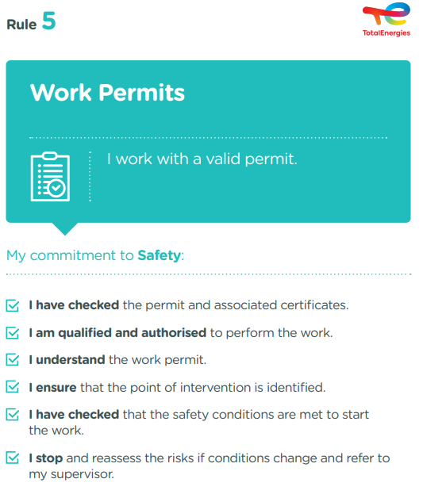
The essence of Golden Rule 5
What changes from the 2017 version of the Golden Rules:
    Notion of "certificate":
    Some high-risk activities require a "certificate" in addition to a work permit.
    Being ʺqualified and authorisedʺ
      The employer qualifies the worker to perform a specific task
      The qualified worker is authorised to perform this task, following the issue of the work permit
    Understand the work permit:
    Prior to the (re)start of the work, the understanding of the work permit is checked at the safety green light.
    Check the ʺsafety conditionsʺ:
    In particular, workers check that the safety conditions defined in the work permit have been met before starting work.
The permit to work process is covered by CR-GR-HSE-402*.
* Company Rules (CR) are limited to internal use.

Slide 6
Permit to work incidents
ACCIDENTS IN THE COMPANY WHERE A REQUIREMENT OF GOLDEN RULE 5 HAS BEEN BREACHED
MAIN RISKS:
The objective of the permit to work process is to identify all risks related to:
  the work
  the environment
  interfaces
  coactivity
and to put in place the associated risk control measures.
The work permit lists the risks identified and the control measures to be implemented.
If the "permit to work" is not respected, workers may be exposed to serious or fatal uncontrolled risks.
2
Fatalities*
4
Lost time accidents**
10
HIPO (High Potential)**
* 2012-2021
** 2017-2021

Slide 7
02.
REX

Slide 8
Illustration of requirements
REQUIREMENT | EVENT | SLIDE
1. I have checked the permit and associated certificates. | CLEANING A KEROSENE TANK | N°9
2. I am qualified to perform the work. | INAPPROPRIATE USE OF A BOOM LIFT | N°10
3. I am authorized to perform the work. | TILTING OF A FORKLIFT | N°11
4. I understand the work permit. | IMPORTANCE OF THE SAFETY GREEN LIGHT BEFORE START | N°12
5. I ensure that the point of intervention is identified. | DEATH OF A CONTRACTOR DURING THE START-UP OF THE ATMOSPHERIC DISTILLATION | N°13
6. I have checked that the safety conditions are met to start the work. | FLASH IN A PETROL TANK | N°14
7. I stop and reassess the risks if conditions change and refer to my supervisor. | INSTALLING A CHAIN ON AN OVERHEAD HOIST | N°15
The descriptions of the circumstances and consequences have been simplified for a better understanding.
A link to each REX is available for more information.

Slide 9
REX
1. I have checked the permit and associated certificates.
> CLEANING A KEROSENE TANK
CIRCUMSTANCES – FACTS
  In a service station, three workers had to carry out a cleaning/degassing operation on a buried kerosene tank, at a depth of 4m, by pumping from outside.
  A worker descended into the tank to bail out the residual product and lost consciousness. A second worker then went down into the tank to rescue him and also lost consciousness. The team leader then went down into the tank, attached by a rope. He managed to pull up the second worker, before he too lost consciousness.
  The station's pump attendants managed to pull up the team leader using the rope.
  The first responder was finally extracted from the tank later by the fire brigade.
CONSEQUENCES
Death of the first person to enter the tank.
LESSONS TO BE LEARNED
Before carrying out any activity, I check the need for a work permit, and certificates if required,
I ensure that I have the work permit and certificates, if required, suitable for the task at hand.
CAUSES
  Lack of knowledge of confined space risks and associated rules.
  Work to be carried out which does not involve entry into a confined space: lack of permit and confined space entry certificate.
Manhole
Inside of the tank
Click here to access the REX

Slide 10
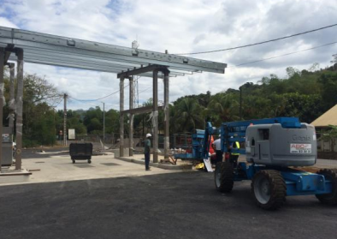
REX
2. I am qualified to perform the work.
> INAPPROPRIATE USE OF A BOOM LIFT
CIRCUMSTANCES – FACTS
  During the installation of a canopy at a service station, a worker was caught between the metal structure of the canopy and the top of the guardrail of the lift’s bucket at neck level
CONSEQUENCES
Loss of consciousness, haematomas, hospitalization and time off work (HIPO).
LESSONS TO BE LEARNED
I do not perform a task or use a tool or equipment if I do not have the required skills.
I ensure that I am trained, qualified and authorised to do so.
CAUSES
  The site manager and the supervisor, who are qualified to handle the boom lift, were on break. The worker wanted to finish a fixing on the canopy before joining them:
    Lack of supervision,
    Worker not qualified to handle the basket.
  Incorrect handling of the basket.
  Lack of appreciation of the risk.
Click here to access the REX

Slide 11
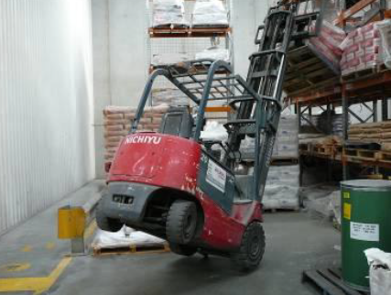
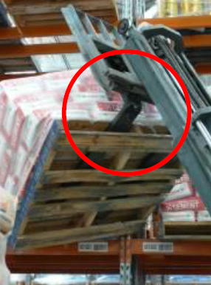
REX
2. I am authorised to perform the work.
> TILTING OF A FORKLIFT
CIRCUMSTANCES – FACTS
  A worker (forklift operator) was trying to remove a 1.4 tonne pallet of raw materials from a rack.
  As he was reversing, the rear wheels started to lift.
  The forklift truck became stuck against the rack.
CONSEQUENCES
No real consequences (HIPO).
LESSONS TO BE LEARNED
I do not perform a task or use a tool or equipment if I do not have the necessary skills,
I ensure that I am trained, qualified and authorised to do so.
CAUSES
  The worker was not authorised to drive this forklift.
  Inadequate order, cleanliness and storage on site.
Click here to access the REX

Slide 12
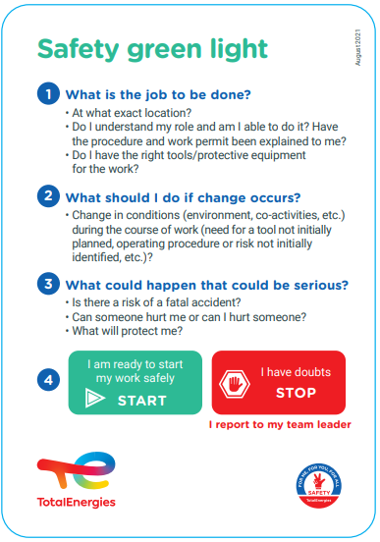
GOOD PRACTICE
3. I understand the work permit.
> IMPORTANCE OF THE SAFETY GREEN LIGHT BEFORE START
Before starting or restarting the work, the operating procedure, the identified risks and the associated risk control measures are explained to the participants using the work permit, at the place of execution.
Subsequently, a safety green light is carried out to encourage a discussion on the understanding of the work permit.
At the end, the participants can decide not to start the work if they have any doubts about safety.

Slide 13
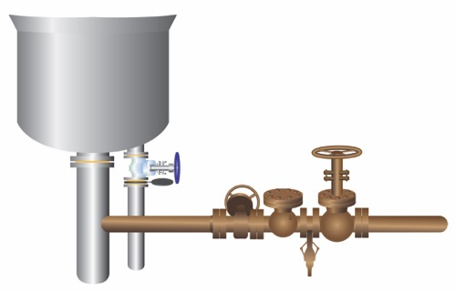
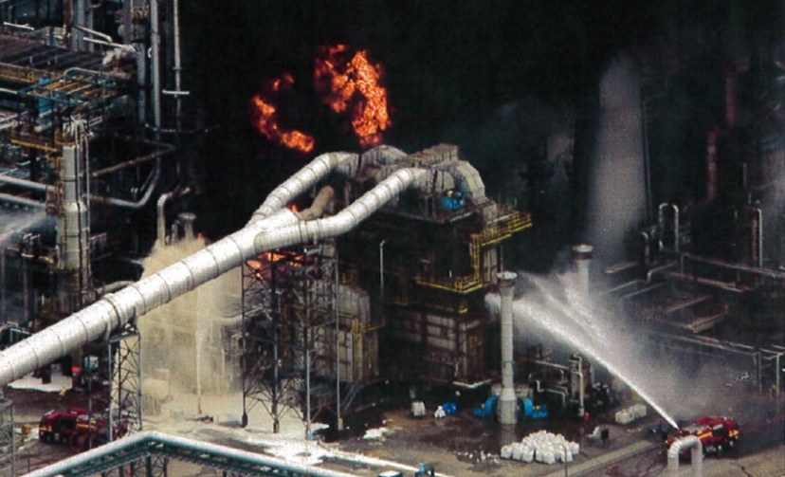
REX
4. I ensure that the point of intervention is identified.
> DEATH OF A CONTRACTOR DURING THE START-UP OF THE ATMOSPHERIC DISTILLATION *
CIRCUMSTANCES – FACTS
  During the restart of a distillation unit, after a planned maintenance shutdown, a steam injection line connected to the bottom of the column had to be isolated by installing a blind between flanges.
  The blind isolation operation resulted in a large leak of very hot product (274°C), which triggered a fire in the intervention area and near the column.
CONSEQUENCES
One death and one injury
Several witnesses received psychological assistance
LESSONS TO BE LEARNED
I scout the area to identify the intervention point,
I confirm the point of intervention with the permit issuer before the work begins.
CAUSES
  Failure to identify the point of intervention and mistakenly opening a set of flanges with hot product under pressure.
  Insufficient risk assessment: the location of the purge used did not confirm the absence of product.
  Lack of supervision and monitoring to carry out blind isolation work on a line during a production unit restart.
Bottom of column
~ 274°C
Opened flange
Location of the flange
to be blinded
Bottoms
output
Low pressure
steam line
Click here to access the REX
*Event before 2012

Slide 14
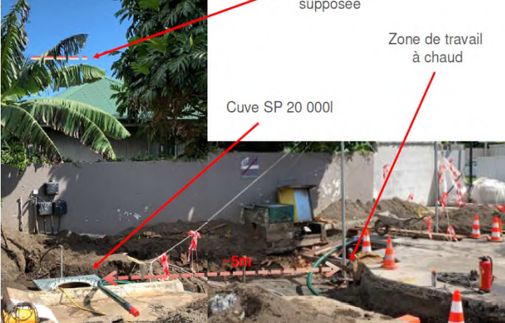
REX
5. I have checked that the safety conditions are met to start the work.
> FLASH IN A GASOLINE TANK
CIRCUMSTANCES – FACTS
  A gasoline tank was inerted with water several days before the incident. In order to degas it, a submersible pump was installed and pumping started towards the oil separator.
  While this tank was being emptied, a sawing and grinding operation began on the steel frame of another tank 5 meters away.
  A spark then fell into the inerted gasoline tank and caused a flash at the manhole.
CONSEQUENCES
No injuriy (HIPO).
LESSONS TO BE LEARNED
Before starting my work :
I ensure that safety conditions are met, including the co-activity of operations,
I comply with the requirements imposed by the work permit.
CAUSES
  The protective screen required by the fire permit was not put in place
  Gasoline layer trapped in the upper part of the tank
  Lack of co-activity management (hot work near degassing equipment)
  Supposed flame height
  Hot work area
  Gasoline tank
Click here to access the REX

Slide 15
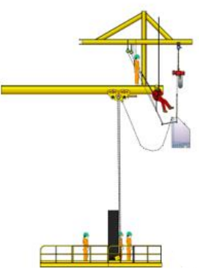
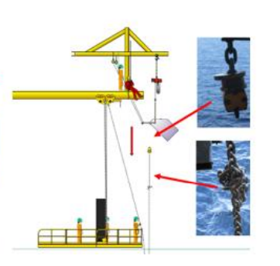
REX
6. I stop and reassess the risks if conditions change and refer to my supervisor.
> INSTALLING A CHAIN ON AN OVERHEAD HOIST
CIRCUMSTANCES – FACTS
  During the installation of a hoist and its chain box, the operation was stopped due to the incorrect positioning of the chain links (U shape).
  Rope access technicians intervened to try to unblock the situation and secure the chain.
  The chain slipped from the chain box onto the work floor and over the safety railing before coming to a sudden stop.
  A worker approached to try to grab the chain, which resumed its fall.
CONSEQUENCES
Worker injury requiring surgery (lost time accident).
LESSONS TO BE LEARNED
In the following cases, I stop working, and the associated permit is suspended:
  general alarm,
  specific instruction to stop work, including by Stop Card,
  failure to comply with one of the requirements imposed by the work permit,
  change in the operating mode of the intervention,
  change in the environment of the place where the work is carried out,
  exceeding the time allocated to the work covered by the work permit,
  the appearance of a risk that was not taken into account in the work permit.
I reassess the risks and refer to my manager.
CAUSES
  Insufficient preparation of the operation and identification of risks.
  The worker was working under a moving load.
  The work was not completely stopped after the U-shaped chain was positioned in order to reassess the situation and redefine appropriate actions.
Click here to access the REX

Slide 16
03.
Further information

Slide 17

The work permit at the office
The work permit allows to identify the risks and to implement the associated risk control measures, so it is also applicable in an office environment.
IN WHICH SITUATIONS ?
Some services and work carried out by a contracted company are subject to a work permit, such as:
  Event-related services (filming, etc.)
  Light bulb change,
  Moving,
  Plumbing, heating, air conditioning, etc.
I NEED TO PREPARE A WORK PERMIT, HOW TO PROCEED?
  I follow the work permit procedure of my entity.
  Here is a typical process:
  Before arriving on site :
  I anticipate the intervention of the contracted company and prepare a work permit,
  I ask the contracted company to fill in the permit, which identifies the risks and control measures associated with its intervention*,
  I send the signed document to the site's safety service if any
  On arrival on site :
  I welcome the contracted company and accompany it to the safety service if any,
  I ensure that the service is carried out correctly,
  Once the service has been completed:
  I escort the contracted company to the safety service if any and close the permit.
  I do not carry out small jobs myself (changing light bulbs, etc.):
  I call on the service responsible for managing the building.
  You need support or a template of work permit?
  For the head office, click here.
At the office, I am also implicated!
* A site visit may be necessary for the effective identification of risks and associated control measures.

Slide 18
Our tools and documents
CR-GR-HSE-402 – Permit to Work process: HSE Company Rule | TotalEnergies HSE Toolbox
E-learning on Permit to Work: https://lizzy.totalenergies.com/
HSE Toolbox – new Golden Rules:
    General material: TotalEnergies Golden Rules – General material
    Roll-out material: TotalEnergies Golden Rules – Roll-out material
REX database: Group_HSE_REXDataBase
Safety+ (good practices per Golden Rule): https://safetyplus.totalenergies.com/en
- examples of good practices:
            https://safetyplus.totalenergies.com/fr/contribution/g0u2we?p_route=wall&p_qs=rules%3D4
            https://safetyplus.totalenergies.com/fr/contribution/67wjk1?p_route=wall&p_qs=rules%3D4
            https://safetyplus.totalenergies.com/fr/contribution/lgpxvz?p_route=wall&p_qs=rules%3D4
            https://safetyplus.totalenergies.com/fr/contribution/oz91dk?p_route=wall&p_qs=rules%3D4

Slide 19
Lexicon
Hazard: An intrinsic property of a product, equipment, process, situation or action that can result in harm to people, the environment and/or assets.
Risk: The combination of the probability of occurrence of a hazardous event and the severity of the impact that may result from exposure to the hazard.
HSE events:
  Incident: Any sudden and undesirable HSE event on a given date, that causes injury or illness, damage to property or facilities, loss of production, environmental damage or damage to the Company's image.
  Near miss: Any sudden and undesirable HSE event on a given date which, in slightly different circumstances, could have had the same consequences as an incident. A near miss does not have an actual severity level but has a potential severity level.
  Anomaly: Any abnormal situation or behaviour, including deviations from a standard, specification, procedure or rule.
HIPO (High Potential) [slide 6]: Incident or near miss with an actual severity level ≤ 3* and a potential severity level ≥ 4** in one or more areas of the Company’s evaluation matrix of the actual and potential severity level of HSE events.
REX HSE: Document for sharing information on an internal or external HSE event, based on a detailed analysis and making recommendations.
* For example, physical consequences with an actual severity level = 3 correspond to a lost time accident.
** For example, physical consequences with a potential severity level of 4 correspond to a fatality.

