Slide 1
Example sheets showing technological risk situations
Appendix to the WDfS 2023 Discussion Workshops Guide
HSE Division
Revision 1 – April 14, 2023

Slide 2
Sommaire
Explosion & fire outbreak on a compressor module on an offshore platform
Loss of containment during a Well Intervention
Collision with a producing gas well
Gas released due to bolt failure on valve to fuel gas skid
Gas released during isolation of Gas Metering Skid
Large gas release during Water Injection Well bleed down
Pipe end cap ejected during nitrogen purge
Explosion of a gas cloud formed by a vacuum truck
Gasoil leak from a flange when the pipeline was put back into service
Methane leak on a valve bonnet
Destruction of a vacuum pump
LPG leak when a unit was restarted
Barge tank overflow during loading
Explosion and fire in a gasoil tank in a service station
Delivery truck overturn
Fire during offloading in a service station
Vapor explosion in a tank undergoing repair
Explosion in a gasoline tank
Gasoline leak when a tank was brought back into service
Disconnection of direct current connectors on a solar power plant
Fire on a transformer on an electrical power plant
Fire on waste activated charcoal
Spillage of digestate into the natural environment
Liquid Natural Gas leak when unloading an LNG carrier
Solar panel fire
Fire in a wind turbine
Fire and explosion on an electricity storage container
Gasoline tank overfilling, explosion and depot destruction
Vehicle fire in the service station after filling the jerrycans
New
New

Slide 3
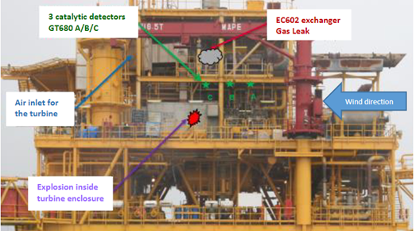
Explosion & fire outbreak on a compressor module on an offshore platform
  A large gas leak caught fire and exploded after being sucked into a compressor. The emergency shutdown was manually activated and the three employees present on the platform were immediately evacuated.
  Advanced corrosion on a pipeline that had already been replaced, was not identified as a cause for concern.
  The faulty gas detection system had been inhibited.
  The deluge system was out of order and had not been tested for 3 years.
  As an Inspection and Maintenance, my role is to ensure that piping and safety systems are inspected, tested and maintained as per requirements.
  As Operations, my role is to ensure the process for management of inhibitions is followed.
  As a Manager, my role is to ensure I have an overview of the downgraded systems on my facilities.
  As Projects, my role is to define a gas detector technology, reliable in all operating conditions.
No fatality.
On the previous day, 45 people were present on a neighboring platform.
Asset damage: USD 10 Million

Slide 4
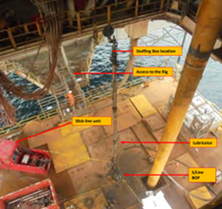
Loss of containment during a Well Intervention
  While pulling out a slickline plug on a gas well, a leak was observed on stuffing box, at the top of the assembly. Several attempts to shut well in by closing the pressure control equipment were made on the different cable-sealing valves, without any success. The safety device was still leaking badly.
  The crew on site were reluctant to cut the cable, drop the tool and close the well at the production head, being concerned to be blamed in the future. The decision to cut was finally taken after 35min of leak – 680m3 estimated of hydrocarbon gas were released
  Wrong packing elements were used in the stuffing box, initiating the leak.
  On the pressure control equipment, equalizing port was left open, by-passing all the sealing safety valves. This was not checked on arrival on site
  The cutter device (shear rams) was not installed – despite requirement - due to lack of height.
  Decision to secure the well by cutting cable was delayed due to lack of emergency procedure and clear responsibilities established.
  As a Well Intervention Supervisor, I ensure that equipment part of well barriers are certified, correctly installed and tested. I’m also empowered to secure the well on any sign of anomaly.
  As a Well Intervention Superintendent, I ensure the design of the operation and equipment mobilized are fully compliant. I regularly control the well barriers are tested on site.
  As a Drilling & Well Manager, I ensure I have a competent and certified Chain of Command, focused on operation safety, rules compliant and ready to secure the well in case of emergency.
  As Metier, I develop :
      A safety culture promoting focus on major risks,
      A chain of command skills for operational safety excellence.
No Injurie.
Loss of hydrocarbon containment: 680 m3 estimated
Potential explosion leading to multiple fatalities

Slide 5
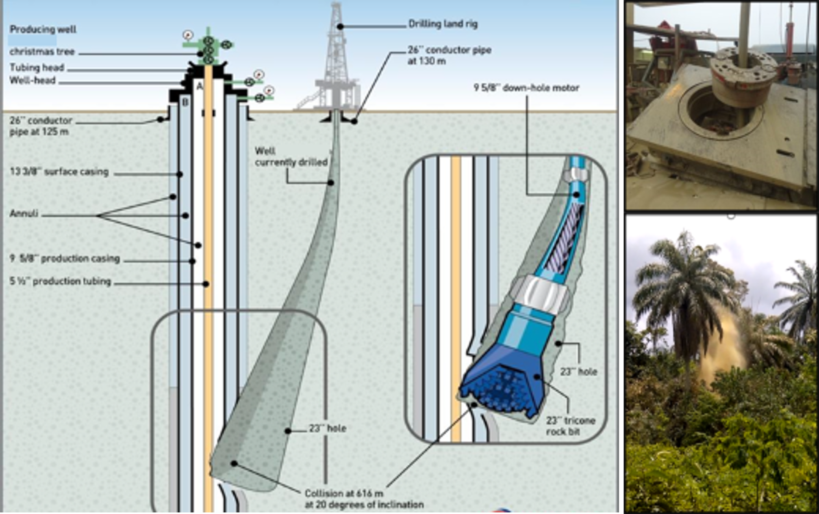
Collision with a producing gas well
  A drilling assembly hit and damaged an adjacent producing well. This resulted in a blowout of mud and gas of the well in progress. The gas escape went out of control with multiple random resurgences in the vicinity of the rig site.
  Mistakes were made in the anti-collision engineering work, including some adjacent wells (the one intercepted) were missing from the assessment.
  The first signs of an obstruction while drilling in the well were not reported nor properly analyzed by the local team.​
  Some key persons of the chain of command were absent and not replaced, on site and in the office.
  As a Drilling Rig Supervisor, I report any drilling anomaly and ensure that adjacent wells are isolated.
  As a Drilling Engineer, I perform & QAQC:
    the well trajectories database,
    the anti-collision work.
  As a Drilling & Well Manager, I ensure I have a competent organization, a fully compliant program and an operational personnel continuity.
  As Metier, I to identify proper tools to assist operational teams for anti-collision design and control, share lessons learnt and adapt referential to guide affiliate organizations.
No Injury.
53 days to kill and control the well, worldwide equipment and personnel mobilization

Slide 6
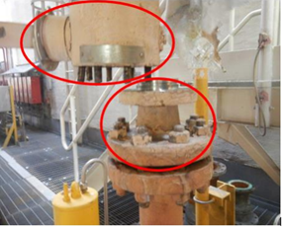
Gas released due to bolt failure on valve to fuel gas skid
  Failure of bolts on manual valve due to cyclic stress from vibration leading to cracks.
  Resultant gas leak from the valve on fuel gas supply line (55 bar).
  Emergency shutdown and general alarm were triggered due to confirmed gas detection.
  An Emergency Shut Down Valve was stuck open, so leak continued until manual valve upstream was closed to stop leak.
  Fortunately, there was no ignition.
  Failed bolts were found to be of the wrong specification.
  As a QA/QC Inspector, I ensure correct material are supplied.
  As a Site personnel, I report anomalies such as vibration.
  As Maintenance Management, I ensure safety critical barriers maintenance program is fit for purpose and implemented
  As Site Manager, I declare Downgraded Situation and implement mitigation and compensatory measures
2 000 m³ of fuel gas released to atmosphere.
Potential explosion leading to multiple fatalities

Slide 7
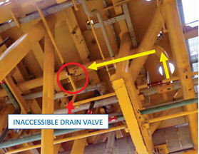
Gas released during isolation of Gas Metering Skid
  A Metering Skid was isolated and depressurized prior to intervention work. It was then to be purged with nitrogen (N2).
  Initial purging connection was found to be inaccessible and changed to another one without area approval.
  The new purging connection was downstream of the isolated metering skid and was on a pressurised system (187 barg).
  When the N2 hose was connected and valves opened, the flexible hose burst releasing flammable gas.
  Gas release detected and Emergency Shut Down 1 (ESD1) automatically activated. Fortunately, there was no ignition.
  The operator manually intervened to close the valves to stop further release.
  As a Site personnel :
      I follow the isolation plan as per Permit to Work
      I stop if the work plan cannot be followed and seek approval for any changes to the work plan.
  As a Production Supervisor, I ensure that critical tasks such as N2 purging are adequately risk assessed and planned
140 kg of fuel gas released to atmosphere.
Potential explosion leading to multiple fatalities.

Slide 8
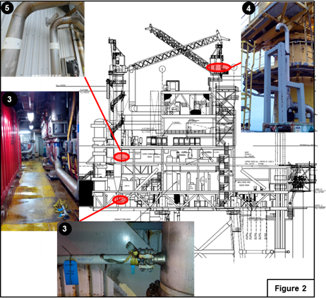
Large gas release during Water Injection Well bleed down
  Over 500kg of flammable gas released in non-hazardous areas of the platform following a bleed down of a Water Injection well.
  Unknown to the platform operations personnel a gas cap had formed in the water injection well.
  When depressurising the well, flammable gas was released into the seawater dump caisson and connecting vents
  In addition, the flammable gas was also released through an unregistered temporary repair into a utility area.
  As a Wells Engineer, I ensure potential well conformance issues are notified to operations.
  As Production Operations, I ensure all relevant hazards have been identified and mitigations put in place, when preparing, reviewing or approving a Permit to Work.
  As a Site Manager, I ensure I have an accurate overview of all temporary repairs on my facilities and other Downgraded Situations.
  As Process Engineering, I ensure that all deviations are assessed during HAZOP studies.
500 kg of fuel gas released to atmosphere.
Potential fire and explosion leading to multiple fatalities.

Slide 9
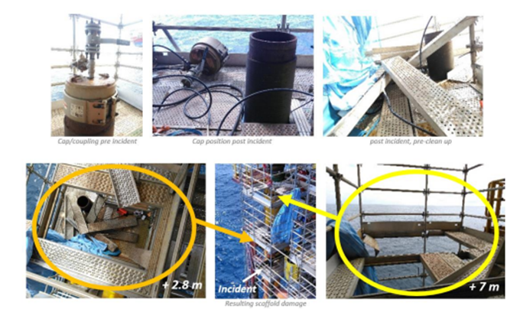
Pipe end cap ejected during nitrogen purge
  Team were attempting to perform Nitrogen pressure purges of the 10m void space to displace residual hydrocarbon in a riser when the end cap was ejected resulting in injuries to 3 persons.
  The end cap was initially incorrectly installed.
  Equipment required for performing the purge operation was inadequate.
  Unsuitable pressure gauge was identified but activity was not stopped.
  The personnel was operating nitrogen manifold in the line of fire of the cap.
  As a Piping Supervisor, I ensure temporary equipment are installed according to manufacturer specification and operating pressure are reported on documentation.
  As a Site Engineer, I ensure that de-rating due to engineered temporary connections is formally communicated and managed.
  As Operations Technician/Supervisor, I ensure that we are correctly equipped for critical operations, and to respond to concerns raised by stopping the task.
  As Operations, I mitigate ‘Line of Fire’ hazard when planning an operational task and barricade area.
  As a Site Manager, I ensure that critical tasks are adequately risk assessed, planned and covered by Permit to Work.
3 people injured, potential fatalities.

Slide 10
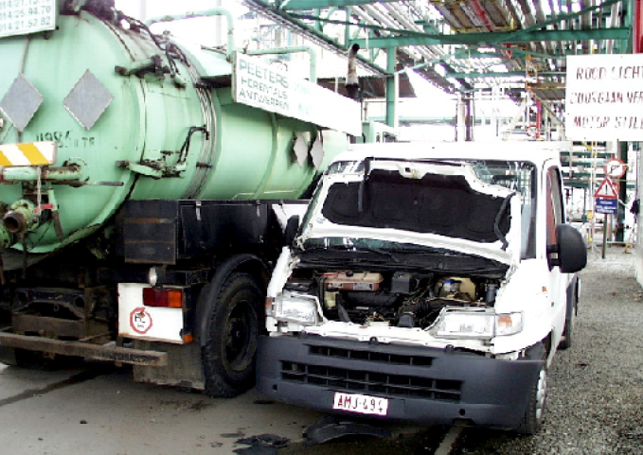
Explosion of a gas cloud formed by a vacuum truck
  A vacuum truck had finished its cleaning operation. The signage to mark out a no entry zone had been removed.
  When a service vehicle drove past the truck, the engine overran and the gas cloud formed by the hydrocarbon vapors discharged through the vent on the truck, exploded.
  As a Work planner, I assess the risks throughout the entire activity and identify the associated barriers.
  As Operations:
    I make sure that any hydrocarbon vapors are deviated to a safe zone.
    I maintain the signage in place.
    I make regular atmospheric checks throughout the activity.
The truck driver sustained burns to the face and the two people in the van were shocked by the explosion.
Potential fatalities.

Slide 11
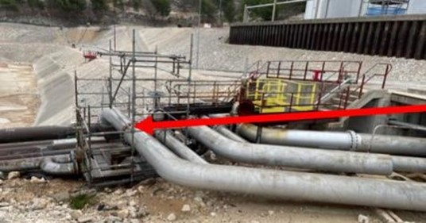
Gasoil leak from a flange when the pipeline was put back into service
  A leak occurred on a flange we had worked on when the gasoil line was brought back into service.
  The tightening torque was insufficient (no sealing procedure).
  As a Work planner, I ensure:
      That the agents are qualified for the work I ask them to do.
      That the work procedures have been followed correctly before putting equipment back into service.
  As a Worker, I make sure that work procedures exist and that I follow them (in this case, the sealing procedures).
  As an Operator, I check the integrity of equipment and that there are no leaks in the field, in particular in the restart and shutdown phases.
Asset damage: 10,000 liters of diesel spilt on the ground.
Potential environmental impact.

Slide 12
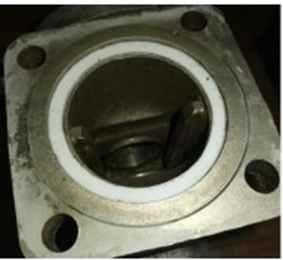
Methane leak on a valve bonnet
  When a steam cracker was restarted, a methane leak was noticed on a valve bonnet at the column base.
  The seal had been changed during the major turnaround and the new (Teflon) seal was not compliant with the technical specifications
  (graphite spiral wound gasket required).
  As a Work planner, I make sure that:
      The agents are qualified for the work I ask them to do,
      The operational procedures have been followed correctly before closing out the work package.
  As a Mechanic, I:
      Ensure that there are operational procedures and make sure they are followed.
      Do not change the type of seal required unless it is validated by the person preparing the work.
Asset damage: loss of
350 kg/hr of methane
to the atmosphere.
Potential explosion causing fatalities.

Slide 13
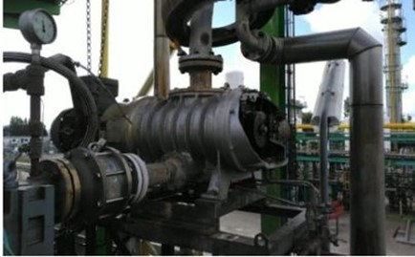
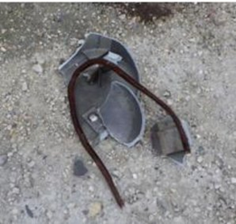
Destruction of a vacuum pump
  To unblock the circuit in a vacuum pump, a decision was made to connect a steam hose to flush out the deposits that were clogging the pump. No risk assessments were run before the operation. The equipment did not resist and shattered into several fragments.
  The pump circuit is not designed to withstand the pressure of steam (10-18 bar).
  As an Operator:
      I do not use a utilities circuit (steam, nitrogen air, etc.) on an item of process equipment, without making sure I know all the potential consequences.
      I do not perform a specific operation without first having run a risk assessment, in which all the representatives of the relevant services participate.
No injury.
Asset damage: projection of metallic debris.
Potential impacts on people and facilities

Slide 14
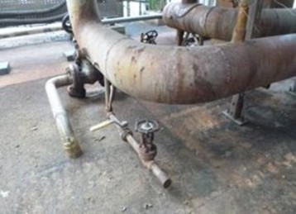
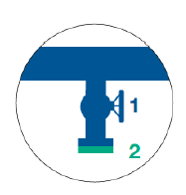
LPG leak when a unit was restarted
  When a unit was restarted, the gas detectors indicated an inflammable gas leak.
  A purge valve had been left open before the facilities were restarted.
  As an Operator:
      I check on site that the drains, vents and lines are all as they should be, before the product is injected into the unit.
      I always use two isolation barriers on drains and vents to prevent leaks into the atmosphere (a valve can be leakproof when it is new, but may leak after a while) SOP #1.
  valve + plug
  or valve + blind flange
37 kg of LPG leaked into the atmosphere.
Potential explosion causing fatalities

Slide 15
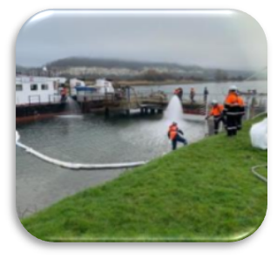
Barge tank overflow during loading
  A barge was being loaded with a mixture of hydrocarbons. The barge tanks were equipped with constant tank level measurement devices, two high-level alarms and an overfill security alarm that shuts down the transfer.
  The alarms were triggered in quick succession.
  The operator relied on the continuous tank level measurement (which was erroneous). One of the tanks overflowed. (The overfill security alarm had been disabled by the crew member).
  As an Instrument technician, is to have measurements, alarms and safety devices that are tested and in good working order.
  As an HR or a Manager, I ensure that the personnel is trained and applies the procedures during operations that may present technological risks.
  As an Operator, I identify the security devices that have been shunted and introduce mitigation measures.
Leak of 300 liters of hydrocarbons, with irisation over 350 m².
Local impact

Slide 16
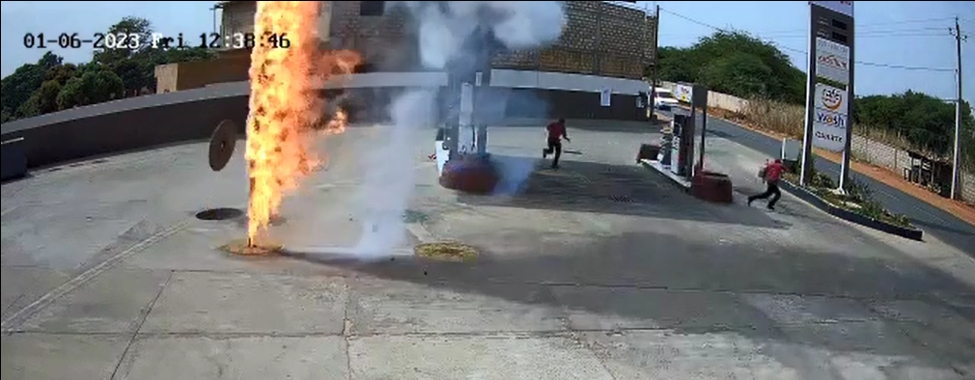
Explosion and fire in a gasoil tank in a service station
  After gauging a gasoline tank, the gauge port was left open. The gasoline vapors spread toward the other gassiol tanks through the wiring sheaths that were not airtight.
  The grounding device for the tanks was damaged.
  An ignition source caused the gasoline vapors to catch fire, causing an explosion and fire.
  The fire was extinguished using the extinguishers on site.
  As a Gas station attendant, is to comply with procedures during tank gauging operations. I flag up any anomalies.
  As a Service Station Manager, I make sure that the procedures are respected and check that they are effectively applied on site. I am informed of and manage downgraded situations.
  As a Maintenance engineer, I perform the scheduled inspections of safety barriers and perform any necessary repair operations.
Fall and fracture of a forearm.
Fire tank covers projected.
Potential fatalities.

Slide 17
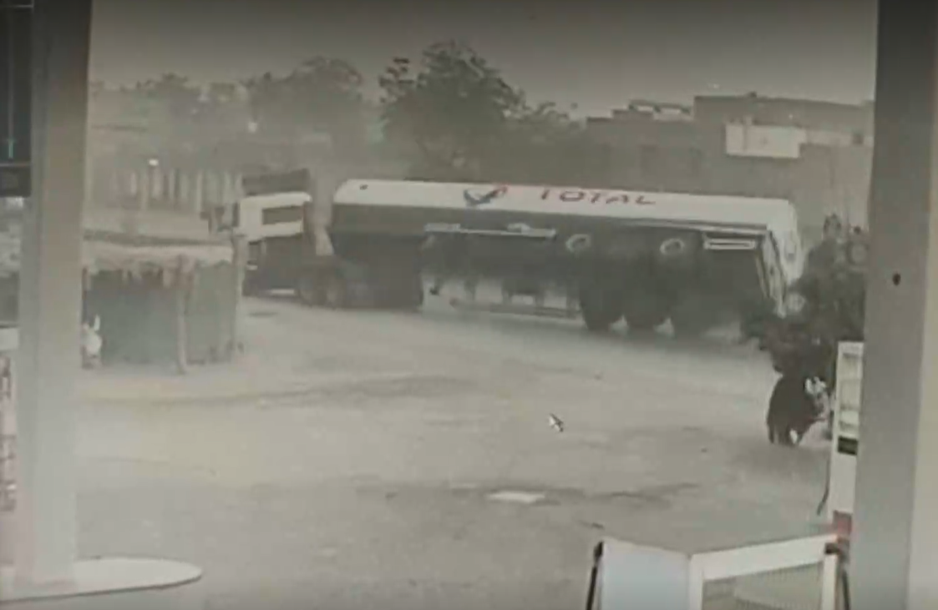
Delivery truck overturn
  A delivery truck carrying 48m³ of diesel overturned in the city on a clear, straight section of road. No collision with a third party.
  One of the four tank compartments was damaged and diesel spilled onto the road. The flames caused by friction on the road did not reach the tank.
  The driver lost control of the vehicle when he nodded off, having driven for a long time without any rest, and at high speed.
  As a Driver:
      I comply with driving times and keep to speed limits,
      I adapt my speed regarding meteorological conditions and road environment,
      I do not take the road if I am not feeling fully alert owing to tiredness, medication, anxiety or any other factor that may affect my driving.
  As a Manager:
      I pass on, inform people of, and explain safety advice and instructions.
      I create the conditions necessary for the instructions to be applied (no phone calls when driving, no emergencies, no tight schedules).
      I discuss things with employees to understand how their job is in the field, and to resolve any difficulties they have in applying safety instructions.
No injuries.
10 m³ of diesel spilt onto the road.
Delivery truck overturn.
Potential fatalities.

Slide 18
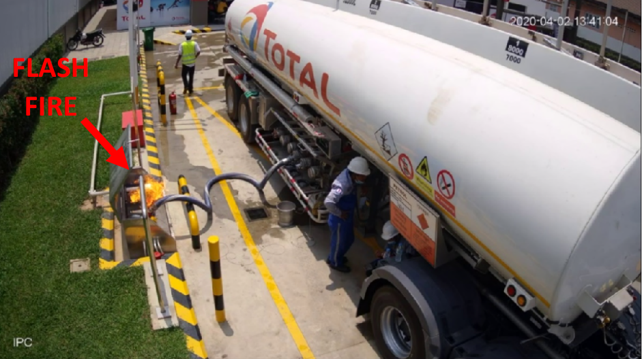
Fire during offloading in a service station
  Fire broke out on the plug of a second gasoline offloading line, when a gasoline delivery was being made to a service station. The fire was caused by sparks owing to static electricity that had built up in the hose, failure of the grounding system and a faulty seal.
  The fire was detected late on, despite the presence of three people on site during the operation. The fire was put out using an extinguisher from the station.
  A similar event would happen several months later in the same service station.
  As a Service Station Manager,
      I enforce the delivery procedures in the station manual and ensure that the facilities are in good working order beforehand,
      I analyse and inform the Company of all site safety events.
  As a Driver,
      I apply the safety instructions (marking, earthing, available hollows, etc.),
      I carry out permanent surveillance of the dumping of flammable products with the first response equipment nearby,
      I report any anomaly.
  As a Manager, I collect and analyse all safety events and take measures to eliminate or reduce risks.
  As a Maintainer, I check the state of the installations (effectiveness of earthing systems, etc.) in accordance with the preventive maintenance plan.
Nobody was injured.
Fire outbreak at the connectors on the fuel storage tanks.

Slide 19
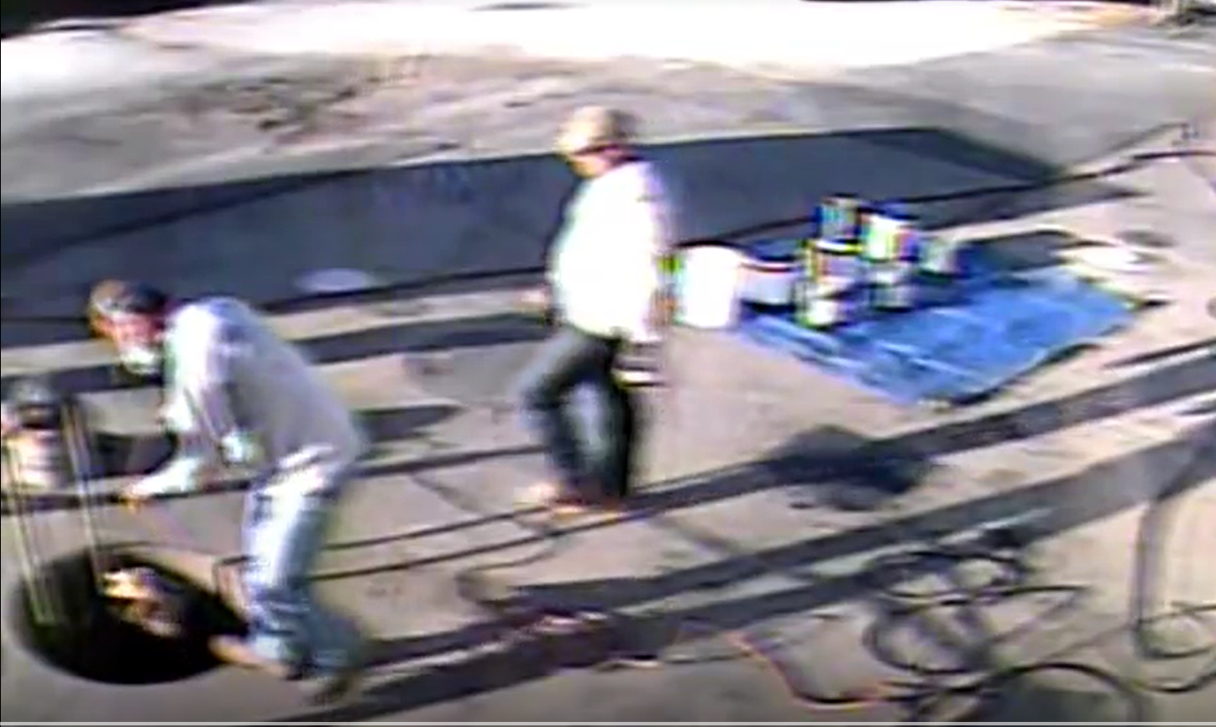
Vapor explosion in a tank undergoing repair
  In a service station, when work was being done to renovate a storage tank that had been isolated for the purpose, a flash was generated by solvent vapors catching fire, when a non-ATEX light was lowered into the tank before operators entered.
  The operator was starting to climb down into the tank when the explosion occurred.
  Vapors from the solvent used to clean the tank before applying paint, generated an explosive phase. No atmospheric checks were performed and the tank was not ventilated.
  As Works Supervisor, is to perform a risk assessment and draft an operating procedure. I define the barriers and make sure that they are implemented.
  As a Worker, I comply with the operating procedure and the barriers defined as preventive measures. I flag up any anomalies and I do not start any activities if I have the slightest doubt.
The agent suffered serious burns and the other members of the team were in a state of shock.
Flash fire in a service station with storage tanks close by.

Slide 20
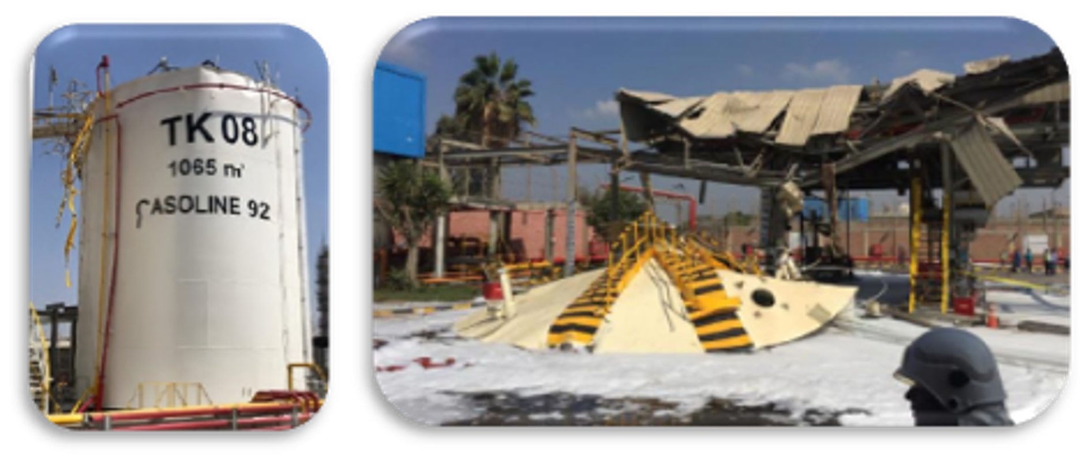
Explosion in a gasoline tank
  In a depot, a gasoline tank had been isolated from the supply circuit so that maintenance work could be performed.
  The day before the incident and before the end of the hot works, the isolation was lifted, allowing a small quantity of gasoline to run into the tank (approximately 12 liters).
  The next day, a team of agents was performing welding operations on the roof, and an explosion occurred, tearing the roof off and projecting it 40 meters away.
  As an Operator:
      I ensure that the tank is isolated (degassed, isolated, and locked out/tagged out) and that an isolation certificate is drawn up.
      I check on site, before authorizing any hot works, that the tank is locked out/tagged out, that the isolation certificate is attached to the permit, and that the absence of gas has been checked at the welding point just before work starts. I also ensure that a fixed gas detector is positioned close by.
      I make sure that the agent validates the safety conditions by signing the hot works permit.
      I make sure that the completion of the work is the subject of a joint report with the agent, before lifting the tank isolation.
  As a Worker:
      I explain the safety measures to my team.
      I run the Safety Green Light.
Two fatalities and four people seriously injured.
A tank and loading station were damaged.

Slide 21
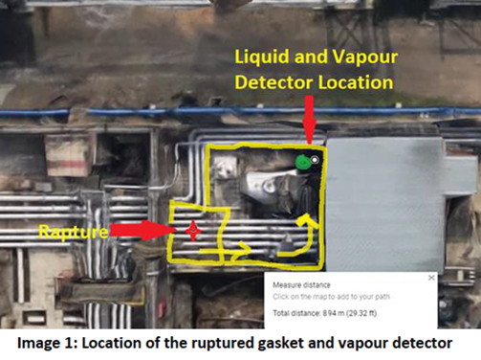
Gasoline leak when a tank was brought back into service
  When a tank was brought back into service a gas detector in the pump room triggered an alarm.
  A maintenance valve that was left closed, generated an overpressure (thermal expansion), causing a flange gasket to rupture.
  As the Prime contractor:
      Is to ensure that a risk assessment is performed before work begins, and to define the associated safety barriers.
      It so ensure that the isolation/deisolation procedures are effectively followed.
  As an Operator:
      Is to check on site, before and after work, that the drains, vents and lines are correctly configured.
      I run a start up review before bringing the equipment back into service.
900 liters of gasoline leaked.

Slide 22
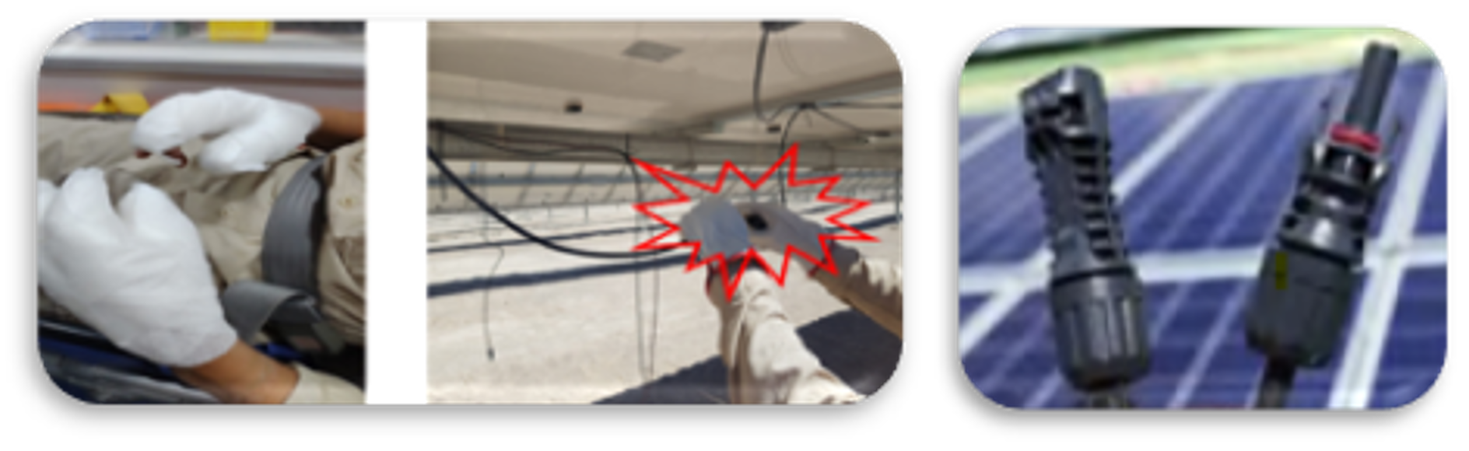
Disconnection of direct current connectors on a solar power plant
  On a work site where solar panels were being installed, a qualified electrician was not aware that the electric circuit for the panels was powered up.
  When he disconnected a connection, an electric arc was produced, causing third-degree burns to both his hands.
  As the Work Planner, I identify that if an electric circuit is opened, the operator could be exposed to an arc, and that electrical production needs to be stopped before work starts, I inform worker on safety measures.
  As a Worker, I do not open electrical circuit under load, I check that there is no residual power before I start work and I wear adequate PPE.
  As a Designer, I assess the risks to workers and to select the most suitable measures to eliminate or reduce these risks.
Electric arc and third-degree burns to both hands.

Slide 23
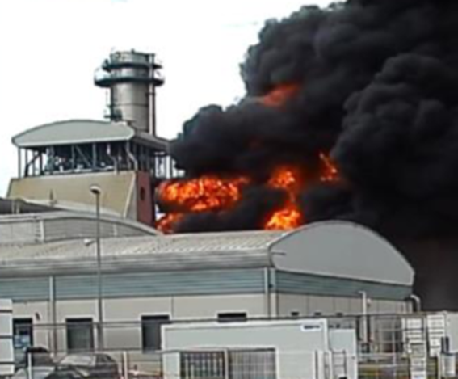
Fire on a transformer on an electrical power plant
  A day after a power station was brought back into service after a scheduled shutdown, a transformer exploded and caused the dielectric oil to catch fire.
  The analysis of the incident identified:
  A failure on the De-Energized Tap Changers (DETC) that created a short circuit between the connectors on the transformer.
  An insufficient electric short circuit protection level.
  Degradation of the dielectric oil before the event.
  As an Operator, I perform the periodic checks as per equipment manufacturer recommendations, note down the facts, and handle any discrepancies.
  As the Designer of a facility, I apply the standards, define the protection devices, draft the recommendations for checks to be performed in maintenance phases.
  As a Maintenance engineer, I perform safety tests on the facilities.
No injuries.
The transformer and neighboring equipment were damaged.

Slide 24
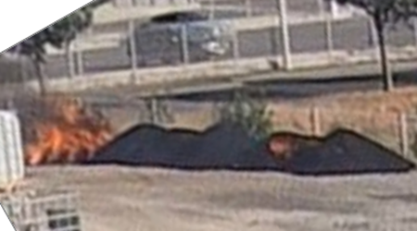
Fire on waste activated charcoal
  Six big-bags of waste activated charcoal had been stored on the ground for several days on an area at the edge of the property.
  One of the bags had burst and a fire broke out as the waste charcoal heated up.
  The fire caught hold and all the stored charcoal caught light.
  As an Operator, I define the loading and unloading phases for the chemicals used in a process, by specifying the risks and the safety barriers required.
  As a Maintenance engineer, I follow the operating instructions and implement the safety barriers required.
  As a Facility manager, I make sure that any products that present risks when stored or handled are managed according to the applicable procedures, and that they cannot catch fire, explode or spill.
No injuries.
All the charcoal stored was consumed in the fire.

Slide 25
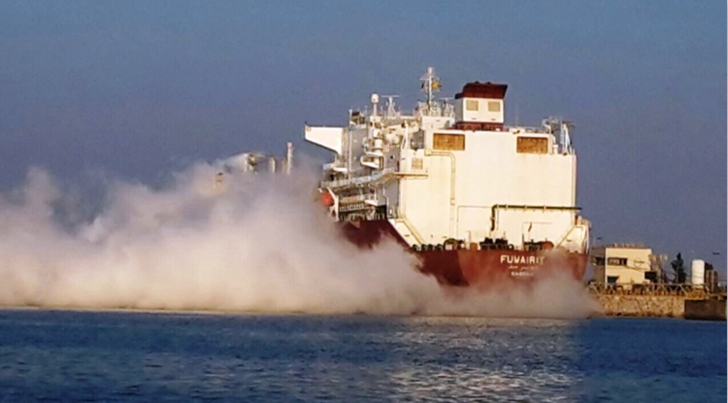
Liquid Natural Gas leak when unloading an LNG carrier
  An LNG carrier was moored at an unloading quay in a large commercial port.
  A few minutes after starting to unload the vessel, LNG escaped from one of the vents on board, generating a cloud which dispersed in the opposite direction to the quay.
  Causes:
  A corroded valve had not been closed properly.
  An automatic protection system had been disconnected beforehand and prevented the automatic safety system from triggering.
  The crew did not react to the safety alarms.
  As the Ship’s officer:
      I conduct the operations required to ensure that the operations and safety systems are highly effective.
      I ensure that the operating procedures are respected.
      I organize training and drills in operations and emergency situations for the crew.
  As the LNG Terminal Manager, I organize constant monitoring of vessels loading/unloading operations.
  As a Crew Member, I follow the procedures and report any anomalies I notice on equipment and during operations.
No injures.
Around 5 tons of LNG leaked.
Potential explosion and fatalities.

Slide 26
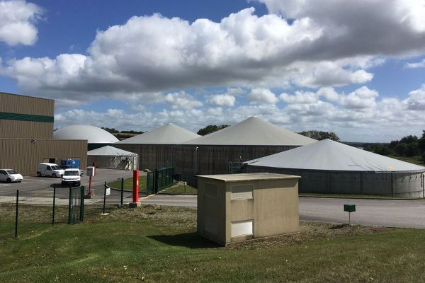
Spillage of digestate into the natural environment
  A tank of digestate - a residual liquid from the process of methanation of organic products with a high ammonia content, was overfilled and overflowed.
  The digestate spilled out into the river near the site. The river supplies 49 towns with drinking water (180,000 people). The Prefecture issued a decree to prohibit the consumption of water in the region for a week.
  As a Designer, I define the facilities with suitable safety barriers.
  As an Operator:
      I perform site rounds to monitor facilities:
      I perform periodic tests to make sure the safety alarms are in good working order.
      I set up the mitigation measures required in the event of a safety barrier failing.
  As a Maintenance engineer, I perform the checks on safety barriers and make any repairs required to ensure their effectiveness.
Potential impact on the region’s inhabitants.
400 m³ of digestate spilt into the environment.

Slide 27
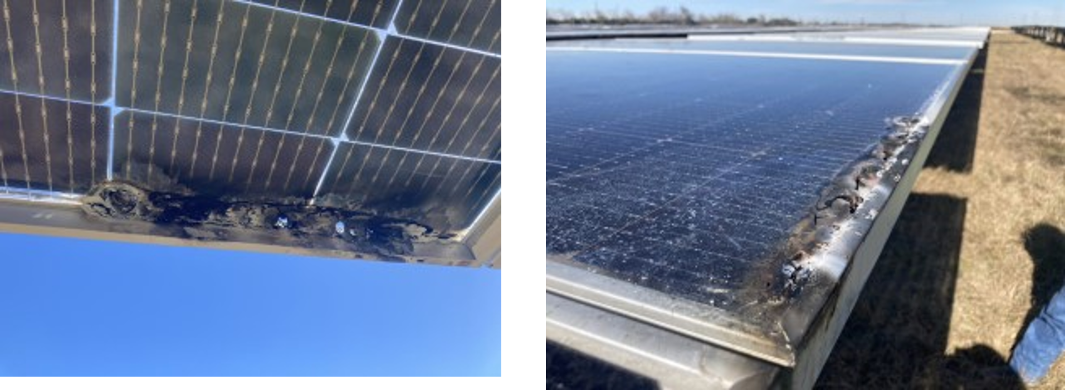
Solar panel fire
  Panels on a solar farm were damaged after the combustion of a connection area at the edge of the panels.
  The analysis of the incident showed that water managed to get into the connectors after panel delamination (quality default), meaning they were no longer watertight, and induced short-circuit.
  As a Project manager, I ensure that a supplier qualification process is defined and applied.
  As a Purchaser, I ensure that the supplier complies with the requirements of the call for tenders.
  As an Operator, I carry out the technical cause analysis of the incidents and communicate REX to improve the standards.
No injuries.
27 solar panels on the farm destroyed.

Slide 28
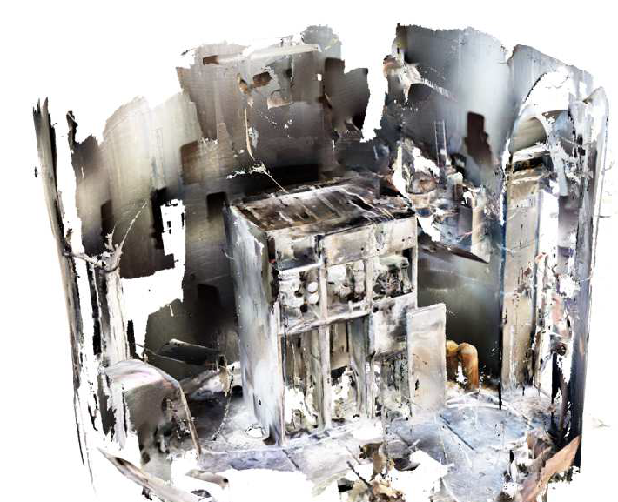
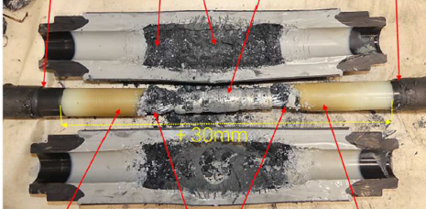

Fire in a wind turbine
A fire damaged the electrical cabinet and transformer located at the bottom part of a wind turbine mast.
The combination of improper mounting and low fire resistance of electrical components allowed electrical cables to overheat leading to fire.
As a Designer, I ensure the compliance of equipment with applicable norms and standards.
As a Purchaser, I ensure the quality of the equipment provided and associated installation procedures.
As a Supervisor, I ensure the quality of the work carried out on site.
No injuries.
Destruction of mast components.
Bottom part of the mast after fire
Detail of electrical cable

Slide 29
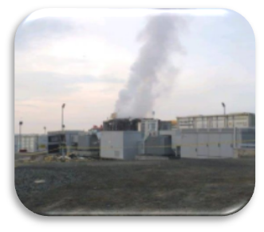
Fire and explosion on an electricity storage container
  A fire broke out on a Battery Energy Storage System (BESS) located in an energy storage facility. One of the doors of the container was accidentally opened twice, allowing oxygen to enter the BESS.
  The container exploded, causing damage to neighboring equipment.
  As a Designer, I consider measures to prevent oxygen ingress in the BESS container in case of thermal runaway.
  As an Operator, I ensure the emergency procedure is kept up to date and train my personnel for emergency situations.
  As an Emergency response manager, I regularly test the procedures related to emergency situations.
No injury.
BESS totally destroyed.
Damage to neighboring equipment.

Slide 30
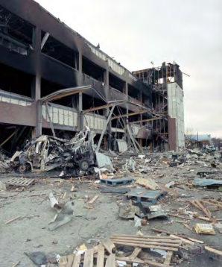
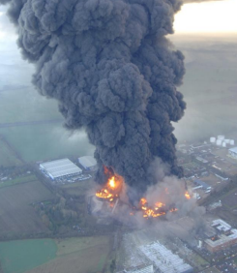
Gasoline tank overfilling, explosion and depot destruction
New
  During a petrol reception, the level continued to rise up to the Independent High Level Switch floating device, which failed to operate, neither to sound the audible alarm in the control room nor to shut down the pipeline. The tank overfilled, creating a large vapour cloud flowing off site.
  The pipeline supervisor discovered the overflow situation and started emergency actions but the vapour cloud exploded. The fire burned for 5 days.
  250 cubic meter of petrol escaped from Tank prior to the explosion.
  As Maintenance, my role is to :
  - fully understand the way the safety equipment I maintain, worked.
  - identify the root cause of recurrent failure on a safety equipment.
  As Operations, my role is to have a clear understanding of the transfers being in operation.
  As Operations, my role is to define filling procedures to define to what level the tanks should be filled and how the alarms should be used.
  As an HR or a Manager, I ensure that the personnel is trained and applies the procedures during operations that may present technological risks.
  As Projects, my role is to design bunds with sealant and other joint materials, which are fire resistant.
No fatality.
43 suffered minor injuries
2000 people evacuated from their homes, 9500 people displaced from their premises
Overall cost :
£ 900 Million

Slide 31
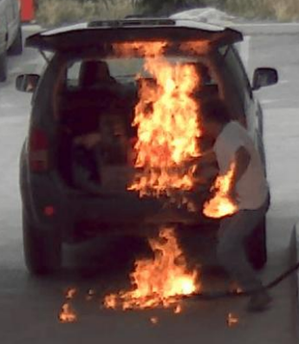
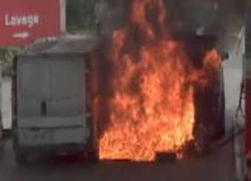
Vehicle fire in the service station after filling the jerrycans
New
  A motorist was filling up 3 jerry cans of gasoline positioned in his trunk.
  While filling the last can, the nozzle of the dispenser ignited. The motorist backed up and fired at the cardboard containing the uncapped jerry cans, which overturned and ignited.
  The fire spread. Customers were evacuated and staff activated the emergency shut down and notified the fire department who intervened 10 minutes later.
  The fire was due to static electricity (accumulated while filling of jerrycans) discharge and the explosive atmosphere in the trunk of the vehicle.
  As a Service Station Manager, my role is to inform customers of the risks associated with filling jerry cans and advise them of the following good practices:
  - use an approved container with a leakproof closure system;
  - place the jerry can outside the vehicle and on the ground;
  - place the dispenser gun in contact with the container (dissipation of electrostatic charges);
  - do not fill the container more than 95% to allow the expansion of the product;
  - do not smoke or make phone calls while filling.
No injuries
Burned vehicles and property damage at the station

