Slide 1
CR-GR-HSE-415 Safety of Aviation Activities
M&S : which differences between CR-GR-HSE-415 and CR-MS-HSEQ-630 company rule?

Slide 2
PERIMETER
Currently covered at Group level: passenger transport
Airplanes Helicopters Infrastructure
NEW COMPANY RULE
REG-GR-HSE-415 :
Safety of Aerial Activities
Added to the scope:
Aerial work New types of aerial means

Slide 3
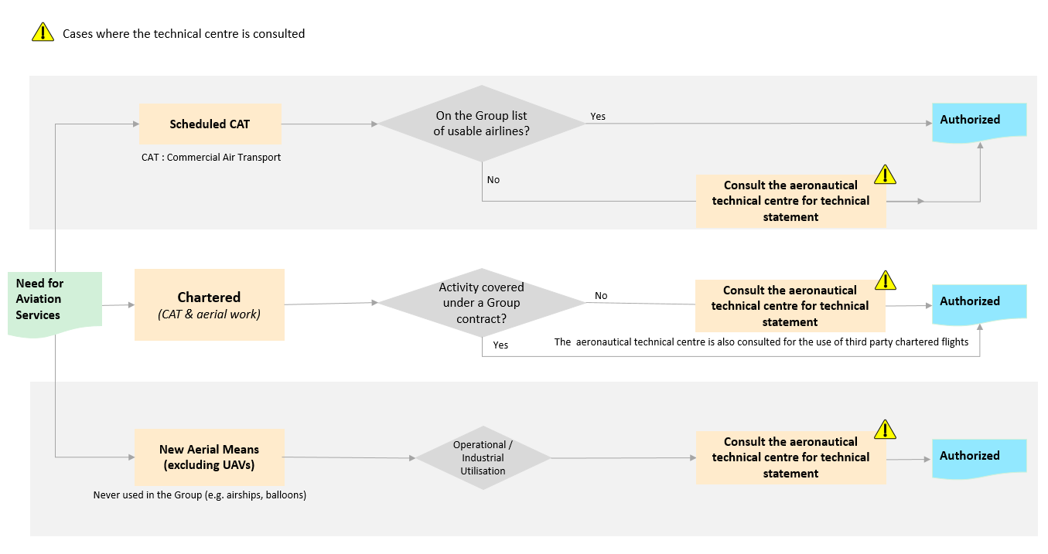
PLANNING PROCESS FOR AERIAL ACTIVITIES
The process for planning aerial activities follows the logic diagram below:

Slide 4
REQUIREMENT OVERVIEW: General Requirements
Requirement 3.1.1 : Operations Continuity
The maximum number of people allowed to travel on the same flight is included in the Business Continuity Plan of the entity or affiliate. Furthermore:
The Group's Chief Executive Officer and Chief Financial Officer do not travel together;
A maximum of one third of the Group Executive Committee members may travel together on the same aircraft;
A maximum of one third of the members of a Branch Codir may travel together on the same aircraft.
Clarification (previous principle: avoid using a single aircraft to transport several personnel from the same team).
Requirement 3.1.2 : Complying with Instructions
Operating instructions of the air operator and the safety instructions issued by the flight crew are respected.
New requirement
Requirement 3.1.3 : Aircraft for Passenger Transport
The aircraft used for the passenger transport are multi-engine, equipped with turbomachines.
No change

Slide 5
REQUIREMENT OVERVIEW: Non-Chartered Flights
Requirement 3.2.1 : Preselected Airlines for Non-Chartered Flights
Airlines companies that can be used are included on the Group list of air operators. In other cases, the aeronautical technical centre is consulted.
Change: Simplification of the previous requirement (DIR-GR-SEC-15 et REG-GR-SEC-15).
Requirement 3.2.2 : Documentation of the Technical Aeronautical Centre Statement
In the case of a request for advice under requirement 3.2.1, the statement is documented and provided to the requesting entity or affiliate after completion of a risk assessment.
Clarification (previous principle: Carriers without IOSA certification or that are not monitored by an internationally recognised national public civil aviation authority must be the subject of a risk assessment prior to use).

Slide 6
REQUIREMENT OVERVIEW: Chartered Flights
Requirement 3.3.1 : Types of Aircrafts for Chartered Flights
Helicopters and airplanes that are authorised:
Are of a civil type, regardless of the activity;
For passenger transport are less than 25 years old for the duration of the charter contract.
Change: Reinforcement that aircraft are of a civil type.
Requirement 3.3.2 : Infrastructure for Chartered Flights
The minimum standards for airports, helipads and ground equipment are selected based on the most restrictive requirements between:
International Civil Aviation Organisation (ICAO) Annex 14, Vol I and II or ICAO Doc 9261, for all infrastructures;
National regulations.
New requirement : Adjustment of OACI definitions to the Group referential.

Slide 7
REQUIREMENT OVERVIEW: Chartered Flights
Requirement 3.3.3 : Risk Analysis for Chartered Flights
Before the establishment of a charter contract:
A risk analysis is conducted by the entity or affiliate taking into account the criteria of Appendix 2, and is then sent to the aeronautical technical centre for advice;
A statement of the advice from the aeronautical technical centre regarding the air operator considered for selection is provided back to the entity or affiliate. If necessary, risk controls are implemented by the entity or the affiliate before commencement of operations
Clarification on the risk analysis.
Requirement 3.3.4 : Prerequisite Documents for Chartered Flights
The verification of the following documents is a prerequisite for a positive statement from the technical aeronautical centre:
A certificate issued by a national civil aviation authority and corresponding to the type of activity carried out for the Group:
­A valid Air Operator Certificate (AOC) for passenger transport or;
­An Aerial Work Certificate (AWC) or equivalent for specialised operations.
A valid Aircraft Maintenance Organisation (AMO) certificate held by the air operator or by its subcontractors;
A valid insurance policy held by the air operator with civil liability coverage. The minimum amount of this insurance is as per the minimum Group Insurance requirements.
Changes:
The perimeter of application is expanded for aerial work.
Insurance requirements are defined by the Group.

Slide 8
REQUIREMENT OVERVIEW: Chartered Flights
Requirement 3.3.5 : Verification of the Implementation Process of Airworthiness Directives by Aeronautical Technical Centre
The internal process of the chartered air operator ensures the implementation of the airworthiness directives regarding the state of registration and those regarding the state of certification of the aircraft.
Change : Reinforcement of the airworthiness directives.
Requirement 3.3.6 : Aeronautical Technical Centre Statement for the Selection of Chartered Air Operators
The technical statement of the aeronautical technical centre is issued on the basis of a documentation review and/or an aeronautical technical audit, which ensures that the air operator meets the Group's requirements.
The technical statement is communicated to the requesting entity or affiliate in the form of a written report, stating at minimum:
The results of the assessment;
For passenger transport, that the valid term of the technical statement is not to exceed a 2 year period;
In the case of aerial work, that the valid term of the technical statement is not to exceed a 3 year period;
The identified gaps with Group requirements, potential operational restrictions, and the need for derogation, if any;
If necessary, the action plan to be completed prior to issuance of the charter contract.
Changes:
Expansion of the scope of application for aerial work.
Reinforcement of validity period of the technical statement.

Slide 9
REQUIREMENT OVERVIEW: Chartered Flights
Requirement 3.3.7 : HSE Contractual Clauses for Charter Contracts
The charter contract with the air operator includes the following provisions:
The details of the derogations obtained vis-à-vis Group requirements, if any;
The obligation to declare any change in subcontractor or aircraft, and consequently the obligation to obtain a prior approval by the aeronautical technical centre;
The list of safety performance indicators and the quarterly reporting obligations (see Appendix 3);
A list of the incident types where reporting is mandatory, including the obligation to send an initial factual report within 24 hours;
The possibility that the Group may mandate the operator to apply optional service bulletins of the manufacturers
No change
Requirement 3.3.8 : Training
Ground personnel at the operated facilities involved in the landing/take-off operations of chartered aircraft receive appropriate training from organisations approved by the aeronautical technical centre.
Passengers transported by chartered helicopter to offshore facilities and/or vessels have up-to-date medical certificates and helicopter underwater emergency evacuation and sea survival (BOSIET, HUET) training certificates obtained from an organisation which is OPITO certified or internally approved by the Group.
No change

Slide 10
REQUIREMENT OVERVIEW: Chartered Flights
Requirement 3.3.9 : Management of Passengers of Chartered Flights
Passengers transported by helicopter to offshore installations and/or vessels carry an Emergency Breathing System (EBS) category A.
Passengers transported by helicopter to offshore installations and/or vessels and that are occupying seats at an emergency exit meet the compatibility requirements for shoulder width.
In the case of aerial work, no passenger shall be present on board the aircraft.
Changes:
Carrying an EBS and occupying seats at an emergency exit compatible with the shoulder width for passengers transported by helicopter
Expansion of the perimiter of application for aerial work.

Slide 11
REQUIREMENT OVERVIEW: Chartered Flights
Requirement 3.3.10 : Restrictions for Chartered Flights
Flights to offshore installations and/or vessels, except for Search And Rescue (SAR) and medical evacuations, are prohibited when the sea state exceeds the certified limits of the helicopter emergency floatation system.
Chartered helicopter night flights are limited to medical evacuations and as necessary for pilots to maintain their qualifications. The only exceptions are flights with passengers at latitudes above 50° North or below 50° South when the daylight period is incompatible with operational requirements, and only:
Subject to the availability of appropriate SAR resources; and
After prior advice by the aeronautical technical centre.
No change
Requirement 3.3.11 : Operational and Technical Flights Surveillance
For any long-term passenger transport, charter contract (> 1 year), and when the technology is available, the aircraft shall be equipped with the following:
Flight Data Monitoring (FDM);
Aircraft Health Usage Monitoring System (HUMS) or Unit/Engine Condition Trend Monitoring System (ECTMS).
The surveillance and analysis processes are implemented by the air operator using these technologies.
No change

Slide 12
REQUIREMENT OVERVIEW: Chartered Flights
Requirement 3.3.12 : Third-Party Chartered Flights for Passenger Transport
The use of third-party charter flights for the passenger transport is subject to a prior approval by senior management of an entity or affiliate after advice from the aeronautical technical centre.
Changes: generalisation of existing good practices.
REQUIREMENT OVERVIEW: Aeronautical Experimentation
Requirement 3.4.1 : Use of New Aircraft Types (Excluding UAVs)
For the operational use of new aircraft types (excluding unmanned aerial vehicles (UAVs)), the aeronautical technical centre is consulted for a technical statement.
New Requirement : formalisation of existing practice.

Slide 13
REQUIREMENT OVERVIEW: Emergency Response
Requirement 3.5.1 : Elements to Include in the Emergency Response Plan
The emergency response plan of the entity or affiliate considers:
For charter flights:
­Accident scenarios and scenarios of overdue aircraft;
­Carrying capacity of chartered aircraft, the estimate of survival time, and the available means of rescue within the zone in the event of an accident.
For non-charter flights:
Accident scenarios.
Changes: clarification on the content (This requirement is aimed mainly at affiliates that have a contract in place with a travel agency other than CWT).
Requirement 3.5.2 : Emergency Response Plan Testing for Charter Flights
Charter flight scenarios in the entity or affiliate emergency response plans are integrated into the annual testing plan, or as soon as possible after the establishment of a long-term charter contract with an air operator.
No change

Slide 14
REQUIREMENT OVERVIEW: Inspections and Audits
Requirement 3.6.1 : Follow-up of Recommendations from Aeronautical Technical Audits
The close out of findings related to non-conformance level 1, made following a technical audit of an air operator, is subject to a technical statement from the aeronautical technical centre.
Note: Non-conformance Level 1: Safety is affected. Urgent action is required.
Clarification of the rule

Slide 15
REQUIREMENT OVERVIEW: Communication and Reporting
Requirement 3.7.1 : Distribution and Archiving of Documentation
The technical statements are communicated to the Group HSE Aviation Activities function and archived according to the Group policy.
New Requirement : formalisation of an existing practice.
Requirement 3.7.2 : Reporting Accidents and Incidents
For charter flights the following events (as defined by ICAO) are reported:
Accidents;
Serious incidents;
Incidents that could have an impact on the airworthiness, the safety of the flight of the aircraft or the personnel on board.
New Requirement
Requirement 3.7.3 : Aviation Activity Report
For HSE performance monitoring, the activity of the chartered air operator report is transmitted quarterly to the Group HSE Aerial Activities function.
Formalisation of an existing practice.

Slide 16
Where to find additional information or documentation?
Publication on WAT: http://wat.corp.local/sites/s215/en-US/Pages/actualites/2019/Publication-nouvelle-regle-HSE-415.aspx
HSE toolbox: https://www.toolbox-hse.total.com/en/one-maestro
REFLEX: group referential documents : https://reflex.sinequa.corp.local/
M&S Branch referential : http://crescendo4all.rm.corp.local/sites/Ref_MS/Pages/Home.aspx
7

