Slide 1
Human Factors, Weak Signals and Communication
H3SE integration kit
Module TCT 4.1

Slide 2
Module objectives
At the end of this half-day module:
You will understand what characterizes the human factor as regards safety,
You will know the concept of weak signals,
You will understand the importance of interpersonal communication in risk management (including taking cultural differences into account).
You will be able to practice active listening.

Slide 3
The human factor in safety

Slide 4
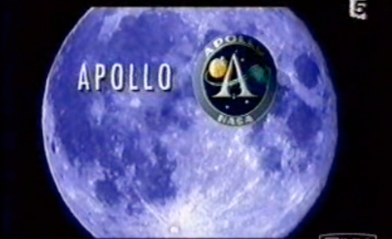
The Apollo catastrophe

Slide 5
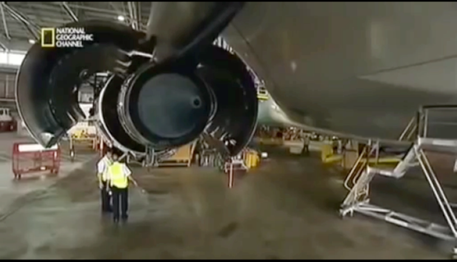
The catastrophe prevented on Qantas flight 32

Slide 6
The human factor: the last barrier
  Safety barriers
Non-formalized activities
People
RISK
Formalized activities
Process
Management systems
RISK
Equipment
Design
RISK
The presence and size of holes in the different barriers (technical, organization, human) are strongly influenced by human and organizational factors.

Slide 7
What characterizes the human factor
The human factor, as regards safety, is characterized by:
  Risk perception (signals and judgment)
  Risk assessment
  Risk taking.

Slide 8
Risk perception

Slide 9
Risk perception is based on the reception and processing of signals (1/2)
Risk perception is…
The perception of external signals that can be regarded as potential risks.
The subjective judgment that individuals possess on the characteristics and the severity of the risk.

Slide 10
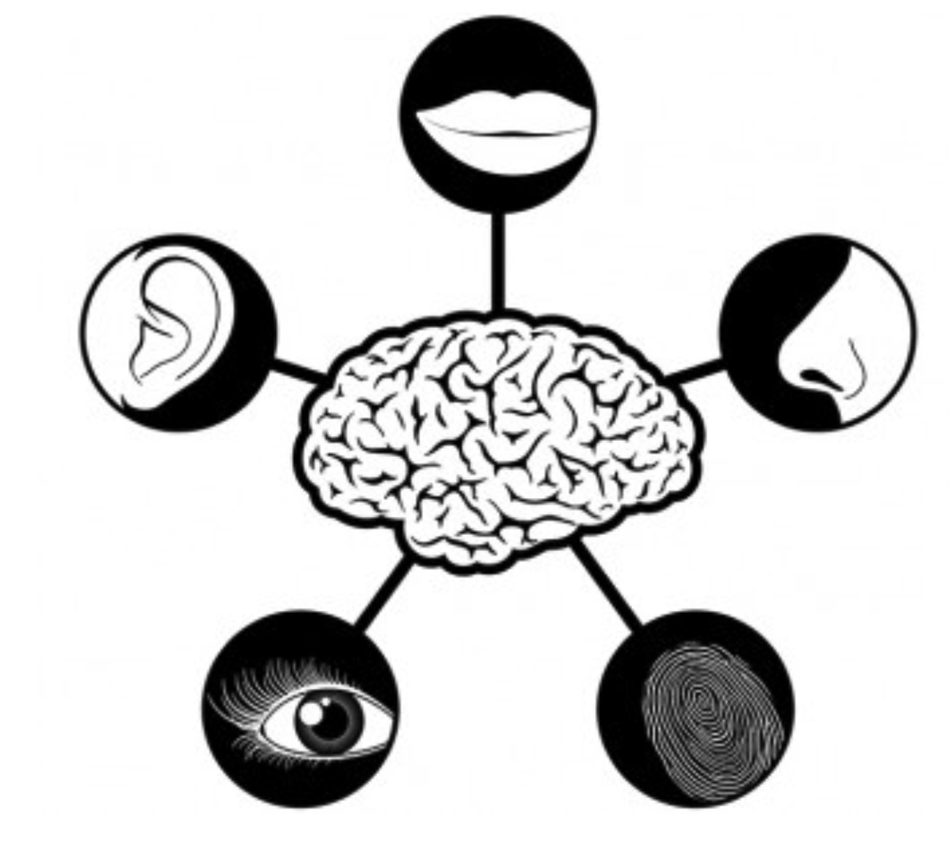
Risk perception is based on the reception and processing of signals (2/2)
The external signals are captured by our 5 senses
These signals…
... can be real or not
... can be interpreted as potential risks

Slide 11
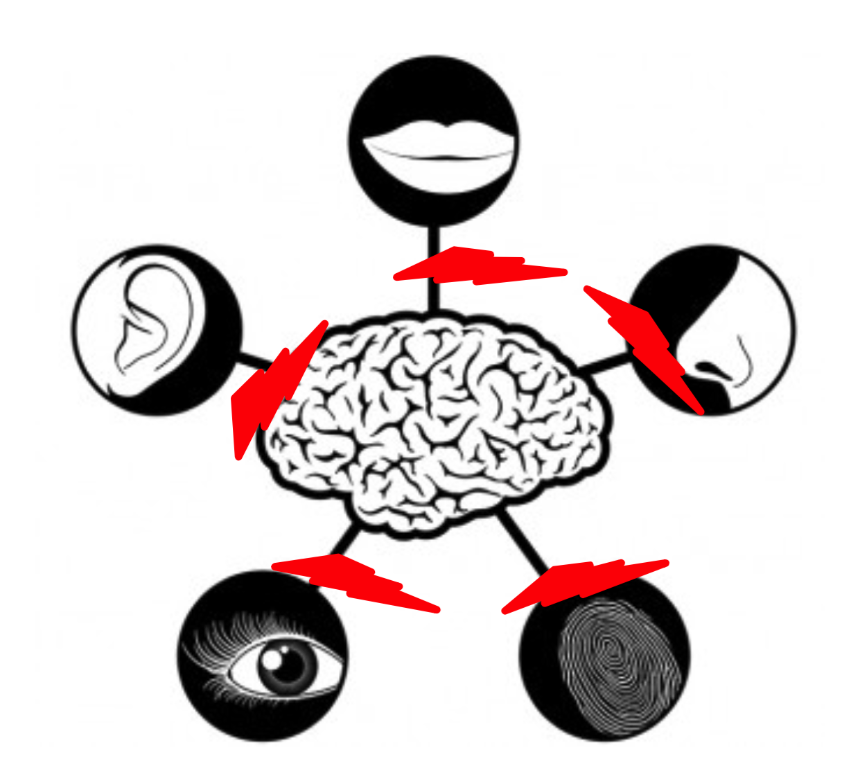
As a neurological phenomenon, perception can be altered
The external signals are captured by our 5 senses
Interferences can occur between external signals and the brain
In this case, the brain no longer processes the data correctly
These interferences can come from various sources
1
Familiarity
Distraction
Saturation
Stress
!
2
3
4
Man has a subjective and irregular risk perception
Notes:
Our senses can be altered by a set of interferences, the most common being:
Familiarity: we become accustomed to a risky situation when it recurs time and again. It ends up becoming normal and we no longer pay attention to it.
Distraction: for example, when we do not pay attention to what we are doing because we are distracted by an event taking place near us (hammer blow to the finger). Or conversely when we are so focused on a task that it prevents us from seeing what is around us.
Saturation: when there is too much information to process and our brain is no longer able to keep up.
Stress: creates a physiological reaction that tends to lock us into our feelings and makes us sensitive to our surroundings.

Slide 12
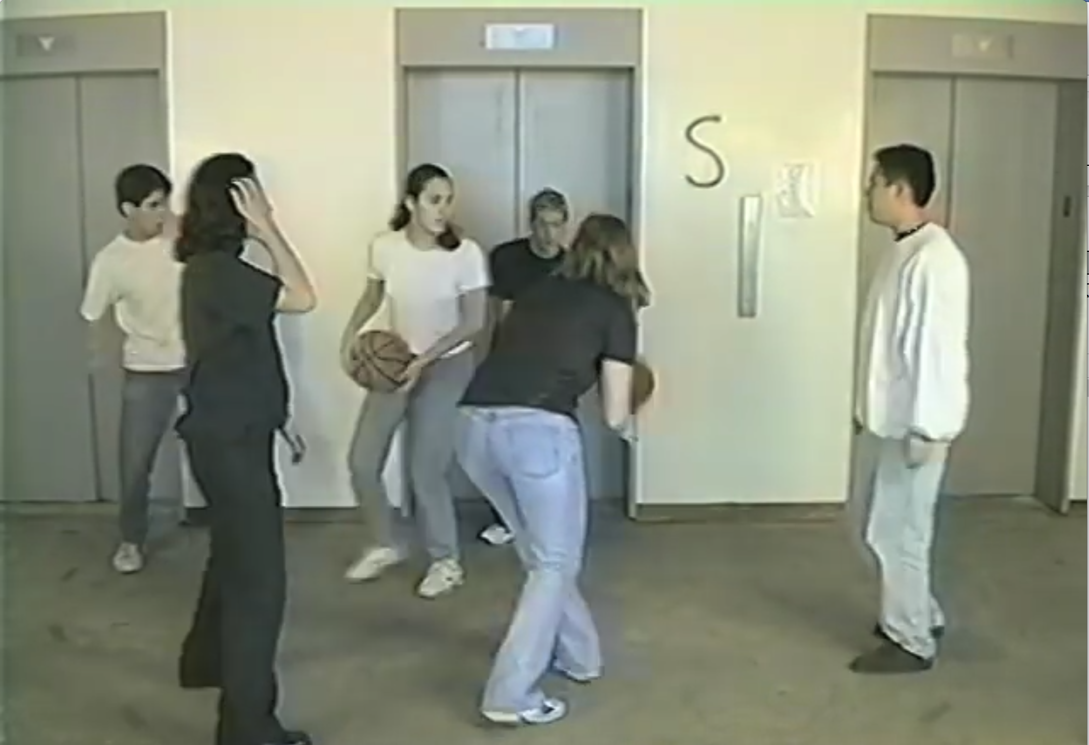
How many passes
How many passes do the players in white make in this film?

Slide 13
Weak signals

Slide 14

Weak signals (1/2)
“A weak signal is an early alert of a change, which becomes increasingly stronger once combined with other signals.”
- Hiltunen, E.
A weak signal is therefore something you see, smell or hear but do not perceive directly as having potential consequences.
Notes:
A weak signal is therefore something you see but do not perceive directly as having potential consequences.
You have surely said to yourself after something big has happened: “I noticed something but at the time, I didn't react to it!”. You have perceived a weak signal but did not analyze it: it was not taken into account in the action that followed.
Weak signals are easier to detect when we are not involved (during visits, audits, etc.), but the challenge is to identify them in our own activities: concentration on a task to be accomplished, fatigue, stress ... are all factors that prevent us from analyzing the situation correctly.

Slide 15
Weak signals (2/2)
Some examples of weak signals:
Operators with too much or too little self-confidence
Excessive assurance during routine activities
Lack of experience in unusual or dangerous activities.
Fatigue, weariness, demotivation, discouragement, provocation, etc.
Various pressures (production, time, financial challenges, etc.)
Condition and adequacy of equipment and tools, housekeeping
Various anomalies
Etc.

Slide 16
Risk assessment

Slide 17
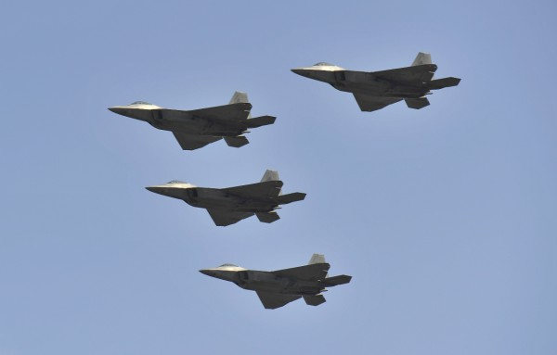
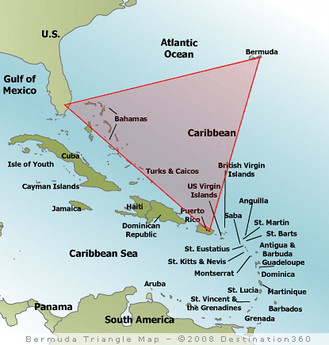
The squadron lost in the Bermuda Triangle

Slide 18
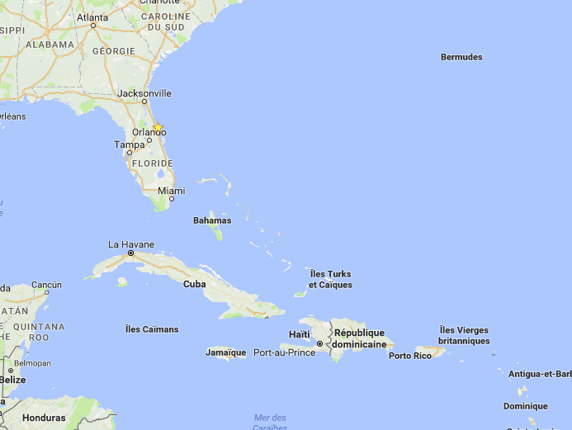
The squadron lost in the Bermuda Triangle – the facts
Where they actually were
Where the captain believed they were

Slide 19
The error in the risk assessment
Errors can be made in risk assessment:
because you have a false perception of reality (mental picture different from reality),
because you take shortcuts:
  Representativeness: Mental shortcut on the probability of an event drawn from your personal experience: "Joe used this shortcut to get back to camp, nothing happened to him!".
  Availability: Mental shortcut based on examples that immediately spring to mind (connected events or situations): "My car has broken down. My colleague, who has the same model as me, had a starter problem, so I have a starter problem."
  Reinforcement: The first information received (“the reinforcement”) has a stronger impact than the information that follows when making a decision:"I bought these shoes at 50% off, it was a bargain, they were €300!"
Notes:
These shortcuts, which we create innately and through experience, are useful for some of the actions we take. These are reflexes that allow us to solve simple problems in everyday life quickly. But for complex situations they are sources of error, especially when the situation should be assessed (to gather the facts).

Slide 20
Risk taking

Slide 21
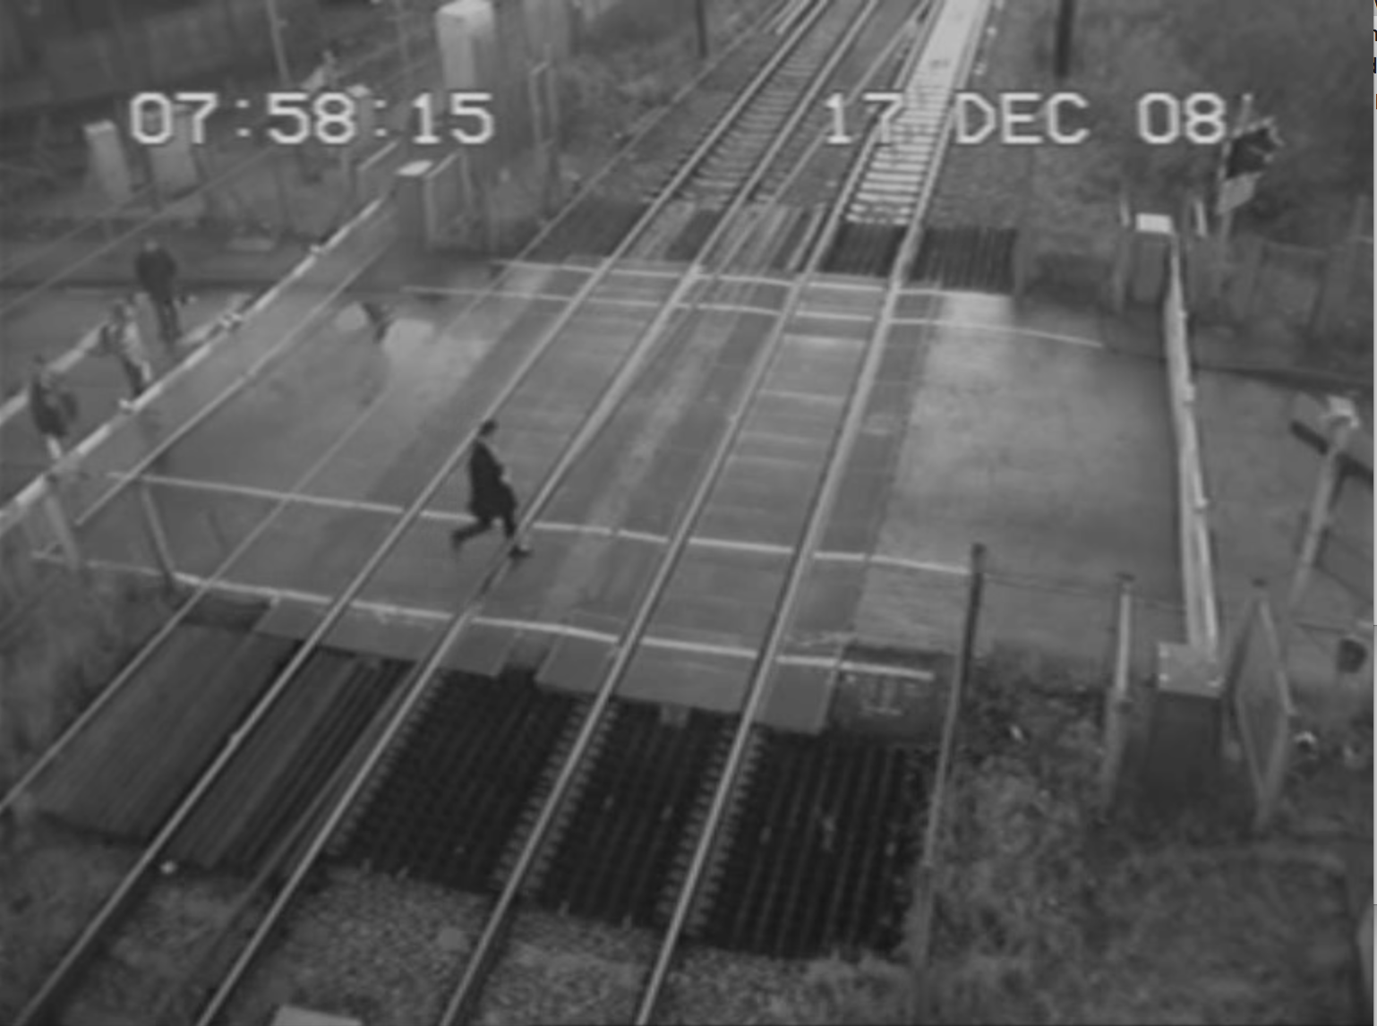
Video of a level crossing

Slide 22
Analysis example – Crossing the railway
Trigger
Behavior
Consequences
Challenge/swagger
Urgent/emergency
Already seen somebody else do it
Time of day
Late for a meeting
Misrepresentation due to the absence of an audible or light signal
Altered perception of the risk
No anticipation of the consequences
Crossing the railway
Negative:
Death
Injury
Fine
Immediate, certain and positive:
Time saved/on time for your meeting
Image/approval of others
Satisfaction (adrenalin)

Slide 23
Aspects of risk taking
The consequences which have the greatest influence on our behaviors:
  Immediate (I)
  Certain (C)
  Positive (+)
We seek more immediate/certain/positive consequences (IC+)
We modify our behavior according to these consequences.
Principle: the consequences (immediate, certain and positive) have a greater influence on behavior than the triggers.
But this is not the only aspect that can push us to take chances; added to it is:
Social pressure
Culture
The role in the family
The role in the organization
Education
Etc.
Risk taking can be attractive because it is socially recognized if successful.
Notes:
In addition to the search for immediate, certain and positive consequences, other factors may lead us to take risks. Risk-taking can even be socially recognized if successful.

Slide 24

Now it’s your turn (1/3)

Slide 25
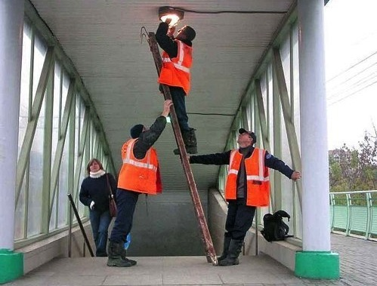
Now it’s your turn (2/3)

Slide 26
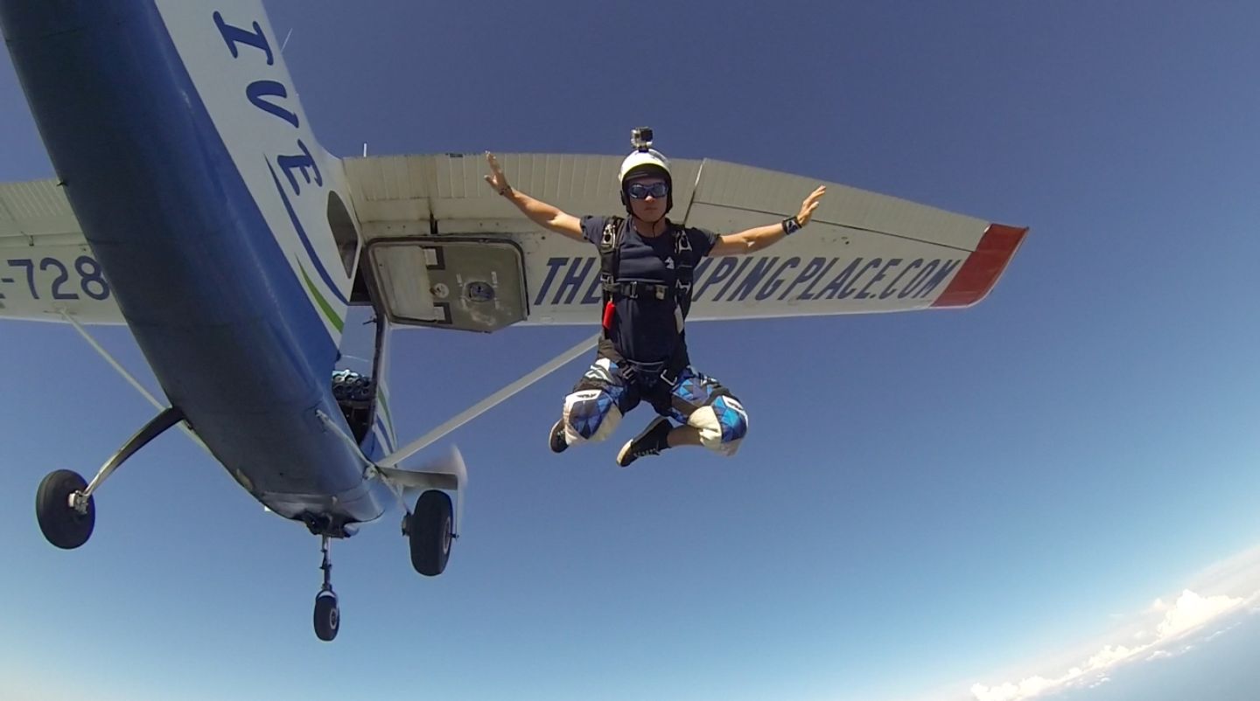
Now it’s your turn (3/3)

Slide 27
What about you?
Have you ever found yourself in a situation where you regretted taking risks?
What do you think was the source of this risk taking?
What do you see as tangible corrective action in light of what you have looked at in this module?

Slide 28
The crucial role of communication

Slide 29

The last minutes of flight AF447 (Rio - Paris)

Slide 30
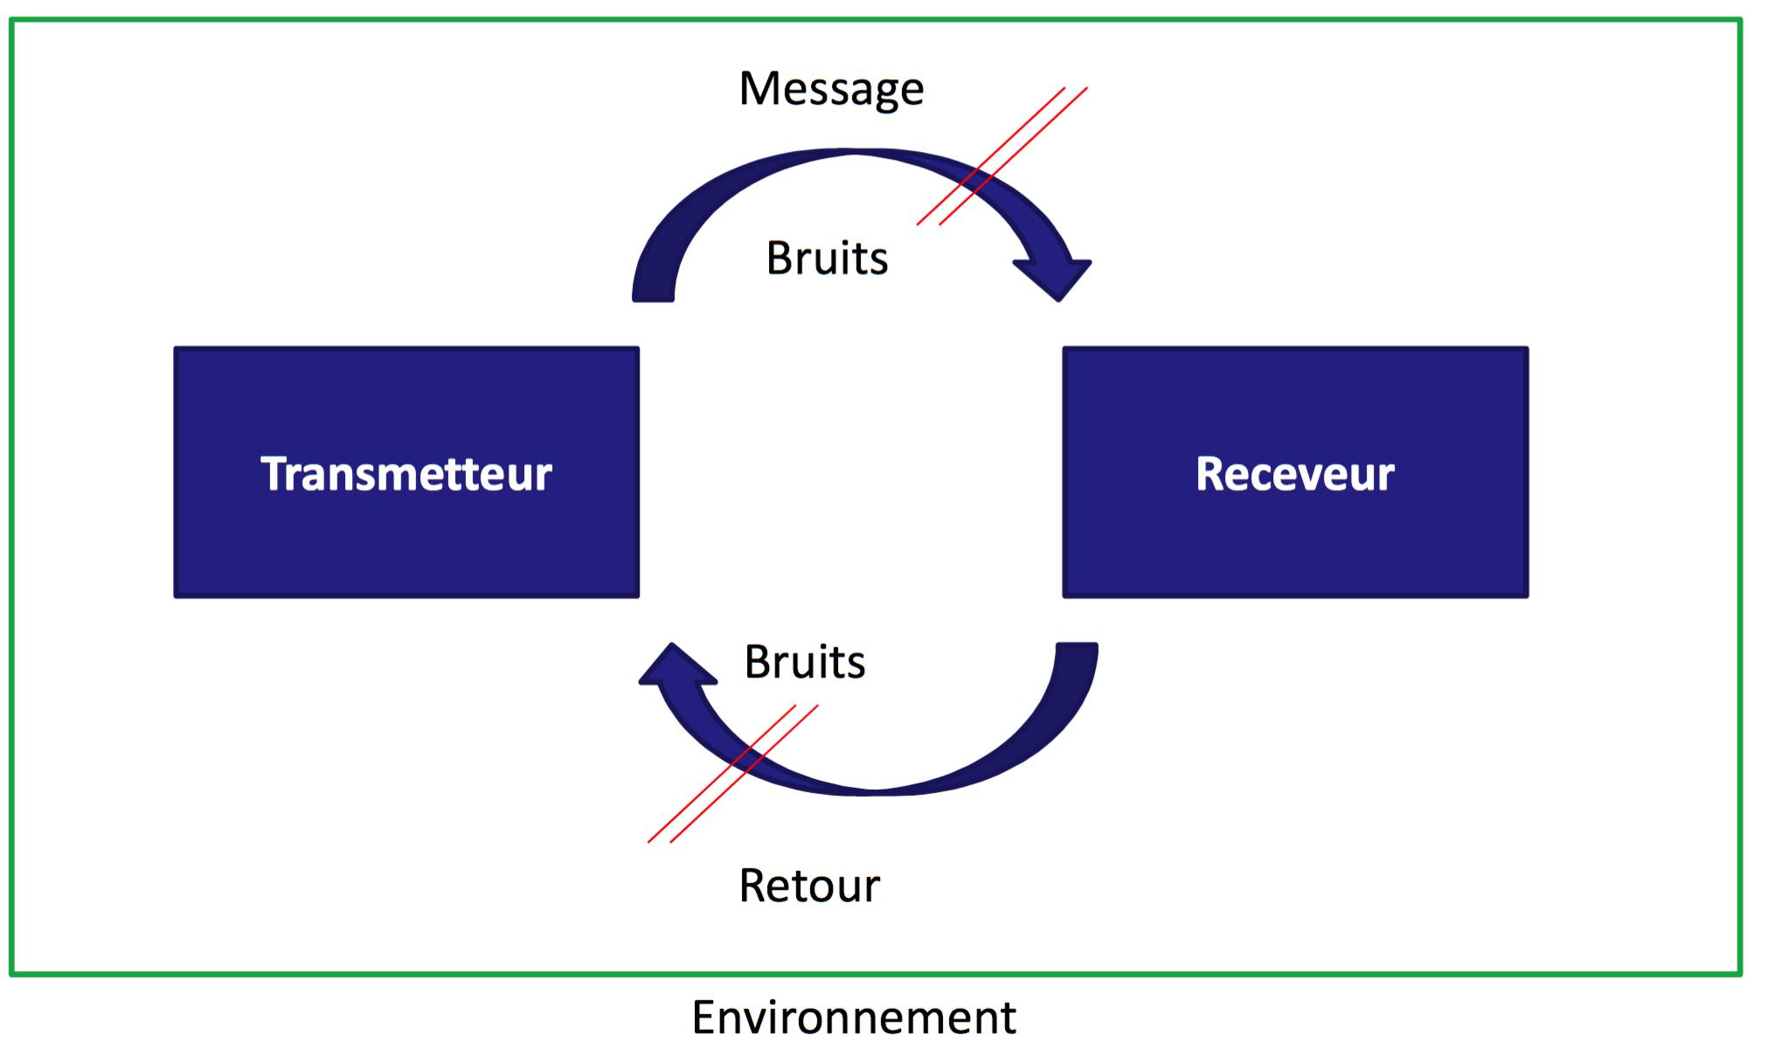
The mechanical model of communication
Transmitter
Receiver
Notes:
The environment surrounding the two communicators can affect understanding of the message. (see the previous example of the Air France flight).

Slide 31
Metacommunication to improve communication
Metacommunication: “the communication of communication”
Non-verbal:
Mimicry
Movements
Appearance
Posture
Distance
Attitude
Paraverbal:
Sound
Volume
Pronunciation
Intonation
Rhythm
Breathing
Interjections
Notes:
Metacommunication is extra information, not just words.
It helps to support the message that you want to pass on. For it to be effective, you must ensure that the person you are communicating with can see you. This is one of the reasons why, for important messages, it is always best to communicate face to face rather than by email or phone.

Slide 32
Active listening – 1st key:
Listen to the person speaking to you and… rephrase
To assure the person you are speaking to that they have been heard and understood...
To encourage them to go further and gather the facts...
To avoid misunderstandings...
Rephrase what you understood from your conversation with the other person:
without judgment or interpretation,
starting with a phrase such as “if I understood you correctly…”

Slide 33
Active listening – 2nd key:
Listen to the person speaking to you and… specify
To understand the meaning of the terms used by the other person.
Specify a name:
“Which kind of (name), precisely?”
Example: This means work - What sort of work, precisely?
Specify a verb:
  “Why (verb), precisely?”
  Example: I can do it - How will you do it, precisely?
Specify general information, such as:
  “We, always, never, a lot…”
Example: Who is "we"?
Really… always? Never?
A lot? How much?

Slide 34
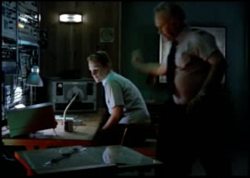
Communication – foreign languages
Funny video

Slide 35
Improving communication in a foreign language – 10 tips
Be specific
Be patient
Avoid idiomatic expressions (e.g.: “go the whole hog” or “hand on heart”)
Ask for clarifications
Pay attention to jargon
Speak softly and clearly
Define basic vocabulary
Regularly check understanding
Provide information via multiple channels (draw, mime, etc.)
Choose the most relevant communication media (face to face, telephone, email, etc.)

Slide 36
Local specificities
Slide to be filled out locally on the cultural specificities of the country that you should be aware of in terms of communication.

Slide 37
How do you improve intercultural communication?
Develop knowledge of the various cultures you encounter
Share practical experience in a simple way
Avoid humor
Adapt the structure, the rhythm and the movements in your communication
Respect the differences
Do not place too much importance on cultural specificities

Slide 38
To sum up
What did you learn about the human factor and behavioral aspect?
What are you going to do differently now that you've seen this?
Does this raise any new issues?

