Slide 1
World Day for Safety
April 28, 2023
Presentation aid for team meetings

Slide 2



Technological risks
Safety is a value that is implemented daily in all our activities by the employees of TotalEnergies and contractors with a common goal: “Zero fatal accidents”.
Often visible in the form of occupational safety rules, Safety is also paramount to control the risks related to our operations and processes to prevent accidents that could impact people, the environment, and our assets.
The Word Day for Safety 2023 will be the opportunity to address the theme of technological risks.
Michel Charton
SVP HSE
Notes:
Michel

Slide 3
WDfS 2023
Technological risks
01.

Slide 4
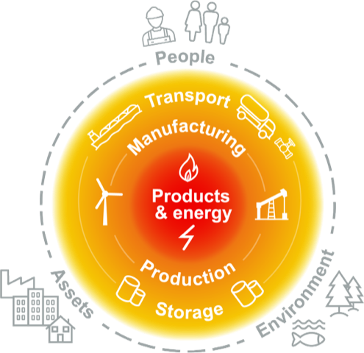


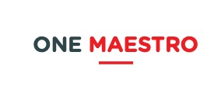
What are technological risks*?
  These are risks for people, the environment or assets, resulting from accidental exposure related to:
  The toxic, explosive, flammable or harmful products used
  Manufacturing and production processes
  The flow of raw materials and finished, stored or transported products.
* as defined in

Slide 5
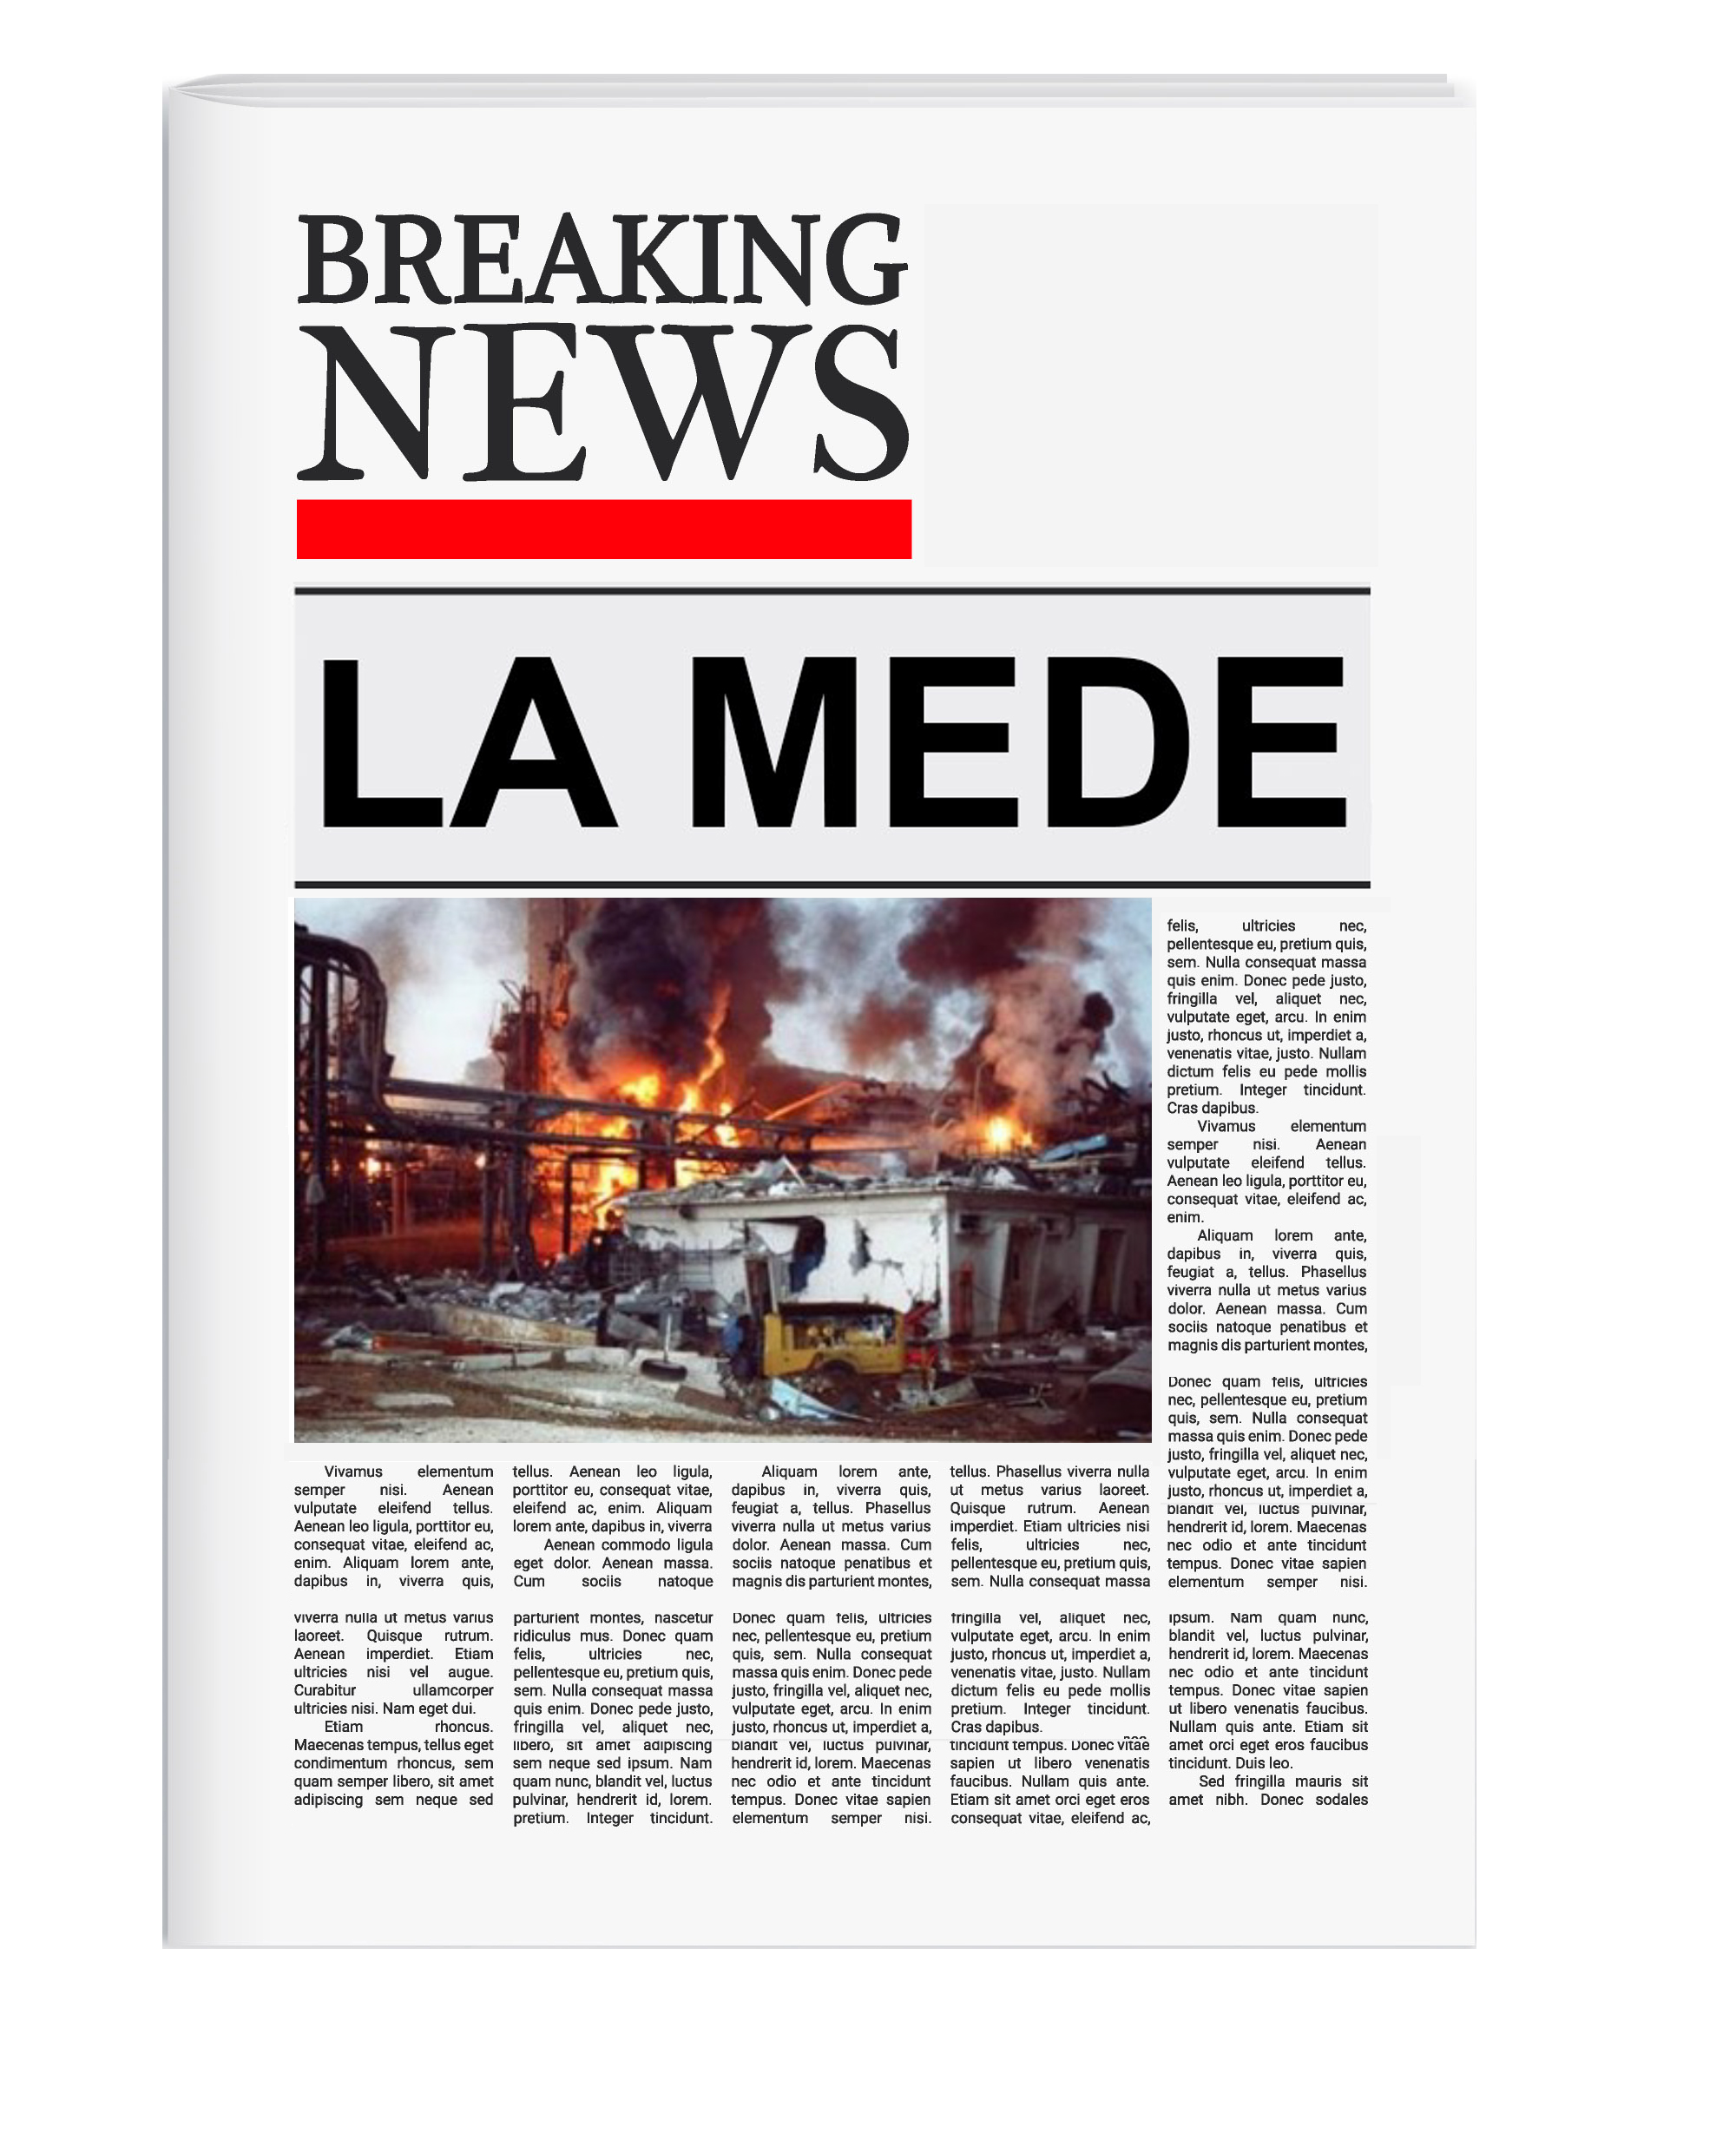

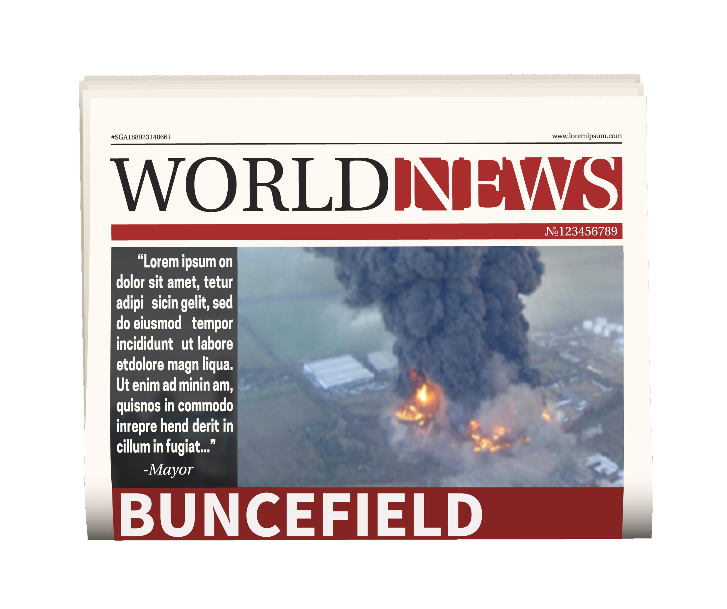

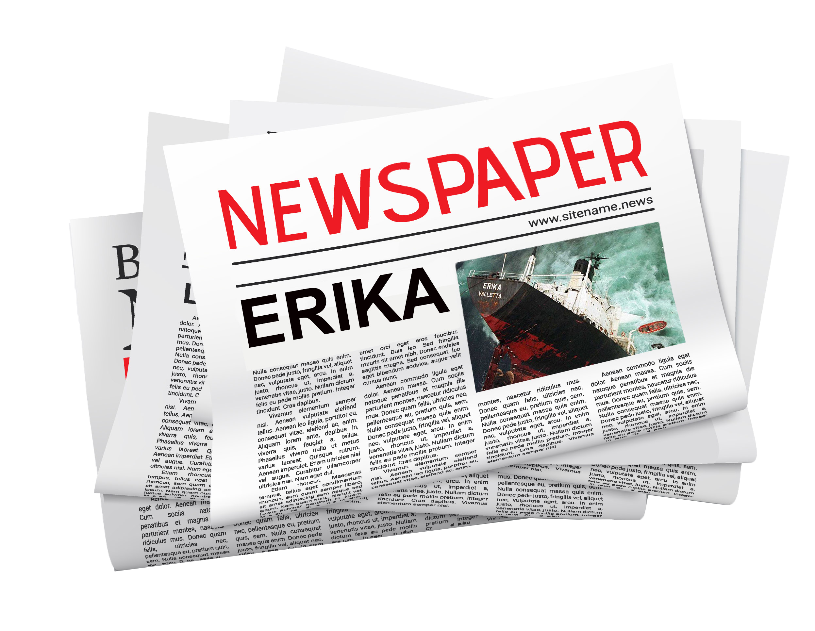
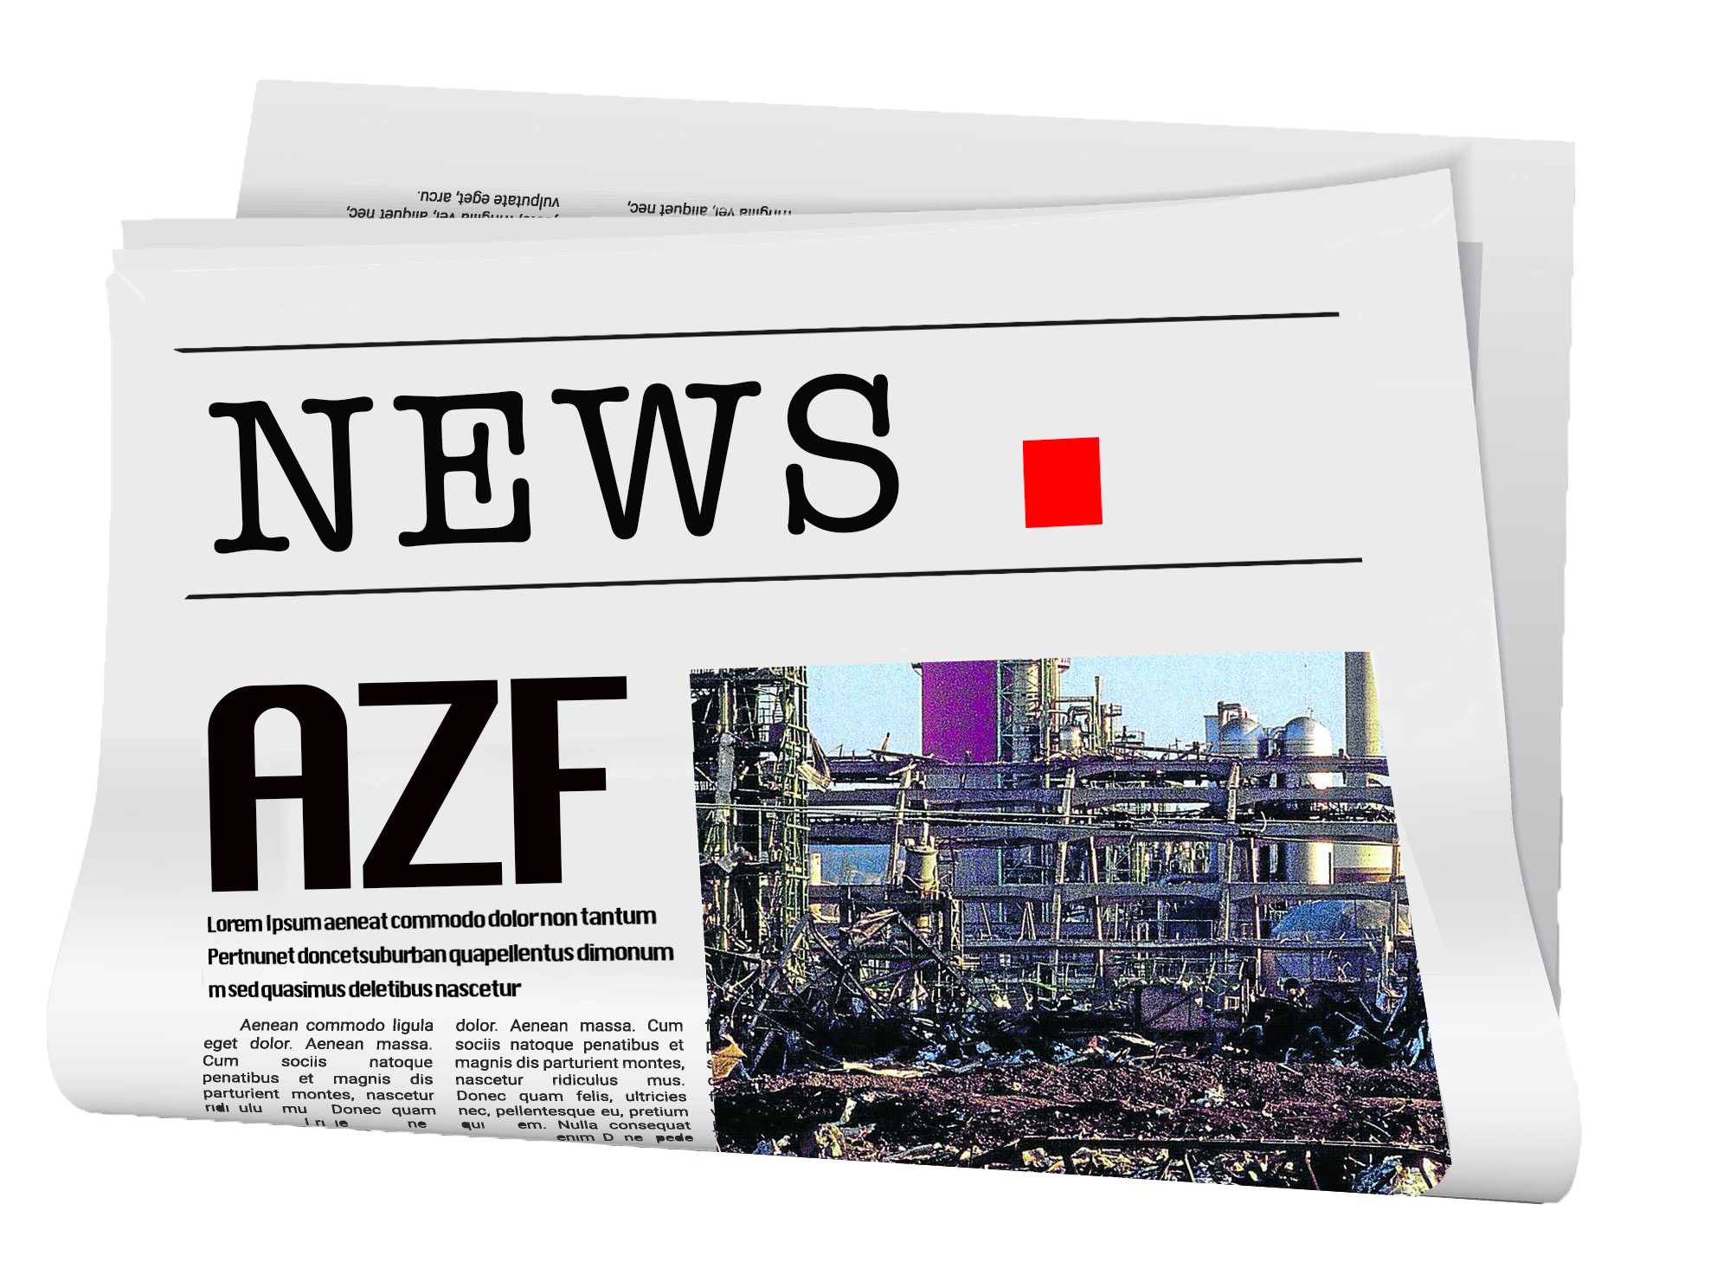

Technological risks
evoke exceptional and disastrous events…
1992
And these events too...
2019 - Lubrizol
2018 - Mostorod
2010 - Macondo
2005 - Texas City
1989 - Exxon Valdez
1988 - Piper Alpha
1984 - Bhopal
1979 - Bantry Bay
1976 - Seveso
1974 - Flixborough
1966 - Feyzin
2005
1999
© Photos: DR
2001

Slide 6

…but technological risks are hidden in daily activities and are more common than you might think
Tank purge valve left open without surveillance
Unusual operating conditions
Ineffective safety level measurement
Electrical connections overheating
Truck overturns and spills product
Flange gasket changed without checking the characteristics
Pipeline inspection planned and not executed
Lifting or mechanical excavation close to gas pipelines
Collision with a subsea pipeline
Inflammable gas vent installed close to a furnace
Grounding wire disconnected
Temporary installation without a study and left for years
etc.

Slide 7

The challenges of technological risk management
Our activities involve technological risks.
  Achieve our goals of ZERO FATAL ACCIDENTS.
  Ensure the safety of our employees, our contractors and third parties.
  Avoid pollution.
  Avoid major accidents that could jeopardize the Company’s continuity.
They must be
managed to

Slide 8
How can technological risks be managed?
1
I know all the potential hazards (e.g. hazardous substances, etc.)
3
I define the technical and/or organizational measures required to manage the risks (e.g. Level Switch High High...)
Identify
hazards
Assess
risks
Define
barriers
Implement and maintain barriers
2
  I assess the presence of potential risk
  situations and the consequences for
  people, environment and assets
  (e.g. overfilling of a tank resulting in pollution...)
4
I implement the defined barriers and ensure their performance (e.g. inspecting equipment or testing barriers). If they fail,
I take measures to attain a similar level
of risk, or I eliminate the risk.
From the referential

Slide 9
What is my role
in technological
risk management?

Slide 10
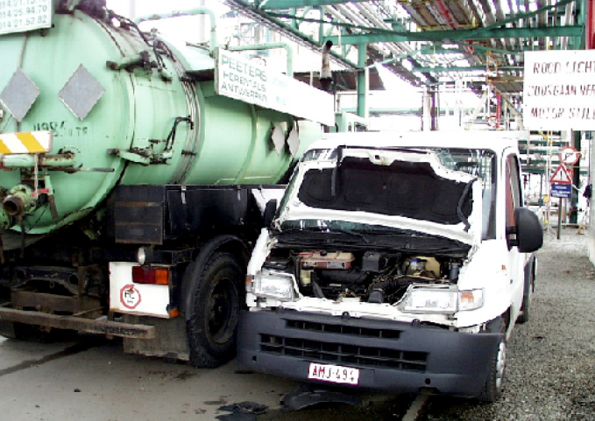
Technological risks are everybody’s business!
Explosion of a gas cloud formed by a vacuum truck
  A vacuum truck had finished its cleaning operation. The signage to mark out a no entry zone had been removed.
  When a service vehicle drove past the truck, the engine overran and the gas cloud formed by the hydrocarbon vapors discharged through the vent on the truck, exploded.
My role
  As a work planner, I assess the risks throughout the entire activity and identify the associated barriers.
  As a Field Operator
    I make sure that any hydrocarbon vapors are deviated to a safe zone.
    I maintain the signage in place.
    I make regular atmospheric checks throughout the activity.
The truck driver sustained burns to the face and the two people in the van were shocked by the explosion.

Slide 11
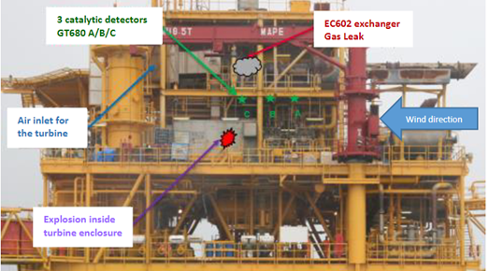
Technological risks are everybody’s business!
Explosion & Fire on an offshore platform Compression Module
A large gas leak caught fire and exploded after being sucked into a compressor. The emergency shutdown was activated manually and the three employees present on the platform were immediately evacuated.
  Advanced corrosion on a pipeline that had already been replaced, was not identified as a cause for concern.
  The faulty gas detection system had been inhibited.
  The deluge system was out of order and had not been tested for 3 years.
My role
  As an Inspector and Maintenance Engineer, I have to ensure that piping and safety systems are inspected, tested and maintained as per requirements.
  As an Operator, I have to ensure the process for management of inhibitions is followed.
  As a Manager, I have an overview of the downgraded systems on my facilities.
  As a Project Engineer, I have to define a gas detector technology, reliable in all operating conditions.
No fatalities. On the previous day, 45 people were present on a neighbouring platform.
Asset damage: USD 10 Million

Slide 12
Organising the WDfS 2023
02.

Slide 13





Use the support material for the WDfS 2023
HSE Toolbox
Form for collecting feedback from discussion workshops
Poster
Managers’ kit (PPT)
Guide for leading a discussion workshop
WDfS 2023 site
for collecting information
One HSE Yammer
Notes:
Nicolas

Slide 14
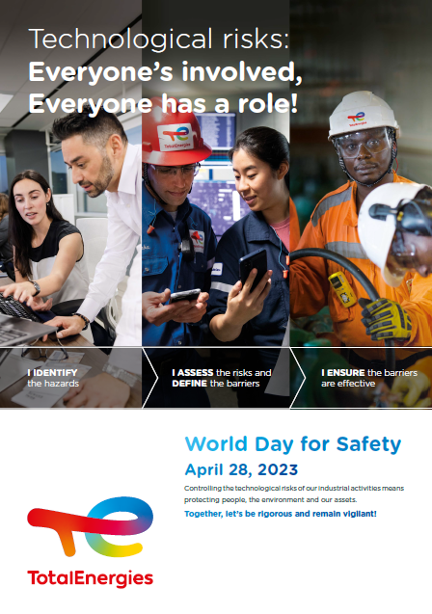
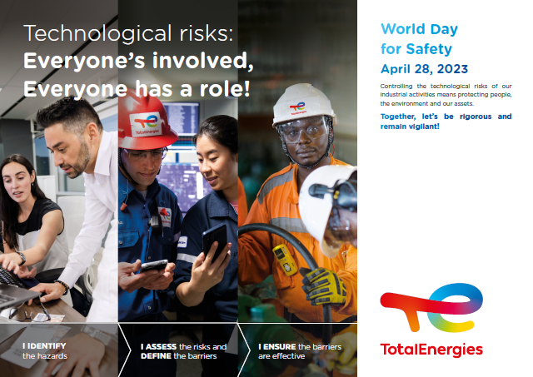
Poster
The poster is available in multiple formats (print & digital):
Horizontal
Vertical
JPG, PDF HD and BD
PPT
Go to the HSE Toolbox HSE
Toolbox HSE | Toolbox HSE (totalenergies.com)

Slide 15
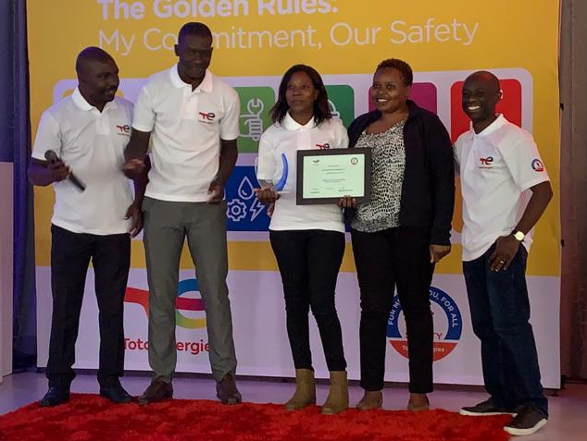
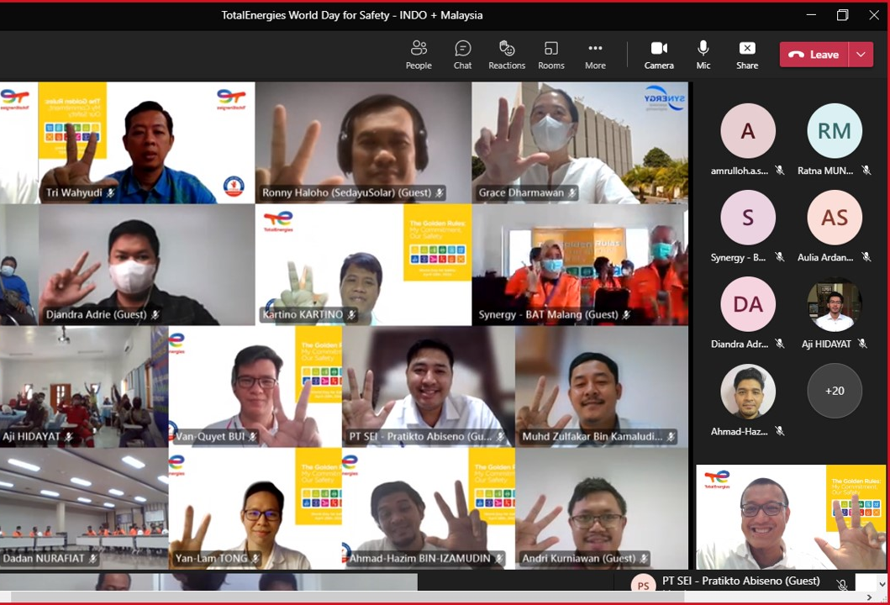
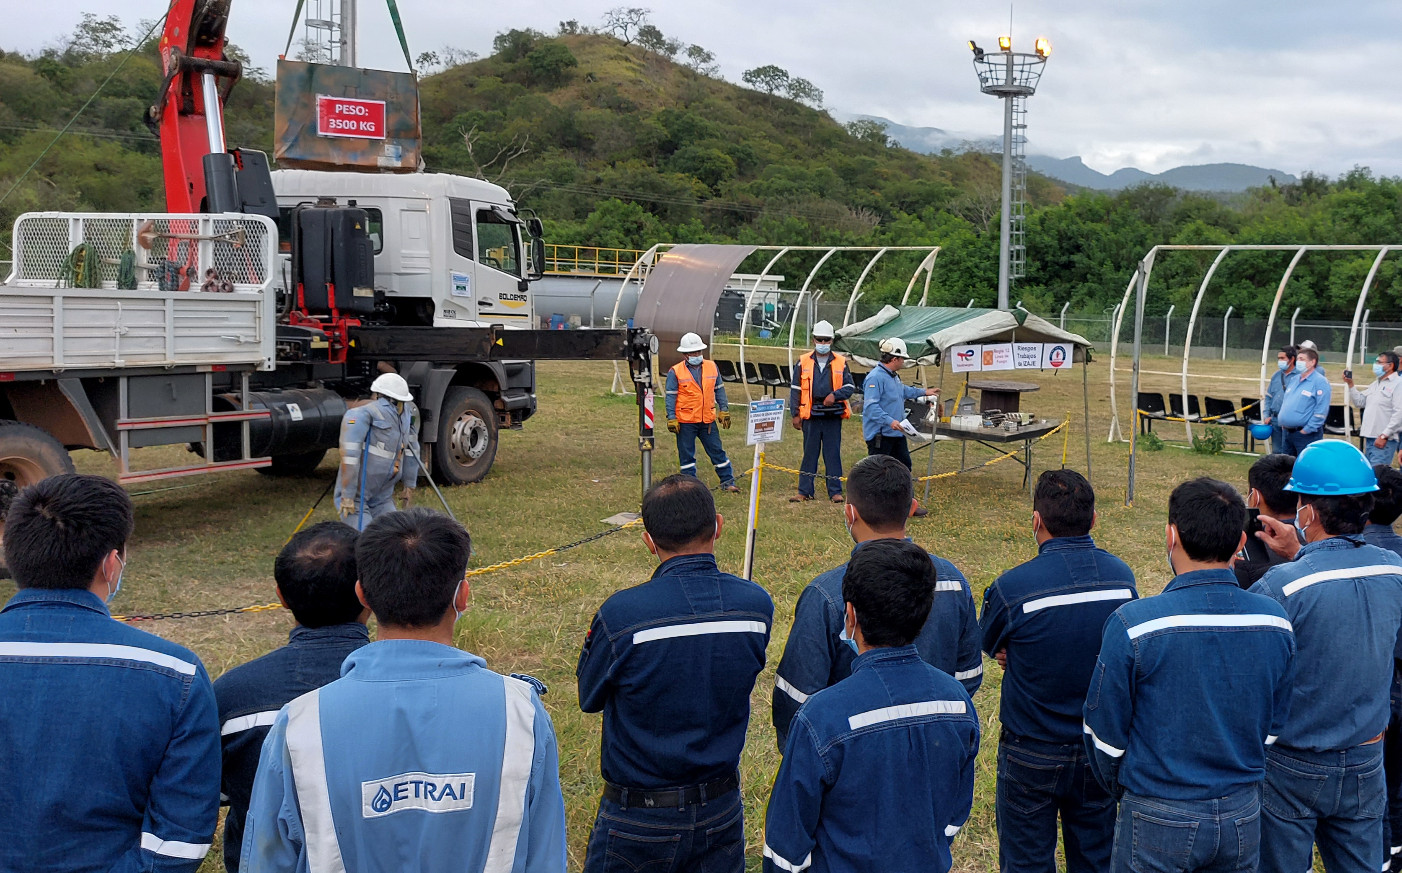
Staging events for the WDfS 2023
The WDfS is a time to celebrate Safety in all the Company’s entities/affiliates and headquarters,
and to federate TotalEnergies employees and contractors.
Select the activities that suit your situation:
    Safety talk or institutional presentation with employees (see managers’ kit).
    Discussion workshop (see support material).
    Presentation/demonstration of best practices implemented (see Safety+).
    Safety, recognition and awards ceremony.
    “Our lives first’’ activities : practices and discussion on Safety green light, carrying out Joint safety tour and Life saving checks.
    Any other activities that correspond to your expectations, rituals of your entity/affiliate.
Notes:
Nicolas

Slide 16
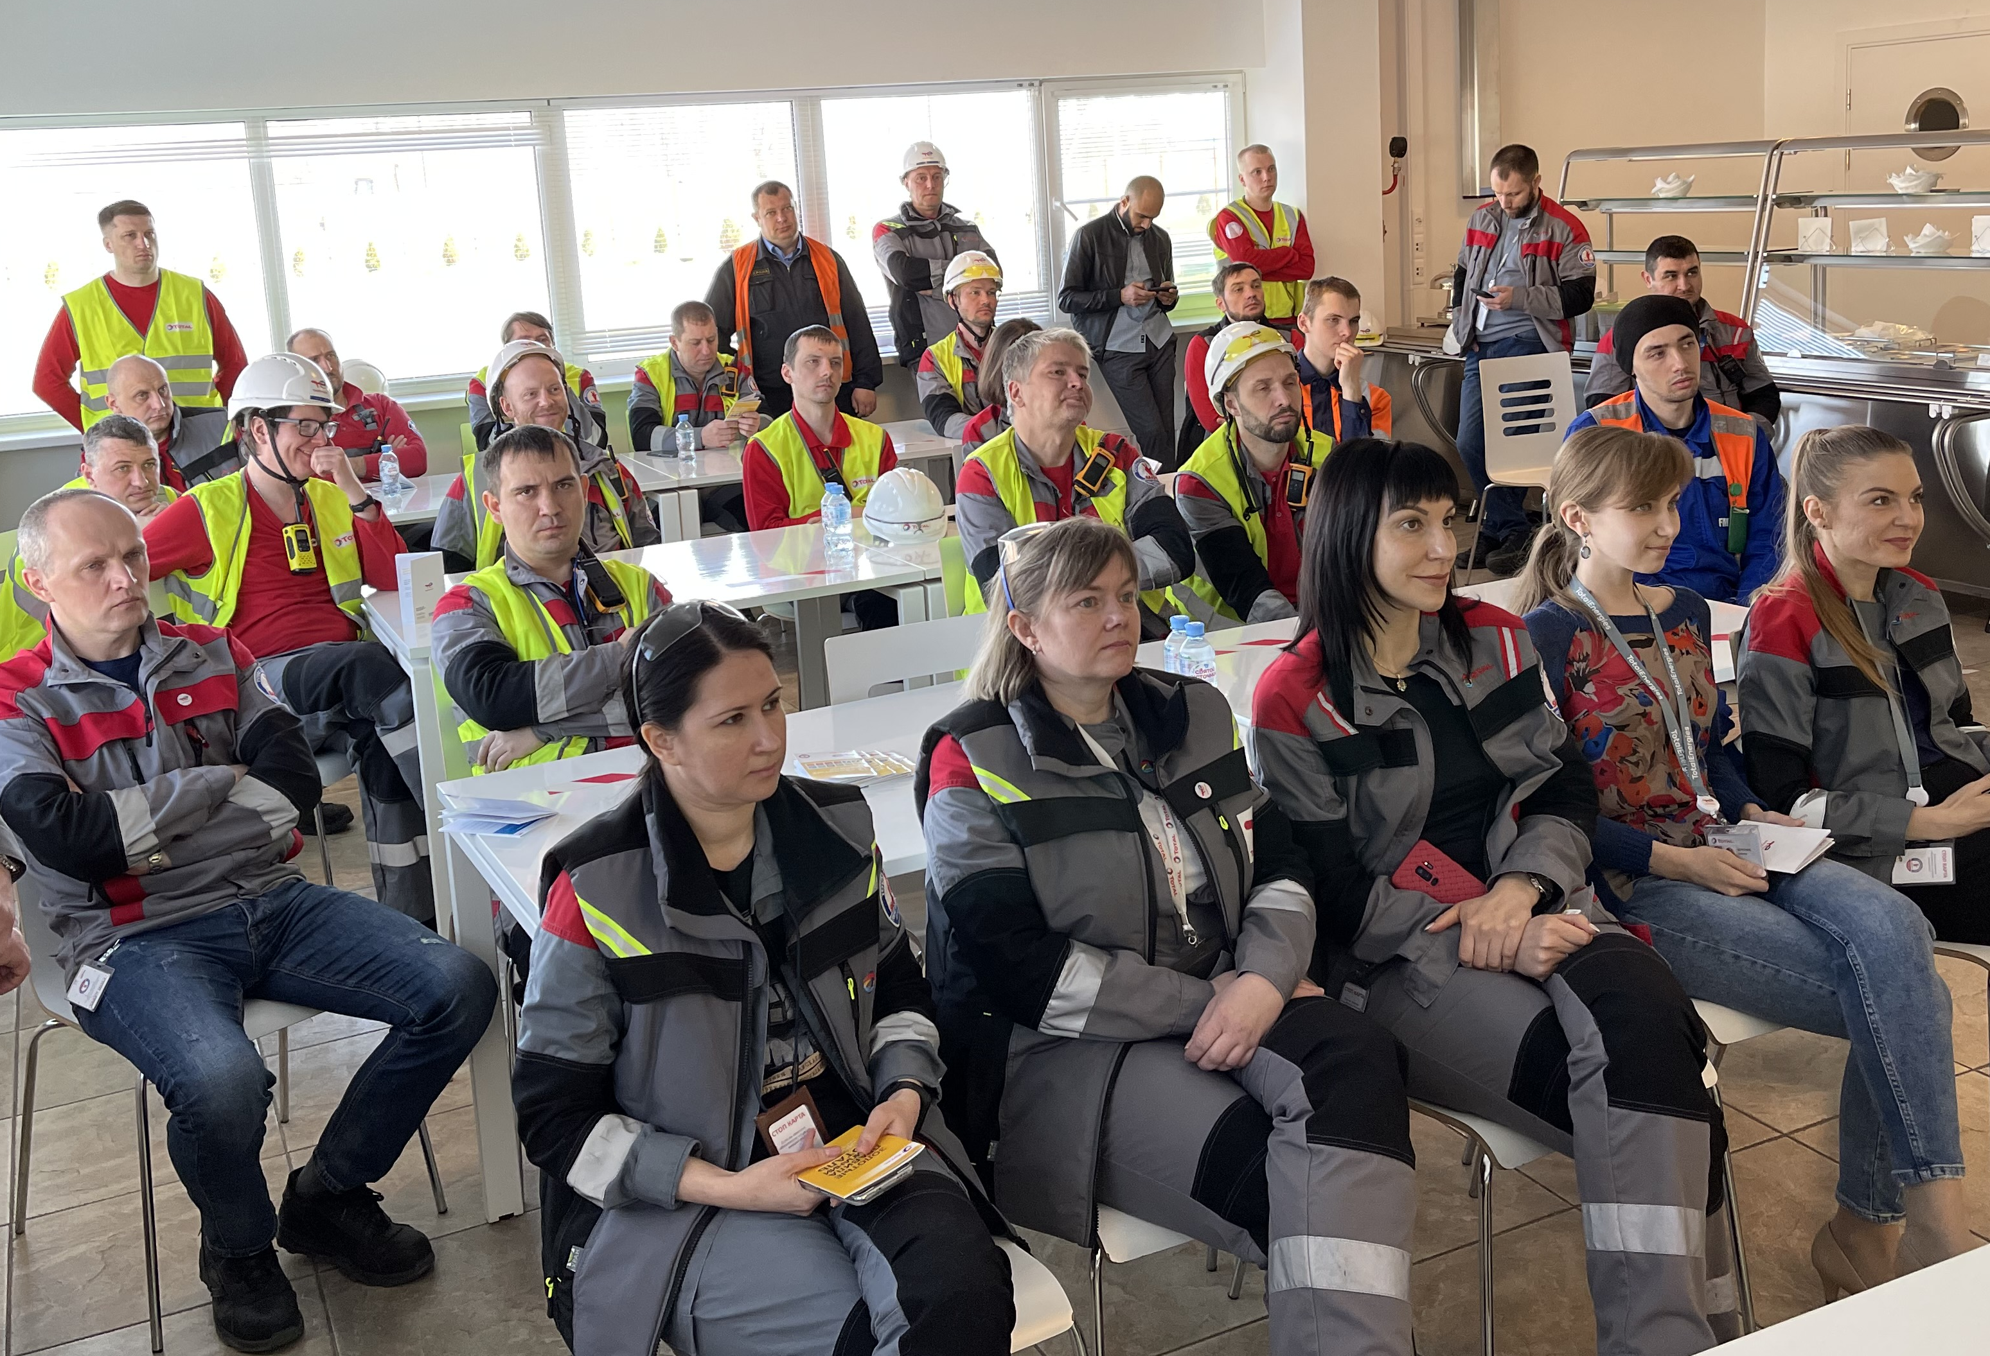
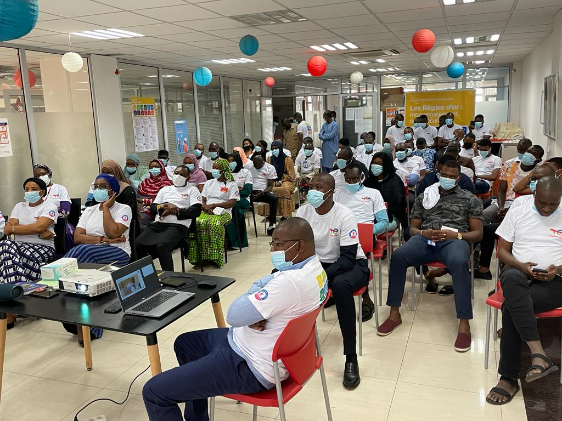
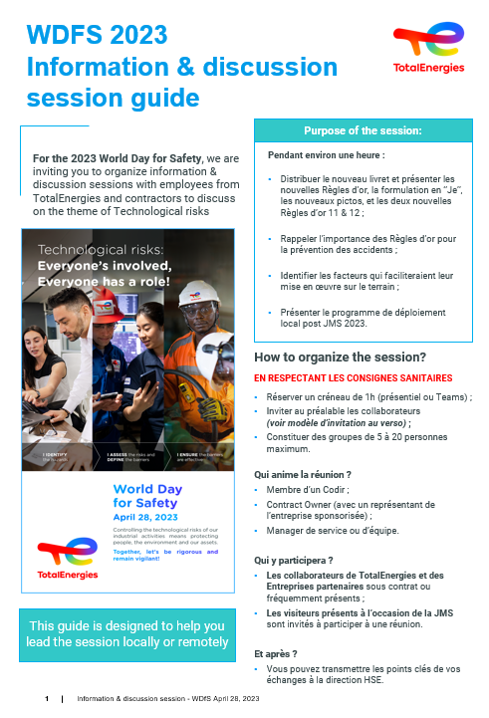
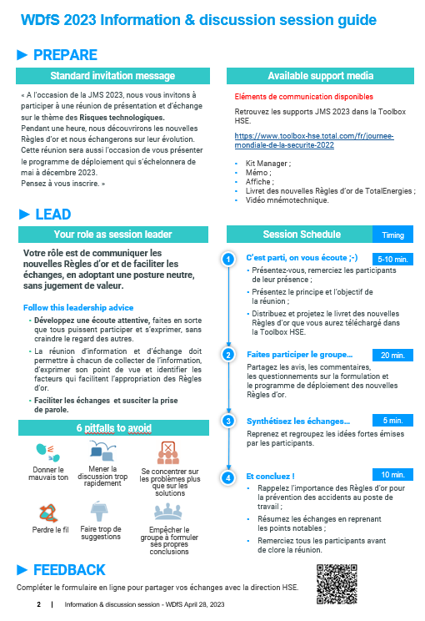
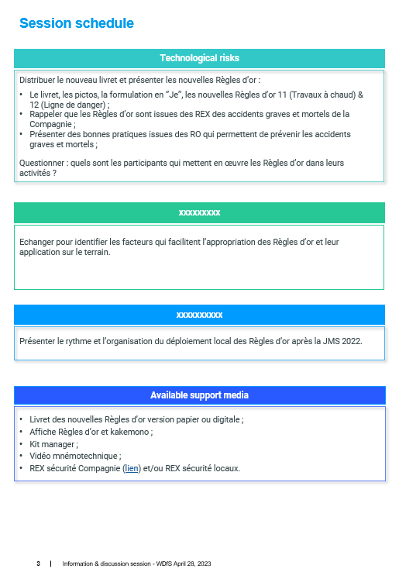
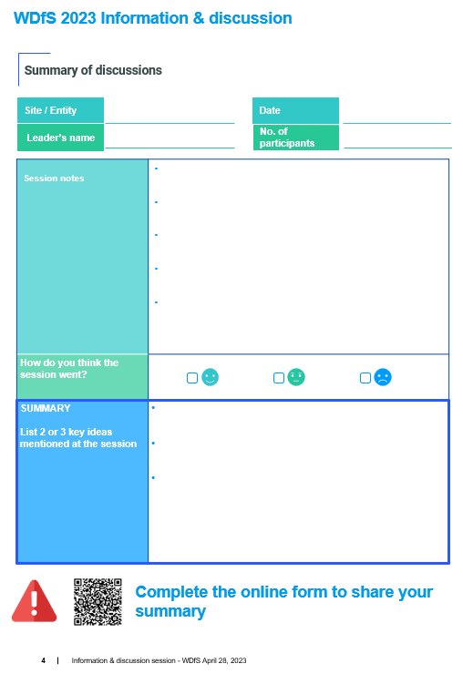
Discussion workshop
Group of people (20 - 25 maximum)
Select and present one or more illustrations of events related to technological risks
Open discussion on the identification of similar local situations, the role of each in the management of technological risks.
Guide available in the HSE Toolbox
Notes:
Nicolas

Slide 17
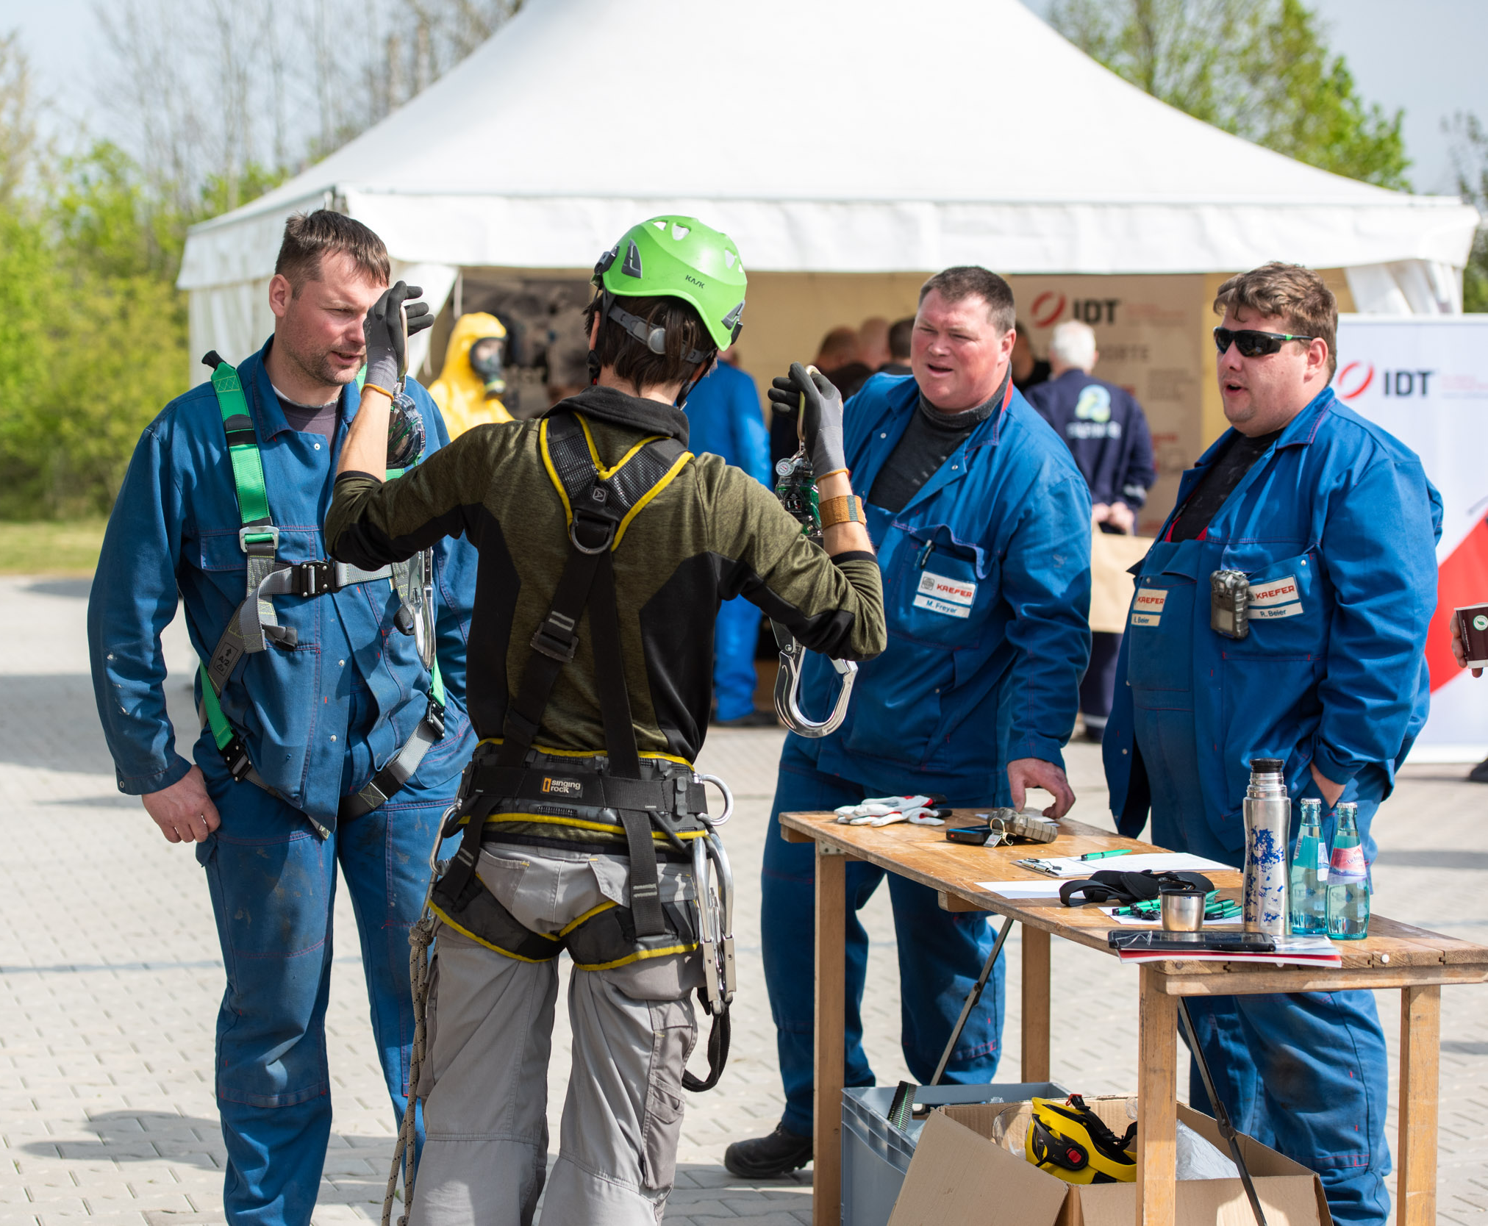
Mobilize contractors
Safety is everybody’s business, including TotalEnergies employees and personnel from contractors.
Which means it is important to involve contractors in your WDfS:
  Members of the Safety Contract Owner network.
  Under permanent contract with the site / entity.
  Working on projects that generate a large quantity of working hours.
Notes:
Nicolas

Slide 18
Thank you!
Notes:
Michiel

Slide 19
Disclaimer and copyright reservation
Definition - TotalEnergies / Company
The entities in which TotalEnergies SE directly or indirectly holds an interest are separate and independent legal entities. The terms "TotalEnergies", "TotalEnergies company" and "Company" used in this document are used to refer to TotalEnergies SE and its affiliates included in the scope of consolidation. Similarly, the terms "we", "us", "our" may also be used to refer to these entities or their employees.
It cannot be inferred from the use of these expressions that TotalEnergies SE or any of its affiliates is involved in the business or management of any other company of the TotalEnergies company.
Disclaimer
This presentation may include forward-looking statement within the meaning of the Private Securities Litigation Reform Act of 1995 with respect to the financial condition, results of operations, business, strategy and plans of TotalEnergies that are subject to risk factors and uncertainties caused by changes in, without limitation, technological development and innovation, supply sources, legal framework, market conditions, political or economic events.
TotalEnergies does not assume any obligation to update publicly any forward-looking statement, whether as a result of new information, future events or otherwise. Further information on factors which could affect the company’s financial results is provided in documents filed by TotalEnergies with the French Autorité des Marchés Financiers and the US Securities and Exchange Commission.
Accordingly, no reliance may be placed on the accuracy or correctness of any such statements.
Copyright
All rights are reserved and all material in this presentation may not be reproduced without the express written permission of TotalEnergies.

