Slide 1
The new Golden Rules
My Commitment, our Safety
Rev.0 – August 2022
Golden Rule 8
Confined Spaces

Slide 2
01.
The essentials

Slide 3
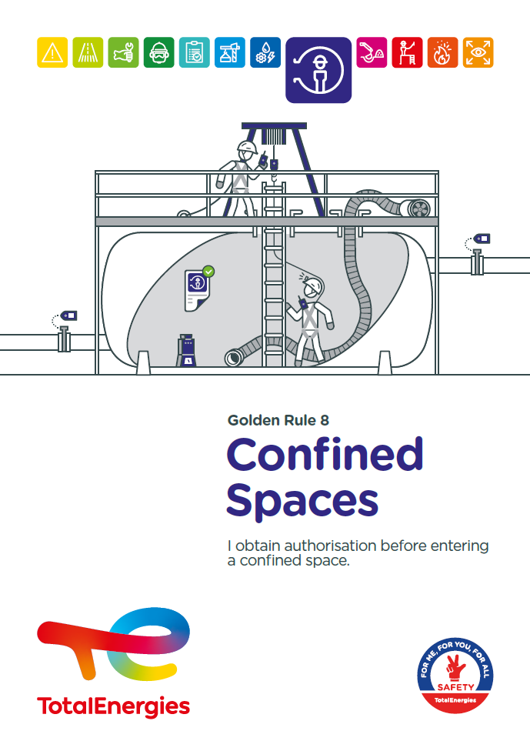
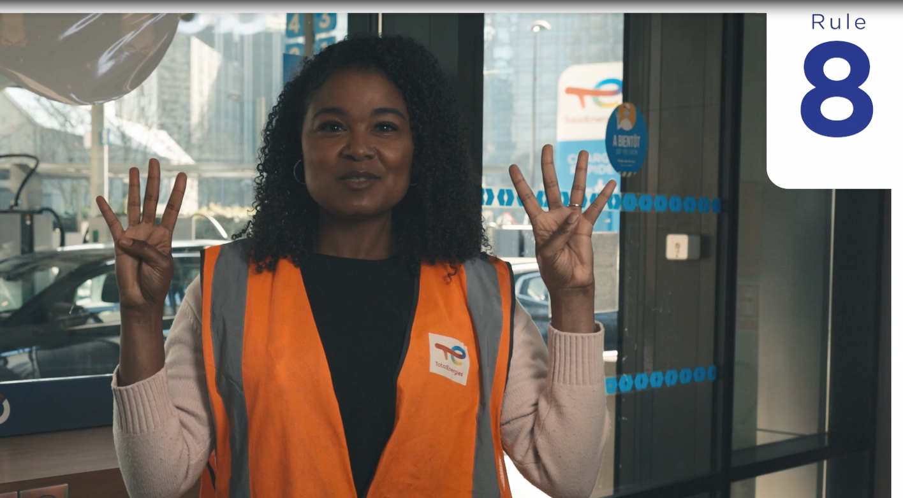
Poster & pictogram
The Golden Rule 8 pictogram « Confined Spaces » represents a person who has entered a confined space.

Slide 4
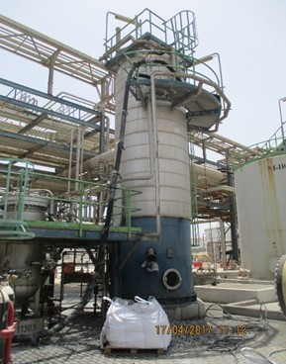
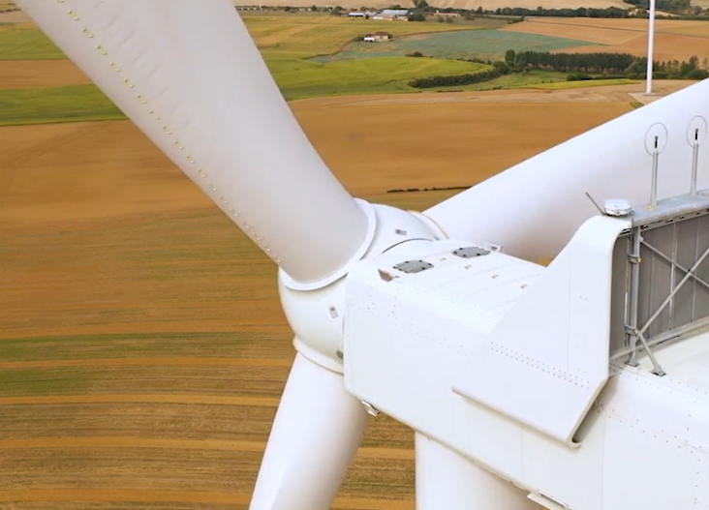
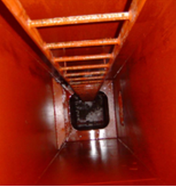
Some definitions
CONFINED SPACES
EXAMPLES OF CONFINED SPACES
A confined space is defined as a space:
completely or partially enclosed
not designed for continuous human occupancy
offering limited means for entry or exit
where there is a risk of injury or illness to entrants due to hazardous substances or conditions.
Industrial reactors
Underground tanks at service stations
Tower and nacelle of a wind turbine
Ballast tanks of ships or platforms at sea

Slide 5
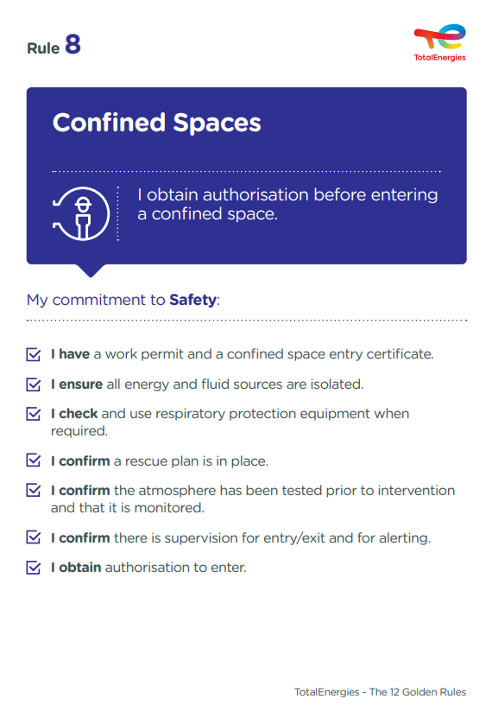
The essence of Golden Rule 8
What changes from the 2017 version of the Golden Rules:
Mention of the « confined space entry certificate »
Any operation involving entry into a confined space requires a work permit accompanied by a confined space entry certificate.
    Mention of the « autorisation to enter »
    The final validation of the confined space entry certificate is conditional on prior checks of:
      - the isolations
      - the atmospheric conditions
      - the implementation of risk control and emergency response measures.
    Mention of the use of a « breathing apparatus » when required
    This equipment is suitable for:
    - the nature of the atmosphere (inert and/or toxic gases)
    - the ambient conditions (temperature, humidity, dust…)
    - the actual time spent in the confined space.
Confined spaces are covered in CR-GR-HSE-429 « HSE Requirements for Confined Space Entry »*.
* Company Rules (CR) are limited to internal use.

Slide 6

Confined Spaces incidents
ACCIDENTS IN THE COMPANY WHERE A REQUIREMENT OF GOLDEN RULE 8 HAS BEEN BREACHED
MAIN RISKS OF CONFINED SPACES
1
Asphyxia /
Intoxication
Fire
Fatality*
1
Difficulty of access and evacuation
Explosion
Lost time accident**
5
Drowning / Burial
Heat
HIPO (High Potential)**
* Periode 2012-2021
** Periode 2017-2021
Several people have collapsed or died in confined spaces while trying to provide assistance – they were not trained and did not wear the proper equipment.
I can be confronted with these risks by being in the immediate vicinity or by partially entering a confined space!
Do not forget the risks not specific to confined spaces such as electrocution, falls…

Slide 7
02.
REX

Slide 8
Illustration of requirements
REQUIREMENT | EVENT | SLIDE
1. I have a work permit and a confined space entry certificate. | CLEANING OF A KEROSENE TANK | N°9
2. I ensure all energy and fluid sources are isolated. | INFLOW OF POTASSIUM HYDROXIDE ON A WORKER DURING WORK IN A TANK | N°10
3. I check and use respiratory protection equipment when required. | LOSS OF CONSCIOUSNESS IN A WATER TANK | N°11
4. I confirm a rescue plan is in place. | INTOXICATION BY PAINT VAPOUR IN A CONFINED SPACE | N°12
5. I confirm the atmosphere has been tested prior to intervention and that it is monitored. | LOSS OF CONSCIOUSNESS IN A MANHOLE CHAMBER OF A FUEL TANK | N°13
6. I confirm there is supervision for entry/exit and for alerting. | THE ROLE OF THE MANHOLE WATCH | N°14
7. I obtain authorisation to enter. | REPLACEMENT OF AN ACTIVATED CARBON BED | N°15
The descriptions of the circumstances and consequences have been simplified for a better understanding.
A link to each REX/Good practice is available for more information.

Slide 9

REX
1. I have a work permit and a confined space entry certificate.
> CLEANING OF A KEROSENE TANK
CIRCUMSTANCES – FACTS
  In a service station, three workers were to carry out a cleaning/degassing operation on an underground kerosene tank, 4 m deep, by pumping from outside.
  One worker descended into the tank to scoop out the residual product and lost consciousness.
  A second worker then went down into the tank to help him and also lost consciousness.
  The teamleader then went down into the tank, attached by a rope. He managed to pull up the second worker, before he too lost consciousness.
  The station's pump attendants managed to pull up the teamleader using the rope.
  The first worker was finally pulled out of the tank later by the fire brigade.
CONSEQUENCES
Death of the first worker to enter the tank.
LESSONS TO BE LEARNED
I enter a confined space after obtaining authorisation in the form of a work permit, accompanied by a validated confined space entry certificate.
CAUSES
  Lack of knowledge of confined space risks and associated rules.
  Work to be carried out did not foresee entry into a confined space: absence of work permit and confined space entry certificate.
Man hole
Interior of the tank
Click here to access the REX

Slide 10
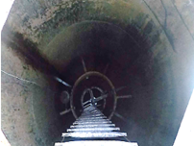
REX
2. I ensure all energy and fluid sources are isolated.
> INFLOW OF POTASSIUM HYDROXIDE ON A WORKER DURING WORK IN A TANK
CIRCUMSTANCES – FACTS
  A worker was working in a spent potash regenerator tank.
  The process circuit built up pressure and caused an influx of spent potash and lime.
  The worker, wearing appropriate chemical clothing, immediately climbed out using the rope ladder.
CONSEQUENCES
No physical consequences (HIPO).
LESSONS TO BE LEARNED
Before working in a confined space, I check that:
all energy and fluid sources have been identified
the appropriate isolation devices have been put in place
CAUSES
  Missing blind (spade) in the isolation plan.
  Valve closed, but leaking.
Click here to access the REX

Slide 11
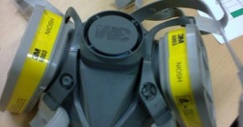
REX
3. I check and use respiratory protection equipment when required.
> LOSS OF CONSCIOUSNESS IN A WATER TANK
CIRCUMSTANCES – FACTS
  A painting operation was in progress inside a water tank.
  The worker was using a vinyl finish paint.
  After 15 minutes, he went out for a break and then returned to the tank, holding his canister filter mask in his hand.
  Screams were heard coming from the tank, which alerted his supervisor.
  The responder had fallen and lost consciousness.
CONSEQUENCES
Loss of consciousness (HIPO).
LESSONS TO BE LEARNED
If entry into a confined space requires the wearing of a respiratory protective device, I check that this equipment is suitable for :
the nature of the atmosphere in question (inert and/or toxic gases)
the ambient conditions (temperature, humidity, dust…)
the actual duration of the presence in the confined space.
CAUSES
  Partial identification of risks and prevention measures related to the handling of hazardous substances.
  Not wearing respiratory protection in the water tank.
  Use of inadequate or defective PPE: the cartridge mask is not suitable for an oxygen-deficient atmosphere.
  Lack of forced ventilation to remove paint fumes and to supply fresh air.
Click here to access the REX

Slide 12
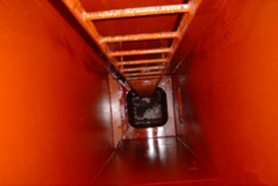
REX
4. I confirm a rescue plan is in place.
> INTOXICATION BY PAINT VAPOUR IN A CONFINED SPACE
CIRCUMSTANCES – FACTS
  Painting work was in progress in a confined space (cofferdam) on a ship.
  The two workers were wearing cartridge filter masks and did not respond to a routine radio check call.
  The safety supervisor at the entry to the confined space alerted the chief officer who then accessed the work area. Visual contact was made with them and they were instructed to evacuate the confined space.
  The first responder returned to the deck on his own.
  The other worker, disoriented, remained in the confined space and was found conscious. His evacuation took almost 3.5 hours, hampered by the difficult passage for the responders, the breathing apparatus cylinders which emptied rapidly, the difficulty in providing fresh air to the victim and the impossibility of moving the victim before he could move on his own.
CONSEQUENCES
Discomfort and dizziness (HIPO).
LESSONS TO BE LEARNED
Before entering a confined space, I check that a rescue plan has been validated. This plan defines how the evacuation of a victim is managed, from the outside or with the entry of competent first aiders, and must be tested regularly.
CAUSES
  Saturation of the confined space with toxic fumes (insufficient ventilation).
  Unsuitable PPE (use of masks with filter cartridges as a means of protection).
  Evacuation plan not adapted to each space and not tested (no procedure for emergency evacuation of spaces during interventions).
  Specific analysis of the risks linked to the painting activity inside the confined spaces not carried out.
Click here to access the REX

Slide 13
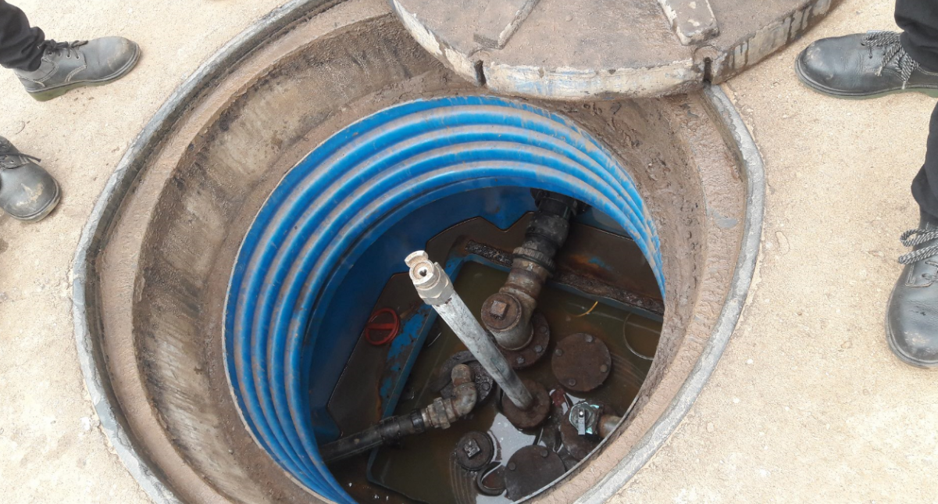
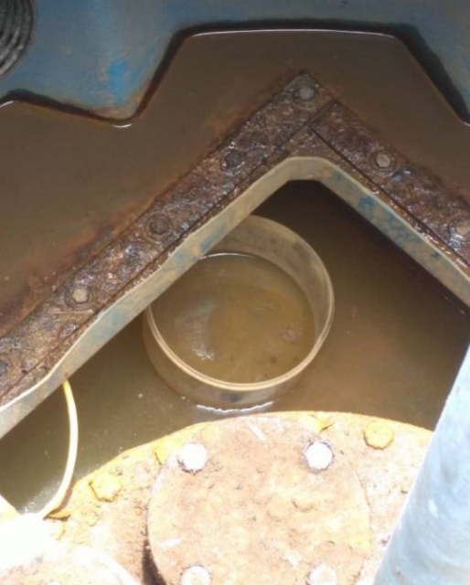
REX
5. I confirm the atmosphere has been tested prior to intervention and
that it is monitored.
> LOSS OF CONSCIOUSNESS IN A MANHOLE CHAMBER OF A FUEL TANK*
CIRCUMSTANCES – FACTS
  At a service station, a worker descended into the inspection chamber covering the manhole of a storage tank to empty rainwater that had accumulated after heavy rainfall.
  The depth of the access chamber was 1.7 m with a diameter of 1.1 m.
  His colleagues later noticed that he had lost consciousness and rushed him to the nearest hospital.
CONSEQUENCES
Momentary loss of consciousness (HIPO).
LESSONS TO BE LEARNED
I ensure that atmosphere tests are carried out on an ad hoc basis:
before the first entry into a confined space
after each significant interruption of the operation in progress, in order to authorise the resumption of entries.
I ensure that the atmosphere is monitored during any operation in a confined space.
CAUSES
  Low oxygen content (13%) and suspicion of petrol or carbon monoxide fumes.
  Lack of awareness of the dangers associated with any confined space operation.
1.7m deep
* Event outside of perimeter
Click here to access the REX
Container used for emptying the water

Slide 14
GOOD PRACTICE
6. I confirm there is supervision for entry/exit and for alerting.
> THE ROLE OF THE MANHOLE SAFETY WATCHER*
Continuous monitoring is implemented for any entry into a confined space.
It is ensured:
either by the continuous presence of a manhole safety watcher, trained and assigned to his mission, positioned immediately next to the access points, and in permanent contact with the entrants.
or by any other technical means offering an equivalent level of control, such as remote surveillance systems.
Continuous monitoring allows in particular:
To control the entry and exit of workers (access authorisation, number of workers, duration of the intervention) and used materials/tools).
To check the physical condition of the workers (breathing difficulties, dizziness, fatigue, thermal stress…) and the general safety of activities in the confined space.
If necessary, to order the evacuation of the workers or alert the emergency teams.
* This good practice is based on requirement 3.4.1 of CR-GR-HSE-429. Company Rules (CR) are limited to internal use.
Click here to access CR-GR-HSE-429

Slide 15
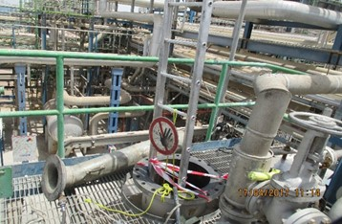
REX
7. I obtain authorisation to enter.
> REPLACEMENT OF AN ACTIVATED CARBON BED*
CIRCUMSTANCES – FACTS
  An operation to replace an activated carbon bed in a reactor was in progress. The reactor had previously been isolated, washed and degassed.
  As the carbon was about to be emptied, a maintenance technician descended into the reactor to estimate the remaining amount to be emptied. He then lost consciousness.
  The site fire brigade was quickly informed and arrived on the scene. One of the firefighters, despite the orders of his supervisor, decided to descend into the reactor without a self-contained breathing apparatus and also lost consciousness.
CONSEQUENCES
2 deaths.
LESSONS TO BE LEARNED
The confined space entry certificate alone does not authorise my physical entry into a confined space! The latter remains conditional on prior and regular checks of the actual conditions of the operation.
CAUSES
  Product sheet not known and not taken into account in the risk analysis. However, it contained information on the risk of oxygen consumption in the event of wetting of the activated carbon.
  Lack of knowledge of the risks of confined spaces and associated rules.
  Non-compliance with the confined space entry process.
* Event outside perimeter

Slide 16
03.
Further information

Slide 17
Our tools and documents
CR-GR-HSE-429 – HSE Requirements for Confined Space Entry: HSE Company Rules
Life Saving Checks – Confined Spaces: Life saving checks
Our Lives First HSE Program – Confined Spaces: Theme 4 – Confined spaces
E-learning on Confined Spaces: https://lizzy.totalenergies.com/
Toolbox HSE – new Golden Rules:
    General material: TotalEnergies Golden Rules – General material
    Roll-out material: TotalEnergies Golden Rules – Roll-out material
REX database: Company HSE REX DataBase
Safety+ (good practices per Golden Rule): https://safetyplus.totalenergies.com/en
    Some good practices:
          https://safetyplus.totalenergies.com/en/contribution/ds7h8k?p_route=wall&p_qs=rules%3D7
          https://safetyplus.totalenergies.com/en/contribution/qfq9yx?p_route=wall&p_qs=rules%3D7
          https://safetyplus.totalenergies.com/en/contribution/7lerx6?p_route=wall&p_qs=rules%3D7
          https://safetyplus.totalenergies.com/en/contribution/16zisn?p_route=wall&p_qs=rules%3D7
          https://safetyplus.totalenergies.com/en/contribution/2oq41o?p_route=wall&p_qs=rules%3D7

Slide 18
Lexicon
Hazard: An intrinsic property of a product, equipment, process, situation or action that can result in harm to people, the environment and/or assets.
Risk: The combination of the probability of occurrence of a hazardous event and the severity of the impact that may result from exposure to the hazard.
HSE events:
  Incident: Any sudden and undesirable HSE event on a given date, that causes injury or illness, damage to property or facilities, loss of production, environmental damage or damage to the Company's image.
  Near miss: Any sudden and undesirable HSE event on a given date which, in slightly different circumstances, could have had the same consequences as an incident. A near miss does not have an actual severity level but has a potential severity level.
  Anomaly: Any abnormal situation or behaviour, including deviations from a standard, specification, procedure or rule.
HIPO (High Potential) [slide 6]: Incident or near miss with an actual severity level ≤ 3* and a potential severity level ≥ 4** in one or more areas of the Company’s evaluation matrix of the actual and potential severity level of HSE events.
REX HSE: Document for sharing information on an internal or external HSE event, based on a detailed analysis and making recommendations.
* For example, physical consequences with an actual severity level = 3 correspond to a lost time accident.
** For example, physical consequences with a potential severity level of 4 correspond to a fatality.

