Slide 1

Safety moment
December 2022
Golden Rule 1
High-Risk Situations

Slide 2
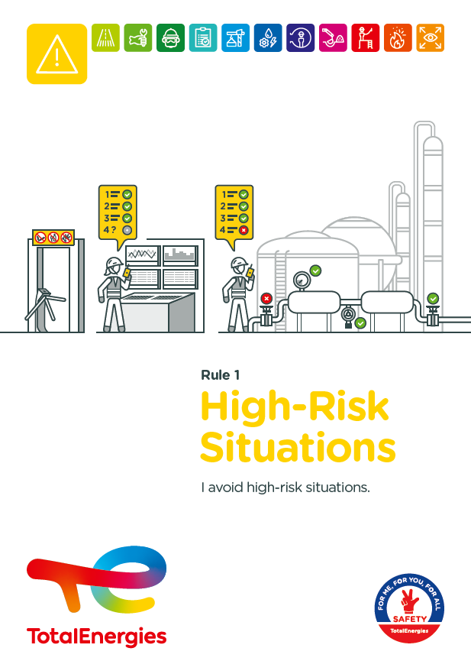
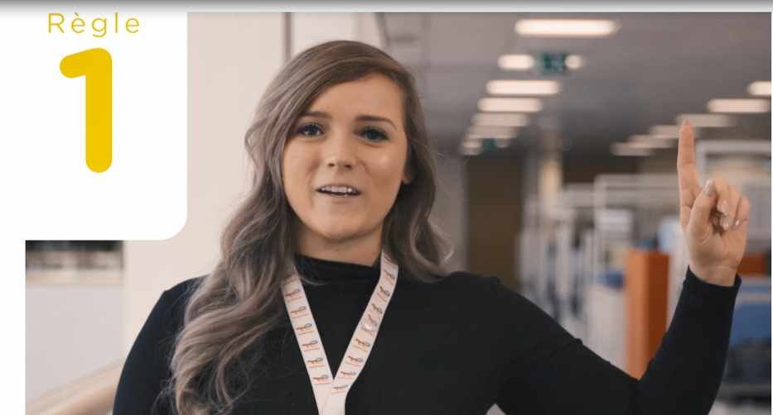

The Golden Rule High-Risk Situations
THE NEW GOLDEN RULES
Communication at the WDfS 2022
Evolution of Golden Rules 1 to 10 to strengthen personal commitment
→ Golden Rules written in "I "
2 new Golden Rules

Slide 3
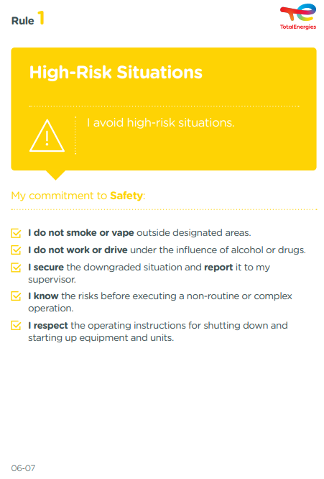
The essence of Golden Rule 1
HIGH-RISK SITUATIONS
Any situation in which one or more persons are exposed to hazards that may result in immediate or long-term damage.
PSYCHOACTIVE OR PSYCHOTROPIC SUBSTANCE
(INCLUDING ALCOHOL AND DRUGS)
A natural or synthetic product, legal or illegal, whose use alters the state of consciousness and has the potential for harmful use, abuse or addiction.
6
Fatalities (2012-2021)
In the Company, where a requirement of Golden Rule 1 has been breached
55
Events with a high severity potential (2017-2021)
On industrial sites, in the office and at home, we are all implicated!

Slide 4
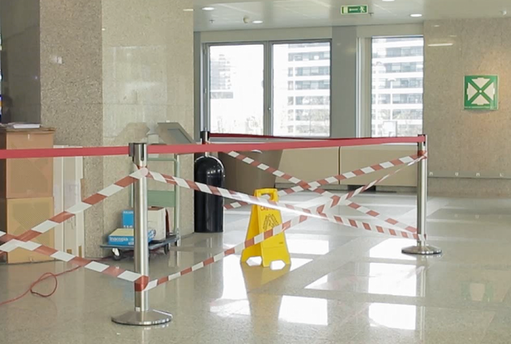

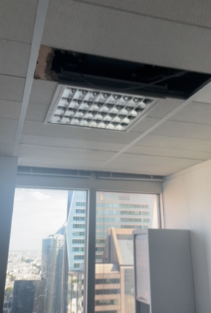

Golden Rule 1 applied to offices
  I do not smoke or vape outside designated areas.
  Psychoactive substances change my behaviour and my state of consciousness (altered perception and coordination, fatigue, etc.)
    I do not work or drive under the influence of alcohol or drugs,
    I do not consume alcohol or drugs at work,
    I comply with the internal policy of my site.
  In the event of a downgraded situation:
    I call the service responsible for the management of the building.
    If the situation is is urgent (major risk of falling, wet false ceiling, etc.), I contact the internal emergency service.

