Slide 1

Safety moment
December 2022
Golden Rule 5
Work Permits

Slide 2
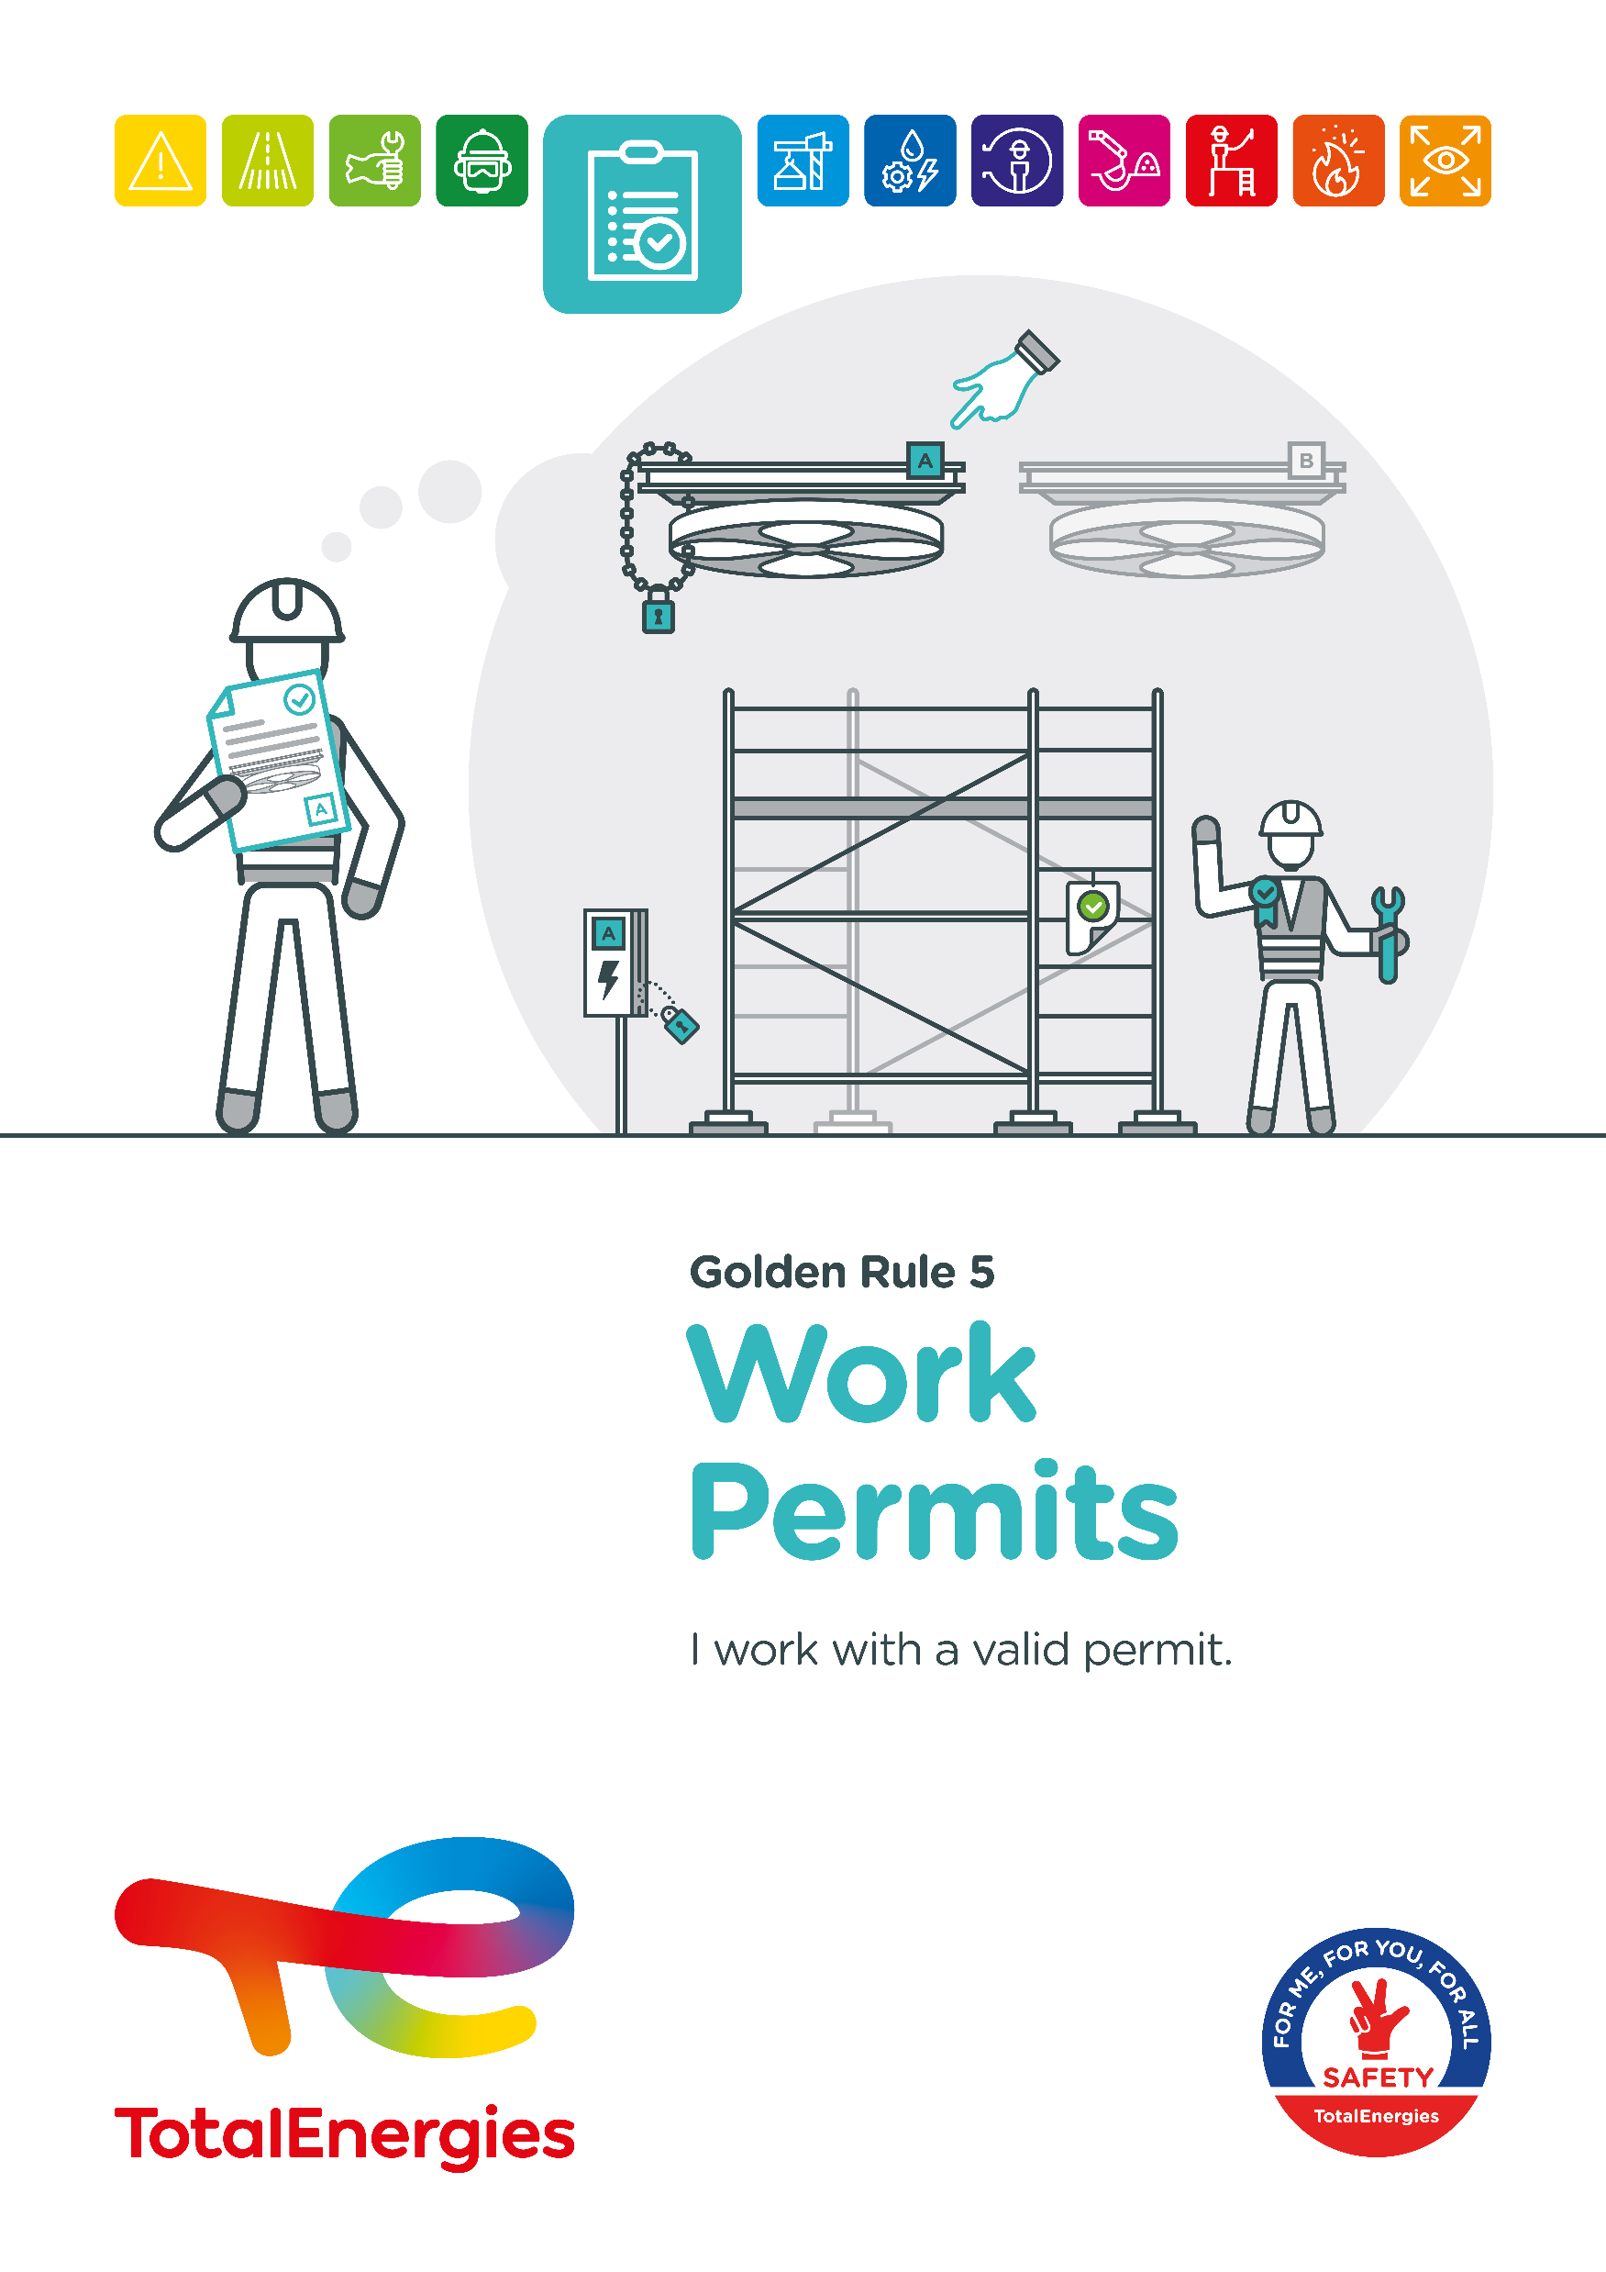



The Golden Rule Work Permits
THE NEW GOLDEN RULES
Communication at the WDfS 2022
Evolution of Golden Rules 1 to 10 to strengthen personal commitment
→ Golden Rules written in "I "
2 new Golden Rules

Slide 3
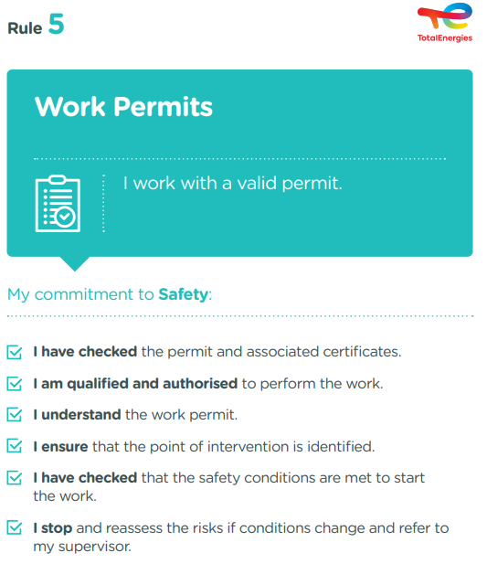
The essence of Golden Rule 5
WORK PERMIT
Its is a documented authorisation issued to carry out work and specifying the place, time and manner.
It allows to identify the risks and to implement the associated risk control measures.
2
Fatalities (2012-2021)
In the Company, where a requirement of Golden Rule 5 has been breached
10
Events with a high severity potential (2017-2021)
On industrial sites, in the office and at home, we are all implicated!

Slide 4
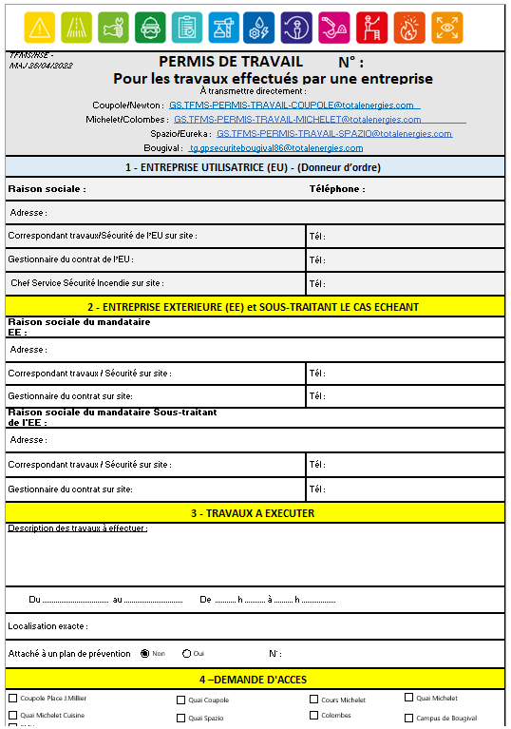
The work permit at the office
  I follow the work permit procedure of my entity.
  Here is a typical process:
  Before arriving on site :
  I anticipate the intervention of the contracted company and prepare a work permit*,
  I ask the contracted company to fill in the permit, which identifies the risks and control measures associated with its intervention,
  I send the signed document to the site's safety service if any
  On arrival on site :
  I welcome the contracted company and accompany it to the safety service if any,
  I ensure that the service is carried out correctly,
  Once the service has been completed:
  I escort the contracted company to the safety service if any and close the permit.
IN WHICH SITUATIONS ?
Some services and work carried out by a contracted company are subject to a work permit, such as:
  Event-related services (filming, etc.)
  Light bulb change,
  Moving,
  Plumbing, heating, air conditioning, etc.
I NEED TO PREPARE A WORK PERMIT, HOW TO PROCEED?
  I do not carry out small jobs myself; I call on the service responsible for managing the building.
  *Available here for PLD (in French only).

