Slide 1

The new Golden Rules
My commitment, our Safety
Rev.0 December 2022
Golden Rule 1
High-Risk Situations

Slide 2
01.
The essentials

Slide 3
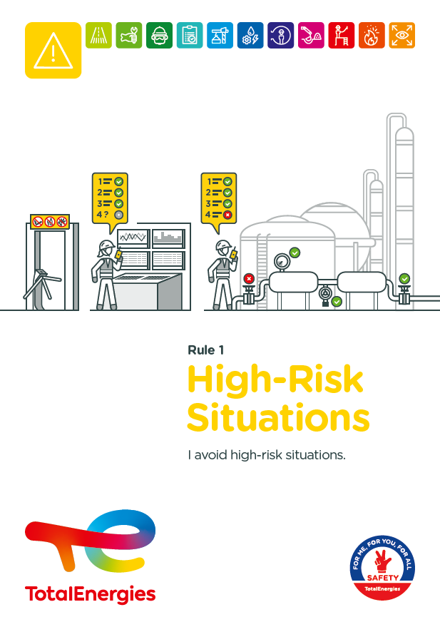

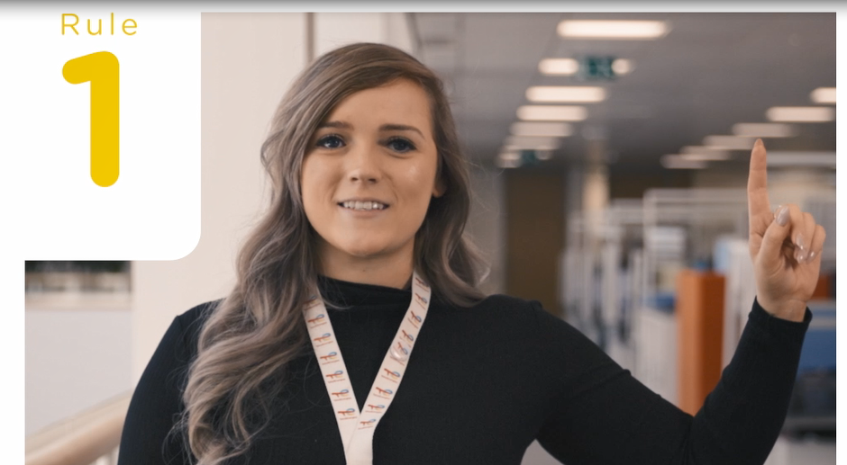
Poster & pictogram
The Golden Rule 1 pictogram "Risk situations" is symbolised by a warning sign that represents risk situations. It is essential to avoid them or, if not possible, to identify and report them.
<

Slide 4
Some definitions
PSYCHOACTIVE OR PSYCHOTROPIC SUBSTANCE
(INCLUDING ALCOHOL AND DRUGS)
HIGH-RISK SITUATIONS
Any situation in which one or more persons are exposed to hazards that may result in immediate or long-term damage.
A natural or synthetic product, legal or illegal, whose use alters the state of consciousness and has the potential for harmful use, abuse or addiction.
DOWNGRADED SITUATIONS
Situations characterised by a temporary increase in the level of risk with the potential to cause a (major) impact on people, the environment and/or property.
NON-ROUTINE OR COMPLEX OPERATIONS
Operations presenting significant HSE risks and meeting one of the following criteria:
Infrequent operations, e.g. once or twice a year or less frequently or for the first time.
Operations involving different trades and therefore requiring a particular effort in coordination and planning.
Long-term operations that may take place over several shifts or days, involving successive teams in their execution, and requiring special management of their handover.

Slide 5
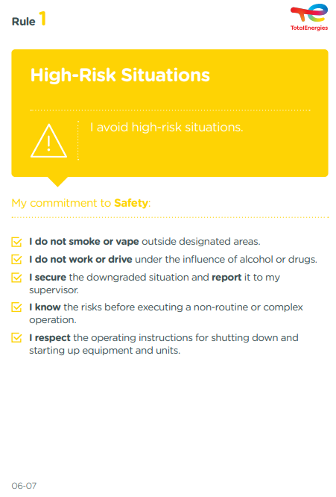
The essence of Golden Rule 1
    What changes from the 2017 version of the Golden Rules:
    Mention of vaping:
      Just like cigarettes, electronic cigarettes are a potential ignition point and should not be used outside authorised areas.
    Mention of securing douwngraded situations:
      It is necessary to immediately secure downgraded situations in an appropriate way, without putting oneself in danger, while awaiting the implementation of permanent corrective measures.
    Mention of knowing the risks before performing a non-routine or complex operation:
      It is essential that everyone involved knows the risks previously identified and associated with the operations to be carried out, especially if they are non-routine or complex.

Slide 6
High-Risk situations incidents
ACCIDENTS IN THE COMPANY WHERE A REQUIREMENT OF GOLDEN RULE 1 HAS BEEN BREACHED
MAIN RISKS IDENTIFIED
Changes in behaviour, consciousness due to alcohol or drug use
Electrocution
6
Fatalities*
Projections (fluids, objects) by pressurised systems
Traffic accident
24
Lost time accidents**
Slips, trips & falls or falling from a height
Entanglement, crushing or jamming related to equipment in operation or stored energy
55
HIPO (High Potential)**
Fire and explosion
Collision, crushing, entrapment with a moving object or equipment
* 2012-2021
** 2017-2021

Slide 7
02.
REX

Slide 8
Illustration of requirements
REQUIREMENT | EVENT | SLIDE
1. I do not smoke or vape outside the designated areas. | FIRE IN A FACTORY | N°9
2. I do not work or drive under the influence of alcohol or drugs. | HIGH-SPEED CAR ACCIDENT | N°10
3. I secure the downgraded situation. | LEAK ON A PUMP | N°11
3. I report the downgraded situation to my supervisor. | FRACTURE OF THE RIGHT FOOT AFTER IMPACT FROM A GAS CYLINDER | N°12
4. I know the risks before executing a non-routine or complex operation. | RUPTURE OF A NITROGEN CONNECTION | N°13
5. I respect the operating instructions for shutting down and starting up equipment and units. | LOSS OF GASOLINE CONTAINMENT | N°14
The descriptions of the circumstances and consequences have been simplified for a better understanding.
A link to each REX is available for more information.

Slide 9

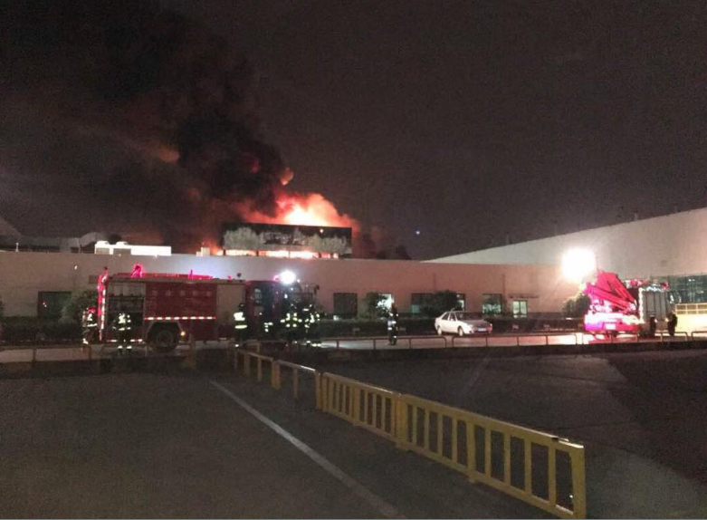
REX
1. I do not smoke or vape outside designated areas.
> FIRE IN A FACTORY
CIRCUMSTANCES – FACTS
  A fire broke out on the top floor of a building preparing mixtures.
  The fire spread to raw materials, oils, carbon black, elastomers, cardboard and packaging plastics.
CONSEQUENCES
No injuries but potential bodily consequences.
LESSONS TO BE LEARNED
Cigarettes, including electronic ones, as well as lighters and matches are potential sources of ignition.
I do not smoke or vape outside the authorised areas, as this can cause a fire or explosion.
CAUSES
  Cigarette butt left in an area where smoking is prohibited caused the fire to start

Slide 10
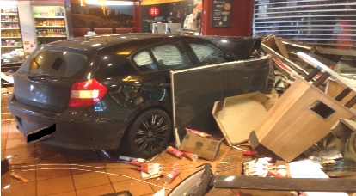
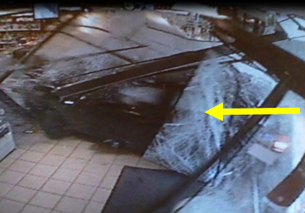
REX
2. I do not work or drive under the influence of alcohol or drugs.
> HIGH-SPEED CAR ACCIDENT
CIRCUMSTANCES – FACTS
  A motorist entered a service station while driving at 100km/h (zone limited to 30km/h).
  He crashed into the shop of the service station.
CONSEQUENCES
No injuries, but several potential fatalities
LESSONS TO BE LEARNED
Alcohol and drugs have harmful effects on their users: negative impacts on perception, coordination and fatigue.
I do not work or drive under the influence of alcohol or drugs.
The internal policy of my site state the rules on site.
CAUSES
  Excessive speed of the car when entering the service station.
  Driving under the influence of alcohol.
Click here to access the REX

Slide 11
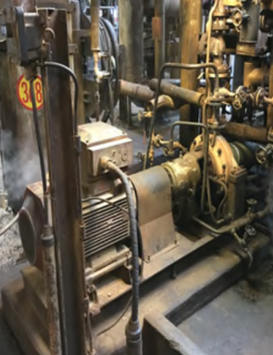
GOOD PRACTICE
3. I secure the downgraded situation.
> LEAK ON A PUMP
CIRCUMSTANCES – FACTS
  A technical problem occurred on a pump.
  After starting the standby pump, workers observed smoke in the unit.
CONSEQUENCES
No bodily consequences (HIPO).
LESSONS TO BE LEARNED
I secure the downgraded situation as far as possible and without putting myself in danger, in order to avoid an accident or a subsequent accident.
CAUSES
  Closed purge valve on a frozen slurry plug that liquefied as the line heated up.
ACTIONS
  Securing the area (installation of steam hoses, fire extinguishers and an emergency truck).
  Shutdown and isolation of the unit,
  Electrical and mechanical inspection of the emergency pump.
  Cleaning up of the area.
Click here to access the REX

Slide 12
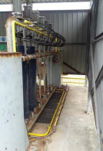
REX
3. I report the downgraded situation to my supervisor.
> FRACTURE OF THE RIGHT FOOT AFTER AN IMPACT FROM A GAS CYLINDER
CIRCUMSTANCES – FACTS
  A gas cylinder came loose and fell from a hydraulic test bench while it was being emptied.
  A worker decided to move it manually without assistance.
  It slipped out of his hands and fell on top of his right foot.
  He fractured a metatarsal of his right foot.
CONSEQUENCES
Fracture of a metatarsal of the right foot – 3 weeks off work.
LESSONS TO BE LEARNED
Reporting downgraded situations is essential so that corrective actions can be taken to avoid accidents.
I therefore report the downgraded situations to my supervisor.
I intervene if I notice a downgraded situation or a dangerous behaviour (Stop Card).
CAUSES
  Technical failure: cylinders being emptied became detached from the hydraulic test bench.
  Absence of mechanical cylinder handling device provided by the manufacturer of the hydraulic test bench.
  Moving a load of 85kg without assistance and/or without suitable tools.
  Previously known degraded situation without reporting to the hierarchy.
Click here to access the REX

Slide 13
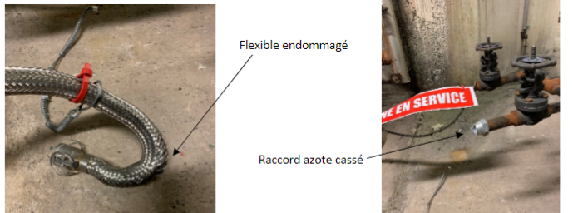
REX
4. I know the risks before executing a non-routine or complex operation.
> RUPTURE OF A NITROGEN CONNECTION
CIRCUMSTANCES – FACTS
  During a production unit shutdown, a reactor had to be kept under an inert nitrogen atmosphere at a pressure of 4 bar.
  Nitrogen racks at a pressure of 200 bar and pressure regulator were supplied and installed by a contractor.
  A feeder and hoses were supplied and installed by TotalEnergies.
  A contractor then opened the manifold and the valve on one of the two nitrogen racks.
  The injection device was then pressurised beyond the nominal pressure of the nitrogen hose (16 bar).
  A few seconds later, the hose connection on the feeder side suddenly broke, tearing off the anti-whiplash device.
  Parts of the assembly were violently projected.
CONSEQUENCES
No actual consequences but potential death (HIPO).
LESSONS TO BE LEARNED
Non-routine or complex operations should be subject to :
a risk analysis
checks on the correct implementation of the defined means in the field and their suitability
CAUSES
  TotalEnergies received the nitrogen injection system without checking that the equipment was suitable for the intended operation.
  Delivery by the service provider of a nitrogen rack with an unsuitable pressure regulator; the allowable pressure was 50 bar whereas it was mounted on a 200 bar nitrogen rack.
  Lack of verification of the suitability of the assembly
Damaged flexible hose
Broken connector
Click here to access the REX

Slide 14
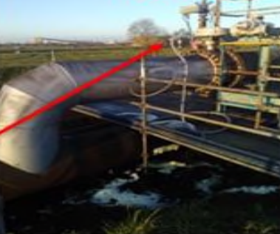
REX
5. I respect the operating instructions for shutting down and starting up
equipment and units.
> LOSS OF GASOLINE CONTAINMENT
CIRCUMSTANCES – FACTS
  The vent of a gasoline pipe had been opened to allow the replacement of a valve on the system.
  The line was then put back into service without the vent being closed.
  A worker discovered a leak (2.5 tons per hour for 8 hours).
CONSEQUENCES
No actual bodily consequences (HIPO).
LESSONS TO BE LEARNED
I respect the operating procedures for stopping and starting equipment and installations.
CAUSES
  Open vent.
  Lack of coordination.
Source
of leak
Click here to access the REX

Slide 15
02.
Further information

Slide 16
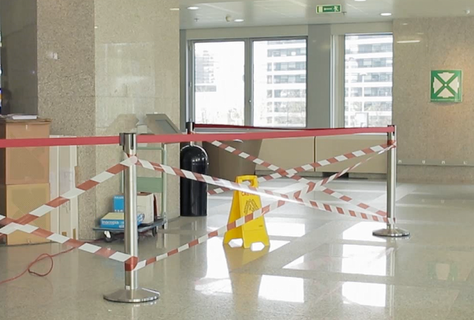

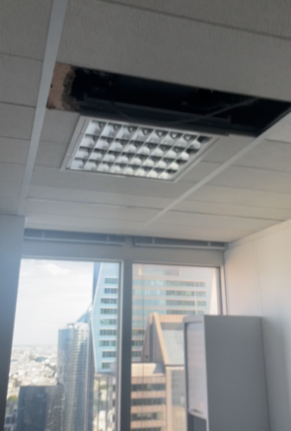
Golden Rule 1 applied to offices
  I do not smoke or vape outside designated areas.
  Psychoactive substances change my behaviour and my state of consciousness (altered perception and coordination, fatigue, etc.)
    I do not work or drive under the influence of alcohol or drugs,
    I do not consume alcohol or drugs at work,
    I comply with the internal policy of my site.
  In the event of a downgraded situation:
    I call the service responsible for the management of the building.
    If the situation is is urgent (major risk of falling, wet false ceiling, etc.), I contact the internal emergency service.
At the office, I am also implicated!

Slide 17
Our tools and documents​
HSE Toolbox (booklets and posters): https://toolbox-hse.totalenergies.com/en
REX database: https://totalworkplace.sharepoint.com/sites/GroupHSEREXDataBase/en-us/Pages/REX%20HSE%20Home.aspx
Safety+ (good practices per Golden Rule) : https://safetyplus.totalenergies.com/en
      Some good practices: https://safetyplus.totalenergies.com/fr/contribution/n3wkhd?p_route=wall&p_qs=desc%3Dalcool
          https://safetyplus.totalenergies.com/fr/contribution/60b9n9?p_route=wall&p_qs=desc%3Ddrogue
          https://safetyplus.totalenergies.com/fr/contribution/9p8lhu?p_route=wall&p_qs=rules%3D0

Slide 18
Lexicon
Hazard: An intrinsic property of a product, equipment, process, situation or action that can result in harm to people, the environment and/or assets.
Risk: The combination of the probability of occurrence of a hazardous event and the severity of the impact that may result from exposure to the hazard.
HSE events:
  Incident: Any sudden and undesirable HSE event on a given date, that causes injury or illness, damage to property or facilities, loss of production, environmental damage or damage to the Company's image.
  Near miss: Any sudden and undesirable HSE event on a given date which, in slightly different circumstances, could have had the same consequences as an incident. A near miss does not have an actual severity level but has a potential severity level.
  Anomaly: Any abnormal situation or behaviour, including deviations from a standard, specification, procedure or rule.
HIPO (High Potential) [slide 6]: Incident or near miss with an actual severity level ≤ 3* and a potential severity level ≥ 4** in one or more areas of the Company’s evaluation matrix of the actual and potential severity level of HSE events.
REX HSE: Document for sharing information on an internal or external HSE event, based on a detailed analysis and making recommendations.
* For example, physical consequences with an actual severity level = 3 correspond to a lost time accident.
** For example, physical consequences with a potential severity level of 4 correspond to a fatality.
Notes:
Définitions « risques » et « danger » (GM-GR-HSE-300 « Evaluation des risques professionnels au poste de travail »)
Définitions HIPO, Incident, presqu’accident, anomalie (CR-GR-HSE-100 « Reporting HSE »)

