Slide 1
global state of Biodiversity and our Company approach

Slide 2
AGENDA
What is Biodiversity
Why it is important
Our Biodiversity Approach

Slide 3
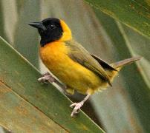
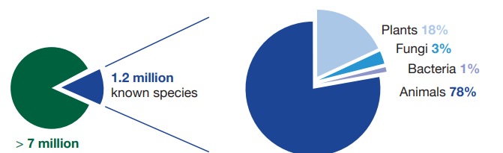
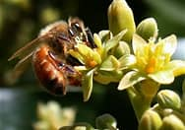
What is Biodiversity? All Life on Earth, Nature
Biodiversity and its components
There are three interdependent levels of biodiversity:
Species diversity, i.e. the number of different plant or animal species in a given community
Genetic diversity within each species
Ecosystem diversity
… And the strong interactions between the species and the ecosystems
Services & Benefits provided to People by Nature
Nature provides four broad categories of ecosystem services:
Supporting services, such as the production of oxygen and formation of soil
Provisioning services, such as the production of food and water
Regulating services, such as the, pollination, regulation of climate and the balance among species
Cultural services, including spiritual and recreational benefits
Notes:
Key messages:
When use the term Biodiversity we mean Nature essentially
Biodiversity includes species (like fauna and flora) but also means the Services and Benefits Nature provides people (for ex. POLLINATION, the air we breath, clean water supply, food like fishes and wood, but also soil fertility for growing our food

Slide 4
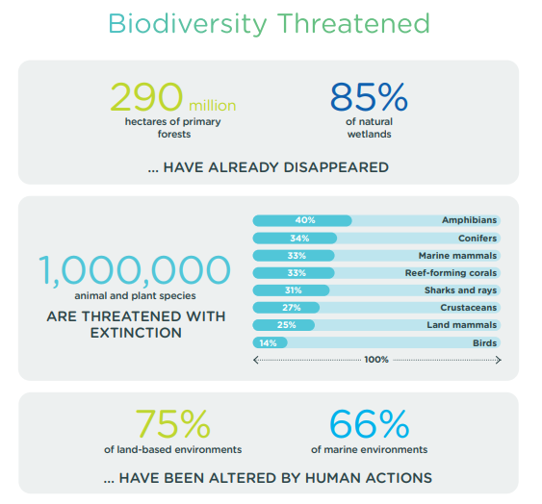
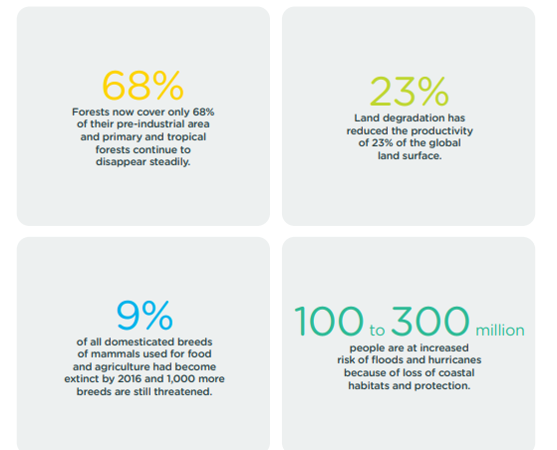
The Global Biodiversity Crisis, a direct threat to humanity
Notes:
Key messages:
IPBES is the equivalent for Biodiversity of the IPCC for Climate (GIEC in French)
Losing biodiversity will destabilize natural ecosystems on which people depend

Slide 5
TotalEnergies Recognitions
Strong stakeholder expectations from TotalEnergies
on Climate
IPBES Conclusions
Role of Business
Due to human activities, a massive global biodiversity loss is in progress, critical threshold are exceeded and a risk of loss of key ecosystem services all essential for humanity.
The Biodiversity Crisis is an immediate term issue largely due to land use changes pressures but also resources over-exploitation and Climate Change.
Even though biodiversity issues have an important local aspect, stake-holders also link them to climate change. Both are key components of the UN Global Biodiversity Framework’s (COP15) scope.
Growing expectations and opportunities for Business to play a role for Biodiversity, limiting its negative residual impacts and seeking positive outcomes, including climate related opportunities.
Notes:
Key messages:
TTE recognizes the IPBES conclusions as these are science based hard facts
The Biodiversity crisis is both a LOCAL and GLOBAL issue and both have to be managed accordingly; the impact of climate change on biodiversity exists and is massive issue; TTE manages both: Climate via its Climate Ambition and Biodiversity via its Biodiversity Ambition and HSE Environmental policy/rules
There are both biodiversity risks (noncompliance, poor image, loss of access to project finance) and opportunities (better image, license to operate, access to lender /partner finance, competitive edge)

Slide 6
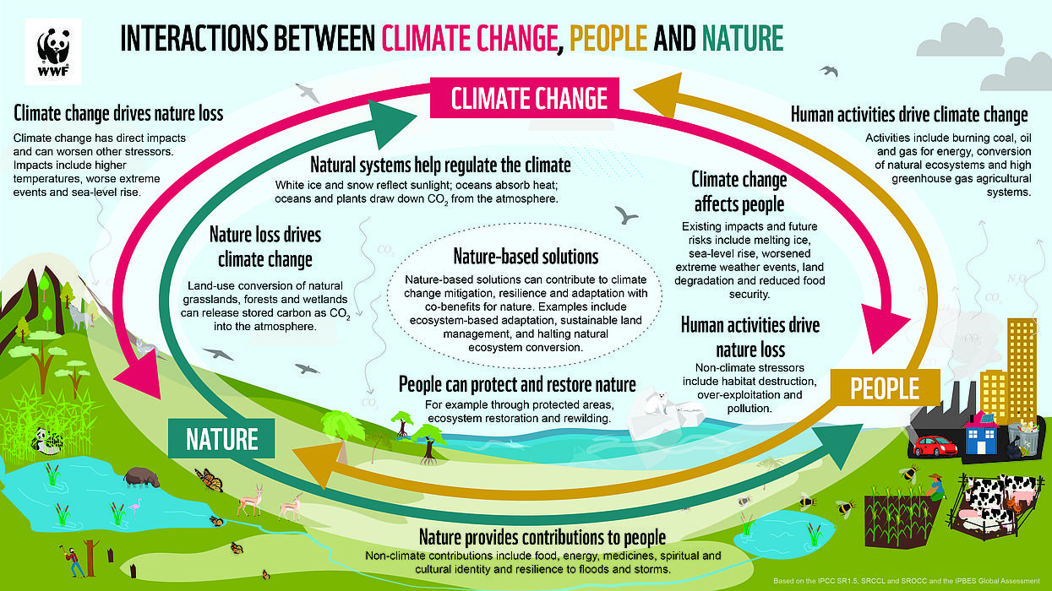
TotalEnergies Recognitions: link between the Climat & Biodiversity Crises
The Climate and Biodiversity global crises are linked
Neither can be solved in isolation
Climate change is the 3rd main cause for global biodiversity loss (IPBES fact), e.g. ocean warming and acidification, stressing forests…
Healthy ecosystems will play their full role in the global carbon cycle, e.g. as natural carbon sinks (NCS)

Slide 7
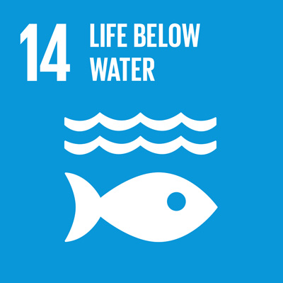
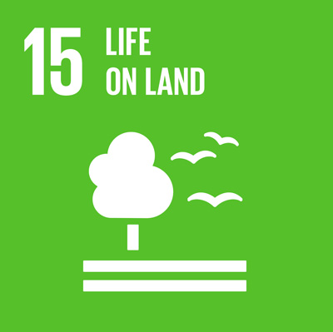
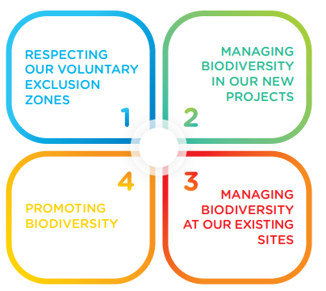
Our Biodiversity Journey
1992
Creation of
2004
WCMC Proteus Partnership
2005
Biodiversity
Policy
2007
Practical Guide to Biodiversity
2016 Response to the SDG Advocates letter and commitment to the SDG
2012, 2013
No go commitments
World Heritage Arctic sea ice
2008
Iconic biodiversity projects
July 2018
voluntary commitments
Engagement with CBD on UN Global Biodiversity Framework (GBF)
June 2018
CBD COP14
2019
2020 Update of
Biodiversity
Ambition with full EXCOM support

Slide 8
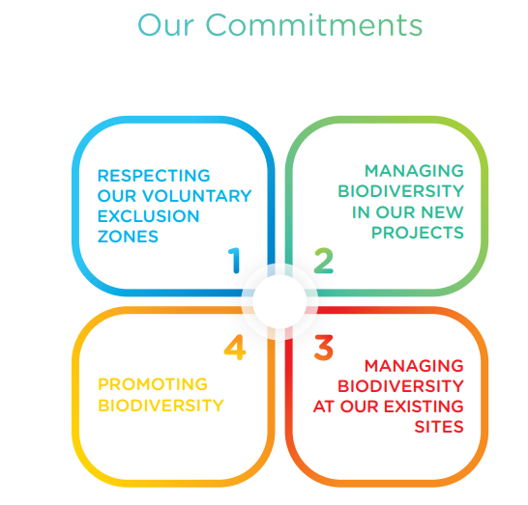
Our Biodiversity Ambition: 4 axes

Slide 9
Our Biodiversity Ambition: 4 axes
What this means:
No GO of E&P activities in UNESCO World Heritage site protected areas, which are internationally protected for their universally recognized biodiversity
No GO of E&P oil exploration in arctic sea ice area which are ecologically highly sensitive.
Results:
We have honored (0 non-compliance) these commitments with since they were taken in 2013 and 2012 respectively and reported publicly this results
TTE is on only broad energy company with the arctic commitment
We produce a yearly UNESCO & Sea Ice Atlas to assist branches project teams for ensuring prospects meet commitments

Slide 10
Our Biodiversity Ambition: 4 axes
What this means:
Develop a Biodiversity Action Plan (BAP) for all projects (EP, GRP, MS, RC) located in IUCN* categories I to IV or Ramsar protected areas.
BAP in IUCN I& II and Ramsar must generate a Net Gain of Biodiversity (= Net Positive Impact), verified by third party
Results:
We currently have 8 BAPs :
EP Tlenga, Uganda (IUCN II, Ramsar & IFC)
EP EACOP, Uganda & Tanzania (IUCN III & IFC)
EP Djeno Terminal, Congo (Ramsar)
EP Tempa Rossa, Italy (IUNC II)
EP, Diyab, UAE (IUCN IV)
EP, Mozambique LNG (IFC)
EP, Papua LNG (IFC)
GRP, La Perrière, Réunion Isl. France (near IUC II and in IUCN V)
*IUCN: International Union for the Conservation of Nature
Notes:
UNESCO, IUCN and Ramsar protected areas are all LEGALLY protected, while other important areas of biodiversity such as KBA (Key Biodiversity Areas) are not legally protected but their importance of biodiversity is internationally recognised.
Ramsar and UNESCO protected are protected under international Conventions (e.g. Ramsar Convention on internationally important Wetlands)
IUCN areas are legally protected areas under national protection statuses.

Slide 11
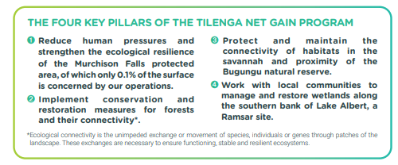
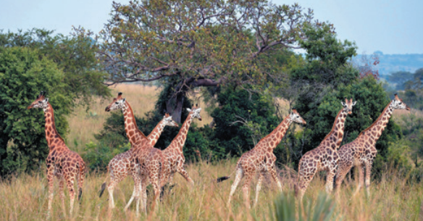
Our Biodiversity Ambition: Project BAPs

Slide 12
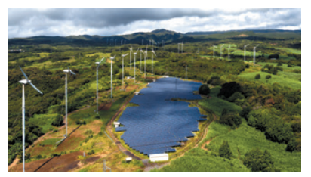
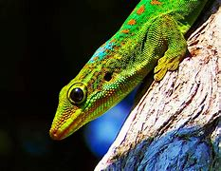
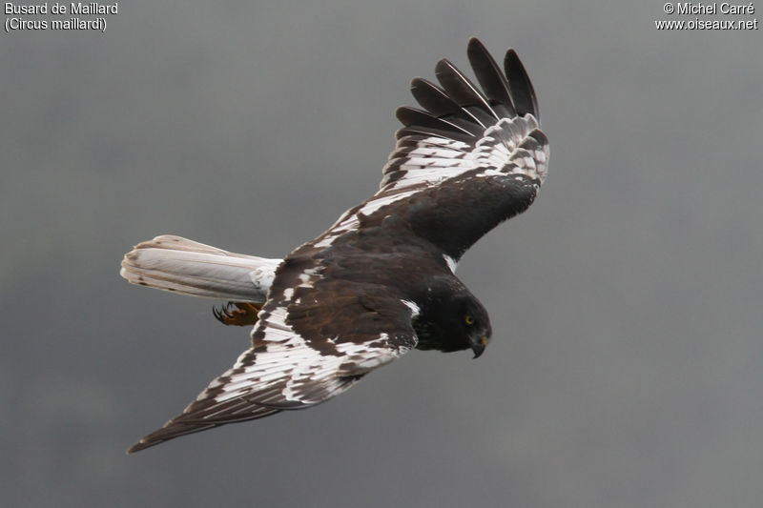
Our Biodiversity Ambition: Project BAPs
Notes:
This plan is required given the context of the installation of a new wind farm in the northwestern part of Réunion Island.
This region is home to mid altitude wetlands, remarkable plant species and several endangered species of animals: including the Bourbon green gecko, a reptile that is native to Réunion Island and the Réunion harrier, both listed as endangered by the IUCN.
The biodiversity action plan seeks to protect these species with specific measures such as the relocation of geckos to specific sanctuaries. An environmental monitoring program for birds and bats will also be conducted during the first two years of the operations in order to adjust the measures if necessary.

Slide 13
Our Biodiversity Ambition: 4 axes
What this means:
Conduct a biodiversity survey at all Environmentally Significant sites and determine need for a BAP (all operated exploration-production sites in production, refineries, petrochemical and polymer sites, gas-fired power plants) by 2025
Voluntary biodiversity approach by M&S
Assess the opportunity of setting biodiversity targets on closed sites or undergoing closure
Results, 2021:
5 biodiversity surveys :, EP Congo offshore, GRP Pont sur Sambre & Bayet (France) CCGT, + RC Grandpuits & (France), (France) refineries
RETIA has identified approx. 14 candidates closed sites for biodiversity restauration objectives
M&S has developed a Biodiversity Road map for its petrol stations

Slide 14
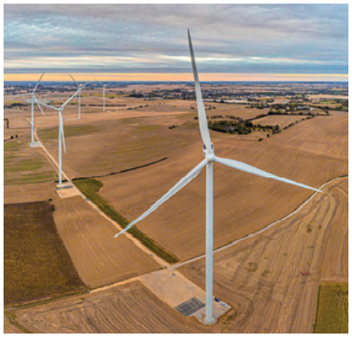
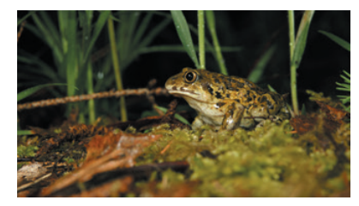
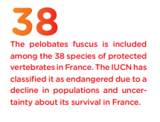
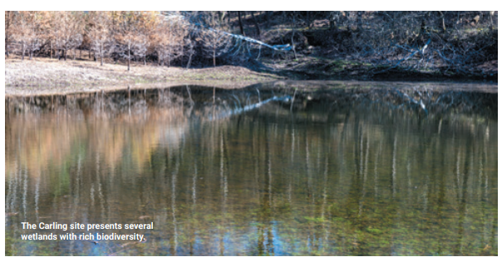
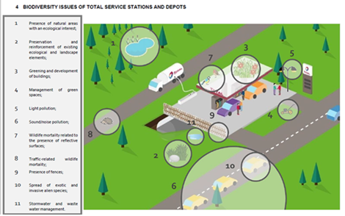
Our Biodiversity Ambition: Biodiversity management at existing sites and closed sites
Biodiversity Road Map
& Biodiversity Guide for 15 000 petrol stations and dépot
Creation of wetland for protected amphibien

Slide 15
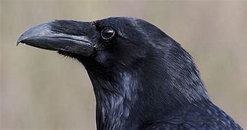
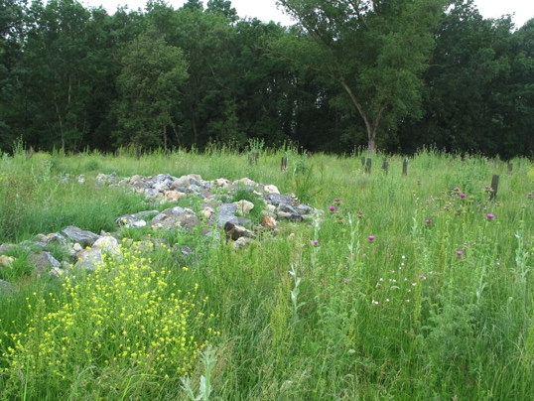
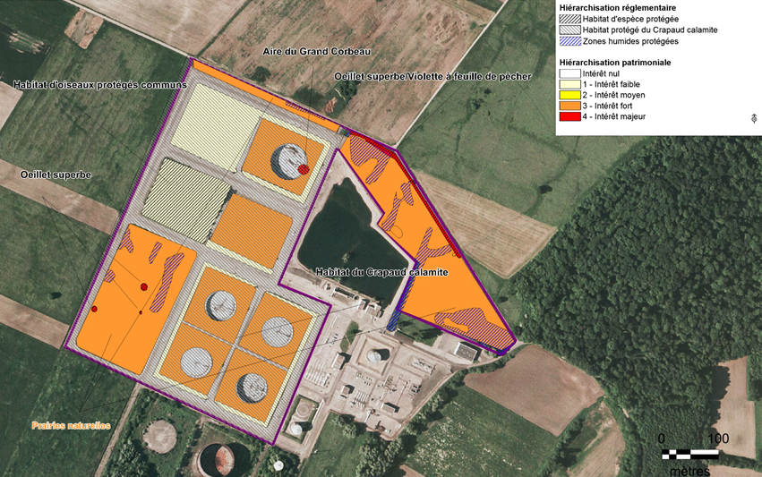
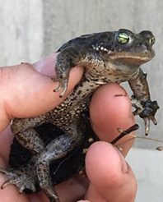
Our Biodiversity Ambition: Biodiversity management at existing sites and closed sites
Oberhoffen-sur Moder (France),
former oil depot:
Raven (protected species) nest relocated from tank of roof
Creation of wetland for protected amphibian
Grande Paroisse à Toulouse, France (Berrges sur Garonne): reptile habitat creation
Notes:
Oberhoffen-surModer (France):
Measures were implemented for the conservation of protected species such as the natterjack toad and the great raven and meadow flora, in connection with the rehabilitation of the former oil depot Oberhoffen-surModer (France). A partnership was signed with the French bird protection league (Ligue de protection des oiseaux - LPO) and the Ecolor engineering firm to establish daytime and wintering shelters and reproduction ponds to install certain species

Slide 16
Our Biodiversity Ambition: 4 axes
What this means:
TotalEnergies Foundation’s support to climate, marine and coastal conservation & research projects
The Action! employee involvement in biodiversity projects
The sharing of our biodiversity data with the scientific community
The TotalEnergies dedicated R&D Biodiversity programme’s actions
Staff Dedicated Biodiversity Training modules (LIZZY, TotalLearning Solutions) for non HSE & HSE staff
Contributions to the broader community : industry biodiversity community of practice
Site & Affiliate CSR activities

Slide 17
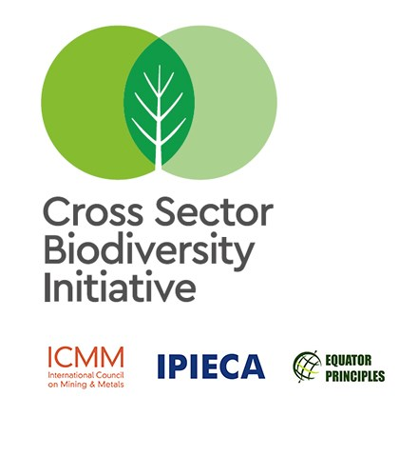
Our Biodiversity Ambition: Promoting Biodiversity
Results, 2021:
TTE Foundation : 6 main support projects
Action ! : 1200 initiatives internationally (in France) in support of biodiversity (PLantNet & Spipoll citizen science,…)
Data Shared on the Global Biodiversity Information Facility platform: 3815 species data records, 4769 data downloads, 16 citations in scientific publications)
R&D: several programmes including environmental-DNA for monitoring, ecological connectivity modelling tools, Mitigation Hierarchy & Nature Based Solution decision making support tools to sites and projects
Complete 4 modules Lizzy Biodiversity Training programme
Participation in many industry associations and community of practices: IPBES, UN-CBD, TNFD, IPIECA, CSBI, AFNOR…
Notes:
BioLit, un programme de sciences participatives pour prendre le pouls du littoral; Porté par l’association Planète Mer, le projet Biolit cherche à faire de chacun d’entre nous un observateur avisé de la biodiversité présente sur les 5 800 km du littoral français métropolitain, 18 000 avec l’outre-mer. L’objectif : transmettre autant de données que possible aux scientifiques afin de mieux comprendre et protéger ces écosystèmes
Protéger les écosystèmes forestiers sur le littoral; Depuis 2018, la Fondation d’entreprise compte parmi les plus grands mécènes de l’ONF et soutient ses actions de restauration et de sensibilisation à la protection de la forêt française. Dans le cadre de la réorientation de son axe d’engagement Climat, Littoraux et Océans, la Fondation a rejoint fin 2020 le fonds Agir pour la forêt.
L’approche multiple de la Tour du Valat pour préserver les zones humides méditerranéennes; En Camargue, le domaine de La Tour du Valat s’étend sur 2 700 ha. Sur ce site naturel privilégié, une fondation reconnue d’utilité publique, institut de recherche, œuvre depuis les années 70 pour la préservation des zones humides méditerranéennes et de leur biodiversité. La Fondation d’entreprise, dans le cadre du programme TotalEnergies Foundation, accompagne ses actions.
L’expédition Antarctique 2.0°C : une étude interdisciplinaire du changement climatique et de l’empreinte humaine sur l’environnement. À la rentrée prochaine, 6 étudiants-chercheurs embarqueront pour une expédition de 6 mois jusqu’en Antarctique. L’objectif est triple : scientifique, pédagogique et de sensibilisation à la démarche scientifique. La fondation d'entreprise, dans le cadre du programme TotalEnergies Foundation, est l’un des premiers partenaires privés à soutenir en mécénat ce projet audacieux.
La Fondation, dans le cadre du programme TotalEnergies Foundation, renouvelle sa contribution au Fonds Nature 2050. Dans ce cadre, elle soutient le Fonds Nature 2050 depuis sa création en 2019. Le Fonds Nature 2050 réunit les contributeurs mécènes, qui souhaitent participer financièrement au programme Nature 2050 et aux projets soutenus dans ce cadre. En 2019 et 2020, la Fondation a ainsi permis l’émergence de nouveaux projets et contribué à l’adaptation au changement climatique et la restauration de la biodiversité sur 8 ha en France, grâce à ce soutien. Une nouvelle convention vient d’être signée, afin de poursuivre cet engagement en 2021 et 2022. Ce programme d’actions national à long terme vise à appliquer concrètement les recommandations de l’Accord de Paris sur le climat (COP21).Un partenariat reconduit pour deux années supplémentaires.
Parc national de Port-Cros : faire connaitre la biodiversité et mieux la protéger. Dans le cadre de l’axe Climat, littoraux et océans du programme de solidarité TotalEnergies Foundation, la Fondation signe une nouvelle convention avec le Parc national de Port-Cros. Sa priorité : la sensibilisation des jeunes et du grand public à la préservation de cet écosystème unique

Slide 18
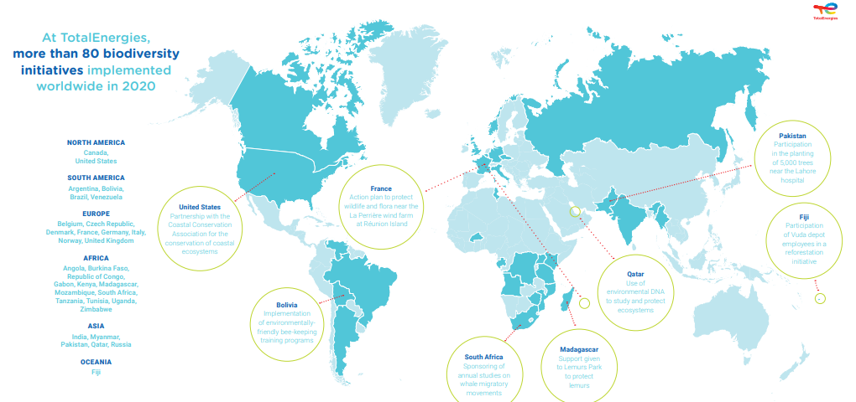
Our Biodiversity Ambition: Over 80 CSR voluntary initiatives promoting biodiversity

Slide 19
Update of 2020 Biodiversity Ambition
The Biodiversity Crises is increasing the performance expectation of Business : TTE needs to adapt its Ambition accordingly to ensure meet our stakeholder expectation and use the opportunities of a leadership position:
2 additional axes that could be developed which offer significant opportunities to the Company:
Contribute to the UN CBD COP15’s 30% terrestrial & marine areas protection target: this target is for states and not business per se , however this is an opportunity for TTE to make contributions with its net gain/ offsets/biodiversity positive project actions
Contribute to the UN CBD COP15’s 20% terrestrial, wetlands & marine areas restoration target : contribute to the collective restoration effort of lost biodiversity values - creation of a restoration fund, with other partners, based on the OGCI model and with IUCN scientific management/guarantee
Next steps?

Slide 20
Thank you.

Slide 21
Annexes

Slide 22
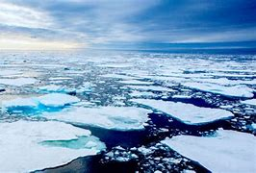
Our Voluntary Exclusion Zones
WHAT
We commit, in recognition of the universal value of UNESCO World Natural Heritage sites, not to conduct oil or gas exploration or extraction operations in these areas.
We commit not to conduct any oil field exploration operations in Arctic sea ice areas.
We commit to publicly report on the implementation of these commitments.
HOW
By annually publishing a map of our licenses in the Arctic sea ice areas, on total.com
By annually updating an internal atlas of UNESCO World Natural Heritage Sites, based on UNESCO public data and comparing the list of new sites to that of our operations.
As of December 31, 2019, none of our oil or gas exploration or extraction operations are located in UNESCO World Natural Heritage Sites.
Notes:
Si la plupart d’entre vous ont déjà une petite idée de ce qu’est la Responsabilité Sociétale des Entreprises, il est important de dire que beaucoup d’idées reçues circulent à ce sujet.
- La RSE, ce n’est pas du greenwashing. Les entreprises ont décidé de s’engager, pas parce qu’elles ont quelque chose à se reprocher, ou pour noyer le poisson, mais parce qu’elles croient que les entreprises font partie de la solution aux problèmes que notre monde rencontre. Ca ne sert pas non plus à compenser des manquements de la part de l'entreprise ou encore des activités jugées non vertueuses par l'opinion publique.
- La RSE n'équivaut pas à se donner bonne conscience. La RSE n’implique pas que des grands discours et des éléments de langage, elle implique aussi et surtout des mesures concrètes et un plan d’action pour passer des paroles aux actes.
- Ce n’est pas seulement du mécénat. Oui, le mécénat fait partie de la RSE, mais il serait faux de réduire cette dernière à cela. Par son action quotidienne, dans la transformation de ses process internes, par la sensibilisation de ses collaborateurs, l’entreprise peut avoir son rôle à jouer pour avoir un impact positif sur la société.

Slide 23
Biodiversity at our Projects
WHAT
We commit to developing biodiversity action plans for each new project on sites located on an area of interest for biodiversity, that is IUCN (International Union for the Conservation of Nature) Protected Area Categories I to IV and Ramsar areas. The action plan shall be in place, at the latest, at the time of commissioning of the site.
We commit to producing a net gain on biodiversity, confirmed by a third-party institution, for each new project on sites located in an area of priority interest for biodiversity, that is IUCN (International Union for the Conservation of Nature) Protected Area Categories I to II and Ramsar areas.
HOW
By annually publishing the number of biodiversity action plans in place or under preparation and reporting on implementation.
By annually reporting on the implementation of our net gain plans.
By publishing third party statement of net biodiversity gain for these projects.
Notes:
Si la plupart d’entre vous ont déjà une petite idée de ce qu’est la Responsabilité Sociétale des Entreprises, il est important de dire que beaucoup d’idées reçues circulent à ce sujet.
- La RSE, ce n’est pas du greenwashing. Les entreprises ont décidé de s’engager, pas parce qu’elles ont quelque chose à se reprocher, ou pour noyer le poisson, mais parce qu’elles croient que les entreprises font partie de la solution aux problèmes que notre monde rencontre. Ca ne sert pas non plus à compenser des manquements de la part de l'entreprise ou encore des activités jugées non vertueuses par l'opinion publique.
- La RSE n'équivaut pas à se donner bonne conscience. La RSE n’implique pas que des grands discours et des éléments de langage, elle implique aussi et surtout des mesures concrètes et un plan d’action pour passer des paroles aux actes.
- Ce n’est pas seulement du mécénat. Oui, le mécénat fait partie de la RSE, mais il serait faux de réduire cette dernière à cela. Par son action quotidienne, dans la transformation de ses process internes, par la sensibilisation de ses collaborateurs, l’entreprise peut avoir son rôle à jouer pour avoir un impact positif sur la société.

Slide 24
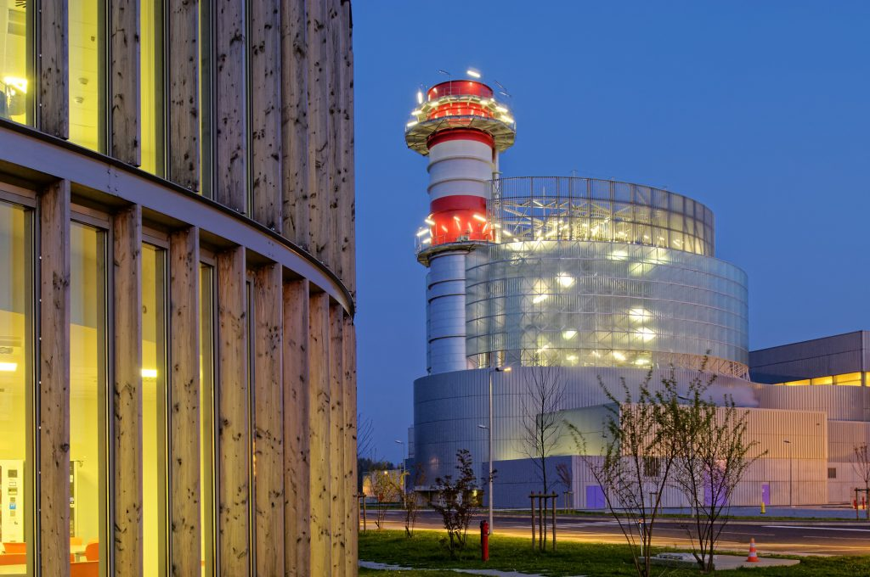
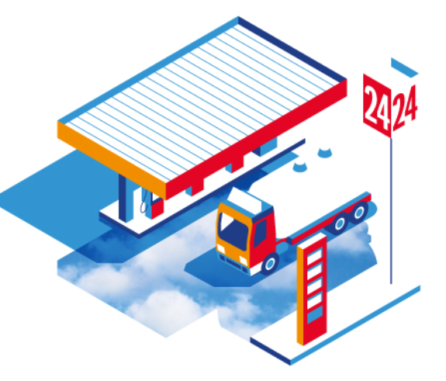
Biodiversity at our Existing Site & Closures
WHAT
We commit to putting in place a biodiversity action plan at each of our environmentally significant sites* which are ISO 14001:2015 standard certified, and to report on the implementation of this plan to our stakeholders.
For sites which are ceasing operations, we commit to considering the development of a dedicated area rich in biodiversity (e.g. rare species habitats, biodiversity sanctuaries, etc.) as one of the options for their rehabilitation.
HOW
By deploying biodiversity action plans in three stages over the period 2022-2025: biodiversity surveys, design of the action plan, implementation and communication of results.
By raising awareness of biodiversity within teams on each site.
By assessing the possibility of redeveloping our closed sites into areas favorable to biodiversity.
By communicating progress and results of the programs publicly, locally and on total.com
* All operated exploration-production sites in production, all refineries, majority petrochemical and polymer sites, all gas-fired power plants
M&S service stations: voluntary approach to apply actions from a dedicated biodiversity actions catalogue across petrol stations located in biodiversity sensitive areas
Notes:
Si la plupart d’entre vous ont déjà une petite idée de ce qu’est la Responsabilité Sociétale des Entreprises, il est important de dire que beaucoup d’idées reçues circulent à ce sujet.
- La RSE, ce n’est pas du greenwashing. Les entreprises ont décidé de s’engager, pas parce qu’elles ont quelque chose à se reprocher, ou pour noyer le poisson, mais parce qu’elles croient que les entreprises font partie de la solution aux problèmes que notre monde rencontre. Ca ne sert pas non plus à compenser des manquements de la part de l'entreprise ou encore des activités jugées non vertueuses par l'opinion publique.
- La RSE n'équivaut pas à se donner bonne conscience. La RSE n’implique pas que des grands discours et des éléments de langage, elle implique aussi et surtout des mesures concrètes et un plan d’action pour passer des paroles aux actes.
- Ce n’est pas seulement du mécénat. Oui, le mécénat fait partie de la RSE, mais il serait faux de réduire cette dernière à cela. Par son action quotidienne, dans la transformation de ses process internes, par la sensibilisation de ses collaborateurs, l’entreprise peut avoir son rôle à jouer pour avoir un impact positif sur la société.

Slide 25
Support to Biodiversity
WHAT
HOW
As part Total Foundation’s Climate, Coastal and Oceans program, we commit to supporting biodiversity related awareness programs, youth education and research actions concerning the ocean and coastal environments.
As part of Total Foundation’s Action! Program, we commit to offering our employees dedicated workdays to conduct action in favor of biodiversity to promote the civic engagement of the Group's employees.
We commit to sharing biodiversity data, collected as part of our environmental studies, with the scientific community and the general public.
By annually publishing the list of projects supported and partners funded by the Total Foundation, in France and internationally, and results.
By evaluating and publishing our performance indicators (e.g. number of youths made aware and trained, number of employees involved on these issues in France and internationally) of the Total Foundation.
By annually sharing biodiversity data from five projects or sites on the international biodiversity data sharing platform Global Biodiversity Information Facility (GBIF) and reporting on this.
By collaborating with the United Nations Nature Conservation Monitoring Centre (UNEP-WCMC) on mapping of sensitive and priority areas.
Notes:
Si la plupart d’entre vous ont déjà une petite idée de ce qu’est la Responsabilité Sociétale des Entreprises, il est important de dire que beaucoup d’idées reçues circulent à ce sujet.
- La RSE, ce n’est pas du greenwashing. Les entreprises ont décidé de s’engager, pas parce qu’elles ont quelque chose à se reprocher, ou pour noyer le poisson, mais parce qu’elles croient que les entreprises font partie de la solution aux problèmes que notre monde rencontre. Ca ne sert pas non plus à compenser des manquements de la part de l'entreprise ou encore des activités jugées non vertueuses par l'opinion publique.
- La RSE n'équivaut pas à se donner bonne conscience. La RSE n’implique pas que des grands discours et des éléments de langage, elle implique aussi et surtout des mesures concrètes et un plan d’action pour passer des paroles aux actes.
- Ce n’est pas seulement du mécénat. Oui, le mécénat fait partie de la RSE, mais il serait faux de réduire cette dernière à cela. Par son action quotidienne, dans la transformation de ses process internes, par la sensibilisation de ses collaborateurs, l’entreprise peut avoir son rôle à jouer pour avoir un impact positif sur la société.

