Slide 1
Campaign kit
05 June 2019

Slide 2
WED 2019 GOALS
Take note / become aware of our Biodiversity commitments and communicate on them;
Continue to boost our existing biodiversity actions based on these new commitments (see Register of Biodiversity Actions, board 25);
Align your future actions for biodiversity with our 16 commitments via dedicated reporting;
Think about your local stakeholders’ expectations in terms of biodiversity and identify the opportunities that these present (e.g. facilitating cohesion between the site and local inhabitants);
Learn to identify and manage awareness of biodiversity on and around your sites (cf. tools, REX and useful links).

Slide 3
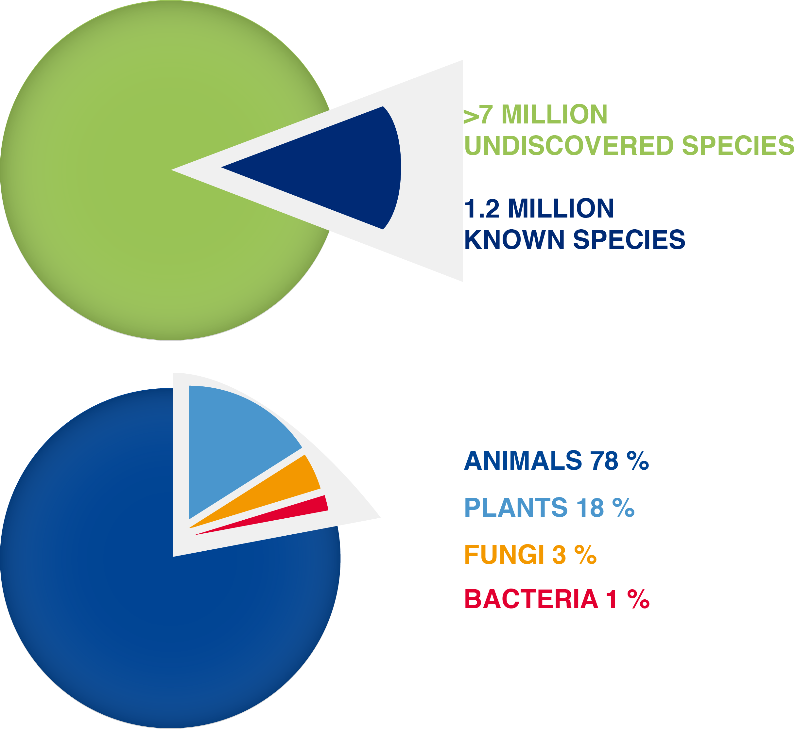
WHAT IS BiodiversitY?
Biodiversity
and its components
3 interdependent levels of biodiversity:
Species diversity: number of animal or plant species;
Genetic diversity within each species;
Ecosystem diversity
+ interactions between these levels.
Services provided by nature
4 types of ecosystem services :
Supporting (production of oxygen, soil formation, etc.);
Provisioning (water, food, etc.);
Regulating (climate, ecological balance, etc.);
Cultural (spiritual and recreational benefits, etc.).

Slide 4
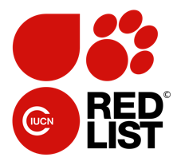
Biodiversity under threat
42%
of terrestrial species
x55
for mammals
of marine species
25%
x24
For reptiles
x100
for amphibeans
Are classified
as endangered
Out of 93,577 species studied, 26,197 are listed as threatened
According to certain studies, the pace of extinction has accelerated since 1900
Notes:
Page Métier Biodiversité du WAT : http://wat.corp.local/sites/s215/fr-FR/Pages/environnement/biodiversite%202018.aspx

Slide 5
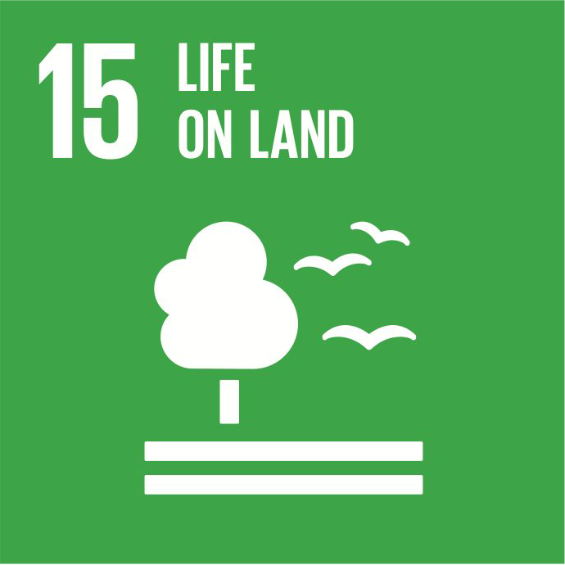
Total and its biodiversity policy
The inclusion of biodiversity in Total’s environmental management system was presented in 2005 in our biodiversity policy, based on 5 pillars:
Applying the Mitigation Hierarchy, an approach to avoid, reduce, mitigate and, if necessary, compensate for any loss in biodiversity;
Taking ecosystem sensitivity into account;
Managing biodiversity by integrating risks and impacts in our environment-management systems;
Reporting to our stakeholders;
Improving knowledge of biodiversity with the help of our local and international partners and industry associations.
Notes:
Page Métier Biodiversité du WAT : http://wat.corp.local/sites/s215/fr-FR/Pages/environnement/biodiversite%202018.aspx

Slide 6
OUR BIODIVERSITY COMMITMENTS

Slide 7
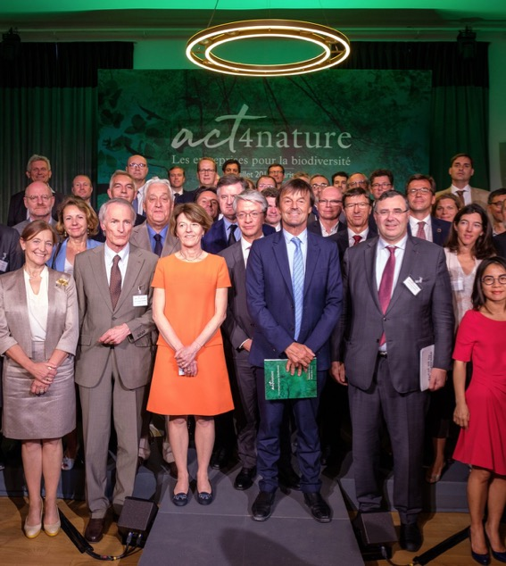
Our commitments in terms of biodiversity
“Given its business, Total sometimes works in sensitive natural environments. We are aware of the stakes involved and have taken measures to ensure that biodiversity and ecosystems are taken into account in our projects and operations.”
Patrick Pouyanné, Chairman and CEO of Total
New public biodiversity commitments were published in July 2018, strengthening our existing commitments.
These form part of a global undertaking to fight against the erosion of biodiversity, and offers the Group the opportunity to contribute to it.
10 joint + 6 individual commitments
Notes:
Page Métier Biodiversité du WAT : http://wat.corp.local/sites/s215/fr-FR/Pages/environnement/biodiversite%202018.aspx

Slide 8
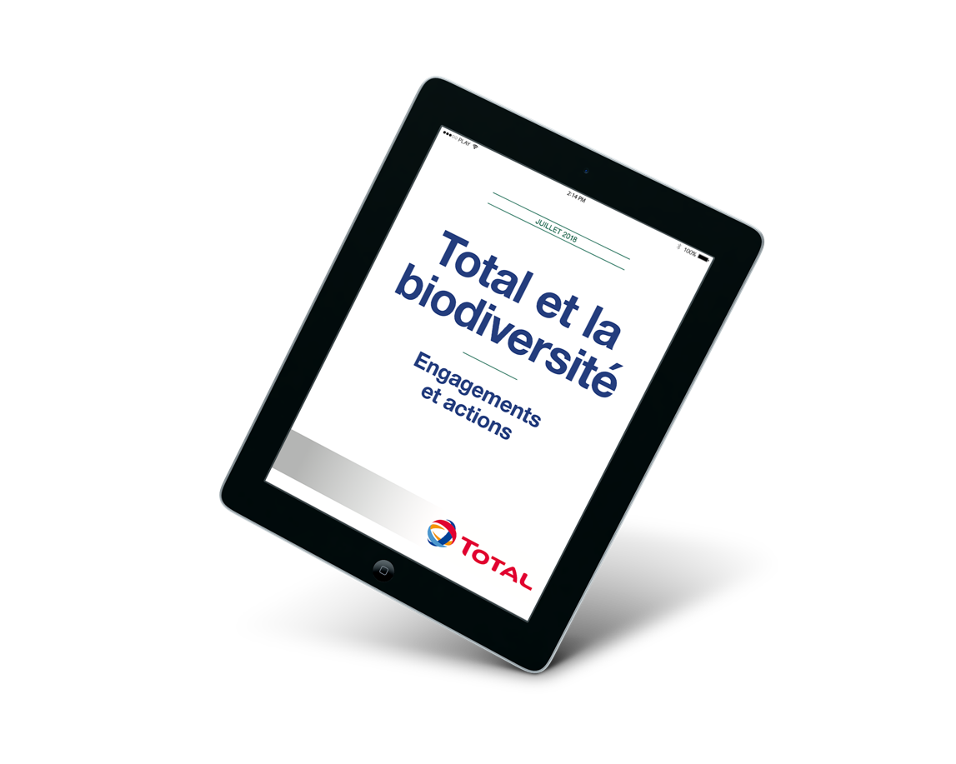
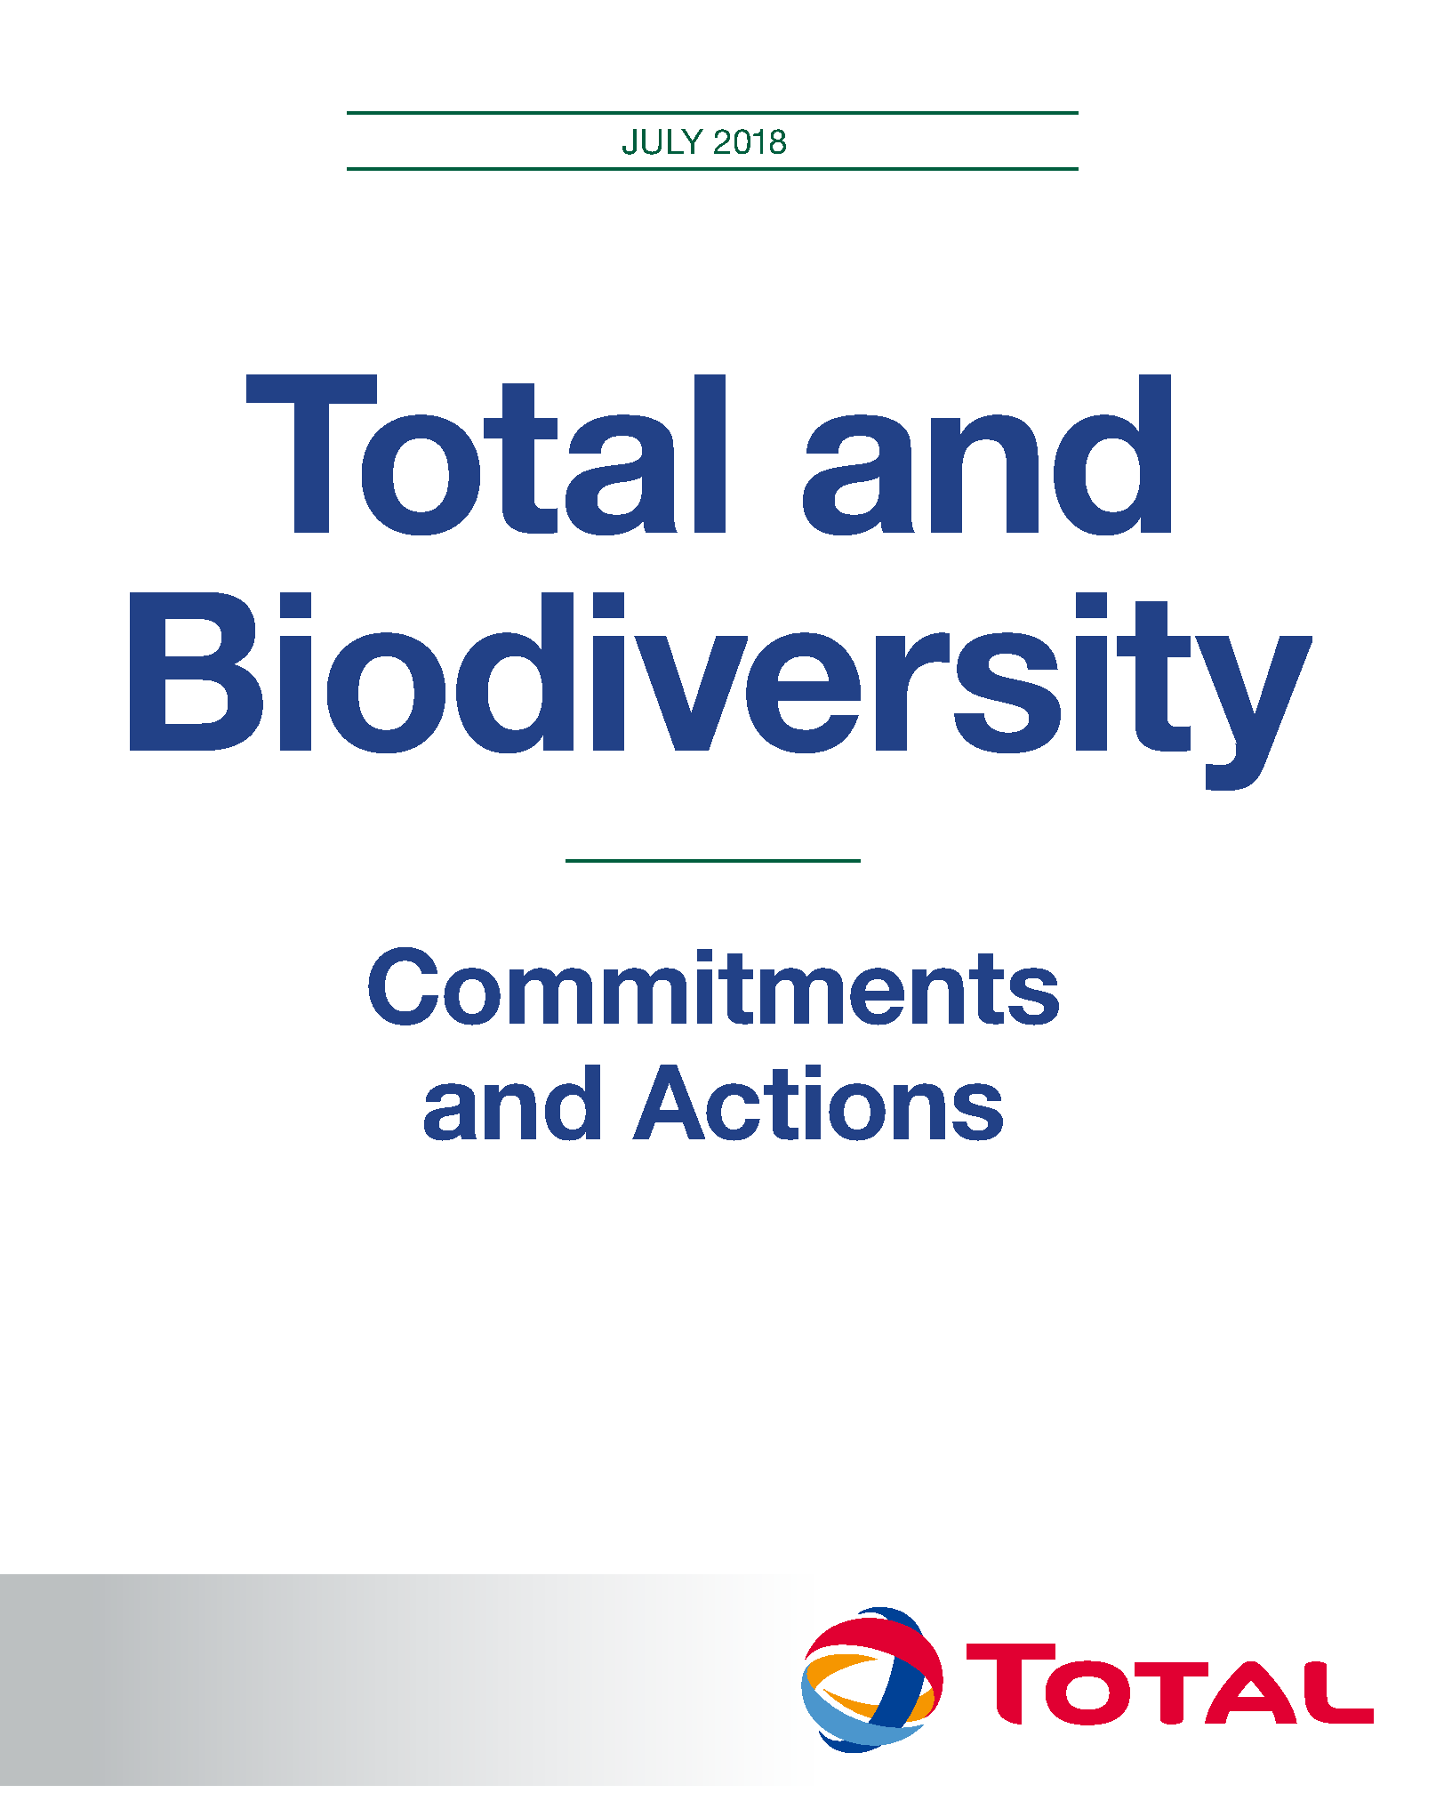
NEW BIODIVERSITY COMMITMENTS
Get the brochure HERE
Notes:
https://www.total.com/sites/default/files/atoms/files/hd_biodiversite_180710.pdf

Slide 9
10 Collective undertakings in a nutshell
Make Biodiversity part of our Corporate Strategy;
Communicate with our stakeholders including public authorities, and contribute to countrywide strategies;
Assess biodiversity, our impacts, dependence and risks;
Manage our impacts: Avoid, Reduce & Compensate, and achieve a Net Positive Impact where possible;
Include Biodiversity in our value chains;
Consider the impact of climate change on Biodiversity;
Develop opportunities offered by Nature-Based Solutions;
Raise awareness, train our staff, promote and encourage initiatives;
Mobilise resources and partnerships;
Issue public progress reports.
Notes:
Page Métier Biodiversité du WAT : http://wat.corp.local/sites/s215/fr-FR/Pages/environnement/biodiversite%202018.aspx

Slide 10
6 individual commitments in a nutshell
Avoid natural sites on the UNESCO World Heritage list, E&P
Avoid Arctic sea ice, E&P oil
Pursue Biodiversity Action Plans
Forest-preservation programme
Share and develop biodiversity data and tools
Raise employee awareness
Notes:
Page Métier Biodiversité du WAT : http://wat.corp.local/sites/s215/fr-FR/Pages/environnement/biodiversite%202018.aspx

Slide 11
OUR BIODIVERSITY
INITIATIVES

Slide 12
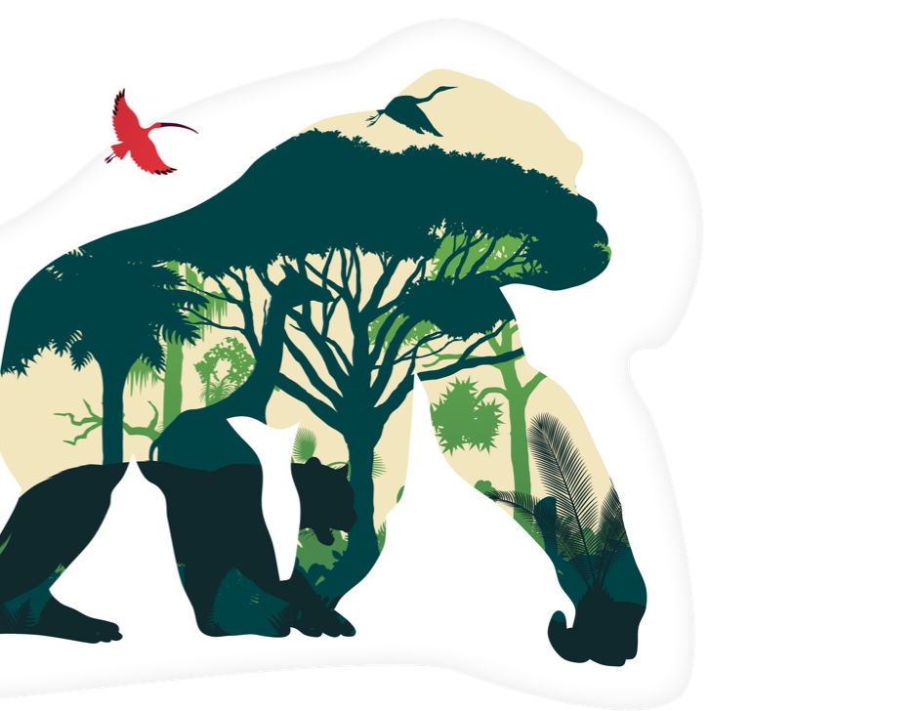
AVOID SENSITIVE AREAS AT A REGIONAL LEVEL
Total does not conduct exploration or production activities in natural areas listed as UNESCO World Heritage sites and avoids any exploration of oil fields in the Arctic sea ice zone.
In the Democratic Republic of the Congo, in 2012, Total was awarded the exploration licence for Block 3 in the Albertine Graben of which one third is located in the Virunga National Park. We pledged to work only in the area located outside the park. Since 2013, we have systematically checked that all new exploration or extraction projects are located outside the borders of natural areas on UNESCO’s World Heritage List.
Notes:
Page Métier Biodiversité du WAT : http://wat.corp.local/sites/s215/fr-FR/Pages/environnement/biodiversite%202018.aspx

Slide 13
AVOID SENSITIVE AREAS AT A REGIONAL LEVEL
In the Arctic sea ice, Total refrains from all oil exploration operations and publishes a list of its licences in this area on its website, in the interest of full disclosure.
Notes:
Page Métier Biodiversité du WAT : http://wat.corp.local/sites/s215/fr-FR/Pages/environnement/biodiversite%202018.aspx

Slide 14
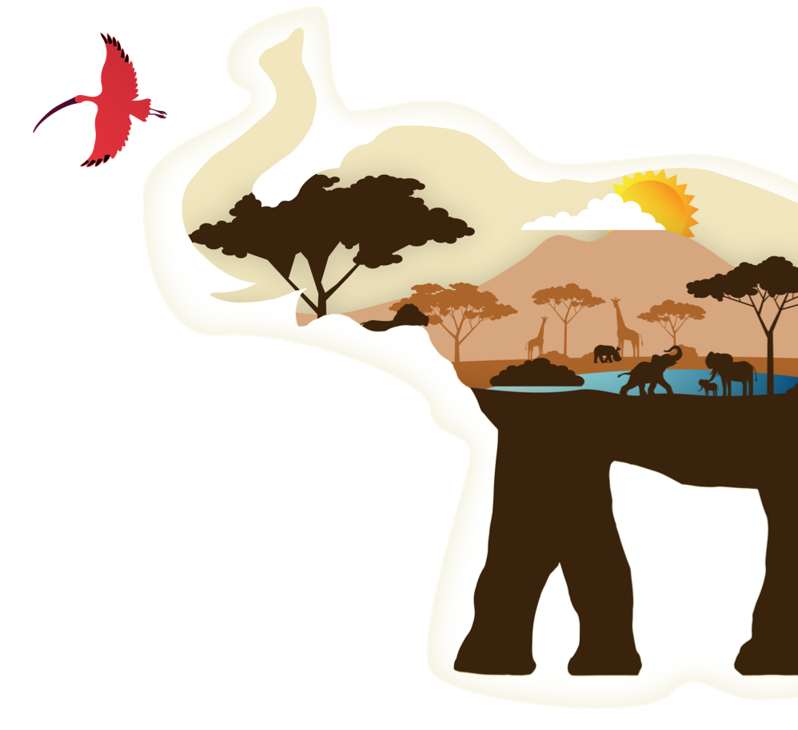
AVOID SENSITIVE AREAS AT A LOCAL LEVEL
We take ecosystem sensitivity into account at a smaller scale.
In Uganda, one of Total’s exploration blocks is partially located in the Murchison Falls National Park. Before we began working, we identified mammal breeding grounds, waterholes and trails used by wildlife to map out sensitive areas to be avoided. This inventory helped us not to impact off-limit areas, and to determine the best season for carrying out work without disturbing the surrounding environment.
Notes:
Page Métier Biodiversité du WAT : http://wat.corp.local/sites/s215/fr-FR/Pages/environnement/biodiversite%202018.aspx

Slide 15
REDUCE IMPACTS
We take care to minimize the impacts of our operations on biodiversity throughout our projects’ lifespan.
In southern Yemen, Total discovered rich coral reefs during preliminary studies for the Balhaf gas liquefication plant. To limit the project’s impact on marine biodiversity, we modified the facility’s design, took measures to contain fine particles and turbidity due to construction, and transplanted certain coral colonies so that they could thrive in conditions similar to their original habitat. The project was monitored by a scientific committee on biodiversity that included a member from IUCN (International Union for Conservation of Nature).
In Uganda and Tanzania, Total adjusted the route of a 1,500 km pipeline to the port in Dar-Es-Salam to avoid certain sensitive areas.
Notes:
Page Métier Biodiversité du WAT : http://wat.corp.local/sites/s215/fr-FR/Pages/environnement/biodiversite%202018.aspx

Slide 16
MITIGATE
To ensure the sustainability of the natural habitats in which we operate, we incorporate mitigation from the beginning of each project and also help to restore degraded natural environments.
In Scotland, during construction of its industrial complex on the Shetland Islands, Total conserved the excavated peat.
It has been stored in conditions that prevent it from decomposing so that it can be returned to the original location when the site closes.
In Indonesia, Total operated in the Mahakam Delta until 2017, in an area where human activity had led to deforestation of the mangrove ecosystem. We responded by planting over 12 million- mangrove tree seedlings.
R&D FOCUS
For future mangrove reforestation projects, our R&D teams, in partnership with a specialised company, have developed artificial tutors to retain sediments and favour the growth of mangrove trees. With the same partner, the Group has also developed a technology for a 3D-printed coral-reef structure to facilitate the natural growth of new reefs.
Notes:
Page Métier Biodiversité du WAT : http://wat.corp.local/sites/s215/fr-FR/Pages/environnement/biodiversite%202018.aspx

Slide 17
OFFSET
Our offset programmes focus on preventing the net loss of biodiversity in natural habitats or, for certain projects, contributing to a net gain in biodiversity.
In Uganda, Total operates the Tilenga project in an area with a particularly sensitive biodiversity that, due to poaching and other pressure from humans, has been degrading. In response, the Group has identified actions that could be conducted in partnership with specialised local and international organisations. These will help to stabilise the situation and even redress the current trend by promoting the increase of priority species and the protection of critical habitats to achieve a net gain in biodiversity.
Notes:
Page Métier Biodiversité du WAT : http://wat.corp.local/sites/s215/fr-FR/Pages/environnement/biodiversite%202018.aspx

Slide 18
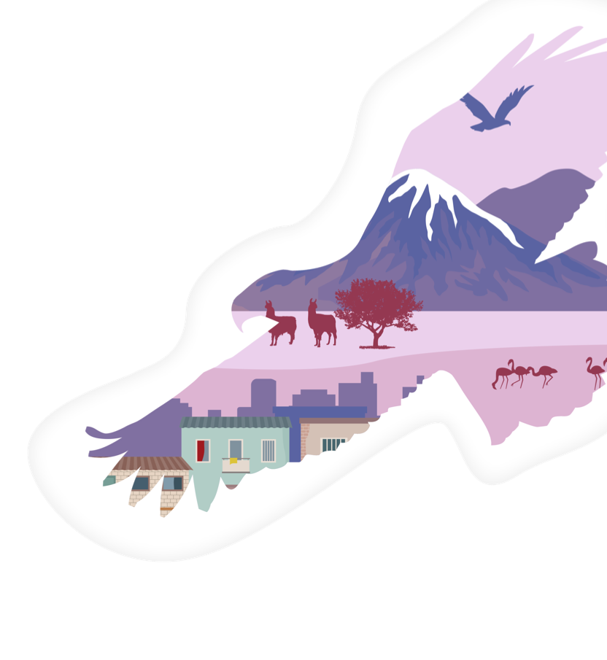
ASSESS ECOSYSTEM SERVICES
By evaluating the services that nature offers to local communities, we can develop appropriate responses for each situation.
In Bolivia, during an exploration campaign in the Incahuasi hills, Total evaluated the services rendered to local communities by the surrounding ecosystems: water, food, medicinal plants, etc. Various methods were used to take stock and decide on actions that would ensure the sustainability of ecosystem services. One of the access roads to the plant was for example designed and built to avoid any impact on the local communities’ water resources.
Notes:
Page Métier Biodiversité du WAT : http://wat.corp.local/sites/s215/fr-FR/Pages/environnement/biodiversite%202018.aspx

Slide 19
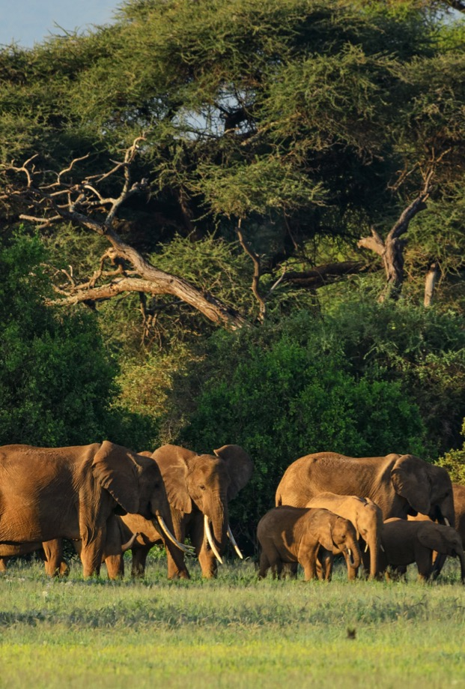
PREPARE BIODIVERSITY ACTION PLANS
We have drawn up biodiversity action plans for our industrial facilities located fully or partially in International Union for Conservation of Nature (IUCN) I to IV sites or Ramsar Convention wetlands protected areas. These plans help us establish priority objectives, implement them with our biodiversity teams and report on the results to our stakeholders.
In Gabon, Total’s former Atora site extended into protected areas that are recognised worldwide as priority habitats for chimpanzees, lowland gorillas, elephants, hippopotami, and other species. Our Biodiversity Action Plan included guidelines and best practices for protecting the primates and limiting disturbances caused by noise and light and the passage of employees and subcontractors. We also contributed to anti-poaching programmes and replanted local vegetation in our areas of operation.
Notes:
Page Métier Biodiversité du WAT : http://wat.corp.local/sites/s215/fr-FR/Pages/environnement/biodiversite%202018.aspx

Slide 20
PRESERVING BIODIVERSITY ON A DAILY BASIS
We take action and follow guidelines to protect and preserve biodiversity at our industrial sites.
In France, Total carefully mapped plant life at its Feyzin refinery near Lyon in order to establish specific grounds maintenance approaches for peripheral areas (mowed once a year), grassed areas (mowed twice a year, with tree and bush trimming when needed) and production areas. Around a quarter of the site is available for the development of local biodiversity.
Again in France, at the Carling petrochemical plant, Total acts for the protection of amphibians by favouring the creation of wetlands which are their natural habitat.
In various countries where Total operates service stations, the Group conducts biodiversity awareness campaigns. These include organising school field trips to discover local ecosystems (mangroves, reefs and forests) and the benefits they provide.
Notes:
Page Métier Biodiversité du WAT : http://wat.corp.local/sites/s215/fr-FR/Pages/environnement/biodiversite%202018.aspx

Slide 21
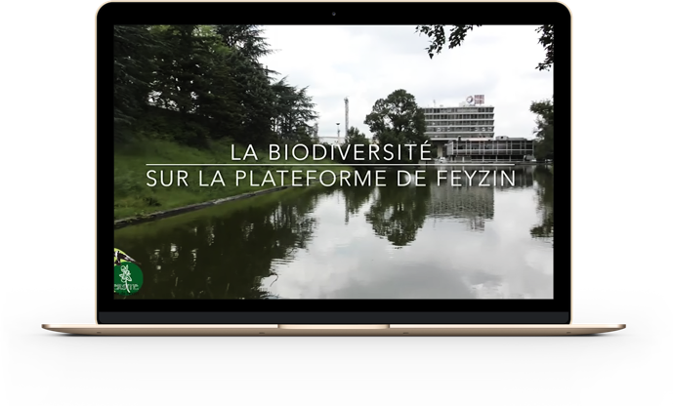
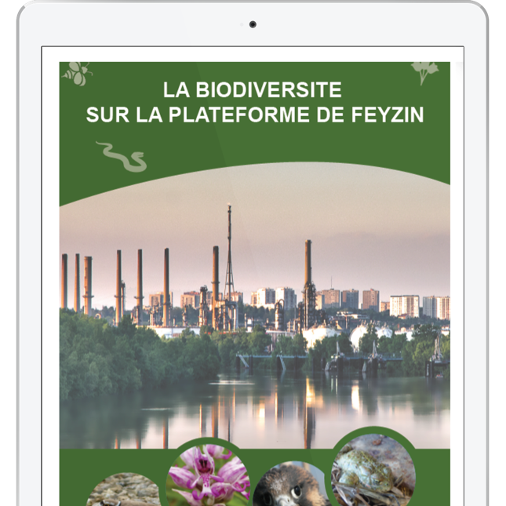
RC BRANCH EXAMPLE
http://wat.corp.local/sites/s275/fr-FR/Documents/DECOUVRIR%20LE%20SITE/Biodiversité/plaquettes%20biodiversité%20v3.pdf#search=biodiversit%C3%A9%20plaquette%20v3
http://wat-social.corp.local/sites/c1b77864-0e46-4078-9ad0-d5828db07599_EN-US/SitePages/Share%20and%20learn%20vid%C3%A9o%20biodiversit%C3%A9%20Feyzin%20(avec%20sous-titres%20ENG).aspx
Notes:
https://www.total.com/sites/default/files/atoms/files/hd_biodiversite_180710.pdf

Slide 22
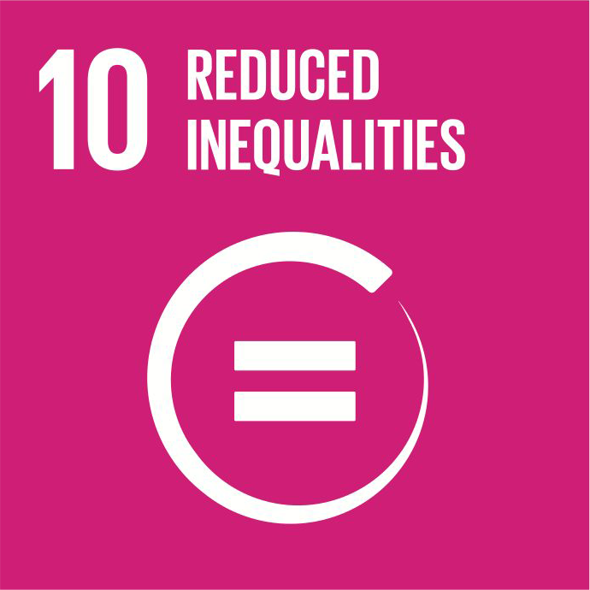
M&S BRANCH EXAMPLE
The Ertvelde MS Lub plant is another example of an industrial site taking steps to further biodiversity (reducing the use of phytochemical products, on-site inventories, and joining the plant to the local green belt).
SDG Mapping Total Ertvelde
Product/service
excellence
Operational
excellence
Organisational
excellence
Notes:
https://www.total.com/sites/default/files/atoms/files/hd_biodiversite_180710.pdf

Slide 23
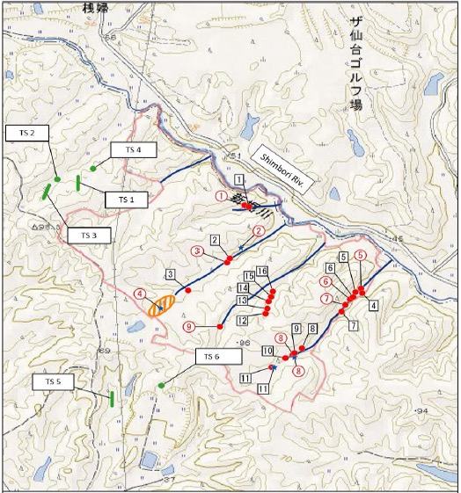
GRP BRANCH EXAMPLE
GRP has also made biodiversity part of its processes like here at Osato,
a new solar power plant in Japan where a mitigation strategy is applied.
Notes:
https://www.total.com/sites/default/files/atoms/files/hd_biodiversite_180710.pdf

Slide 24
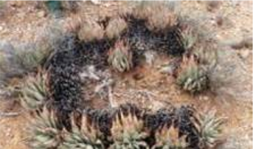
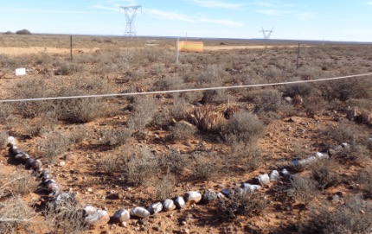
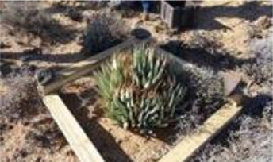
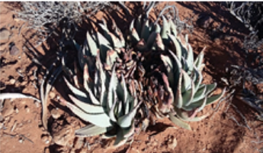
DEMARCATION & RESETTLEMENT
– BUILDING PHASE
Resettlement:
plants found during the building phase must be relocated to a similar environment that is not affected by the works.
Aloe claviflora - Protected species.
Demarcation of no-go areas
Notes:
https://www.total.com/sites/default/files/atoms/files/hd_biodiversite_180710.pdf

Slide 25
Link to an interactive map of the Group’s Biodiversity actions
Notes:
https://www.total.com/sites/default/files/atoms/files/hd_biodiversite_180710.pdf

Slide 26
FIND OUT MORE

Slide 27
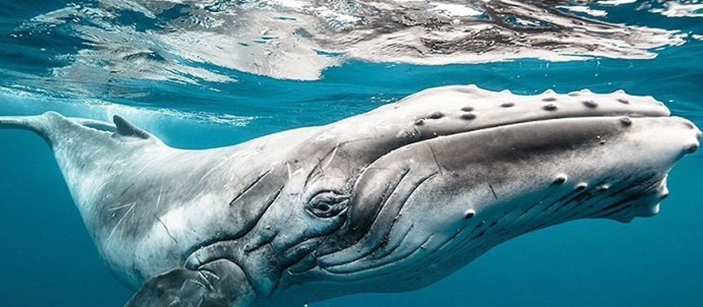
YOUR BIODIVERSITY CONTACT
Our internal Biodiversity workgroup meets every three months.
To join them, please contact Steven Dickinson: steven.dickinson@total.com
BIODIVERSITY NETWORK MEETING
12 APRIL 2018
Notes:
https://www.total.com/sites/default/files/atoms/files/hd_biodiversite_180710.pdf

Slide 28
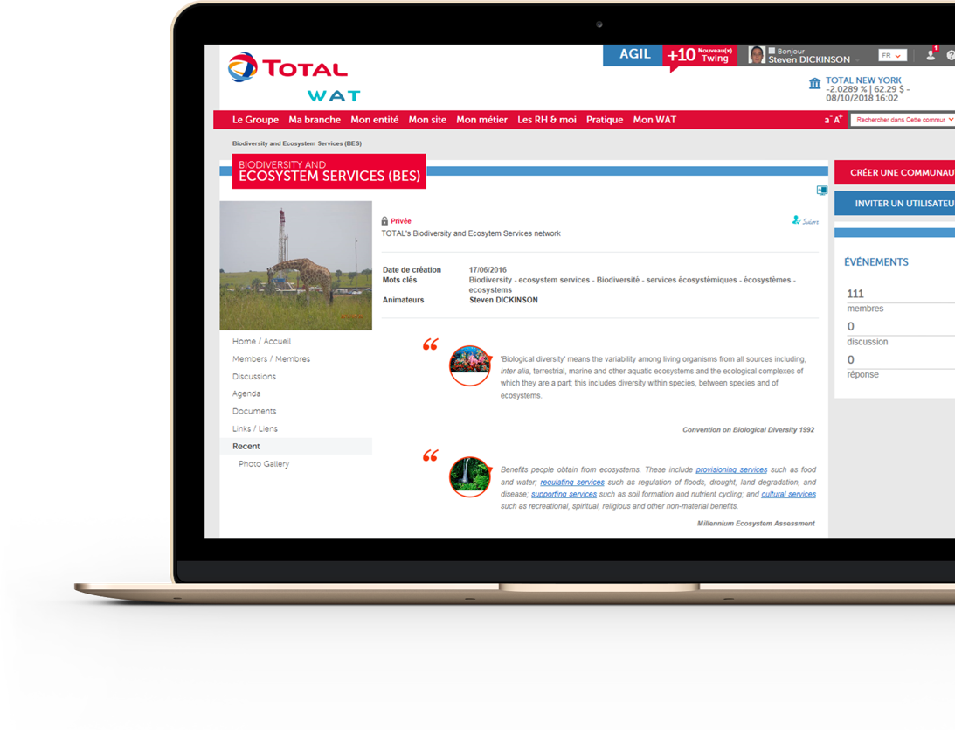
BIODIVERSITY COMMUNITY
Feel free to join our (private) Biodiversity Community any time you want.
Contact Steven Dickinson : steven.dickinson@total.com
Link to our Biodiversity Community on WAT
Notes:
https://www.total.com/sites/default/files/atoms/files/hd_biodiversite_180710.pdf

Slide 29
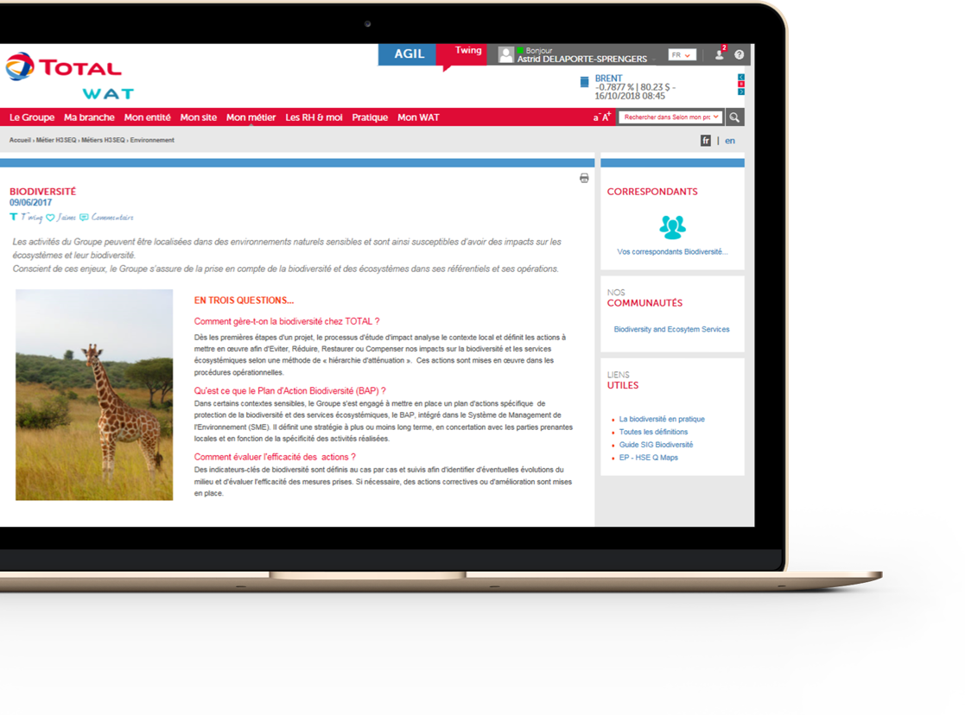
WAT PAGE
Our WAT Environment page has all the information on Biodiversity at Total (Group Rules, REX, Documentation).
Link to the Biodiversity sector page on WAT
Notes:
https://www.total.com/sites/default/files/atoms/files/hd_biodiversite_180710.pdf

Slide 30
APPENDICES

Slide 31
10 COLLECTIVE
UNDERTAKINGS IN DETAIL (1/2)
Include biodiversity in our corporate strategy by using available scientific knowledge;
Talk with all our stakeholders about their expectations and our impacts, actions and progress;
Assess the different aspects of biodiversity that concern us using direct and indirect impact, risk and progress indicators, and if needed to make a decision, assess the cost of our impacts and dependence on properly functioning ecosystems;
Promote the progressive inclusion of biodiversity in decisions made throughout our value chains, from the production of raw materials to the processing of post-consumer waste;
In the first instance avoid and reduce, and in the last instance compensate for our impact, and depending on each case, aim at least for an absence of net loss, or even a net gain in biodiversity in our operations and geographic areas of influence, taking account of the need for ecosystems to adapt to climate change;
Notes:
https://www.total.com/sites/default/files/atoms/files/hd_biodiversite_180710.pdf

Slide 32
10 COLLECTIVE
UNDERTAKINGS IN DETAIL (2/2)
Focus on Nature-based Solutions (NbS) and ensure that they are deployed in a scientifically sound manner that is beneficial for biodiversity, notably by promoting a diverse range of solutions;
Include biodiversity in our discussions with public officials so that the issue is taken into account in public policy. Contribute to national biodiversity strategies when we are asked to participate;
Raise awareness among our employees and provide training on biodiversity and how it relates to their work; promote and encourage their initiatives to protect nature and recognise their involvement and good practices;
Allocate resources and establish appropriate partnerships to support and monitor our tangible actions in the field;
Issue public progress reports on the deployment of these collective undertakings and of our individual commitments described on the following page.
Notes:
https://www.total.com/sites/default/files/atoms/files/hd_biodiversite_180710.pdf

Slide 33
6 INDIVIDUAL COMMITMENTS IN DETAIL
Total conducts no oil and gas exploration or extraction operations at natural sites included on the UNESCO World Heritage List (at 31 December 2017);
Total conducts no oil exploration activities in Arctic sea ice;
Total develops biodiversity action plans for operated production sites located in the most sensitive protected areas corresponding to International Union for Conservation of Nature (IUCN) I to IV and Ramsar protected areas;
Total commits to implement, as part of Total Foundation, a global programme for the preservation of forests, mangroves and wetlands, as well as restoration projects of degraded land to balance the development of agriculture and forest preservation, based on partnerships and integrating youth education and awareness initiatives;
Total, in partnership with specialised institutes like the UN-Environment World Conservation Monitoring Centre, develops innovative tools and methods to analyse and model biodiversity data collected during baseline studies and makes sure these are shared with the scientific community;
Total raises employee awareness of biodiversity issues through actions to promote biodiversity in its office buildings.
Notes:
https://www.total.com/sites/default/files/atoms/files/hd_biodiversite_180710.pdf

