Slide 1
Contingency Planning for Accidental Surface Water Pollution​ GROUP HSE RULE (CR-GR-HSE-705)
EXECUTIVE SUMMARY
This rule sets specific requirements to be observed in contingency planning for accidental surface water pollution.

Slide 2
Purpose: Defines the conditions under which a Spill Contingency Plan (SCP) is required and sets out contingency planning requirements aimed at minimising the consequences of accidental spills of hydrocarbons or other Hazardous and Noxious Substances (HNS) with the potential to impact surface waters.
Scope of Application: Applicable for all operated Group entities and affiliates.
Replaces:
DIR-GR-ENV-002 Preparedness for Response to Accidental Surface Water Pollution​
CR-EP-HSE-094 Oil Spill Preparedness & Response Policy in Exploration & Production​
CR-RC-HSE-044 Preparedness for Response to Accidental Surface Water Pollution​
CR-MS-HSEQ-461 Preparedness for Response to Accidental Surface Water Pollution​
REFLEX publication date: 30/09/2019.
Effective date: 3 months following date of publication.

Slide 3
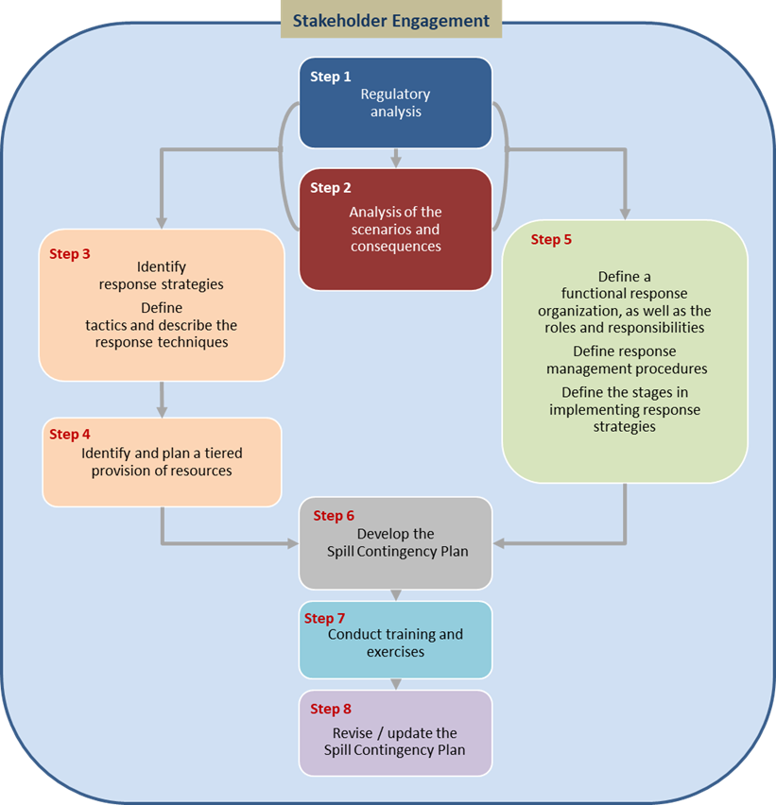
SPILL CONTINGENCY PLANNING PROCESS
Figure 1: Overview of the spill contingency planning process

Slide 4
REQUIREMENT OVERVIEW: Scenarios Assessment
Assessment of Surface Water Spill Scenarios and their Consequences (Requirement 3.1.1)
A documented assessment of surface water spill scenarios and their potential consequences is performed with the participation of internal or external specialists.
This assessment is revised whenever there is a change in the nature or scale of activities.
No change

Slide 5
REQUIREMENT OVERVIEW: Spill Contingency Plan
Spill Contingency Plan (SCP) (Requirement 3.2.1)
A SCP is required when the documented assessment indicates that there is one or more surface water spills scenarios of severity ≥ 3 according to the Group Evaluation Matrix of Actual and Potential Severity Levels of HSE Events.
No change
The list of relevant stakeholders.

Slide 6
REQUIREMENT OVERVIEW: Spill Contingency Plan
Minimum Content of an SCP (Requirement 3.2.2)
The SCP contains as a minimum:
Applicable legal and regulatory requirements;
A spill alert and notification procedure in accordance with applicable obligations;
A description of the pollution scenarios and their consequences including the anticipated evolution over space and time;
Details of the physical properties, toxicity, reactivity, etc. of chemical products in the form of Material Safety Data Sheets (MSDS);
The measures to be taken immediately following a spill, including tools, equipment, and procedures to be used;
The response strategies and associated tactics to be implemented for the scenarios;
The definition and identification of all the internal and external technical and organisational resources required to implement the response strategies, including logistics;
The specific tasks of each key player in the management of the spill response;
The elements to take into account to monitor the health and environmental impacts of the pollution;
Spill response exercise requirements (including type, contents, scope and frequencies);
The list of relevant stakeholders.
No change

Slide 7
REQUIREMENT OVERVIEW: Spill Contingency Plan
Use of Specialised Support Services (Requirement 3.2.3)
Specialised support services are used for the preparation of the initial SCP or a major subsequent update. Such support services are provided by the division in charge of crisis management and oil spill response or by approved spill contingency specialist contractors.
New requirement for MS, RC and GRP, but already implemented.
Spill Contingency Plan Review (Requirement 3.2.4)
The review frequency is defined within the SCP. It is reviewed at a minimum once every 5 years or whenever a significant change in the situation or context is identified.
New requirement for GRP
Review frequency was not defined in GRP. Review period was already every 5 years for RC and MS, and 3 years for EP.
Communication of the SCP (Requirement 3.2.5)
The latest approved version of the SCP is made available to the division in charge of crisis management and oil spill response and other support teams as identified by the relevant Branch to allow for spill response support according to this rule.
New requirement for all branches, but already practiced.

Slide 8
REQUIREMENT OVERVIEW: Spill Response Organisation
Spill Response Preparedness Coordinator (SRPC) (Requirement 3.3.1)
A SRPC is formally designated whenever a SCP is required.
The specific tasks of the SRPC are documented.
Training and time are allocated to this function.
No change
Mobilisation of Resources for Spill Response (Requirement 3.3.2)
To enable the efficient mobilisation of the necessary resources in response to accidental spills:
The mobilisation of internal and locally contracted resources is managed by the entity or affiliate.
Call-out Authorities are informed by the entity or affiliate to mobilise spill response resources under Group framework agreements.
No change

Slide 9
REQUIREMENT OVERVIEW: Spill Response Organisation
Training and Competency (Requirement 3.3.3)
All personnel involved in the spill response have the necessary training to perform their specific functions during spill response events.
No change

Slide 10
REQUIREMENT OVERVIEW: Spill Response Exercises
Spill Response Exercises (Requirement 3.4.1)
Where a SCP is required, spill response exercises are planned and conducted (based on scenarios from the SCP) at least once per year and include the deployment of spill response equipment held by the entity or affiliate.
Risk assessments for such non-routine activities are prepared during the planning, and safety measures are applied during the execution of all exercises.
Where the spill response is subcontracted and managed by an external organisation, such an organisation is requested to conduct spill response exercises and the entity or affiliate participates or observes these exercises.
Improvement actions arising from spill response exercises are recorded and tracked.
No change

Slide 11
REQUIREMENT OVERVIEW: Self-Assessments
Self-Assessments of Spill Response Preparedness (Requirement 3.5.1)
Self-assessments of spill response preparedness are conducted as a minimum once every 2 years.
New requirement for all branches, but already being practiced.

