Slide 1
SafeDriver – Everywhere, Every Day
Safety Stand Down

Slide 2
SafeDriver – Everywhere Every Day
1
Context
5’
2
Message from the Senior Vice President of the Marketing & Services Branch
5’
3
Causes and consequences of road traffic accidents
15’
4
Workshop
50’

Slide 3
Context
Safety Stand Down

Slide 4
Context
Since January 2020, 52 serious or potentially serious accidents involving heavy goods vehicles occurred, including 31 rollovers (i.e. almost two per month).
Most of these accidents are related to driver behaviour.
Most of those accidents could have been avoided.
After several years of decreasing accident rates, our results have stagnated.
Severe Vehicle Accident Rate (SVAR)
Our objective: Zero responsible accidents

Slide 5
Message from Mr Alexis Vovk Senior Vice President of the Marketing & Services Branch
Safety Stand Down

Slide 6
Points to be discussed
VidEo

Slide 7
Causes and consequences of our accidents
Safety Stand Down

Slide 8
Causes of accidents*
Most of our accidents (2/3) are related to driver behaviour.
External factors (third parties, weather conditions, infrastructure) cause around 1/4 of our accidents.
Few events are caused by mechanical problems, after the significant efforts made to renew our fleet and run comprehensive roadworthiness tests.
*Inhouse SVAR data from 2019 & 2020

Slide 9
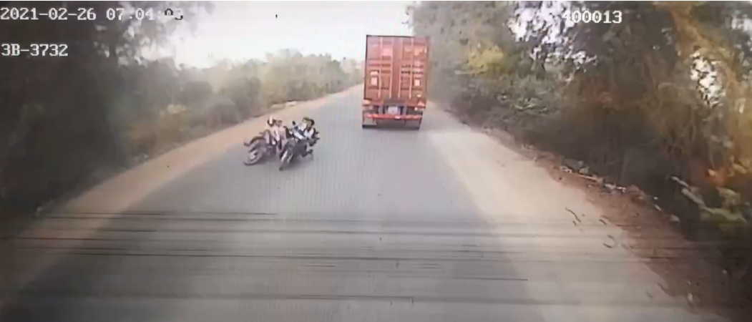
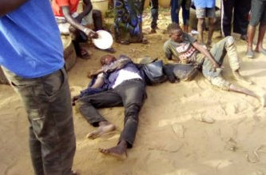
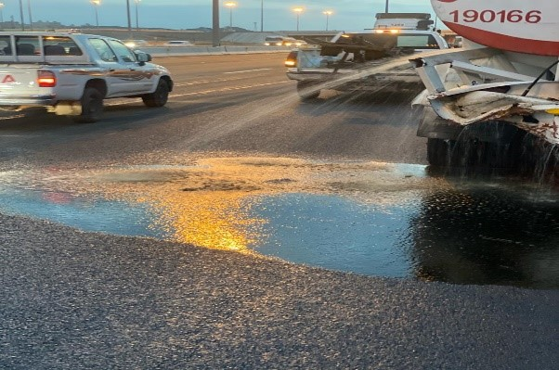
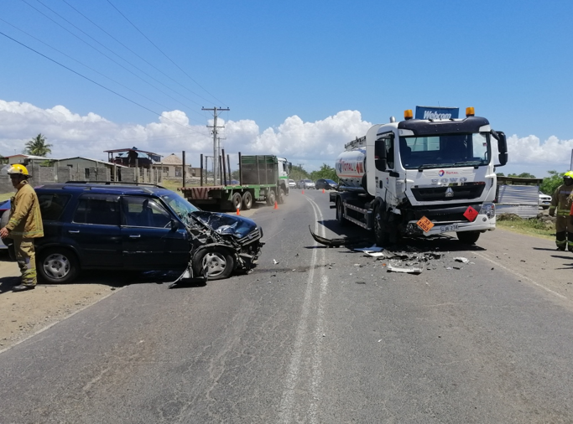
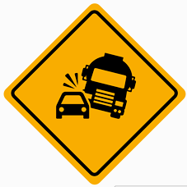
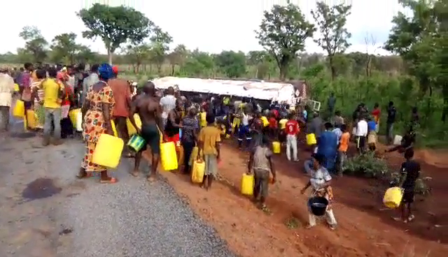
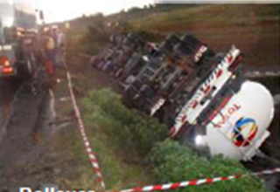
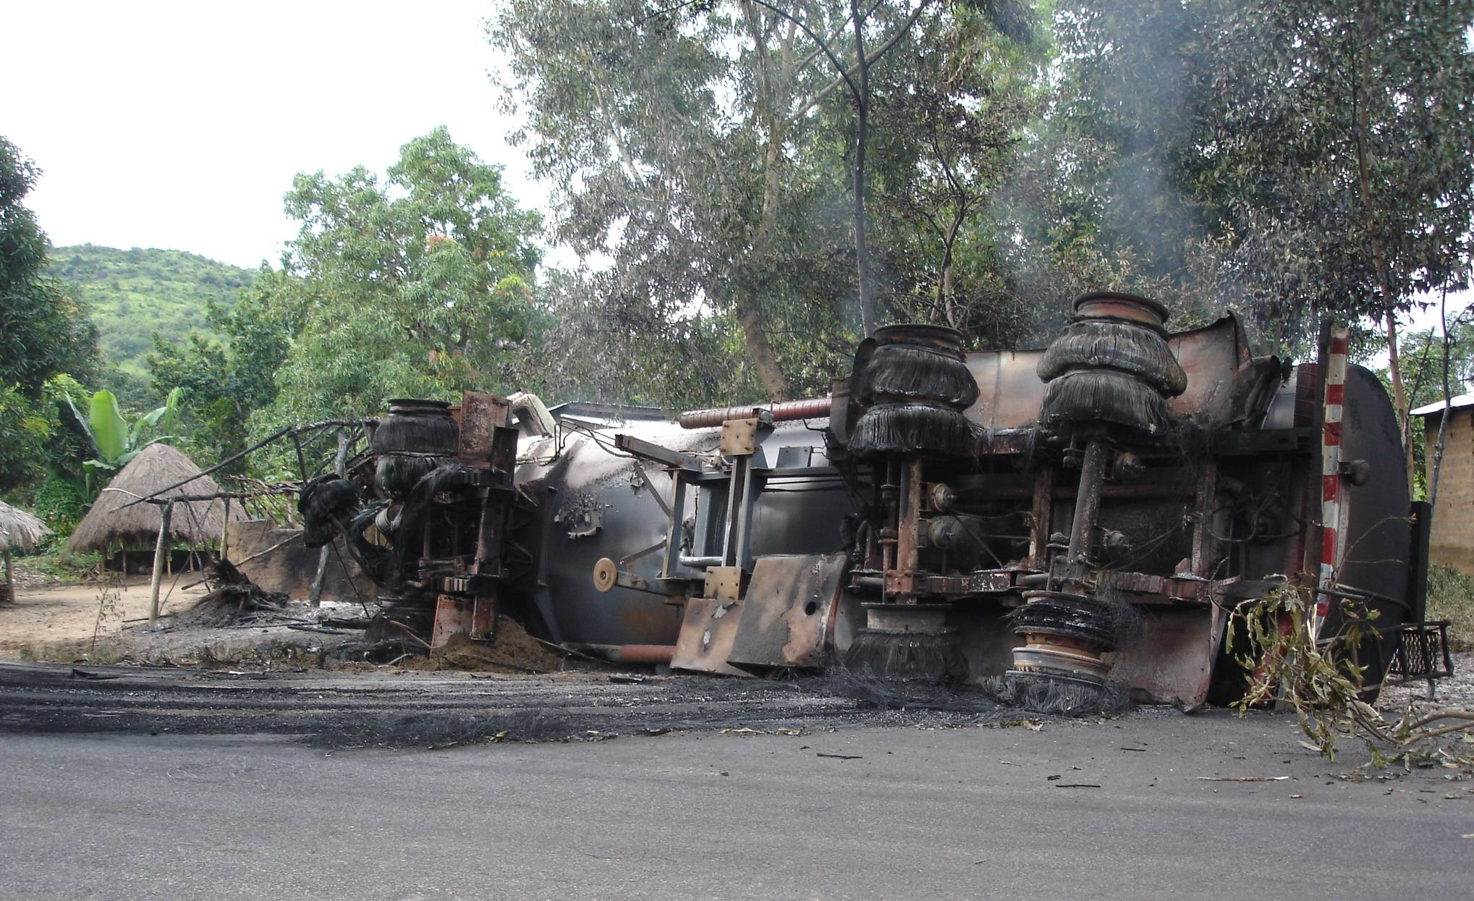
Behaviour-related causes*
Accidents
Consequences
Speed
40 %
Fatality or serious injury
Fatigue
20%
Collision with vulnerable users
Dangerous maneuver
10%
Loss of containment
Loss of control**
10%
Collision between vehicles
Looting
Distraction
6%
Rollover
Major accident
*Inhouse SVAR data from 2019 & 2020
** Excluding events related to speed, fatigue and distraction

Slide 10
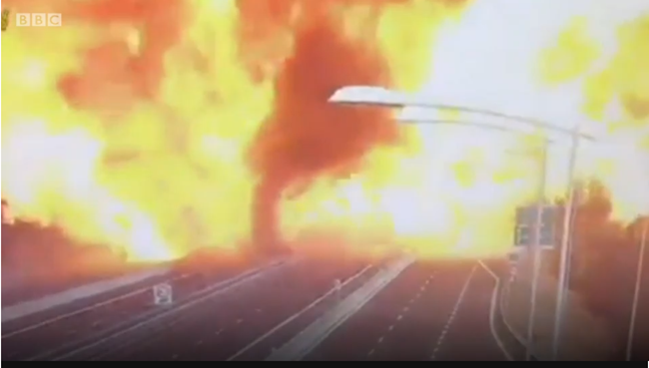
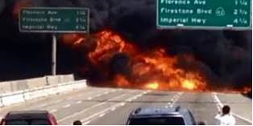
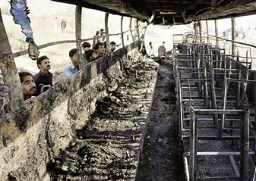
MAJOR ACCIDENT EXAMPLES (ExternAL)
Tuesday August 7, 2018, Bologna Italy.
An LPG tanker ran into the back of a truck which had stopped in traffic on a crowded highway. The collision caused a fire and subsequent truck explosion.
3 fatalities and 70 people injured
Friday August 24, 2018, 105 Freeway in Hawthorne USA
A fuel tanker truck collided with another vehicle and burst into flames. An eyewitness reported that a silver Range Rover was speeding and swerving between lanes when the driver lost control and crashed into the central divider.
2 fatalities
Monday January 21, 2019, Pakistan
A bus hit a fuel tanker and burst into flames. The incident took place when a speeding coach carrying passengers collided with an oil tanker coming from the opposite direction. Most passengers suffered burn-injuries because the coach and the fuel tanker caught fire after the collision.
At least 27 fatalities

Slide 11
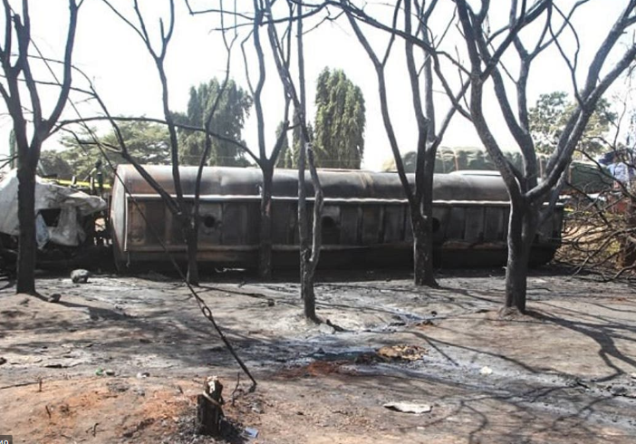
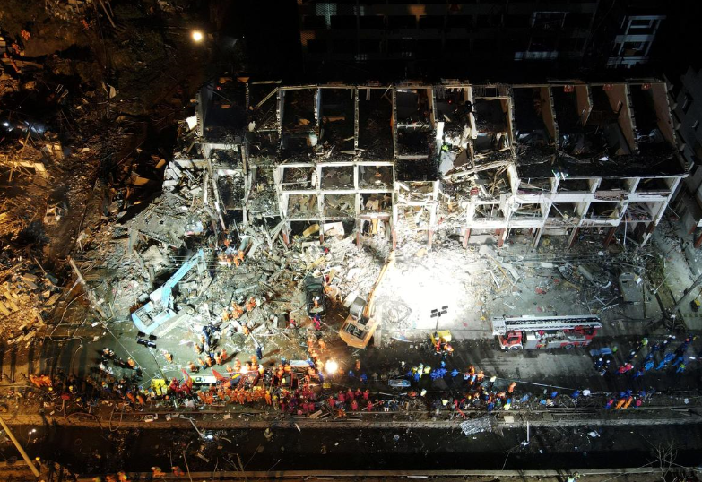
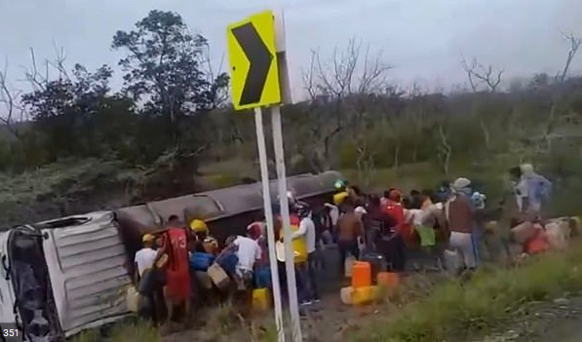
MAJOR ACCIDENT EXAMPLES (ExternAL)
Saturday August 10, 2019, Tanzania
EXEMPLES D’ACCIDENTS MAJEURS (EXTERNES)
A fuel tanker overturned in Dar es Salaam, the capital city of Tanzania. People were trying to recover fuel from the vehicle, when it caught fire.
At least 64 fatalities and 70 people sustained serious burns.
Saturday June 14, 2020, China
An LPG tanker truck exploded in southeast China. The incident occurred at a highway exit in Taizhou, Zhejiang. The tanker overturned due to high speed. There was an initial fire, followed almost two minutes later by a Vapor Cloud Explosion.
19 fatalities and 172 injured
Monday July 6, 2020, Colombia
After an overturned fuel tanker exploded in northern Colombia. Crowds had gathered around the tanker to try to siphon off fuel when the vehicle burst into flames.
At least 7 fatalities and over 40 people injured.

Slide 12
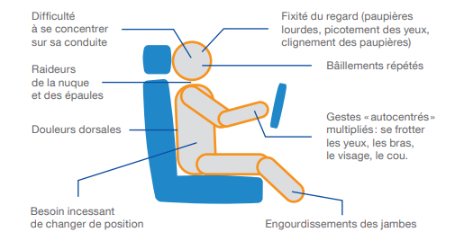
FATIGUE
Consequences of tiredness:
Know how to recognize the signs of fatigue
Know how to recognize the signs of fatigue
Difficulty to maintain trajectory and speed
Tendency to take risks
Impaired judgment and decision-making quality
Reduced awareness and span of attention
Increased reaction time
Microsleeps
Falling asleep
Difficulty concentrating on driving
Itchy or sore eyes
Heavy eyelids
Fixed gaze
Stiffness in the neck and shoulders
Yawning
Back pain
Need to rub the eyes, touch the face, the neck
Rules and best practices:
Constant need
to change position
Numbness in legs
I prepare my itinerary before every journey
I leave after sufficient rest
I get enough sleep (7 to 8 hours)
I respect the defined driving and resting times
I take a break at the first signs of fatigue
I am particularly vigilant at certain times of day (1 p.m. - 3 p.m) and night (2 a.m. - 5 a.m.)
I don't struggle to stay awake, it’s a lost battle. I stop and have some rest.
Fatigue while driving causes 20% of our behaviour related accidents

Slide 13
DISTRACTION
The main sources of distraction:
Rules and best practices:
Being on the phone
Sending or reading messages
Fiddling with a device (radio, SatNav, etc.)
Trying to recover an object on the floor or on the back seat while driving
Trying to find or handle an object (cellphone, map, document, etc.)
Smoking, eating or drinking
When driving:
I do not use my cellphone (even with a hands-free kit)
I do not read messages
I do not send messages
I program the GPS only when the vehicle is stationary
I avoid any action that could distract my attention and if necessary I stop to carry it out
Consequences of distraction:
Increased reaction time
Impaired judgment
Narrowed field of vision
Driving distractions cause 6% of our behaviour related accidents.
ONISR 2018 (Observatoire National Interministériel de la Sécurité Routière)

Slide 14
SPEED
Speeding is the main cause of our accidents
Causes:
Rules and best practices:
Overconfidence
Poor situation assessment
Poor anticipation
Goal set to reach a destination at a specific time
Fatigue
Distraction
I do not exceed speed limits
I adapt my speed to road configuration and traffic conditions
I keep a safe distance away from the vehicle in front of me
I put my foot in front of the brake when approaching potential danger
I respect other road users
I pay special attention to pedestrians and two-wheelers
I anticipate other drivers errors
I am aware of my own limits
Speed causes 40% of our behaviour
related accidents

Slide 15
IN SHORT
We (Drivers, Transporters, Total) must do everything we can to further reduce our impact
We are professionals and not just random road users
Despite difficulties, despite constraints, despite other road users, we must keep leading by example
Our safety and that of other road users must be our main concern
We must follow local driving rules as well as applicable requirements.
Rules are aimed at protecting ourselves as well as others.
Safety must take precedence over pure compliance with requirements.
Our behaviour is the key to our safety, that of other road users and of the public
No journey is important enough to risk our life or the lives of others
What can we do to further improve safety together?
We propose to discuss this during a workshop

