Slide 1
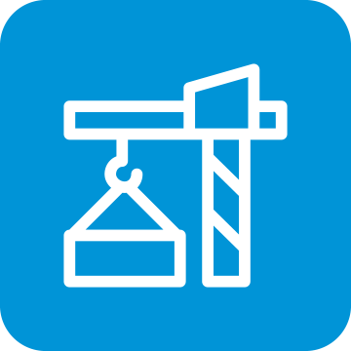
The new Golden Rules
My Commitment, our Safety
Rev.0 – October 2022
Golden Rule 6
Lifting Operations

Slide 2
01.
The essentials

Slide 3
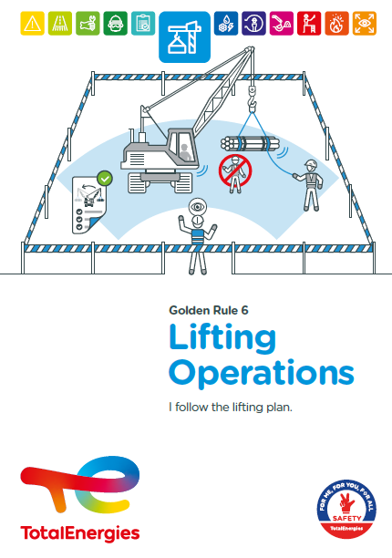
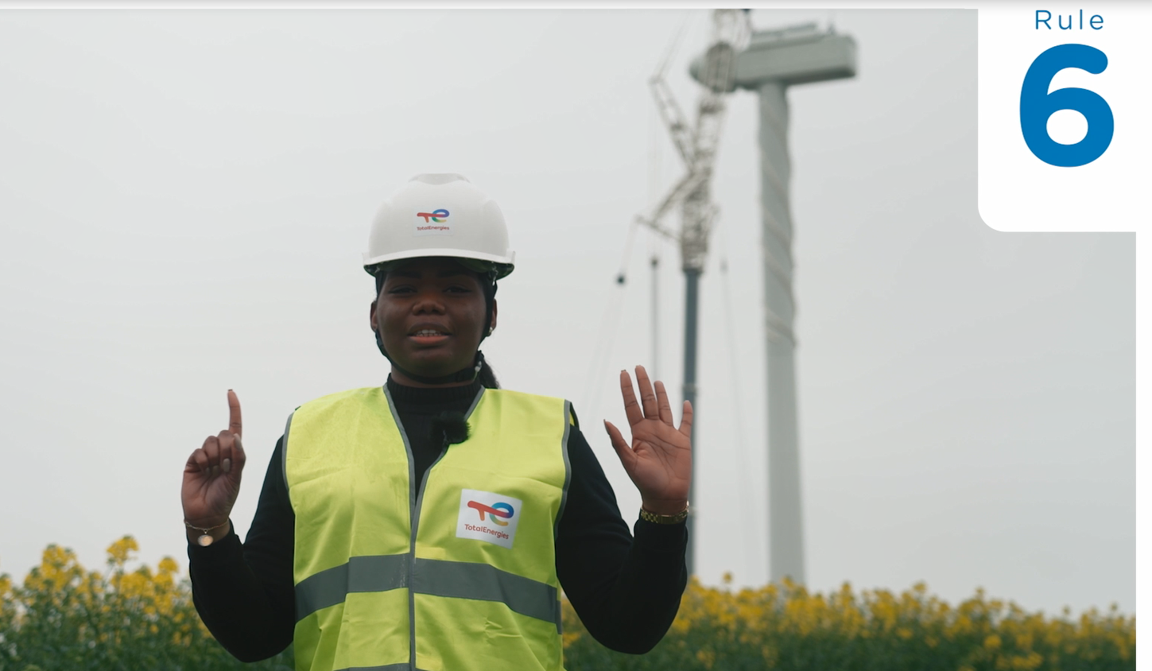
Poster & pictogram
The pictogram in Golden Rule 6 "Lifting Operations" shows a load suspended from a lifting device.

Slide 4
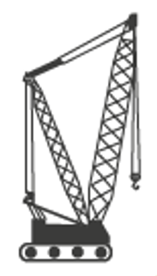
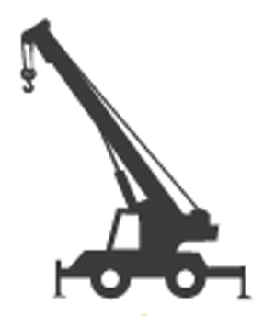

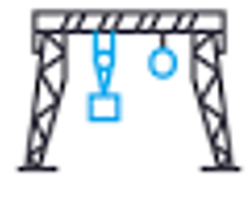
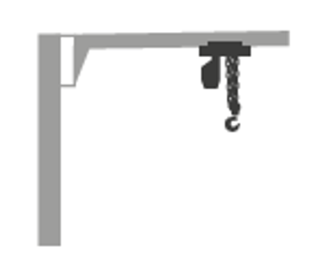
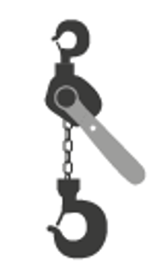

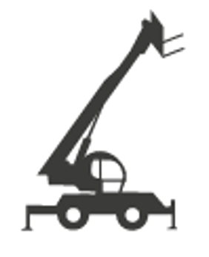
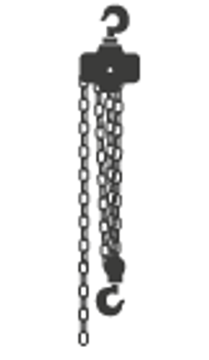
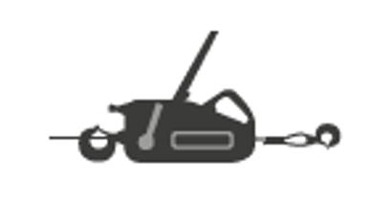

Some definitions
LIFTING
CRANAGE
Mechanical operation carried out by means of lifting devices which involves lifting, lowering, or suspension of a load. In the event of a failure of the lifting device or any of its accessories, the load does not remain stationary.
Loader crane
All-terrain mobile crane
Crawler crane
Gantry crane
CRANAGE
Lifting of a suspended load by means of a crane or other non-portable lifting devices.
RIGGING
MECHANICAL HANDLING
RIGGING
Lifting operation carried out by means of portable lifting equipment (chain hoist, winch, lever hoist, etc.).
Jib crane with (un)powered hoist
Industrial or all-terrain counterbalanced forklift truck
Hand-operated lever chain hoist
MECHANICAL HANDLING
Moving a load by means of a lifting device (excluding cranes) without the use of lifting accessories.
Hand-operated chain hoist
Wire rope hoist
Lift truck with telescopic jib
Rotary lift truck with telescopic jib

Slide 5
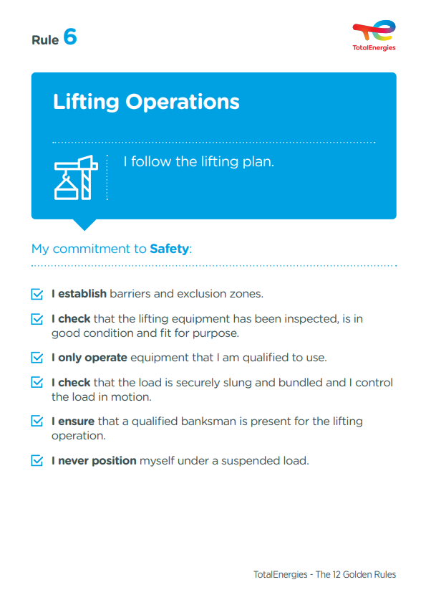
The essence of Golden Rule 6
What changes from the 2017 version of the Golden Rules:
Mention of the "qualification":
"I only operate equipment that I am qualified to use".
"I ensure that a qualified banksman is present for the lifting operation".
    Everybody involved in the preparation and execution of a lifting operation (including the lifting equipment operator and the banksman):
      is trained in accordance with its roles and responsibilities;
      has the theoretical and practical knowledge of the tasks and equipment entrusted to him.
    The qualification alone does not authorise the holder to carry out on his own the operations for which he is qualified.
    A driving authorisation is the employer's recognition of a worker's ability to perform a specific task safely.

Slide 6

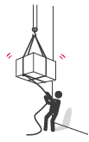
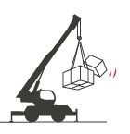
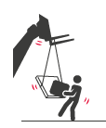
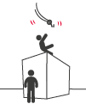
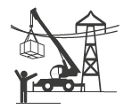
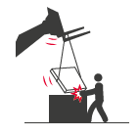


Lifting incidents
ACCIDENTS IN THE COMPANY WHERE A REQUIREMENT OF GOLDEN RULE 6 HAS BEEN BREACHED
MAIN RISKS OF LIFTING OPERATIONS (INCLUDING MECHANICAL HANDLING)
4
Fatalities*
Drop of the load
(e.g. sling rupture)
Drop of part of the load (bundling issue)
Load shifting
Shock, collision, crushing during load control
25
Lost time accidents**
58
HIPO (Haut Potential)**
Fall of a person when lashing the load
Burns or electrocution from contact or arcing with overhead power lines
Jamming of arms, hands when receiving the load
Overturning or Rollover (sideways)
* Period 2012-2021
** Period 2017-2021
Tipping (forward)

Slide 7
02.
REX

Slide 8
Illustration of requirements
REQUIREMENT | EVENT | SLIDE
1. I establish barriers and exclusion zones. | FALL OF INSULATION ELEMENTS DURING A LIFTING OPERATION | N°9
2. I check that the lifting equipment has been inspected, is in good condition and fit for purpose. | FALL OF AN OVERHAUL BALL | N°10
2. I check that the lifting equipment has been inspected, is in good condition and fit for purpose. | SLING FAILURE ON THE FORK OF A FORKLIFT TRUCK | N°11
3. I only operate equipment that I am qualified to use. | FORKLIFT TILT | N°12
4. I check that the load is securely slung and bundled and I control the load in motion. | NEAR ACCIDENT DURING THE DISMANTLING OF A MINI CANOPY | N°13
5. I ensure that a qualified banksman is present for the lifting operation. | ELECTRIC ARC BETWEEN LIFTING EQUIPMENT AND HIGH VOLTAGE LINE (150KV) | N°14
6. I never position myself under a suspended load. | DROP OF A 120 KG PIPE | N°15
The descriptions of the circumstances and consequences have been simplified for a better understanding.
A link to each REX/Good practice is available for more information.

Slide 9

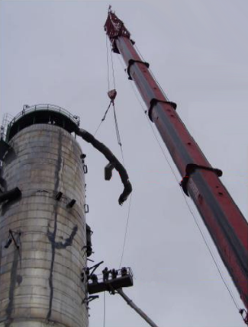
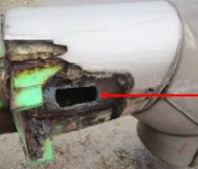
REX
1. I establish barriers and exclusion zones.
> FALL OF INSULATION ELEMENTS DURING A LIFTING OPERATION
CIRCUMSTANCES – FACTS
  The dismantling of a column on a shutdown unit was ongoing.
  In order to lift the pipes, they were partially uninsulated and openings were created for the metallic slings to pass through. After the installation of the guiding rope and of the slings, the element was cut and transported to the ground with a crane.
  A worker was cutting piping with a cutting torch, at a height of 50 meters, from a MEWP (Mobile Elevating Work Platform).
  A limited area was marked out inside the worksite.
  When one of the pipes was being lifted, it hit the column and a sheet of insulation fell to the ground, partially cutting the fire hose.
  A person was located into the zone, at a few meters from the cut fire hose.
CONSEQUENCES
Potential death of the worker (HIPO).
LESSONS TO BE LEARNED
I take into account the effect of the height of fall, the mass and shape of the object being lifted and the obstacles that may deflect the load (deflection height) in determining the exclusion zone on the ground.
CAUSES
  The piping being partially uninsulated in order to allow the lifting operation, the insulation elements were no longer sufficiently fixed to the piping.
  Worker present into the limited marked out zone.
  Piping bumped into the column (unguided load).
Opening created for the sling
1
1
Fall of an insulation element during the lifting of the piping
2
During the lifting operation, the persons in the MEWP were moved out of the way
2
Click here to access the REX

Slide 10
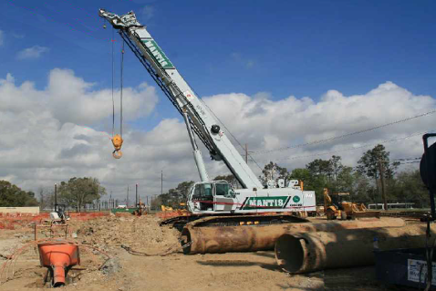
REX
2. I check that the lifting equipment has been inspected and is in good condition.
> FALL OF AN OVERHAUL BALL
CIRCUMSTANCES – FACTS
  A mobile telescopic boom crane used for a lifting operation experienced operational issues.
  A repairman was dispatched to the job site, but could not locate the job site.
  Workers from the work site remedied the crane’s operational issues and the crane remained in operation.
  During the extension of the crane boom, the whip line overhaul ball moved upwards until it came into contact with the high limit switch (crane safety shut down protection), but the latter did not stop the crane operation, contrary to what was expected.
  Subsequently, the overhaul ball fell and struck a worker standing under the crane’s boom.
CONSEQUENCES
Death of the worker
LESSONS TO BE LEARNED
I do not pass under the boom if the crane is in use.
As the operator of the lifting device, I ensure that I carry out the daily visual check before use and that the safety systems installed on the crane are working.
As the person in charge of the lifting operation, I make sure that the crane is not in degraded mode and if necessary I inform the whole team before the start of the operation.
CAUSES
  The crane operational issues were not addressed by a qualified technician.
  The crane remained in operation with known functional anomalies.
  Workers were positioned under the crane’s extended boom with a load.
  The decision to stop the crane operation was not taken.
1
1
Boom
2
2
High limit switch
3
Main hook
3
4
Steel sleeves
4
Click here to access the REX

Slide 11
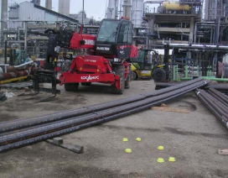
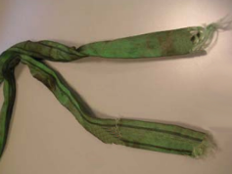
REX
2. I check that the lifting equipment is fit for purpose.
> SLING FAILURE ON THE FORK OF A FORKLIFT TRUCK
CIRCUMSTANCES – FACTS
  An unloading operation was assigned to two workers.
  The machine was at the location and already equipped with forks.
  The 2 workers unloaded the tubes from the truck onto the ground.
  After the truck left, the tubes had to be stowed away.
  The banksman (also slinger) then passed slinging straps around each bundle and suspended them from a fork of the forklift.
  Under the weight of the load of 3.5 t, these straps broke, and the nearby worker received the package on his foot (protected by the safety shoe).
CONSEQUENCES
Foot injury of the worker. Complications led to the partial amputation of his foot.
LESSONS TO BE LEARNED
Before any lifting operation, I ensure that the lifting equipment is suitable and compatible with the operation to be carried out.
CAUSES
  A worker was present near the lift.
  The forks are not suitable for lifting a suspended load (shearing of the sling on a sharp edge of the blade of the fork).
1
Forklift
1
2
4 Pads on the floor during the operation
3
Load of 3,5 tons of heaters tubes
4
Fork
4
2
3
5
Victim
5
1
Rupture of the sling
2
Onset of a rupture
3
Corresponds to the width of the blade of the fork
1
2
3
Click here to access the REX

Slide 12
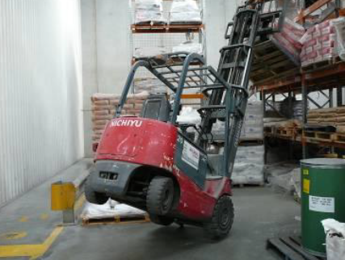
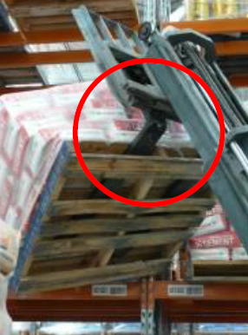
REX
3. I only operate equipment that I am qualified to use.
> FORKLIFT TILT
CIRCUMSTANCES – FACTS
  A worker (forklift operator) was trying to remove a 1.44t pallet of raw materials from a rack.
  As he was reversing, the rear wheels started to lift.
  The forklift truck got stuck against the rack.
CONSEQUENCES
No actual severity (HIPO).
LESSONS TO BE LEARNED
Before using a lifting equipment, I make sure that I am qualified and authorised to operate this equipment.
CAUSES
  The worker was not authorised to drive this forklift.
  Inadequate housekeeping and stowage on site.
Click here to access the REX

Slide 13
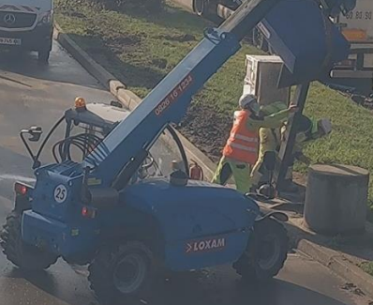
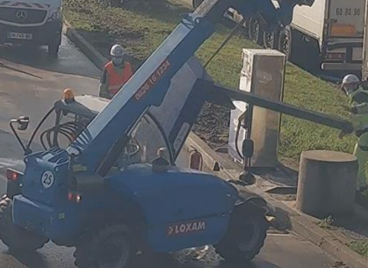
REX
4. I check that the load is securely slung and bundled and I control the load in motion.
> NEAR ACCIDENT DURING THE DISMANTLING OF MINI CANOPY
CIRCUMSTANCES – FACTS
  A mini canopy had to be dismantled.
  A lift truck with telescopic jib was provided for the operation.
  The support pole of the canopy was anchored to the ground.
  The canopy was slung at a single point on the pole.
  When the ground anchor of the canopy was released, it tipped over.
CONSEQUENCES
No injury (HIPO).
LESSONS TO BE LEARNED
Before any lifting operation, I ensure that the load is properly slung and secured.
During the lifting operation, I control the moving load and ensure that it is stable at all times.
CAUSES
  Lifting force on a load still fixed to the ground by a point.
  Incorrect slinging.
  Lack of knowledge of lifting practices, untrained slinging personnel.
  Unusual task, carried out in a hurry.
  Modification of the operating procedure without an associated risk analysis.
  Incorrect use of the lift truck with telescopic jib (the lift truck intended to hold the load, to put it down on the ground, being turned into a lifting device for the mini canopy).
Click here to access the REX

Slide 14
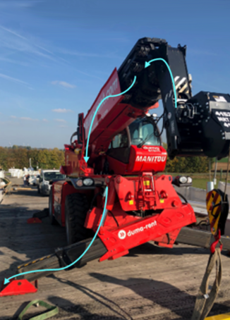
REX
5. I ensure that a qualified banksman is present for the lifting operation.
> ELECTRIC ARC BETWEEN LIFTING EQUIPMENT AND HIGH VOLTAGE LINE (150KV)
CIRCUMSTANCES – FACTS
  Lifting equipment (type MANITOU) was used to move parts of a bridge that had to be dismantled.
  In order to be able to reach and move a wooden crossbeam, the crane operator raised the boom of the lifting equipment.
  The end of the boom came close (+/- 50 cm) to a high-voltage line (150kV) located in the vicinity of the work area.
  This manoeuvre generated an electric arc between the lifting equipment and the overhead power cable.
  The electrical energy was discharged through the metal frame via an existing bolt under the forklift's stabilisers.
  The contracted crane operator was apparently unaccompanied.
CONSEQUENCES
Several potential deaths (HIPO).
LESSONS TO BE LEARNED
For any lifting operation, I ensure that an authorised banksman is present.
In addition, for any operation near power lines, I ensure that the banksman or his assistant controls the distance between this line and any part of the crane, or the load being lifted.
CAUSES
  Absence of detailed operating procedures with a formalised risk analysis.
  Safety instructions sent by the power line operator to the lifting works contractor were not communicated to the on-site team.
  Failure to respect the safety distance between the lifting equipment and the very high voltage line.
  Absence of a lift plan.
  Absence of a banksman.
  Worker with the sun in his eyes.
Electrical current path
Click here to access the REX

Slide 15
REX
6. I never position myself under a suspended load.
> DROP OF A 120 KG PIPE
CIRCUMSTANCES – FACTS
  A 120kg pipe was being lifted between a column and a scaffold adjacent to the column.
  During this operation, several people were positioned on different levels of the scaffolding.
  This lifting operation was carried out blind: the crane operator and the banksman communicated by walkie-talkie.
  During the lifting process, the pipe caught on a structural beam, which released the tension in the sling's choke point and allowed the pipe to slip and fall.
  As it fell, the pipe hit two workers on the scaffolding.
CONSEQUENCES
Worker 1: open wound of the right wrist and fracture of a finger – lost time accident (6 weeks).
Worker 2: double fracture of the right forearm – lost time accident (3 months).
LESSONS TO BE LEARNED
I never stand under a suspended load.
I do not plan to work simultaneously with a lifting operation on upper levels if the fall of the object being lifted could impact on lower levels.
CAUSES
  The obstacle was not spotted.
  The lifting operation was carried out blind.
  The space was small and crowded.
  The workers were under the load.
Click here to access the REX

Slide 16
03.
Further information

Slide 17
Our tools and documents
GM-GR-HSE-460 - Preventing Accidents Related to the Use of Forklift Trucks
GM-GR-HSE-460_en_1.pdf (sharepoint.com)
Life Saving Checks – Lifting operations: Life saving checks
E-learning on Lifting Operations: https://lizzy.totalenergies.com/
Toolbox HSE – new Golden Rules:
    General material: TotalEnergies Golden Rules – General material
    Roll-out material: TotalEnergies Golden Rules – Roll-out material
REX database: Company HSE REX DataBase
Safety+ (good practices per Golden Rule): https://safetyplus.totalenergies.com/en
          https://safetyplus.totalenergies.com/en/contribution/pxqcws?p_route=wall&p_qs=rules%3D5
          https://safetyplus.totalenergies.com/en/contribution/iyejvv?p_route=wall&p_qs=rules%3D5
          https://safetyplus.totalenergies.com/en/contribution/l9ww9i?p_route=wall&p_qs=rules%3D5%26desc%3Dlevage
          https://safetyplus.totalenergies.com/en/contribution/3399to?p_route=wall&p_qs=rules%3D5%26desc%3Dlevage

Slide 18
Lexicon
Hazard: An intrinsic property of a product, equipment, process, situation or action that can result in harm to people, the environment and/or assets.
Risk: The combination of the probability of occurrence of a hazardous event and the severity of the impact that may result from exposure to the hazard.
HSE events:
  Incident: Any sudden and undesirable HSE event on a given date, that causes injury or illness, damage to property or facilities, loss of production, environmental damage or damage to the Company's image.
  Near miss: Any sudden and undesirable HSE event on a given date which, in slightly different circumstances, could have had the same consequences as an incident. A near miss does not have an actual severity level but has a potential severity level.
  Anomaly: Any abnormal situation or behaviour, including deviations from a standard, specification, procedure or rule.
HIPO (High Potential) [slide 6]: Incident or near miss with an actual severity level ≤ 3* and a potential severity level ≥ 4** in one or more areas of the Company’s evaluation matrix of the actual and potential severity level of HSE events.
REX HSE: Document for sharing information on an internal or external HSE event, based on a detailed analysis and making recommendations.
* For example, physical consequences with an actual severity level = 3 correspond to a lost time accident.
** For example, physical consequences with a potential severity level of 4 correspond to a fatality.
Notes:
Définitions « risques » et « danger » (GM-GR-HSE-300 « Evaluation des risques professionnels au poste de travail »)
Définitions HIPO, Incident, presqu’accident, anomalie (CR-GR-HSE-100 « Reporting HSE »)

