Slide 1
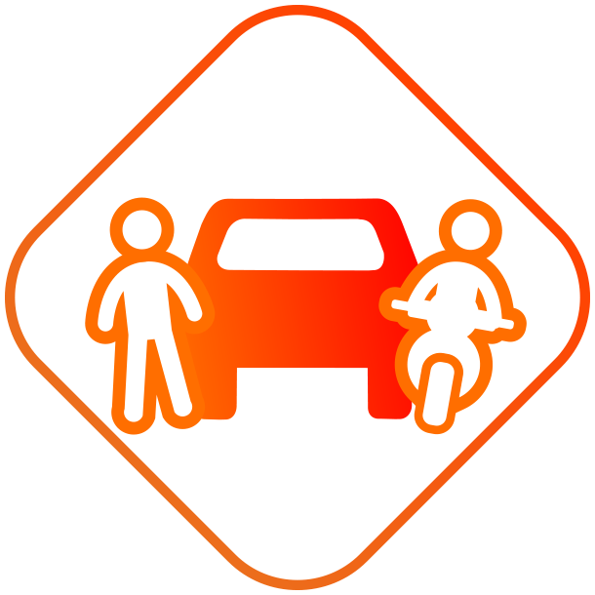
I'm a #SafeDriver
I pay attention to other road users and pedestrians when I’m driving

