Slide 1
The new Golden Rules
My Commitment, our Safety
Rev.0 – June 2022
Golden Rule 10
Work at Height

Slide 2
01.
The essentials

Slide 3
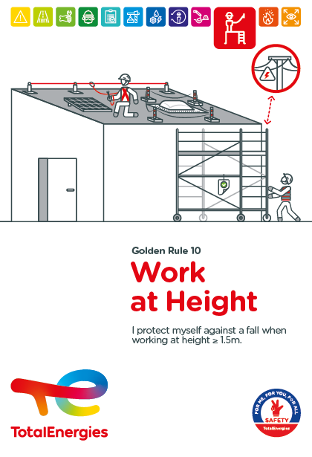
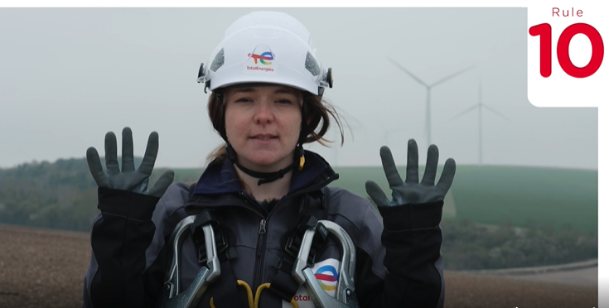

Poster & pictogram
The Golden Rule 10 pictogram « Work at Height » shows a person carrying out an activity at height, while being secured by a fall prevention device connected to an anchor point.
Affiche Règle d’or 10

Slide 4
Some definitions
WORK AT HEIGHT*
EXAMPLES OF WORK AT HEIGHT
Work at a height refers to work and movements generating a risk of a person falling with a height difference of ≥ 1.5 metres.
By extension, it also concerns the activities necessary for carrying out certain work at height and which expose the worker to:
  A risk of falling objects
  A risk of tipping over
  A risk of electrocution near or in contact with overhead power lines
  A risk of crushing at height when using Mobile Elevating Work Platforms (MEWP)
Use of temporary equipment**
Activities on an elevated location
Mobile elevating work platforms (MEWP)
Truck or railcar domes
Scaffolding
Roofs of buildings or tanks
Individual mobile platforms (light weight)
Floors of facilities
Ropes
* Some local regulations may impose a more restrictive definition of work at height.
** Warehouse access ladders (without a secure platform on all four sides), standard stepladders without a secure top and portable ladders are not used as workstations.

Slide 5
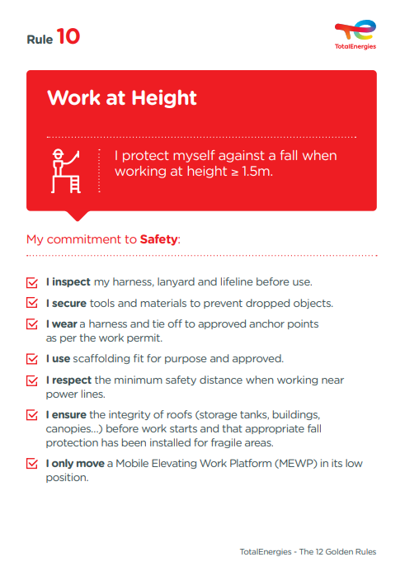
The essence of Golden Rule 10
What changes from the 2017 version of the Golden Rules:
Lowering the height defining work at a height from 2.0 to 1.5 m.
Increase from 6 to 7 requirements, with the addition of the first requirement relating to the inspection of fall prevention devices before use.
Adaptation of the requirement to wear a safety harness, now linked to the prevention measures defined in the work permit.
Reinforcement of the requirement on moving MEWP, by removing the possibility of moving them in the deployed position "with specific authorisation".
    Order of the requirements:
    The first 3 requirements cover "fall of persons" (via the PPE aspect) and "fall of objects". The last 4 requirements cover the risks related to "work at height equipment" and "the working environment".
Work at height is covered in CR-GR-HSE-425 "HSE Requirements for Work at Height "*.
* Company Rules (CR) are limited to internal use.

Slide 6
Work at Height incidents
ACCIDENTS IN THE COMPANY WHERE A REQUIREMENT OF GOLDEN RULE 10 HAS BEEN BREACHED
MAIN RISKS OF WORK AT HEIGHT
7
Fatalities* (including a 1,6m fall)
Falling objects
Fall of persons
23
Tipping over
Electrocution
Lost time accidents**
47
Crushing (by vertical or lateral displacement)
HIPO (High Potential)**
* 2012-2021
** 2017-2021

Slide 7
02.
REX

Slide 8
Illustration of requirements
REQUIREMENT | EVENT | SLIDE
1. I inspect my harness, lanyard and lifeline before use. | GOOD PRACTICE RELATED TO THE USE OF A HARNESS | N°9
2. I secure tools and materials to prevent dropped objects. | A TOOL FALLING NEAR AN EMPLOYEE | N°10
3. I wear a harness and tie off to approved anchor points as per the work permit. | 22 METRE FALL WHILE DISMANTLING SCAFFOLDING | N°11
4. I use scaffolding fit for purpose and approved. | GOOD PRACTICE ON CHECKING SCAFFOLDING | N°12
5. I respect the minimum safety distance when working near power lines. | ELECTROCUTION WHILE USING A MOBILE SCAFFOLD | N°13
6. I ensure the integrity of roofs (storage tanks, buildings, canopies…) before work starts and that appropriate fall protection has been installed for fragile areas. | 10 METRE FALL THROUGH A ROOF | N°14
7. I only move a Mobile Elevating Work Platform (MEWP) in its low position. | CRUSHING OF THE DRIVER OF A MEWP AT HEIGHT | N°15
The descriptions of the circumstances and consequences have been simplified for a better understanding.
A link to each REX is available for more information.

Slide 9


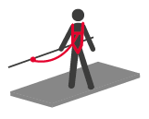
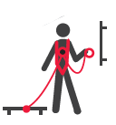
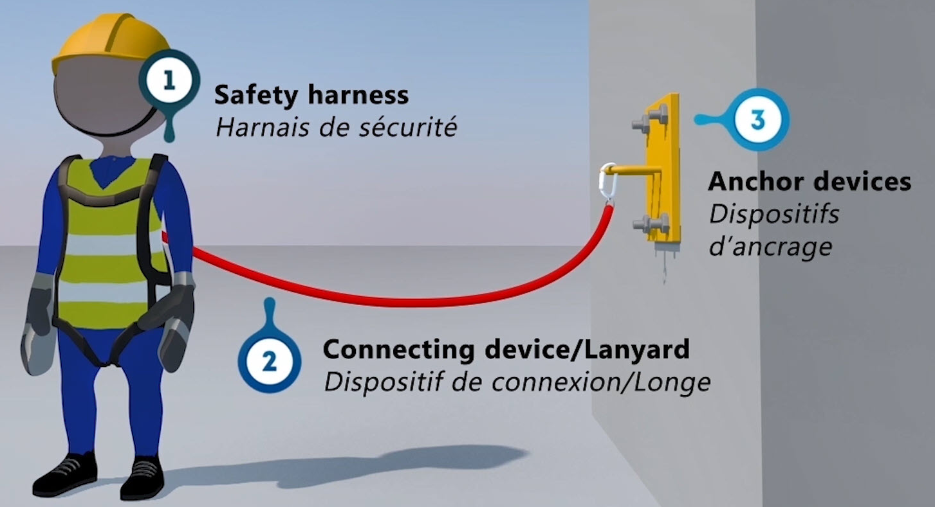
GOOD PRACTICE
1. I inspect my harness, lanyard and lifeline before use.
> GOOD VERIFICATION PRACTICE
Complete system = safety harness + connecting device + anchor device
A
SAFETY HARNESS:
body retention device
  It is essential to:
  Check that the harness is suitable for the task to be performed and the user's body size.
  Check the condition before and after each use (seams, tears, etc.) and the use-by date.
  Discard any defective harness for disposal.
C
ANCHOR DEVICE :
a point or structure used to attach the connecting device. This may be a fixed anchor point, a lifeline, a rail, a textile strap...
  It is essential to:
  Only attach to approved anchor points.
  Check the condition of the anchor device before and after use.
A
C
B
CONNECTING DEVICE:
a set of components connecting the safety harness to the anchorage device
  It is essential to:
  Check that the connecting device is attached to the harness and to a validated anchorage point.
  Check the condition of the connection device (lanyard, shock absorber, retractor, etc.) before and after use.
B
The components of the complete system must be compatible with each other. A defect in just one of these three links means that the entire fall protection chain is no longer secured!

Slide 10
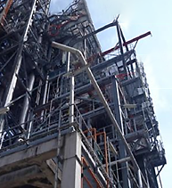
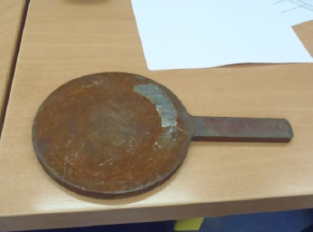
REX
2. I secure tools and materials to prevent dropped objects.
> A TOOL FALLING NEAR AN EMPLOYEE
CIRCUMSTANCES – FACTS
  Construction work took place in a production unit.
  An isolation device, stored in an unsecured manner, fell 45 metres.
  While falling, the 1.5kg object passed close to a worker who was working 25 metres below.
CONSEQUENCES
Potential death of the worker.
LESSONS TO BE LEARNED
During work at height, I secure tools and equipment to prevent them from falling.
At all times, including after work, I put away any unused objects (tools, bars, rods, nuts, hoses...).
CAUSES
  Isolation device not stored and secured.
  Unidentified risk of falling objects during observation rounds in the unit.
Click here to access the REX
Do not store objects high up in the office (on a cupboard, on a window sill, etc.).

Slide 11
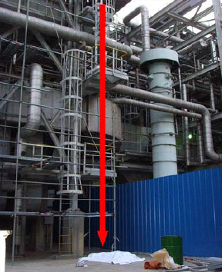
REX
3. I wear a harness and tie off to approved anchor points
as per the work permit.
> 22 METRE FALL WHILE DISMANTLING SCAFFOLDING*
CIRCUMSTANCES – FACTS
  A worker was dismantling a scaffolding.
  He was wearing a safety harness that was not attached to an anchor point.
  While moving on the unstable and partially dismantled scaffolding, he lost his balance and fell 22 metres.
CONSEQUENCES
Death of the worker.
LESSONS TO BE LEARNED
When I work at heights of 1.5 metre or more with a work permit, I wear a safety harness and attach myself permanently to suitable anchor points defined in advance.
CAUSES
  Incomplete training on the risks associated with work at height.
  The worker's harness was not attached to an anchor point.
Click here to access the REX
* Event prior to 2012

Slide 12

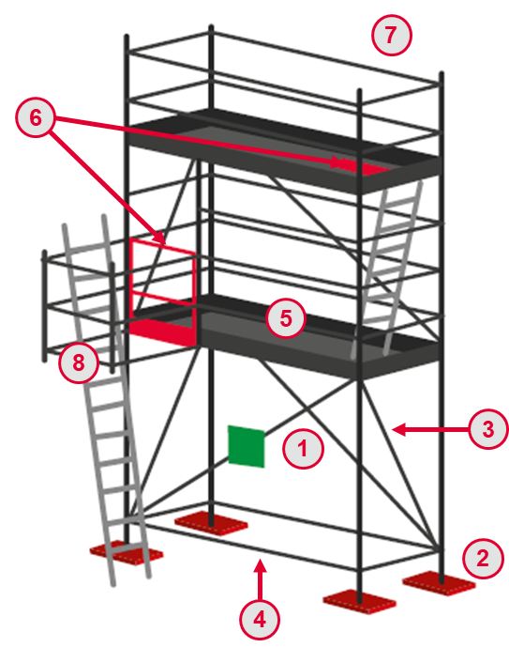
GOOD PRACTICE
4. I use scaffolding fit for purpose and approved.
> GOOD PRACTICE ON CHECKING SCAFFOLDING
9
CHECKING THE GENERAL CONDITION OF A SCAFFOLD
7
Presence of a safety label (green if the scaffold is compliant).
Scaffold legs are properly braced (load distribution plates in full contact with the surface).
The structure comprises crossbraces.
The horizontal braces are properly fixed on the bases.
The working platforms are complete and unobstructed.
The access gates or traps are closed.
Full guard rails (top and middle rails, and toe board) are installed on all working platforms.
All ladders are secured.
Respect for safety distances from potential hazards (power lines, co-activity).
6
5
8
1
3
2
4

Slide 13
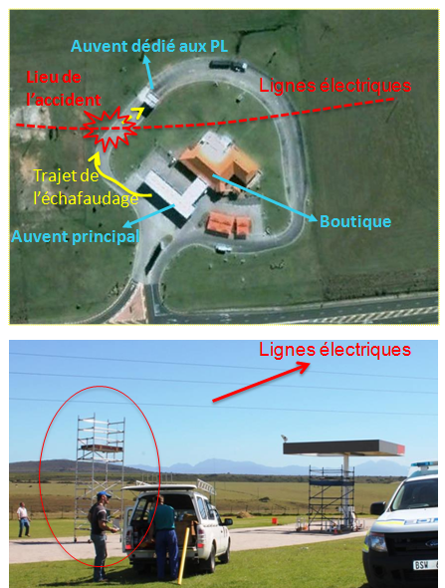
REX
5. I respect the minimum safety distance when working near
power lines.
> ELECTROCUTION WHILE USING A MOBILE SCAFFOLD
CIRCUMSTANCES – FACTS
  Two workers were using a mobile scaffold for painting work.
  When the scaffolding was moved near 22 kV overhead lines, an electric arc occurred with the metal structure of the scaffolding.
  The two workers were electrified.
CONSEQUENCES
Death of one worker.
Amputation of the forearm of the second worker.
LESSONS TO BE LEARNED
I ensure that the risk represented by power lines is taken into account when working at height.
I respect the minimum safety distance from power lines.
CAUSES
  Insufficient risk assessment (proximity of power line not taken into account).
  Insufficient training on the risks of electrification when working at height near power lines.
Power lines
Canopy dedicated to trucks
Accident
location
Power lines
Path
of the scaffold
Main canopy
Shop
Click here to access the REX

Slide 14
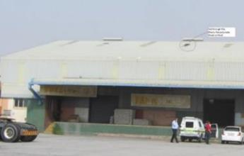
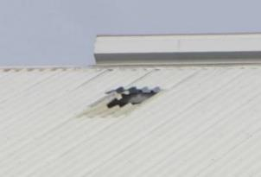
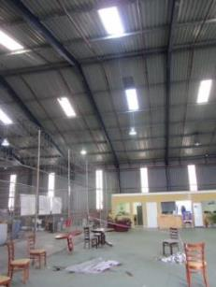
REX
6. I ensure the integrity of roofs (storage tanks, buildings, canopies…) before work starts and that appropriate fall protection has been installed for fragile areas.
> 10 METRE FALL THROUGH A ROOF
CIRCUMSTANCES – FACTS
  Two workers were inspecting a sheet metal roof of a warehouse for repair.
  During the work, one of the two workers fell through a skylight.
  He fell approximately 10 metres to the floor of the warehouse.
CONSEQUENCES
  Death of the worker.
LESSONS TO BE LEARNED
Before accessing a roof, I make sure that an inspection of the premises has been carried out in order to identify the fragile areas, including the access, and to define the most appropriate prevention and protection measures:
Collective protections such as: temporary guardrails or nets below the work area.
Individual protection: safety harness attached via a suitable device to a validated anchor point.
CAUSES
  Lack of risk assessment and definition of corresponding prevention measures.
  No supervision of the intervention.
Click here to access the REX

Slide 15
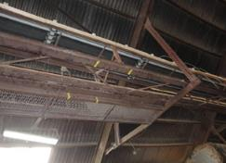
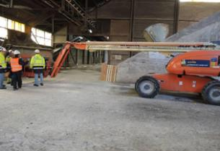
REX
7. I only move a Mobile Elevating Work Platform (MEWP) in its low position.
> CRUSHING OF THE DRIVER OF A MEWP AT HEIGHT
CIRCUMSTANCES – FACTS
  During asbestos removal work in a storage hall, a worker handled on his own a MEWP designed for this work.
  He reversed the MEWP with the basket deployed at a height of 5 metres and was pinned against a metal beam located behind him.
CONSEQUENCES
  Death of the worker.
LESSONS TO BE LEARNED
I do not move a MEWP in the deployed position.
I do not use a MEWP alone, without a second authorised person on the ground who is qualified to operate a MEWP.
CAUSES
  Starting the job in advance, without a work permit.
  Using the the MEWP without a supervisor.
  Moving the MEWP in its deployed position.
Click here to access the REX

Slide 16
03.
Further information

Slide 17
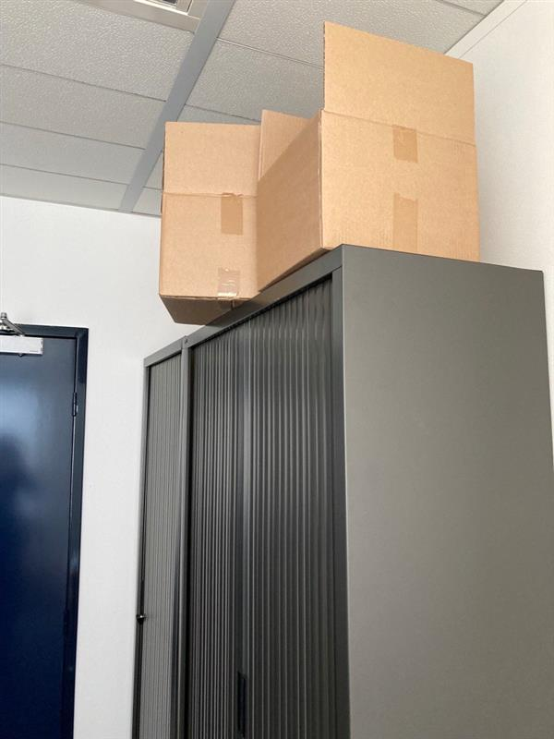
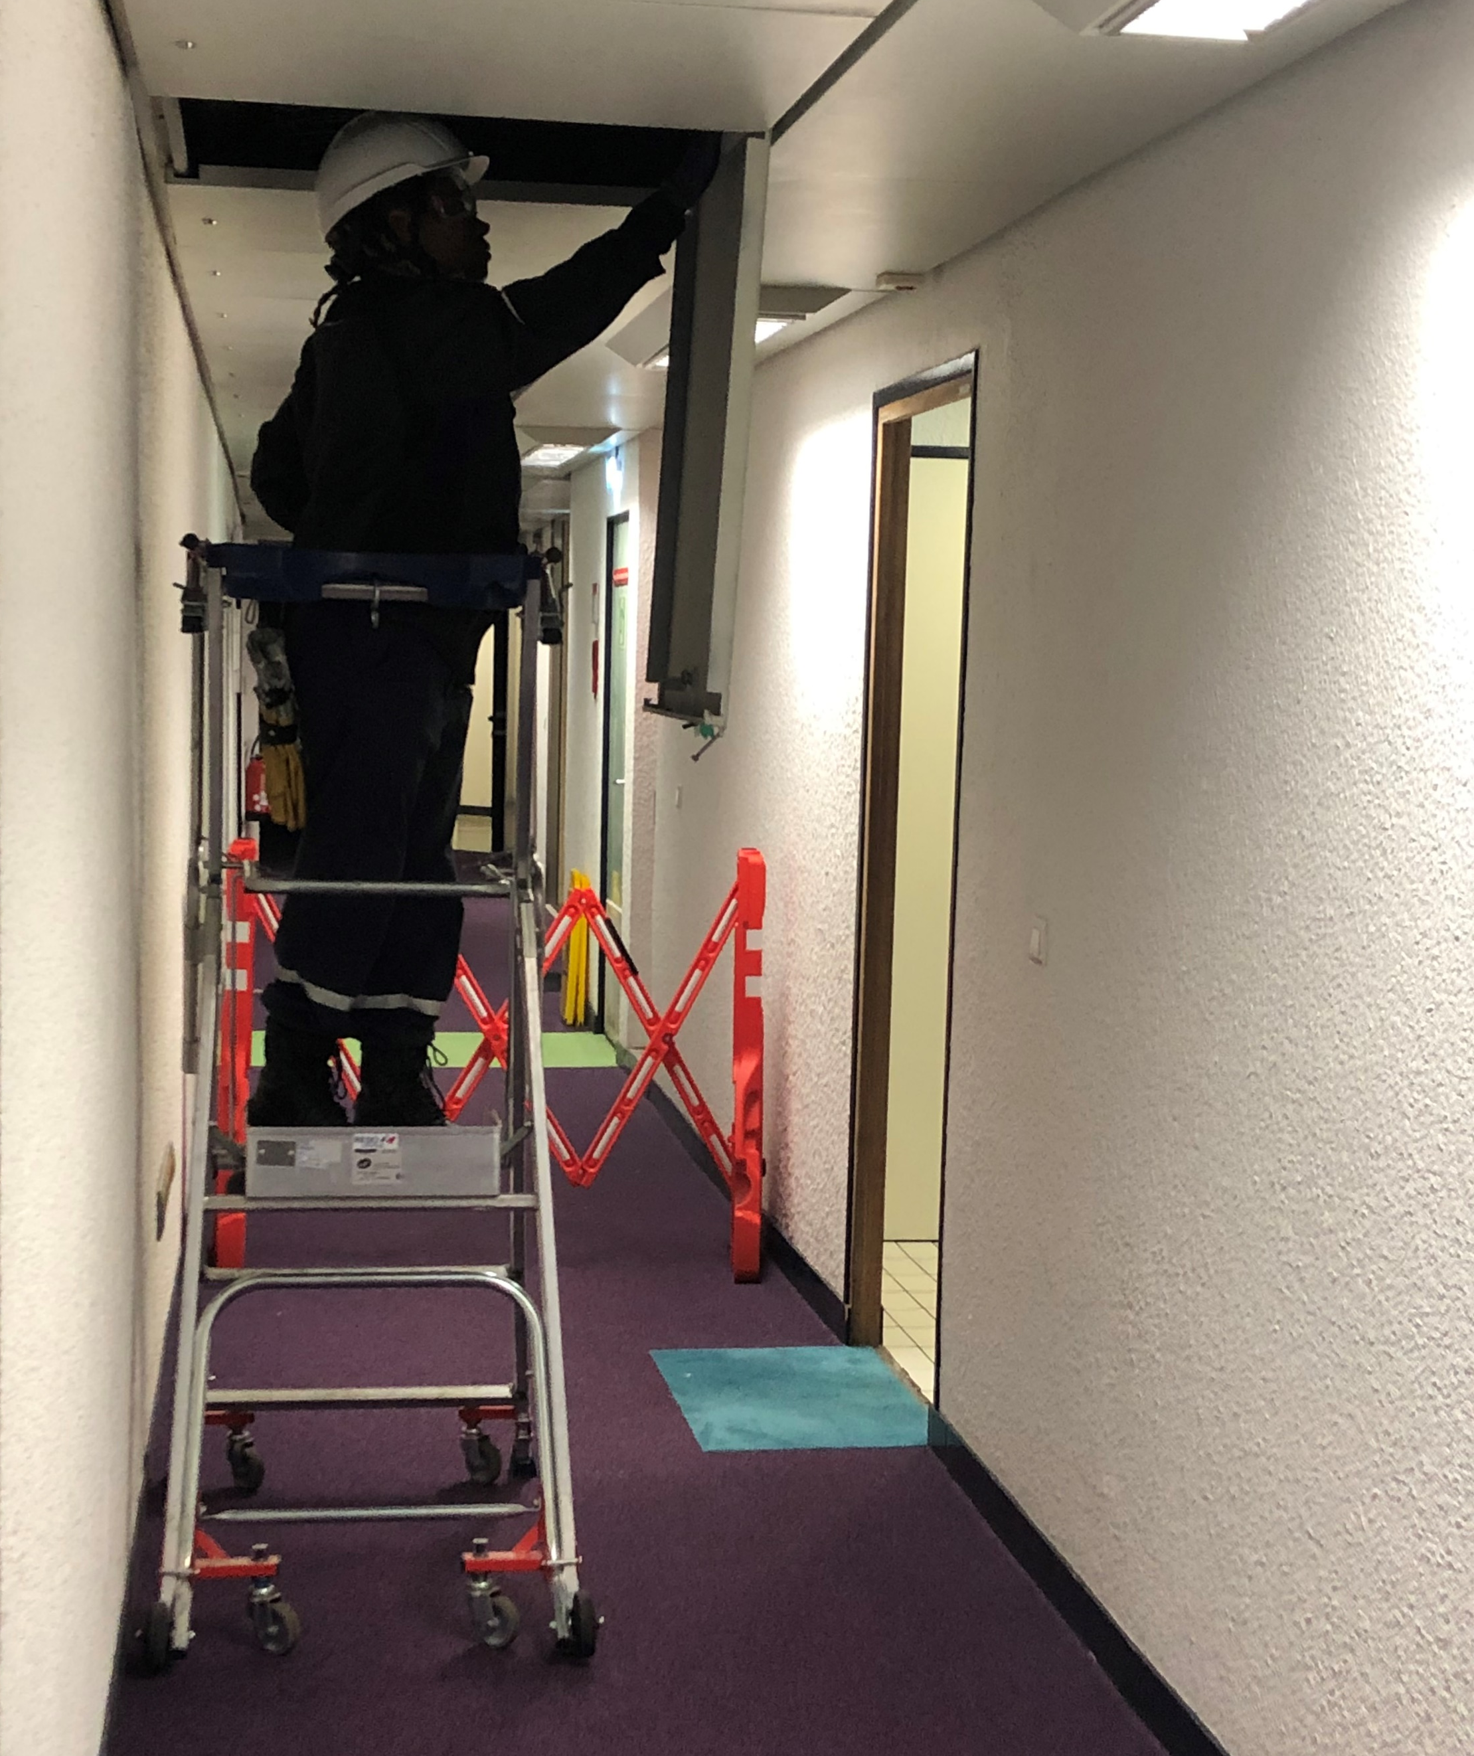
Examples of work at height in the office
When working at height, I use work equipment authorised by my work permit (rolling work platform...).
I respect safety barriers and perimeters (works, maintenance).
I do not place objects on cupboards...
Even for heights lower than 1.50m, I prefer to use safe equipment and do not climb on desks, tables or chairs.
At the office, I am also implicated!

Slide 18
Our tools and documents
CR-GR-HSE-425 – HSE requirements for Work at Height : HSE Company Rules
Life Saving Checks – Work at height: Life saving checks
Our Lives First HSE Program – Work at height: Theme 1 : Work at height
E-learning on work at height: https://lizzy.totalenergies.com/
Toolbox HSE – new Golden Rules:
    General material: TotalEnergies Golden Rules – General material
    Roll-out material: TotalEnergies Golden Rules – Roll-out material
REX database: Company HSE REX DataBase
Safety+ (good practices per Golden Rule): https://safetyplus.totalenergies.com/en

Slide 19
Lexicon
Hazard: An intrinsic property of a product, equipment, process, situation or action that can result in harm to people, the environment and/or assets.
Risk: The combination of the probability of occurrence of a hazardous event and the severity of the impact that may result from exposure to the hazard.
HSE events:
  Incident: Any sudden and undesirable HSE event on a given date, that causes injury or illness, damage to property or facilities, loss of production, environmental damage or damage to the Company's image.
  Near miss: Any sudden and undesirable HSE event on a given date which, in slightly different circumstances, could have had the same consequences as an incident. A near miss does not have an actual severity level but has a potential severity level.
  Anomaly: Any abnormal situation or behaviour, including deviations from a standard, specification, procedure or rule.
HIPO (High Potential) [slide 6]: Incident or near miss with an actual severity level ≤ 3* and a potential severity level ≥ 4** in one or more areas of the Company’s evaluation matrix of the actual and potential severity level of HSE events.
REX HSE: Document for sharing information on an internal or external HSE event, based on a detailed analysis and making recommendations.
* For example, physical consequences with an actual severity level = 3 correspond to a lost time accident.
** For example, physical consequences with a potential severity level of 4 correspond to a fatality.
Notes:
Définitions « risques » et « danger » (GM-GR-HSE-300 « Evaluation des risques professionnels au poste de travail »)
Définitions HIPO, Incident, presqu’accident, anomalie (CR-GR-HSE-100 « Reporting HSE »)

