Slide 1
World Day for Safety April 29, 2022
Presentation aid for team meetings

Slide 2
The 12 Golden Rules
Safety is a core value in the Company. It’s the cornerstone of our operational excellence in all of our business lines.
Together, as employees of TotalEnergies and contractors, let us commit ourselves personally and collectively to ensure safety on a daily basis in our operations and on our sites with a common goal: “Zero fatal accidents.”
Our Golden Rules, established on the basis of lessons learned, are essential to achieve our ambition in terms of safety. By taking ownership and implementing them with constant vigilance, for ourselves and for our colleagues, the Golden Rules will fulfill their aim and become embedded in our daily activities.
I’m convinced that all accidents can be prevented!
Everybody’s commitment to systematically apply the Golden Rules, everywhere, every day, is perfectly in line with the Company’s ambition: to put sustainable development at the heart of our strategy, our projects and our operations.
Michel Charton​
Senior Vice President HSE

Slide 3
The new Golden Rules of TotalEnergies
01.

Slide 4
Why Golden Rules ?
Safety is a value
Safety is a value.
Our slogan commits us to Safety: for me, for you, for all. The safety organisation is based on a set of reference documents (MAESTRO, GR).
Simple and applicable
by all – employees of TotalEnergies and contractors – the 12 Golden Rules of TotalEnergies reinforce our control of risks in the workplace to prevent accidents.
TotalEnergies strives for operational excellence, including achieving high levels of safety performance
Operational excellence
The return on experience from our accidents
Based on return on experience from our most serious and fatal accidents, a set of requirements is contained in the 12 Golden Rules of TotalEnergies.

Slide 5
Why an evolution of the Golden Rules ?
The survey of 18,000 respondents* conducted in early 2021 showed that :
The requirements of the Golden Rules are understood and evaluated as effective in preventing accidents.
However, not all the Golden Rules are easy to follow on site.
This finding prompted the reformulation on the basis of the suggestions
from the survey to improve the Golden Rules and their application
*Employees of the Company and contractors

Slide 6
Reformulation of the Golden Rules
2017
2022
Golden Rules of Total
Reformulated in 2017 with the instructions formulated as « Must » and « Must not »
Aiming for strict compliance
Stringent application of the rules
Direct link with sanction policy & disciplinary actions
Golden Rules of TotalEnergies
Formulated as « I… » and limited to instructions for the front line workers
Aiming for personal commitment.
Systematic application of the rules through appropriation
Easier to apply in the field.
Moving from prohibition/obligation to personal commitment

Slide 7
What happens to the 12 Golden Rules?
WHAT IS MAINTAINED
The number of Golden Rules remains the same (12).
The order of the rules remains the same.
Of the 12 topics covered by the Golden Rules, 10 topics remain unchanged*.
WHAT IS EVOLVING
The formulation of the prescriptions in the first person singular, focusing on the individual actions to be undertaken by the stakeholders.
Two topics disappear: « Change management » and « Simultaneous operations or co-activities », these topics remain covered by the Company's rules**.
Two new topics: « Hot work » and « Line of fire ».
*Golden Rule #4 is limited to Personal Protective Equipment
**CR-GR-HSE-302 Change management & CR-GR-HSE-402 Permit to work process
Notes:
-Jusqu’à présent, pas de RO dédié pour Travail à chaud (couvert par PTW RO5, mais pas explicite)
Travail à chaud fait parti du TOP5 des activités à risques mortels (réf. Campagne Nos vies avant tout)
-Ligne de danger: alignement avec les règles de l’industrie – vigilance partagé, coactivité…
-Les thèmes qui disparaissent (RO11 et RO12) concernent des exigences organisationnelles qui ne sont pas dans les mains des intervenants sur le terrain

Slide 8
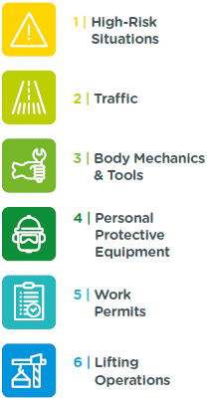
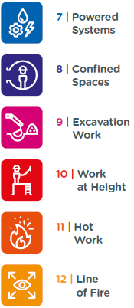
Our 12 Golden Rules

Slide 9
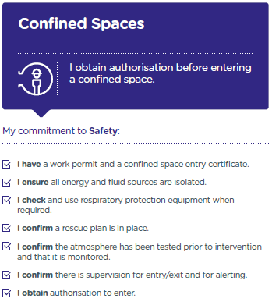
Example – Golden Rule 8
The first sentence summarising the expected behaviour related to the Rule.
My commitment to Safety : check boxes opposite each of the behaviours and actions in bold, highlighting the personal commitment, ownership and rigour expected in the implementation of the Golden Rules.

Slide 10
Stop Card
With the reformulation of the Golden Rules, the Stop Card has also been updated:
Formulation in the first person singular.
The commitment to intervene which integrates the notion of doubt, the main obstacle to intervention*.
* The survey of 18,000 respondents conducted in early 2021 showed that 30% of respondents do not intervene when they spot a dangerous situation. For 50% of them, doubt is the main reason

Slide 11
Implementing the Golden Rules at work
How can we move from a written rule to a rule implemented in the workplace?
Rule implemented
in the workplace
Written rule
A phase of appropriation is essential!
It is a major challenge to increase our safety performance, to protect ourselves from serious and fatal risks in the workplace and to achieve our common goal of « zero fatal accidents ».
Notes:
​​

Slide 12
Appropriate and apply the new Golden Rules
Communicate
Discuss
The ways in which the rules are applied
Apply
Good practices are
Disseminate and communicate all the
of the Golden Rules.
Reminder :
the rules are not negotiable,
they are binding on everyone.
are discussed with the professionals in charge of the work.
identified.
Difficulties are reported
to be analysed.
Principles of appropriation
WDfS 2022
Roll out post WDfS

Slide 13
During the WDfS 2022
02.
Organise and participate

Slide 14
Find the supporting material for the WDfS 2022
HSE Toolbox
Yammer One HSE
Manager kit (PPT) Information & exchange meeting guide
Mnemonic video
Form for collecting the summaries of the information & exchange meetings
Information gathering site
WDfS 2022

Slide 15
Facilitating the WDfS 2022
The WDfS is a time to celebrate safety in all of the Company's entities/affiliates and headquarters,
bringing together TotalEnergies employees and contractors.
Remote or on site, choose the activities that suit your situation:
Chat or institutional presentation with employees (see manager kit).
Information & exchange meeting on the new Golden Rules (see dedicated support).
Presentation/demonstration of good practices in implementing the Golden Rules (see Safety+).
Safety ceremony, recognition and awards.
“Our lives first’’ activities:
Safety green light – practices and discussion,
Joint safety tours,
Life saving checks.
Any other activity that meets your expectations, rituals of your entity / affiliate.

Slide 16
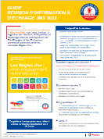
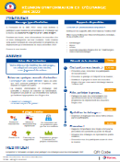
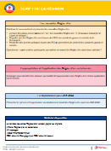
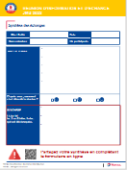
Information & exchange meeting
Hand over and present the new Golden Rules.
To discuss and identify the factors that facilitate the appropriation of the Golden Rules and their application in the field.
Present the pace and organisation of the local roll out of the Golden Rules after the WDfS 2022.
Guide available in the HSE Toolbox.

Slide 17
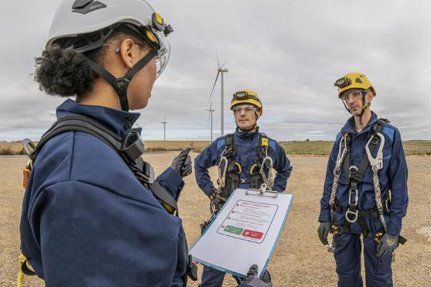
Mobilising contractors
Safety is everyone's business, both TotalEnergies employees and contractors. That is why it is important to involve contractors in your WDfS :
Members of the Safety Contract Owner network,
Under permanent contract with the site/entity,
Working on contracts generating a large number of hours worked.

Slide 18
After the WDfS 2022
03.
Roll out of the Golden Rules

Slide 19
Roll out planning
Launch of the new Golden Rules on the occasion of WDfS 2022.
Periodic communication on the Golden Rules via the HSE contact network: firstly the new Golden Rules and secondly those relating to the TOP 5 high risk activities.
April 29, 2022
World Day for Safety
12-Line of fire
10 Work at height
11 Hot work
8 Confined spaces
7 Powered systems
6 Lifting operations
MAY 2022 | JUN | JUL | AUG | SEP | OCT | NOV | DEC
WAT HSE editorial on the Golden Rule(s) of the month
9 Excavation work
5 Work permits
4 PPE
3 Body mechanics & tools
2 Traffic
1 High-risk situations
This communication is sent periodically (7x)
Push mail to HSE contacts & provision of materials in the HSE Toolbox on the Golden Rule(s) of the coming month

Slide 20
Golden Rules roll out supporting material
Golden Rules booklet.
Mobile app « Golden Rules ».
Mnemonic video.
Poster for each Golden Rule.
Dedicated PPT’s on the Golden Rule(s) of the coming month.
Safety+ to report on good practices in Golden Rules implementation.
Dedicated Yammer to ask questions about Golden Rules implementation.

Slide 21
Thank you!

Slide 22
Disclaimer and copyright reservation
Definition - TotalEnergies / Company
The entities in which TotalEnergies SE directly or indirectly holds an interest are separate and independent legal entities. The terms "TotalEnergies", "TotalEnergies company" and "Company" used in this document are used to refer to TotalEnergies SE and its affiliates included in the scope of consolidation. Similarly, the terms "we", "us", "our" may also be used to refer to these entities or their employees. It cannot be inferred from the use of these expressions that TotalEnergies SE or any of its affiliates is involved in the business or management of any other company of the TotalEnergies company.
Disclaimer
This presentation may include forward-looking statement within the meaning of the Private Securities Litigation Reform Act of 1995 with respect to the financial condition, results of operations, business, strategy and plans of TotalEnergies that are subject to risk factors and uncertainties caused by changes in, without limitation, technological development and innovation, supply sources, legal framework, market conditions, political or economic events.
TotalEnergies does not assume any obligation to update publicly any forward-looking statement, whether as a result of new information, future events or otherwise. Further information on factors which could affect the company’s financial results is provided in documents filed by TotalEnergies with the French Autorité des Marchés Financiers and the US Securities and Exchange Commission.
Accordingly, no reliance may be placed on the accuracy or correctness of any such statements.
Copyright
All rights are reserved and all material in this presentation may not be reproduced without the express written permission of TotalEnergies.

