Slide 1
CR-GR-HSE-114 Assessment and Monitoring of HSE Risks of Assets Operated by Others
New company rule for M&S

Slide 2
New rule
Scope of application: non-operated domain, patrimonial interest.
Integration of legal review feedback from Buncefield REX.
Use of an existing tool (extract from CORISK « HSE Grid»), known by all Branches to perform HSE sensitivity rather than creating new tools.
Publication date in REFLEX: 28/01/2019
Effective date: within 6 months following publication.

Slide 3
REQUIREMENT OVERVIEW: Asset HSE Risk Assessment
Requirement 3.1.1 : HSE Risk Level Evaluation, Monitoring and Revision
The HSE risk level of the assets operated by others is evaluated.
This evaluation is revised upon any change that can significantly impact the HSE risk level and, at minimum, every 5 years.
Circumstances are continually monitored so that any significant change can be detected.
Requirement 3.1.2 : Designated Person
The designated person managing the patrimonial interest in the asset is in charge of assessing, monitoring and revising the asset HSE risk level.
This person is trained in JV HSE management.

Slide 4
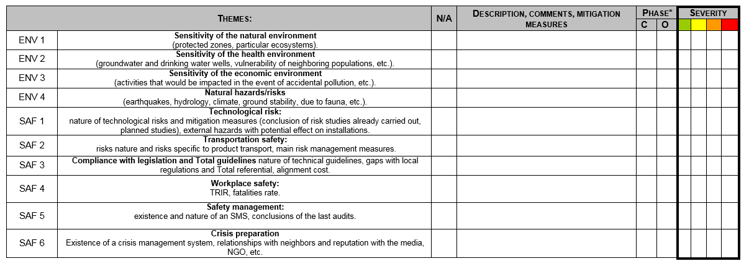
REQUIREMENT OVERVIEW: Assets HSE Risk Assessment
Requirement 3.1.3 : Criteria for HSE Sensitivity Level Assessment
The assessment of the HSE risks level of an asset operated by others is conducted according to adapted criteria of the Corisk grid and, at minimum, the 10 criteria defined below.
These 10 elements are the minimum elements to be considered in an HSE risk level assessment in assets operated by others.

Slide 5
REQUIREMENT OVERVIEW: Assets HSE Risk Assessment
Requirement 3.1.4 : Classification of Assets with High HSE Sensitivity
If HSE risk levels are rated as "high" or "very high" as per requirement 3.1.3, the asset is classified as having a high HSE sensitivity.
The assessment is then submitted to the relevant branch HSE Division for the HSE métier’s opinion.
Requirement 3.1.5 : High HSE Sensitivity Assets Register
This requirement applies to branch HSE Divisions.
A register of assets with a high HSE sensitivity as well as the corresponding designated persons is kept up to date.

Slide 6
REQUIREMENTS OVERVIEW: HSE Vigilance
Requirement 3.2.1 : HSE Vigilance
For any asset rated with high HSE sensitivity, an HSE vigilance questionnaire is completed on an annual basis.
If one of the answers to the questions is affirmative, an HSE vigilance note is generated and communicated according to a notification protocol defined by the relevant branch.
Actions to be implemented internally and vis-à-vis the third-party operator are then defined within the relevant branch and are subject to regular monitoring.

Slide 7
HSE Vigilance Questionnaire
Question | HSE Theme | HSE Vigilance Questionnaire
This questionnaire is to be filled out and updated annually for any asset qualified as having high HSE sensitivity according to the criteria of requirement 3.3.1.
Q1 | HSE Reporting | Partners do not periodically receive (ideally quarterly) the relevant HSE performance indicators (e.g. lost time frequency rate, loss of containment, fires and explosions, high potential events, audits completion rates, greenhouse gas [GHG] emissions). Or, partners never receive analysis or action plans for improvement related to events of real severity level ≥ 4 or potential severity ≥ 5 (see CR-GR-HSE-801). | TRUE | FALSE
Q2 | HSE Performance | The asset has experienced a high potential event of severity 5 (see CR-GR-HSE-801) or more, or two fatalities or more in the past year and the quality of analysis and/or associated action plans for improvement is not sufficient. | TRUE | FALSE
Q3 | Compliance with HSE Legislation | Several notifications have been received from the administrative authorities or from the police during the past year for non-compliance with the national or local regulations in place. | TRUE | FALSE
Q4 | Emergency Preparation | The capacity to manage a crisis is questioned (e.g. no regular exercises, lack of technical means for communication, evacuation, or for adequate response means, no procedures, missing scenarios, unavailability of critical equipment for fire or pollution control). | TRUE | FALSE
Q5 | Major Risks | The state of installation and critical equipment integrity is alarming (e.g. numerous losses of containment, frequent breakdowns, low availability of installations, lack of spare parts, obsolescence of safety systems). Numerous uncertainties regarding quality/performance of major risk mitigation barriers (e.g. operational integrity, team competencies, efficiency of risk reduction action plans). | TRUE | FALSE
Q6 | Greenhouse Gas | Noticeable increase in GHG emissions in a year due to changes in operating conditions (e.g. emissions above thresholds set by regulations, operating permits or Group’s commitments). | TRUE | FALSE
Q7 | Risk Awareness | State of installation or operator capacity to manage the HSE risks has not confirmed by a recent (< 5 years) on-field audit or review involving a competent person from Total. | TRUE | FALSE
Q8 | Exposure of Total as Partner | High probability, in case of a crisis (industrial or media incident) leading to the Group being involved or investigated due to: -Disproportionate size or reputation vis-à-vis other partners; or -Technical implication (e.g. presence of seconded personnel at key positions). | TRUE | FALSE
Q9 | Societal, Environmental, or Reputation Exposure | The operator is subject to complaints or litigations related to the respect of human rights or HSE practices that are not compliant with the Group’s principles and commitments. | TRUE | FALSE

Slide 8
REQUIREMENT OVERVIEW: HSE Risk Management
Requirement 3.3.1 : Contractual Arrangements
In accordance with applicable local regulations and their respective decision rules, the entities or affiliates involved in the negotiation of agreements related to assets operated by others ensure clauses allowing for the implementation of this rule’s requirements are adopted.
At a minimum, the right to HSE audits on the asset is contractually guaranteed.
Requirement 3.3.2 : HSE Management Monitoring
The rights and procedures outlined in the agreements of asset operated by others are exercised in order to ensure appropriate monitoring of HSE management by the asset operator.

Slide 9
Where to find additional information or documentation?
Publication on WAT: http://wat.corp.local/sites/s215/en-US/Pages/R%C3%A8gles%20HSE/CR%20114/CR-1Evaluation-et-suivi-des-risques-HSE-des-actifs-op%C3%A9r%C3%A9s-par-des-tiers-.aspx
HSE toolbox: https://www.toolbox-hse.total.com/en/one-maestro
REFLEX: group referential documents : https://reflex.sinequa.corp.local/
M&S Branch referential : http://crescendo4all.rm.corp.local/sites/Ref_MS/Pages/Home.aspx
7

