Slide 1
CR-GR-HSE-801 Management of HSE Events and Return on Experience
M&S : which differences between CR-GR-HSE-801 and CR-MS-HSEQ-131 company rule?

Slide 2
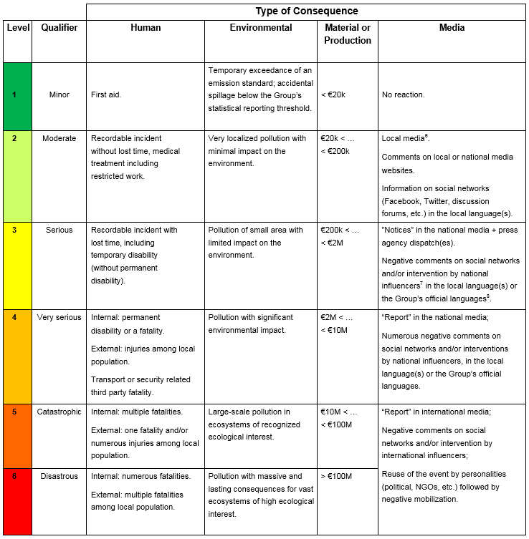
REQUIREMENT OVERVIEW
Requirement 3.1.1 : Steps to Manage HSE Events
In accordance with local regulations, all HSE events are managed according to the following four steps:
Note: For HSE events that occur within industries or professional organizations outside the Group's operated domain, lessons learned are shared with relevant entities, affiliates or métiers through the HSE Corex process (appendix 4).
No change
Requirement 3.2.1 : Evaluation of the Severity Level
The severity level of HSE events are evaluated according to the Evaluation Matrix of Actual and Potential Severity Level in appendix 1.
Note: For anomalies, only evaluations of potential severity level ≥ 4 are recorded.
The initial evaluation of an HSE event can be reviewed after analysis (e.g. considering new information, findings).
No change

Slide 3
REQUIREMENT OVERVIEW
Requirement 3.3.1 : Communication
HSE events with actual severity level ≥ 4 (or media impact ≥ 3), or those likely to evolve rapidly to these levels, are subject to:
Immediate alerts sent to the contact persons of the branch and the Group through two parallel channels:
the reporting line;
the duty function.
Alerts sent to local authorities;
Alerts sent to relevant stakeholders.
No change
Requirement 3.4.1 : Information Gathering
Any HSE event is subject to prompt information gathering (including relevant material elements) related to the event’s circumstances, facts and effects.
Considering locally applicable laws and regulations, the procedures to be followed during information gathering are defined while considering any separate analysis that may be carried out simultaneously, in particular requests and investigations by official authorities (e.g. emergency services, administrative or judicial authorities).
No change

Slide 4
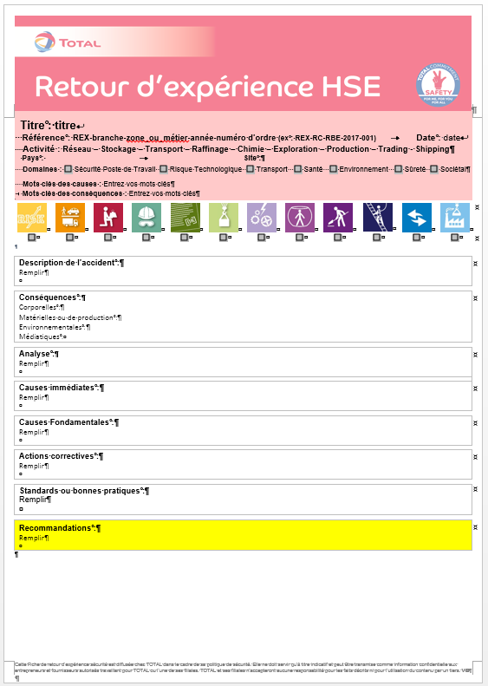
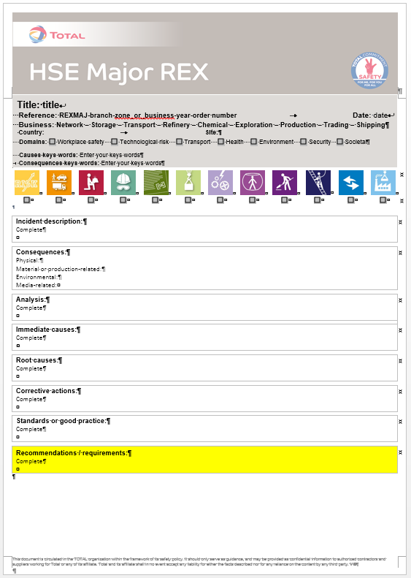
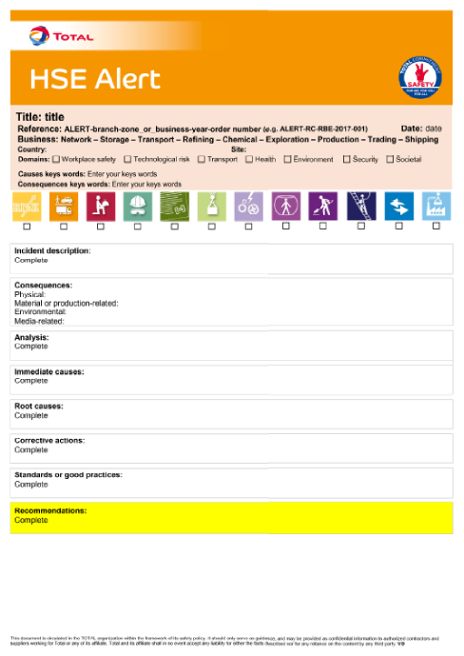
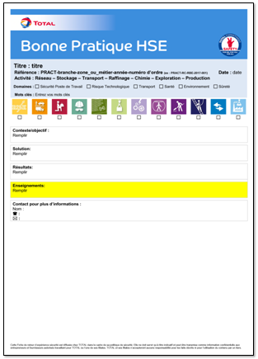
REQUIREMENT OVERVIEW
Requirement 3.4.2 : Analysis of HSE Events
All HSE events are analysed using a method that is appropriate to its actual or potential severity and re-evaluated as necessary. The requirements of the table "HSE Event Analysis Methods" (see appendix 2), which states the expected means, methods, analysed criteria, documentation, communication and deadlines, are applied.
For HSE events with actual or potential severity ≥ 4 or for Tier 1 or Tier 2 Loss of Primary Containment events, the root cause analysis method (or an equivalent systematic one) is used.
Requirement from the table « HSE Event Analysis Method»
In case of a fatal accident or any other HSE event with an actual or potential severity level ≥ 5, the Major Incident Analysis and Return on Experience department of the Group HSE division is mobilized and a Major HSE Event Analysis Committee is set up.
Requirements concerning Tier 1 or Tier 2 and the Major HSE Event Analysis Committee are new.
Requirement 3.5.1 : HSE REX Documents
The HSE REX documents are written within the time set out in the table 1 "Types of HSE REX Documents" and are issued following the validation of the HSE Corex, excluding directly issued HSE alerts.
Formalisation of the validation process.
Rationalisation of the multiple documents in place in the branches.

Slide 5
REQUIREMENT OVERVIEW
Requirement 3.5.2 : Local HSE Corex
A monthly local HSE Corex is set up to review:
HSE events of the entity or affiliate and to select those that will be detailed in HSE REX documents.
Recommendations from the branch or Group HSE Corex.
Follow up of action plans, if applicable.
At least once a year, the work of the local HSE Corex is reviewed to identify local HSE management system improvement opportunities.
This requirement did not previously exist even if certain entities or affiliates had already established this practice.
Requirement 3.6.1 : Implementation of HSE REX Documents
HSE REX documents relevant to the entity or affiliate are known and explained to personnel. The learnings/recommendations are followed, as necessary, in an action plan. The entity or affiliate puts in place performance indicators and monitors performance in order to ensure the effectiveness of the HSE return on experience process.
The REX explanation at the site or affiliate level was not required.
Requirement 3.6.2 : Recommendations Issued from a Major HSE REX
In addition to requirement 3.6.1, each branch monitors the implementation and effectiveness of the applicable recommendations resulting from a Major HSE REX.
No change

Slide 6
Where to find additional information or documentation?
Publication on WAT: http://wat.corp.local/sites/s215/en-US/Pages/Règles%20HSE/CR%20801/Nouvelle-règle-HSE--.aspx
HSE toolbox: https://www.toolbox-hse.total.com/en/one-maestro
REFLEX: group referential documents : https://reflex.sinequa.corp.local/
M&S Branch referential : http://crescendo4all.rm.corp.local/sites/Ref_MS/Pages/Home.aspx
7

