Slide 1


MANAGER KIT
AVRIL, 26 2021
WORLD DAY FOR
SAFETY
26 AVRIL 2021
Les
Règles d’or,
partout,
tous les jours.
JOURNÉE MONDIALE
DE LA SÉCURITÉ

Slide 2






Our lives first: safety close to the field
Notes:
Since 2019, goal of zero fatal accidents. Program our lives first: joint safety tours, safety green light, live saving checks.
The WDfS 2021 is enriched to revisit the basics: our Golden Rules everywhere, every day.
IPSOS survey brings lessons of first importance that we will discover.
Two main axes:
Applying a rule in the field is not always very easy, expressing doubt and saying STOP is also not so easy.
Our rituals need Golden Rules well anchored by all to know how to identify risks in the field and intervene in the event of a dangerous situation.

Slide 3
Golden Rules Survey Feedback

Slide 4





Survey basics
  2 Objectives:
  to measure Golden Rules adoption: the extent to which the Golden Rules have taken root.
  to identify the key factors that improve understanding, ownership and application of Golden Rules.
  From Jan. 28th until Feb. 24th 2021
  18 000 respondents: 12 500 Total employees & 5 500 contractors
  Participation of Frontline workers/Employees (50%), Supervisors (20%) & Managers (30%)
  84 selected entities/affiliates, across all the Branches
  Questionnaire translated in 11 languages
  Communication : memo and mail with dedicated survey link & poster with QR code

Slide 5
Survey results
A high level of safety is perceived across Total sites, hierarchical levels, staff & contractors alike.
Golden Rules are widely known, understood, applied, reminded & checked.
However, key learnings can be drawn to improve adoption… and better prevent hazards.
Knowledge: GR are perceived as known, especially by Supervisors and Contractors, less so by Managers.
Comprehension: GR are perceived as understood, especially by Supervisors and Contractors, less so by Managers.
Application: GR are perceived as being applied regularly, regardless of hierarchical levels and equivalently between Total staff and Contractors.
Repetition: GR are frequently reminded, specifically by Supervisors and Contractors, at least on a weekly basis.
Control: proper application of GR is frequently checked, specifically by Supervisors and Contractors, at least on a weekly basis.
Known on site
95%
Under-stood
95%
Regularly applied
83%
Checked
87% at least monthly
Re-minded
82% at least monthly
Golden Rules
are…
Note: GR = Golden Rules

Slide 6

A few benchmarks
Contractors are as familiar with GR as are Total staff.
At EP & MS, both Total and Contractors' staff have a good knowledge & understanding of GR.
RP, GRP & HLD need to improve on knowledge and understanding of GR.
On the site where you work, would you say the Golden Rules are overall ...
Known
Understood
Rules are known: yes definitely
 | Total staff (%) | Contrac-tors (%)
RP | 21 | 22
EP | 59 | 68
MS | 66 | 65
GRP | 28 | 42
HLD | 21 | 44
% Yes definitely
% Yes somewhat
% No
% Does not want to answer

Slide 7






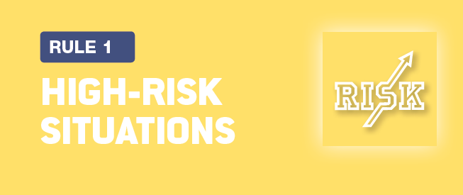
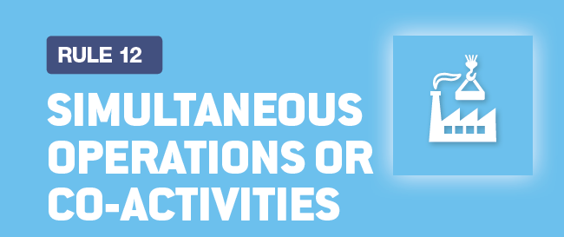




Which golden rules are best understood?
Overall, respondents understand all the requirements of the Golden Rules that most concern them in their day-to-day activities.
All requirements of these rules are best understood
All equirements of these rules are slighlty less understood
94% say all requirements of this rule are understood
89%
93%
87%
92%
87%
91%
86%
91%
86%
90%
84% say all requirements of this rule are understood

Slide 8
Which golden rules prevent accidents most?
Globally, GR are perceived as effective in preventing accidents.
Traffic, Lifting & High-Risk GR prevent the most.
Body Mechanics and Tools, Simultaneous Operations & Change Management prevent the least.
Rules perceived as effictively preventing accidents
Rules perceived as less effectively preventing accidents
82% say applying this rule definitively prevents an accident
77%
81%
77%
81%
76%
80%
75%
79%
71%
79%
70% say applying this rule definitively prevents an accident

Slide 9
are golden rules very easy to follow?
Protective Equipment, Traffic and Work Permits are easiest to follow.
Powered Systems, Change Management and Simultaneous Operations are more difficult to follow.
Globally though, GR are not straightforward to follow.
Most easy rules to follow
Less easy rules to follow
72% say this rule is very easy to follow
52%
67%
52%
59%
51%
58%
51%
54%
39%
54%
39% say this rule is very easy to follow

Slide 10


In summary
Requirements of GR are understood and evaluated as effective in preventing accidents.
However, not all GR are very easy to follow on site.
Each requirement is understood (%)
Definitely prevents accidents (%)
Very easy to follow on site (%)
100% of respondents agree
84% to 94%
of respondents agree, depending on GR
70% to 82%
of respondents agree, depending on GR
39% to 72%
of respondents agree, depending on GR
0% agree

Slide 11
GR preventing an accident vs GR very easy to follow
Lifting, Powered Systems, Work at Height GR are not very easy to follow. Why?
High level of prevention and easy to follow
Rule is very easy to follow (%)
Lower prevention and less easy to follow
Rule definitely prevents an accident (%)

Slide 12
Workshop topic #1
What would make GR application and compliance easier?
Discuss specific situations you have faced that make compliance with certain rules difficult.
Review how rules are actually explained and illustrated.
Is work preparation critical to improve awareness and compliance?
What do you expect of management in that respect?
→ A manager explains useful GR requirements, coaches team members, sollicits feedback, promotes best
practices and checks compliance.

Slide 13
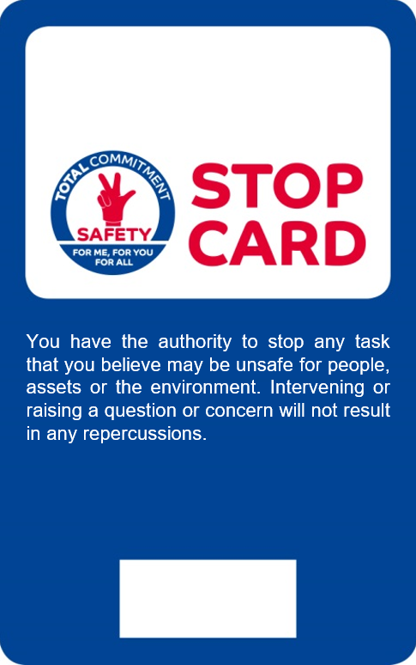

Flagging a risk is not straightforward – why?
30% of respondents do not intervene when spotting a hazardous situation. These are the reasons:
If you did not intervene in a dangerous situation that you witnessed, what were the reasons?
%
Multiple answers allowed

Slide 14
workshop topic #2
How to overcome doubt and promote "speak up" if a possible hazard is observed?
Have you ever observed a potentially dangerous situation and have you intervened?
  If you did, what happened then (reaction of co-workers/peers, hierarchy)?
  If not, what was the reason?
What would it take to overcome doubt and speak up?
What can your manager or colleagues do to help?
What can you do to help others?
→ A manager reminds his team that intervention is an obligation, practices the Safety green light, sollicits
speak up as welcome, illustrates how flagging hazards enables to "Go Home Safe".

Slide 15
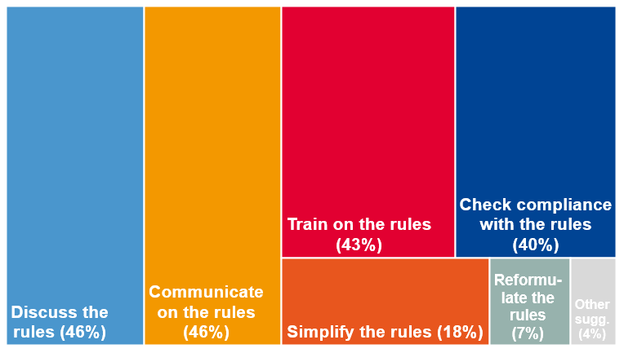
18 000 respondents tell us what to do
Golden Rules are not negotiable. But they deserve continuous explanation to fully work.
Here are 4 bottom up requests:
What would be your suggestions for improving the Golden Rules and their application?
1
2
3
4
Multiple answers allowed

Slide 16
workshop topic #3
How to improve Golden Rules and their adoption?
Spend time reviewing selected GR requirements as a team: those that are difficult and why.
Use your own language to articulate selected GR. Explain why they prevent which type of injuries.
Memorize selected GR requirements. Illustrate best practices. Discuss non compliance.
Check compliance more frequently. Use checks to coach and illustrate specific risks.
→ A manager spends the time to engage some of these topics with his team.

Slide 17

In summary
This first survey shows that:
Employees feel safe at their work place ;
Total's Golden Rules are known, understood, applied, reminded and checked ;
The perceived ease of application is not as straightforward as the perceived relevance of some rules (Workshop #1);
The main obstacle to intervening when witnessing a hazard is the uncertainty in appreciating risk and hence speaking up (Workshop #2);
To improve adoption of GR, respondents want more discussion, training and control (Workshop #3).

Slide 18
Organize and take part in the WDFS 2021

Slide 19
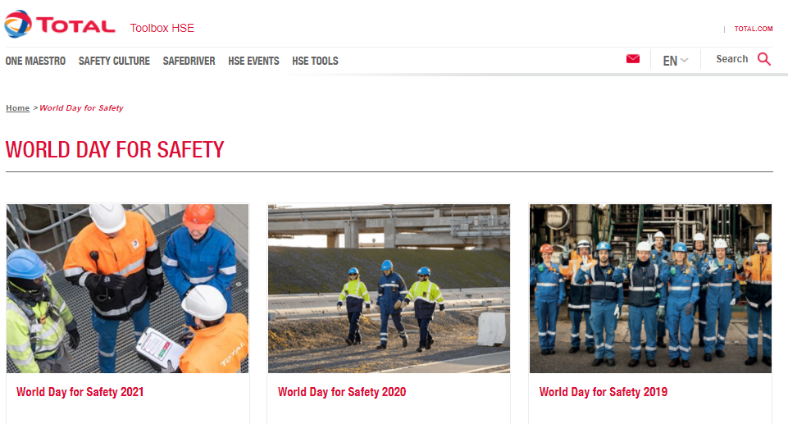


Hse toolbox
All the support media are available in the HSE Toolbox,
and can be easily downloaded using a computer, tablet or smartphone.
In particular:
Memo
Poster
Managers’ kit
Discussion
Workshop guide
https://www.toolbox-hse.total.com/en/world-day-safety-2021

Slide 20

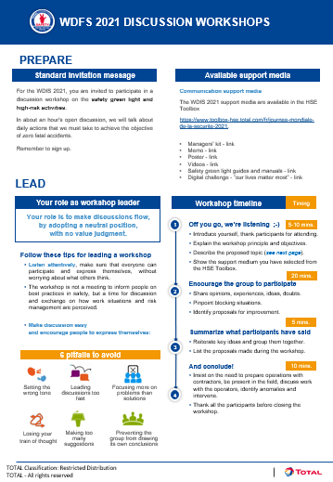
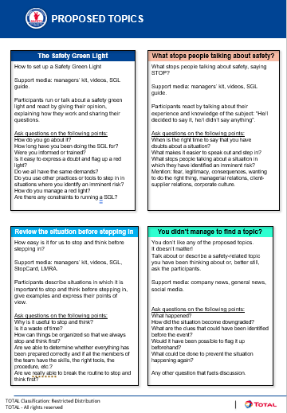
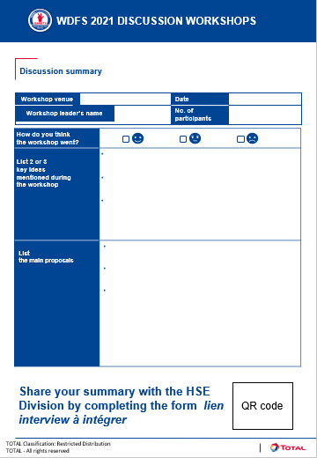
DISCUSSION WORKSHOPS
  Organize discussion workshops with Total and Contractor employees to discuss the results of the IPSOS survey.
  Follow the dedicated guide and lead a constructive discussion to help anchor the Golden Rules among employees and make it easier to step in in the event of a dangerous situation.
  Identify important points and suggestions that arise from the discussions to pass them on to the Group HSE Division.

Slide 21

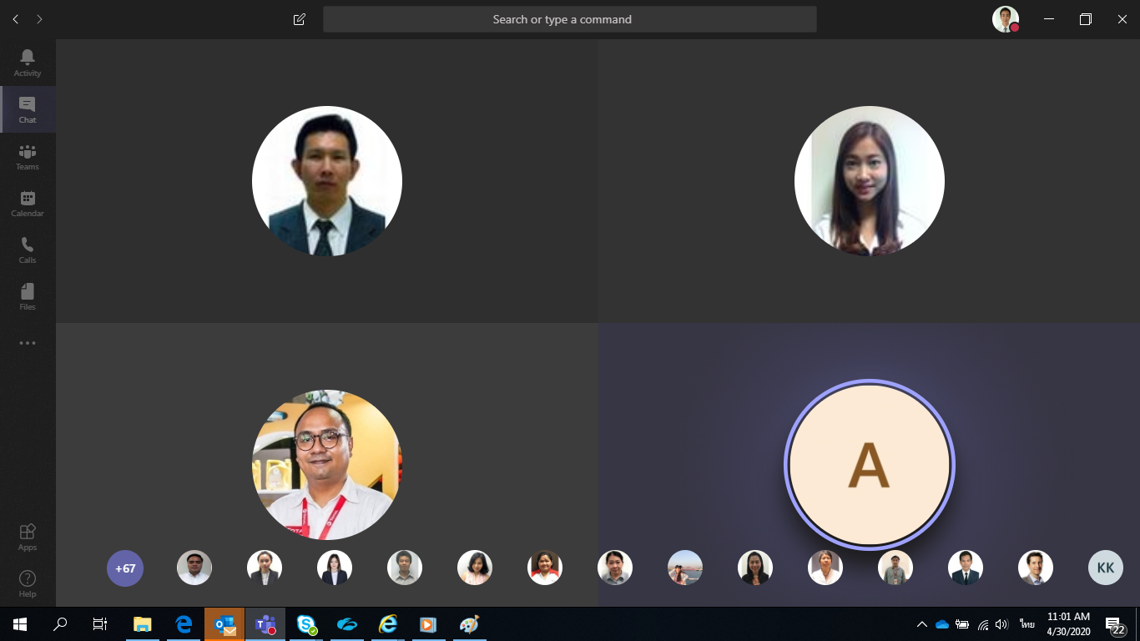
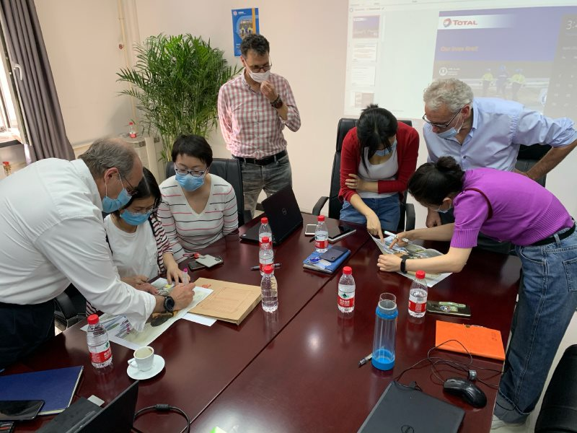
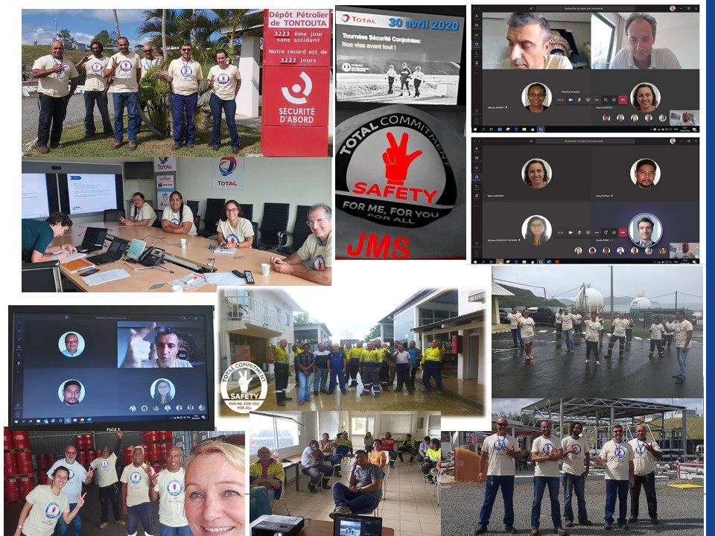
“RISKS” digital challenge
During one hour, play to the Risks digital challenge.
Alone or by team, enjoy to find riddles and participate to a safe truck race.
Website access or printed version.
Teams compatible

Slide 22
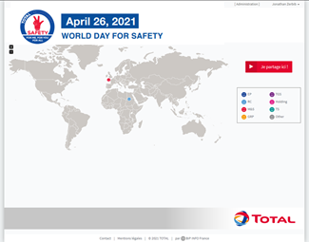

WDfS 2021 collect and share website
A website has been created especially for the WDfS 2021 so that you can upload your photos & videos, post a comment or print a poster for your site.
A souvenir video - accessible to everyone - will be made using the best images. Watch and see if you can spot yourself in the clip!
A map of the world will also be created, pinpointing all the entities that took part in the WDfS.
https://wdfs.total.com
Login: email address
Password: WDFS2021

Slide 23
WDfS – remote or on site
The WDfS is a time to celebrate Safety in all the Group’s entities/affiliates and headquarters, and to federate Total and contractor personnel.
Whether you are working remotely or on site, select the activities to suit your situation:
    Reporting of survey results (managers’ kit).
    Discussion workshops (support media) & transmission of noteworthy points.
    Digital safety challenge (or paper version).
    Safety green light - practices and discussion.
    Joint safety tours with contractors.
    Presentation/demonstration of best safety practices.
    Safety ceremony and Awards.
    Any other activities that correspond to your expectations, or rituals in your entity/affiliate.

Slide 24


