Slide 1
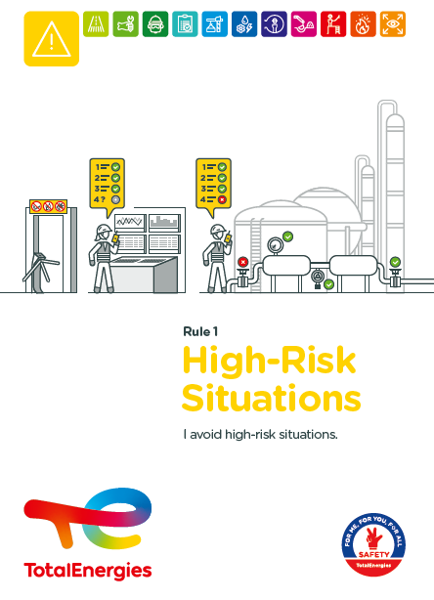
DEPLOYMENT WORKSHOP GUIDE Golden Rule 1 - “HIGH-Risk situations”
TotalEnergies’ new Golden Rules are changing, with the use of the first person in the wording of the requirements, and the replacement of the themes of rules 11 & 12 with “Hot Work” and “Line of Fire”.
In order to ensure maximum effectiveness of the Golden Rules, all TotalEnergies and Contractor employees need to make them their own.
This appropriation process is organized in two stages:
Stage 1 during the WDfS 2022: communicate on the new Golden Rules.
Current Stage 2: once the deployment kit for Golden Rule 1 has been presented, discuss ways of implementing the requirements.
Together with the deployment kit, this guide is designed to help you organize and facilitate a deployment workshop for the Golden Rule 1.
Workshop objectives
By listening attentively and encouraging everyone to participate:
Review the requirements of Golden Rule 1 and the associated deployment kit.
Discuss how the requirements can be put to practice.
Identify and comment on good practices and any associated difficulties.
Organizing a workshop
What to do before the workshop?
Book a time slot.
Invite employees in groups of 5 - 15 (max.) participants.
Who should attend?
TotalEnergies and Contractor employees.
Who leads the workshop?
A department or team manager.
Where should the workshop be held?
In a meeting room equipped with a video projector, and on site whenever possible.
Notes:
Instructions

Slide 2
deployment workshop guide – GR 1
PREPARE
Available support media
You can access the support media for the new Golden Rules in the HSE Toolbox: https://toolbox-hse.totalenergies.com/en/golden-rules-general-and-roll-out-materials
Booklet on TotalEnergies' new Golden Rules.
Golden Rule 1 deployment kit.
Etc…
LEAD
Your role as workshop leader
Workshop schedule
With the whole group, discuss how each requirement of the Golden Rule can be applied in practice.
Identify good practices and any difficulties in applying the rules.
Pick out the key points and summarize the discussions.
Follow this leadership advice
Encourage attentive listening, create a climate where everyone can participate and give their opinions, without fearing what other people might think.
Give everyone the opportunity to express their points of view, share their experience and gather information.
Facilitate discussions
Start the workshop...
In a meeting room or on site.
Introduce yourself and thank participants for being there.
Remind them of the basic workshop rules and expectations.
Present the GR01 deployment kit...
Go over the definitions, present the accidentology rate and the objectives of the Rule.
Present the REX that illustrate each of the requirements.
And how do you apply the Golden Rules...?
Use the REX as a basis for discussion and ask participants to describe how they apply them on site.
Summarize the discussions...
Prepare a written summary of the discussions with participants and highlight:
good practices
difficulties
in complying with each requirement (see the example on the next page).
Pick out the key points and report on the discussions
Good practices are shared in the Safety+ tool (see instructions on the following pages).
Any difficulties are reported on the Yammer community “New Golden Rules”
1
2
3
EVERYONE MUST HAVE THEIR SAY!
4
6 pitfalls to avoid
Setting the wrong tone
Leading the discussion too fast
Focusing more on the problems than on the solutions
5
Losing the thread
Making too many suggestions
Preventing the group from reaching its own conclusions
Steps 4 and 5 are crucial for the appropriation of the Golden Rules. Knowing about and sharing what actually happens in the field, contributes to the systematic and effective application of the Golden Rules.
Notes:
Be professional

Slide 3
Example of how a REX can be used to facilitate the workshop
Example of a REX from the GR 1 deployment kit
And how do you apply the Golden Rules...?
Use the REX in the kit as a starting point for discussion and ask participants to describe the ways in which each requirement of the Golden Rule 1 is applied on site.
How do professionals ensure that the requirements are followed?
-
-
-
-
-
What difficulties are encountered in complying with the requirements?
-
-
-
-
Notes:
Deployment kit

Slide 4
Sharing good practices
Share a good practice in Safety+ Safety+ access
Why should I share a good practice?
Sharing a good practice:
highlights the professional attitude of everyone involved in successfully completing a given activity.
It also ensures that the methods used are shared with as many people as possible to improve safety in the workplace.
How do I share a good practice?
Open the Safety+ contribution page on a computer.
Select an image or photo.
Describe the good practice by writing the first line as follows: “DEPLOYMENT OF THE NEW GOLDEN RULES - GR XX”
Complete the fields and select the relevant Golden Rule. Under the +info tab, select “deployment of the new Golden Rules”.
You can also attach a file here.
Report any difficulties
Reporting a difficulty on the Yammer thread “New Golden Rules Roll-out” Yammer - New Golden Rules roll-out / Nouvelles Règles d'or déploiement
Why should I report difficulties?
Reporting on difficulties means:
Describing how things actually happen in the field and the obstacles to applying requirements.
Communicating with the management team and the authors of the rule so that the application conditions can be defined together, without compromising accident prevention.
How do I report a difficulty?
Open the Yammer community “New Golden Rules” on a computer HERE
Publish a comment in the news feed, with or without a photo, and give the Golden Rule number, the requirement you are talking about and the difficulties you have in applying it.
Remember to describe the context.
Notes:
Idea of organizational management for safety:
Use factual and accurate situations. Focus the discussion (start from the specific and move to a broader spectrum).
Encourage the creation of collective viewpoints.
Empower people to act when confronted with danger, have the individual and collective means to act, regain control.
Limit collective defense strategies (focus on the objective to reach and not on the dangers).
Give feedback on the discussions at local level so it can be taken on board by management.
Recommend holding this kind of workshop on a regular basis to discuss safety at work.

