Slide 1

The new Golden Rules
My Commitment, our Safety
Golden Rule 7
Powered Systems
Rev.0 – September 2022

Slide 2
01.
The essentials

Slide 3
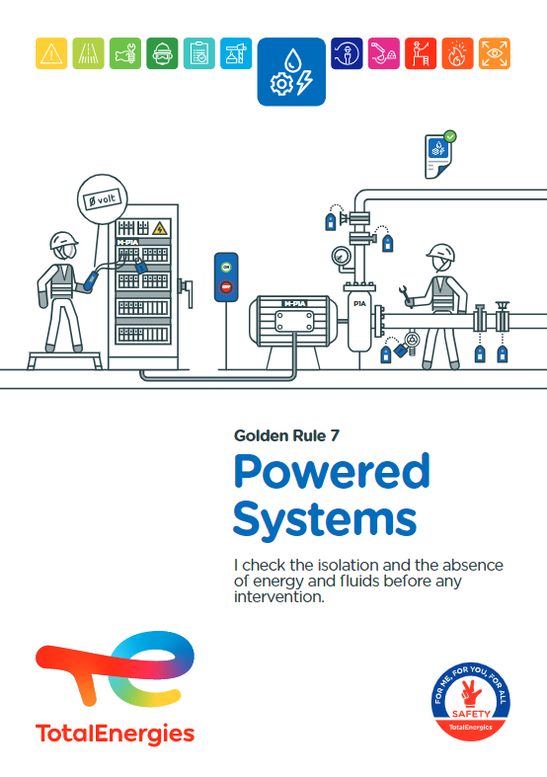
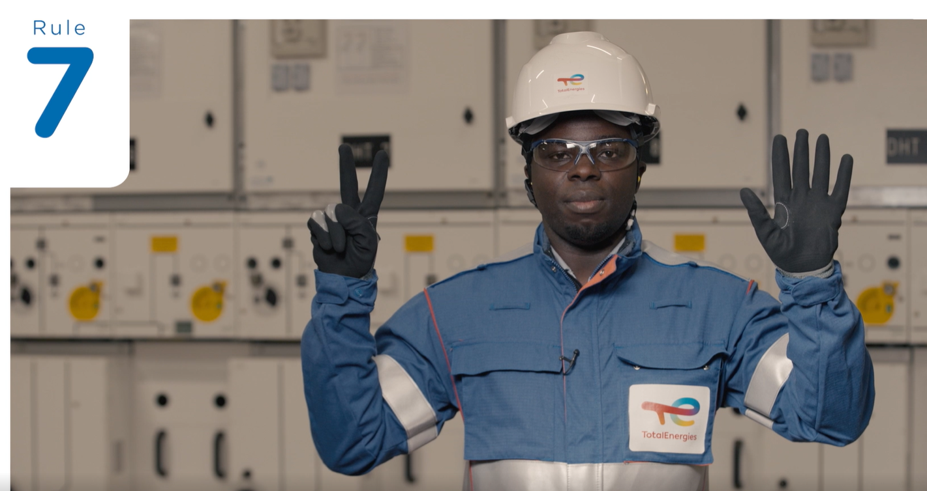
Poster & pictogram
The Golden Rule 7 pictogram ʺPowered Systemsʺ represents a cogwheel, a lightning bolt and a drop, symbolising mechanical, electrical and fluid energy sources respectively (*).
(*) Gases and liquids are grouped together under the heading of “fluids”.

Slide 4
Some definitions
POWERED SYSTEMS
EXAMPLES OF ENERGIES
A powered system is any equipment, a circuit or an installation that has non-isolated energy source and/or contains hazardous substances.
ELECTRICAL ENERGY
(and electrostatic energy)
Electrical cables, power lines, batteries, ...
MECANICAL ENERGY
  Moving equipment (rotating machines, cutting tools, presses, conveyor belts, ...), static equipment under tension (springs, cables, cylinders, ...)...
THERMAL ENERGY
Heat (steam, flames, hot products, hot equipment, ...) or cold (liquefied gases, pressurised gas expansion, ...).
ENERGY ISOLATION
MAIN TYPES OF ENERGY
PRINCIPALES ÉNERGIES
Isolation is a safety procedure intended to ensure the protection of people and equipment against the consequences of any accidental maintenance of residual energy or any spurious appearance or reappearance of energy and/or fluids, gases or liquids, whether dangerous or not.
HYDRAULIC OR PNEUMATIC ENERGY
(fluids)
Pressure, velocity or flow of a liquid or gas.
IONISING RADIATION
Radioactive sources (metallurgical radiographic testing, level sensors, ...).
Click here for details of the isolation process

Slide 5
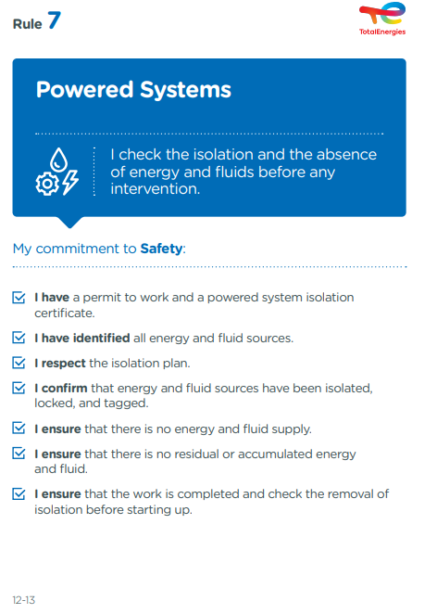
The essence of Golden Rule 7
What changes from the 2017 version of the Golden Rules:
Mention of the ʺisolation certificateʺ:
The isolation certificate is an integral part of the isolation file in the same way as the risk analysis, the isolation diagram and the isolation plan.
    An isolation certificate does not authorise to start the work.
Mention of the identification of ʺall energy and fluid sourcesʺ:
The risk analysis for an isolation starts with the identification of all energy and fluid sources present.
Verification of isolation and absence of energy and fluids are part of the requirements of CR-GR-HSE-428 ʺHSE Requirements for the Isolation of Powered Systemsʺ.
* Company Rules (CR) are limited to internal use.

Slide 6
Powered Systems incidents
ACCIDENTS IN THE COMPANY WHERE A REQUIREMENT OF GOLDEN RULE 7 HAS BEEN BREACHED
MAIN RISKS OF POWERED SYSTEMS
3
Fatalities*
70
Electrification, Electrocution, Burns, Source of ignition, Blinding by electric flash
Entrapment, Pinching, Crushing, Cutting, Shock, Puncture
Lost time accidents**
77
HIPO (High Potential)**
Hydraulic, Pneumatic, Mechanical Projections
Burns
* Period 2012-2021
** Period 2017-2021

Slide 7
02.
REX

Slide 8
Illustration of requirements
REQUIREMENT | EVENT | SLIDE
I have a permit to work and a powered system isolation certificate. | Electric shock while working on a metering cabinet | N°9
2. I have identified all energy and fluid sources. | Arc-flash burns during maintenance of a photovoltaic inverter | N°10
3. I respect the isolation plan. | H2S LEAK DURING BLINDING/ISOLATION OPERATION | N°11
4. I confirm that energy and fluid sources have been isolated, locked, and tagged. | A FINGERTIP TORN OFF WHEN REPLACING A BELT | N°12
5. I ensure that there is no energy and fluid supply. | ELECTROCUTION WHEN PREPARING A TRANSFORMER FOR MAINTENANCE | N°13
6. I ensure that there is no residual or accumulated energy and fluid. | WORKER BURNED DURING PIPE INSTALLATION WORK | N°14
7. I ensure that the work is completed and check the removal of isolation before starting up. | ELECTRICAL RECONNECTION OF EQUIPMENT STILL IN THE PROCESS OF BEING WORKED ON | N°15
The descriptions of the circumstances and consequences have been simplified for a better understanding.
A link to each REX/Good practice is available for more information.

Slide 9

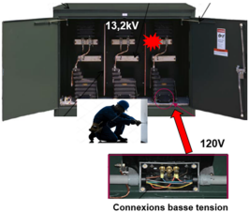
REX
1. I have a permit to work and a powered system isolation certificate.
> Electric shock while working on a metering cabinet
CIRCUMSTANCES – FACTS
  On a construction site of a solar farm, two tasks were to be carried out:
    Task A: work on a 480V transformer.
    Task B: Modification of the low voltage wiring, 120V, in a 13.2 kV meter.
  The operator, informed only of task A, proceeded to de-energise the system to carry out task A, without involving the team. He then informed the workers, by a hand signal, that the de-energisation had been carried out.
  The workers started work without carrying out the zero voltage check and without wearing the appropriate PPE.
  Task A was successfully completed, but while performing task B on the 13 kV meter that remained energised, one of the workers received an electric shock.
CONSEQUENCES
Second and third degree burns.
LESSONS TO BE LEARNED
I ensure that for any work involving a powered system, I have an approved permit to work, with an approved isolation certificate attached.
I participate in the explanation of the work to be carried out at the work site and ensure that it is understood by all.
CAUSES
  No isolation of the 13 kV meter and no zero voltage check performed.
  Work not discussed between workers and operator. Not all energy sources identified.
  Absence of risk analysis and work permit: the risks linked to task B (meter left energised) were not identified and assessed.
  Lack of work permit and lockout procedure on site for energised systems.
Click here to access the REX
Low voltage connections

Slide 10
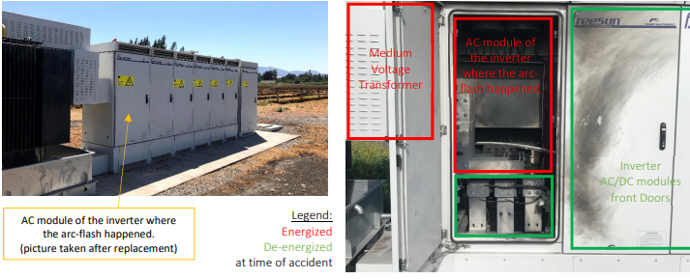
REX
2. I have identified all energy and fluid sources.
> Arc-flash burns during maintenance of a photovoltaic inverter
CIRCUMSTANCES – FACTS
  A maintenance activity on the central inverter of a ground-mounted solar farm was in progress.
  An electric arc occurred between two phases on the busbar (which remained energised at 690 V / 3200 A), between the inverter and the high-voltage transformer.
  The electrical arc severely burned a worker.
CONSEQUENCES
Third degree burns, but potential death (HIPO).
LESSONS TO BE LEARNED
I ensure that a risk analysis has been carried out before any energy systems are isolated.
It systematically lists all the energy and fluid sources present.
CAUSES
  Lack of a complete identification of all electrical sources (busbars left energised).
  No isolation diagram.
  Absence of isolation (no zero voltage test).
  Switching off by the worker himself, without cross-checking by another worker.
Click here to access the REX

Slide 11
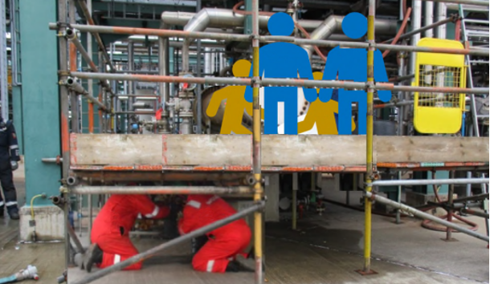
REX
3. I respect the isolation plan.
> H2S LEAK DURING BLINDING/ISOLATION OPERATION
CIRCUMSTANCES – FACTS
  An exchanger was made available for inspection work (isolated and degassed with steam).
  An isolation plan was prepared for the operation.
  A scaffolding was erected for general access to prepare for the extraction of the bundle, before the piping sections were removed.
  While removing a section of piping to prepare and isolate the exchanger, H₂S was released, exposing 5 workers to the toxic gas.
  One of the workers lost consciousness.
CONSEQUENCES
First aid for one worker and a lost time accident for another.
LESSONS TO BE LEARNED
I ensure that the isolation plan is respected.
CAUSES
  Isolation not in accordance with the isolation plan.
  Incomplete and unverified degassing.
  H2S leakage through a flange.
Click here to access the REX

Slide 12
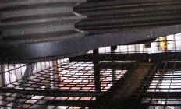
REX
4. I confirm that energy and fluid sources have been isolated, locked and tagged.
> A FINGERTIP TORN OFF WHEN REPLACING A BELT*
CIRCUMSTANCES – FACTS
  A belt replacement operation on an air cooler was in progress.
  The worker positioned the belts by hand and the blades of the air cooler - not being blocked - were set in motion by an air current.
  His ring finger was caught between the belt and the pulley.
CAUSES
  Air cooler motor electrically locked out, but blades not mechanically locked.
  Method used and instructions not suitable:
    manual handling,
    choice not to lock the blades,
    lack of use of safety devices provided on the equipment.
  Risk in the company's operating procedure not taken into account.
LESSONS TO BE LEARNED
I identify all energy sources (electrical and mechanical in this case), and ensure that they are isolated.
I therefore ensure that the energy sources are:
Isolated: use of isolation devices to separate the equipment/installation from its energy sources.
Locked: use of lockout devices to ensure that the isolation is maintained.
Tagged: use of signaling devices to physically inform of the status of the isolated equipment/installation.
CONSEQUENCES
Partial amputation of the first phalanx.
Click here to access the REX
Accident area
Zone de l’accident
*Event prior to 2012

Slide 13
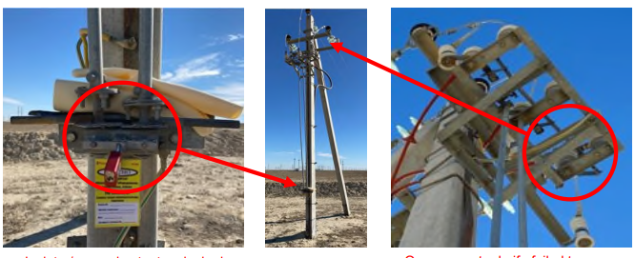
REX
5. I ensure that there is no energy and fluid supply.
> ELECTROCUTION WHEN PREPARING A TRANSFORMER FOR MAINTENANCE
CIRCUMSTANCES – FACTS
  The work included an inspection of the internals of a transformer by 2 workers (electricians).
  The disconnecting devices on the pylon had been activated and locked, in order to cut off the power supply to the transformer.
  However, a faulty disconnecting switch on the pylon remained in its original position.
  In preparation for the zero voltage and earthing test, the team opened the front and rear access doors and panels of the inadequately isolated transformer.
  Prior to carrying out the zero voltage and earthing test, one of the workers entered the transformer and touched the live section.
  He was not wearing isolating PPE and received a fatal electric shock.
CONSEQUENCES
Death of a worker, and one potential death (worker coming to his rescue).
LESSONS TO BE LEARNED
I wear the appropriate PPE for the electrical work.
I make sure beforehand that the zero voltage check step is properly identified in the isolation certificate.
Before any work is carried out, I carry out a zero voltage check on each of the active conductors, as close as possible to the point of work, using an approved zero voltage checking device (adapted to the nominal voltage of the circuit and checked).
I ensure that electrical isolation practices systematically include approved means of checking for absence of voltage (adapted to the nominal voltage of the circuit and verified).
CAUSES
  Mechanical failure of the disconnecting device
  Physical contact with the live transformer
    No zero voltage check carried out,
    Inappropriate PPE.
Click here to access the REX

Slide 14
REX
6. I ensure that there is no residual or accumulated energy and fluid.
> WORKER BURNED DURING PIPE INSTALLATION WORK
CIRCONSTANCES – FAITS
  Workers were replacing a pipe.
  The isolation valve was not tight and a bucket was collecting the dripping gasoline (about 2 litres).
  While a worker was assembling two flanges with bolts and nuts, using non-ATEX tools, a flash occurred.
  A fire started.
CONSEQUENCES
One worker with severe burns to arms, legs and part of the body.
LESSONS TO BE LEARNED
Before any work is carried out on powered systems, I ensure that the circuit is correctly isolated (valves closed and tight) and that a prior check for the absence of energy (hazardous substance, pressure, etc.) is carried out and confirmed.
CAUSES
  Ignition of gasoline contained in the pipework by sparks generated by the operations (non-ATEX tools).
  Poor management of safety and control of work:
    Lack of risk analysis,
    Lack of a work permit,
    Non-application of the lockout/tagout procedure (fluid isolation not effective because of an internally leaking valve).
Pipe to
the loading station
PUMPING UNIT
OPERATION 1
PIPELINE
Flanges
A and B
bolted in place
A
Vapors
from the hydrocarbon leak ignited at flange A
Welders
B
TLS
technician
(victim)
OPERATION 2
Valve
not correctly
isolated
Cutting and grinding work in preparation for welding
Pump
Pump outlet
Click here to access the REX

Slide 15
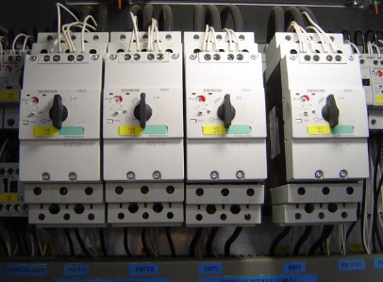
REX
7. I ensure that the work is completed and check the removal of isolation before starting up.
> ELECTRICAL RECONNECTION OF EQUIPMENT STILL IN THE PROCESS OF BEING WORKED ON
CIRCUMSTANCES – FACTS
  A team of workers (mechanics) was checking the belts of a dryer after having cut off the power supply to the equipment in the electrical substation by unplugging the power drawer.
  During the momentary absence of the workers, the operator energised the equipment again, thinking that the work was finished.
CONSEQUENCES
Potential injury of workers (HIPO).
LESSONS TO BE LEARNED
I ensure that isolations and de-isolations involve all intervening parties to ensure a common understanding of the situation.
I ensure that the end of the work is communicated and formally confirmed prior to de-isolation.
CAUSES
  Re-energising equipment undergoing maintenance by another team working nearby.
  Poor coordination of those responsible for operations that have taken place simultaneously.
  Non-compliance with the isolation/de-isolation rules (work permit).
Click here to access the REX

Slide 16
03.
Further information

Slide 17
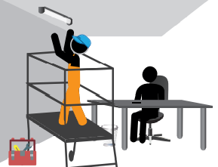
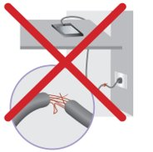
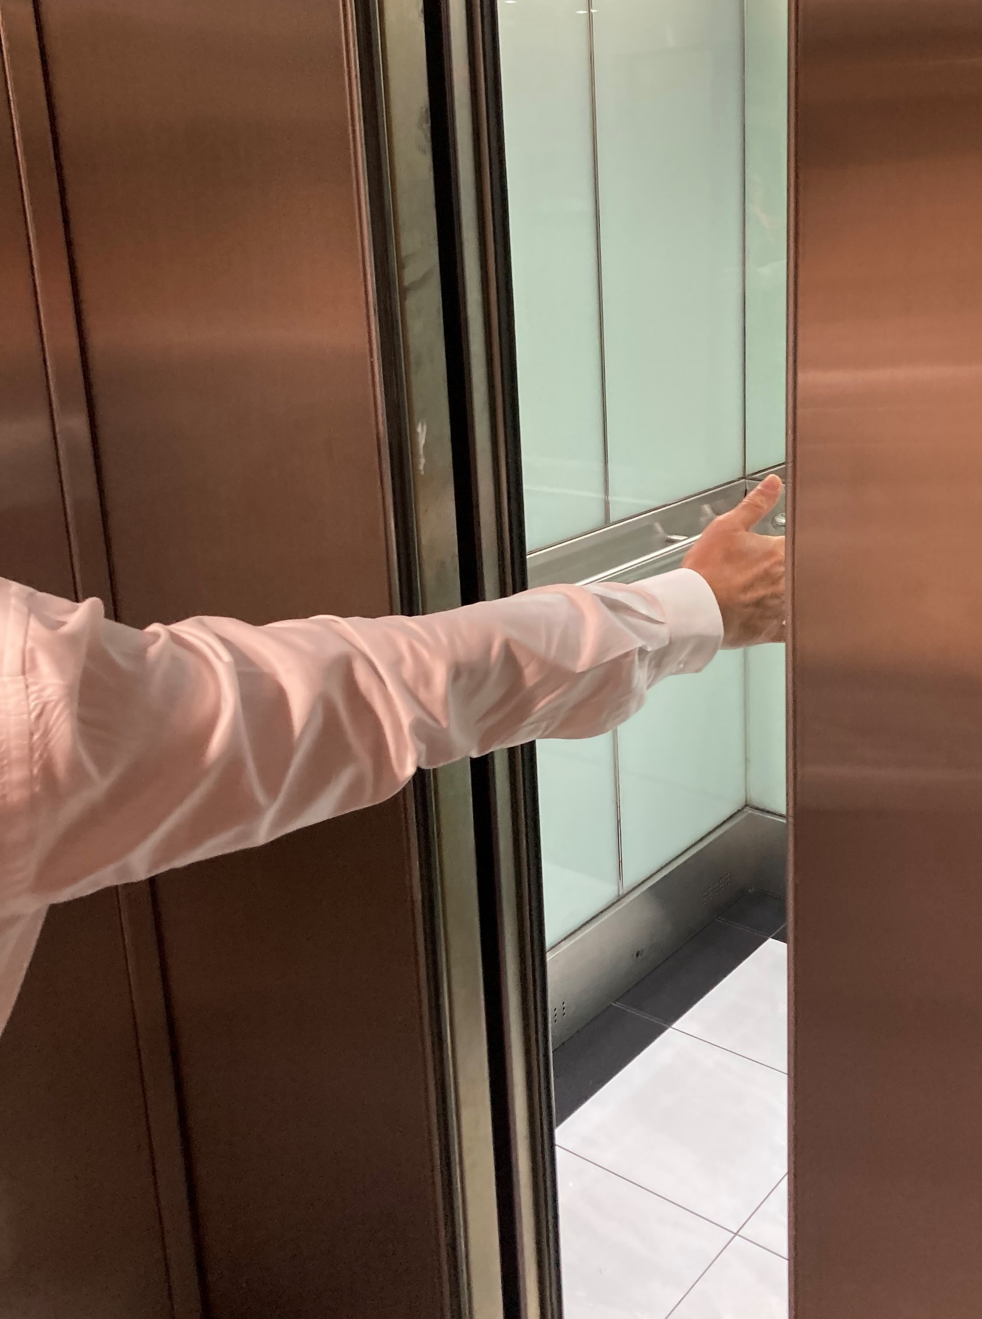
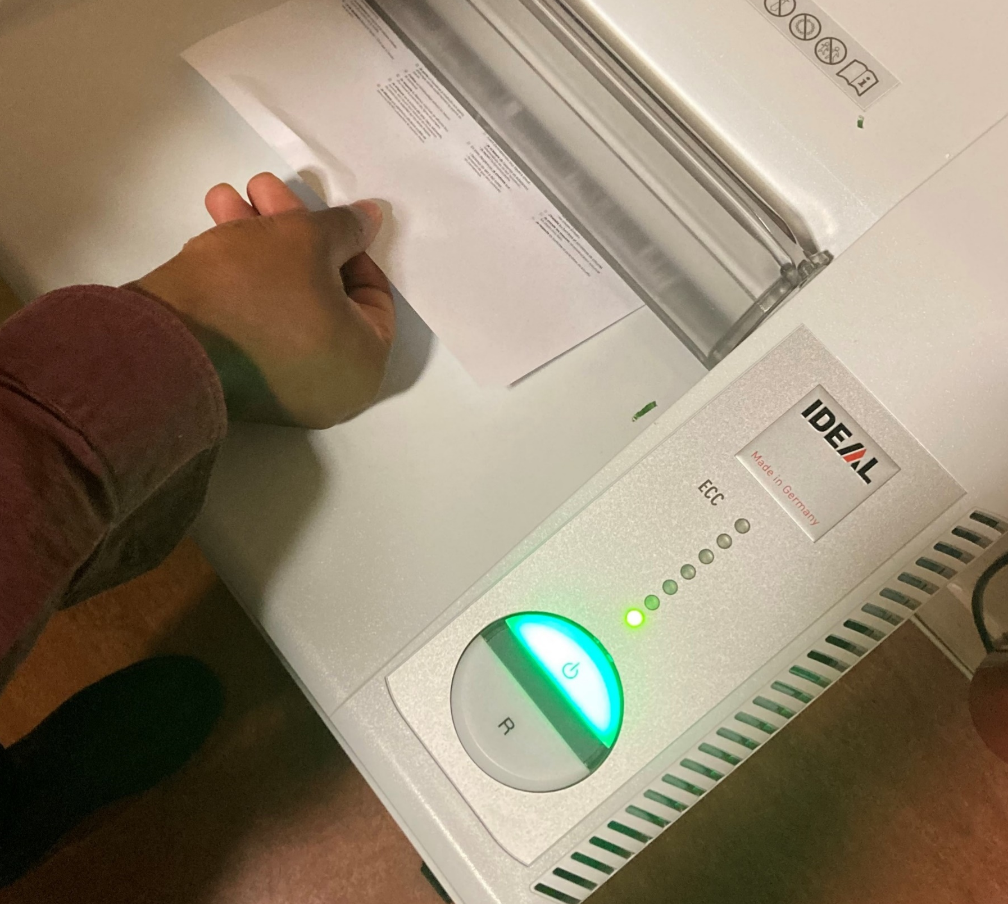
Examples of risks associated with powered systems in offices
Electrocution
I do not carry out small jobs myself (changing light bulbs, etc.): I call on the service responsible for managing the building.
I do not use the equipment if the wire is stripped and dispose of it.
Crushing
I do not obstruct the closing of automatic doors.
Entrapment
I don't put my hand in the shredding machine.
At the office, I am also implicated!

Slide 18
Our tools and documents
CR-GR-HSE-428 – HSE Requirements for the Isolation of Powered Systems: HSE Company Rules
Life Saving Checks – Work on process de-energised systems & Life Saving Checks – Work electrical de-energised systems: Life saving checks
Our Lives First HSE Program – Work on energised systems: Theme 2 – Work on energised systems
E-learning on Powered Systems: https://lizzy.totalenergies.com/
Toolbox HSE – new Golden Rules:
    General material: TotalEnergies Golden Rules – General material
    Roll-out material: TotalEnergies Golden Rules – Roll-out material
REX database: Company HSE REX DataBase
Safety+ (good practices per Golden Rule): https://safetyplus.totalenergies.com/en

Slide 19
Lexicon
Hazard: An intrinsic property of a product, equipment, process, situation or action that can result in harm to people, the environment and/or assets.
Risk: The combination of the probability of occurrence of a hazardous event and the severity of the impact that may result from exposure to the hazard.
HSE events:
  Incident: Any sudden and undesirable HSE event on a given date, that causes injury or illness, damage to property or facilities, loss of production, environmental damage or damage to the Company's image.
  Near miss: Any sudden and undesirable HSE event on a given date which, in slightly different circumstances, could have had the same consequences as an incident. A near miss does not have an actual severity level but has a potential severity level.
  Anomaly: Any abnormal situation or behaviour, including deviations from a standard, specification, procedure or rule.
HIPO (High Potential) [slide 6]: Incident or near miss with an actual severity level ≤ 3* and a potential severity level ≥ 4** in one or more areas of the Company’s evaluation matrix of the actual and potential severity level of HSE events.
REX HSE: Document for sharing information on an internal or external HSE event, based on a detailed analysis and making recommendations.
* For example, physical consequences with an actual severity level = 3 correspond to a lost time accident.
** For example, physical consequences with a potential severity level of 4 correspond to a fatality.

Slide 20
Isolation process of powered systems
IMPLEMENTATION
3
ISOLATION
4
LOCK-OUT – TAG-OUT
2
DE-ISOLATION
Install the isolation devices defined in the isolation file to separate the equipment or installation from its energy sources.
Lock out and tag isolating devices. In the particular case of electrical lockout, have the worker lock out the electrical isolating devices. Otherwise, secure the Isolating Authority’s lockout/tagout key in a lockout box.
Remove any isolation, lock-out and tag-out devices after the works protected by these isolating devices are finished and the relevant work permits have been closed out.
This removal shall be carried out by the Isolating Authority after the removal of the locking and tagging devices belonging to the worker.
2
THE ISOLATION FILE
5
RELEASE OF STORED ENERGY
PERFORMING WORKS
Prepare a file including: up-to-date isolation diagrams verified at the place of work, risk analysis, list of isolation devices, isolation certificate, safety procedure or operating mode, etc.
Discharge the energy stored in the isolated system before any intervention.
IMPLEMENTATION
DE-ISOLATION
PREPARATION
RISK ASSESSMENT
1
6
CHECK FOR ABSENCE OF ENERGY
1
TEMPORARY DE-ISOLATION
Carry out a risk analysis before any isolation.
Validate the risk analysis by visiting the work site to identify the equipment and all energy sources.
Select the required isolation devices in accordance with the relevant procedure.
ISOLATION
Record in the isolation certificate any de-isolation, including temporary de-isolation. Any temporary de-isolation for testing purposes shall be validated by the approving authority.
Before any intervention, carry out a prior check on the absence of energy by the Isolating Authority in the presence of the Executing Authority.
Stop the work if this is not possible and carry out a risk analysis.

Slide 21
Types of isolation
MECHANICAL ISOLATION
To be carried out when a risk linked to the movements of mechanisms remains after their driving energy (electrical, hydraulic) has been stopped and isolated.
  These movements can be caused by:
  An external influence (e.g. an aerator blade driven by the wind),
  Energy accumulated by inertia, compression (compressed springs), gravitation (potential energy) or pressure (hydraulic/fluidic accumulator).
PROCESS ISOLATION (FLUIDS)
Isolation of systems powered by hydraulic and thermal energy and isolation of chemical products or active biological substances.
Controlling the risk posed by fluids* (products) and which is linked to their toxicological properties (acute and chronic effects), physical-chemical properties (flammable, explosive, etc.), and their conditions of use (flow rate, pressure, temperature).
ELECTRICAL ISOLATION
Isolation of systems powered by electrical energy (both for electrical and non-electrical work).
Controlling the risk posed by electricity.
(*) Gases and liquids are grouped together under the heading of “fluids”.

