Slide 1
Safety moment
July 2022
Golden Rule 10
Work at Height

Slide 2
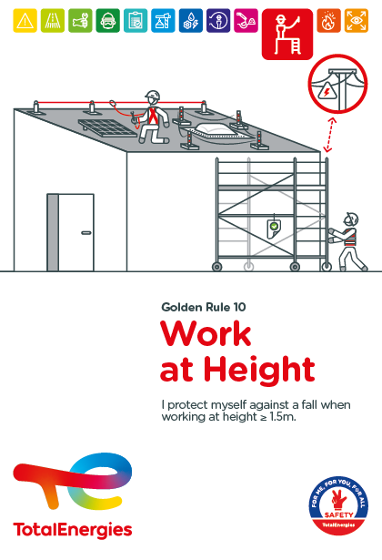
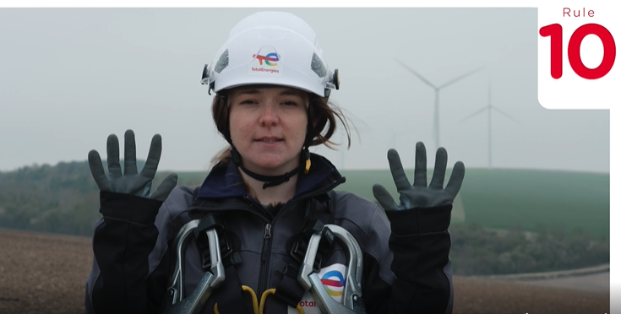


The Golden Rule 10 Work at Height
THE NEW GOLDEN RULES
Communication at the WDfS 2022
Evolution of Golden Rules 1 to 10 to strengthen personal commitment
→ Golden Rules written in "I "
2 new Golden Rules

Slide 3
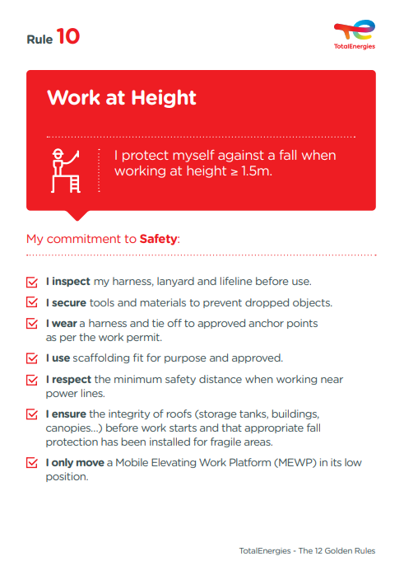
The essence of Golden Rule 10
WORK AT HEIGHT
Work at a height refers to work and movements generating a risk of a person falling with a height difference of ≥ 1.5 metres (2 metres previously).
7
Fatalities (including a 1,6m fall) (2012-2021)
In the Company, where a requirement of Golden Rule 10 has been breached
47
Events with a high severity potential (2017-2021)
On industrial sites, in the office and at home, we are all implicated!

Slide 4
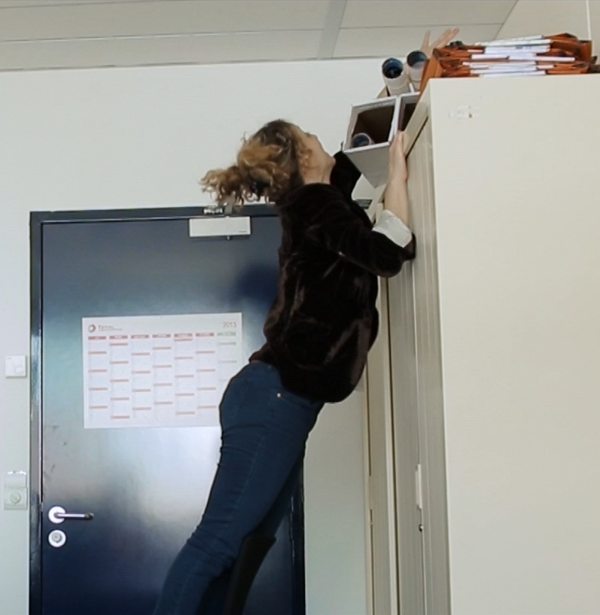
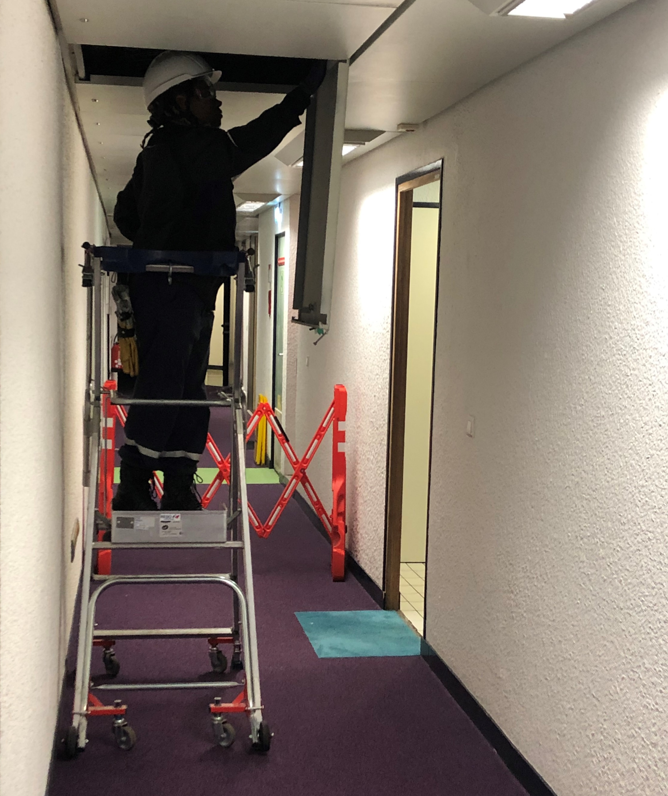
Examples of risks associated with working at height in offices
Fall of persons
Tipping over
Falling objects
I do not place objects on cupboards...
I do not climb on desks, tables or chairs.
I respect safety barriers and perimeters (works, maintenance).
If necessary, I call the building management service (I dial 16 in La Défense).
OTHER RISKS
Electrocution in the vicinity of a power line
Crushing when maneuvering a basket

