Slide 1
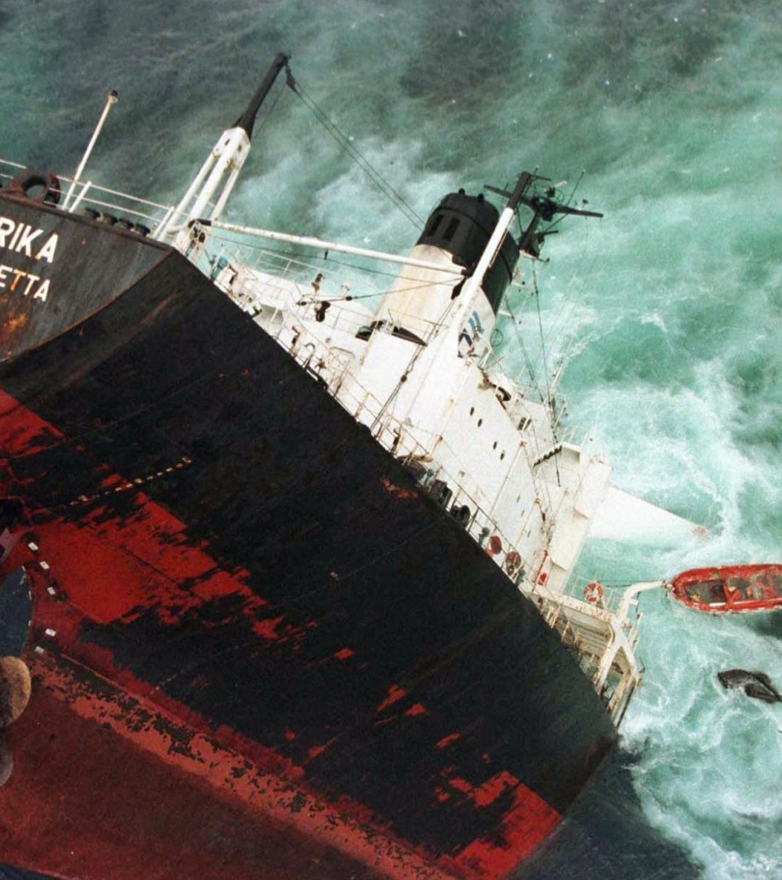
World Day for Safety
April 22, 2024
Sinking of the Erika
December 12, 1999
Source : TotalEnergies - Erika_A_DEF_181220

Slide 2
Let's share 9 accidents that have marked the history of the Industry and of the Company
The Branches have selected 9 “historic” accidents of our industry or of the Company which are printed in our collective mind.
These incidents have been specifically chosen because they have led, through their analysis, to modify and improve our ways of operating and therefore to enhance the safety of our operations.
In the Manager Kit, each accident is summarized on a slide.
In addition to that, an additional media (PPT or video) will be provided in the HSE Toolbox for further explanation:
This PPT has been selected by Tradinng-Shipping. It deals with the dramatic sinking of the Erika ship in 1999 off the French Brittany coast and led to a major pollution.
We recommend that you use these media as part of your workshops to discuss these accidents and their lessons for the Company with all the participants.

Slide 3
Summary
Description of the accident
Direct causes
Indirect causes
Environmental consequences
Regulatory and industry returns of experience
Lessons for the Company

Slide 4
Description of the accident
On December 12, 1999, the oil tanker Erika was caught in a storm with heavy seas and force 8/9 winds.
The internal structures of the oil tanker Erika failed.
The ship's hull tore and then broke in two.
The 26 crew members were evacuated by helicopter, all safe and sound.
The Erika was carrying heavy fuel oil destined for Italy's national utility ENEL.
Of the 37,000 tons of fuel oil transported, a large quantity was spilled, 11,000 tons were recovered the following summer by pumping into the wreck.
Total chose to charter the Erika, in good faith, based on a seaworthiness certification renewed in 1999 and issued by the Italian certification body RINA.
The Erika had good reports from the inspectors and had already been chartered by large companies (BP, Repsol).

Slide 5
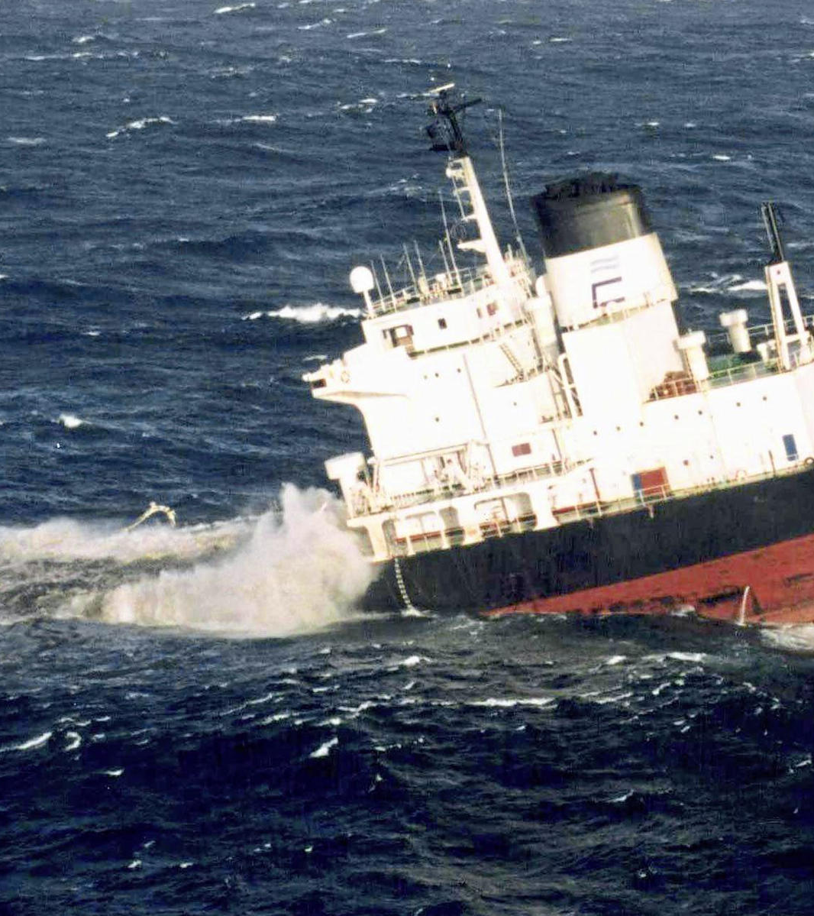
Direct Causes
Structural fatigue, the Erika was 24 years old.
Severe corrosion of the ship's structures.
The actual condition of the vessel's structures did not correspond to the certification established by the RINA.
5
World Day for Safety 2024 – support for explanation - Erika

Slide 6
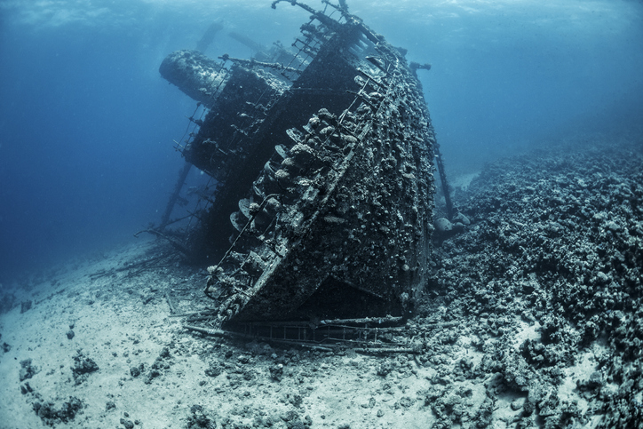
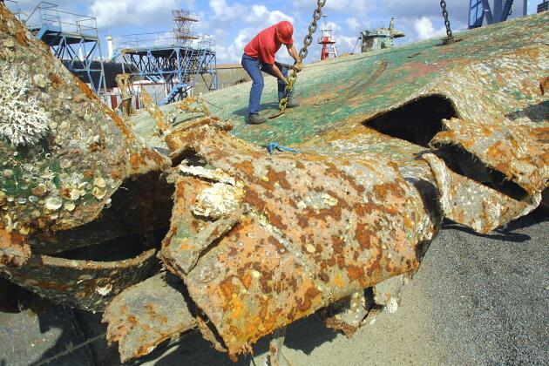
Indirect causes
Lack of maintenance and control.
Faulty operator management.
Heat-accelerated corrosion due to transport of heated product (heavy fuel oil).
A Force 8/9 storm.
World Day for Safety 2024 – support for explanation - Erika

Slide 7
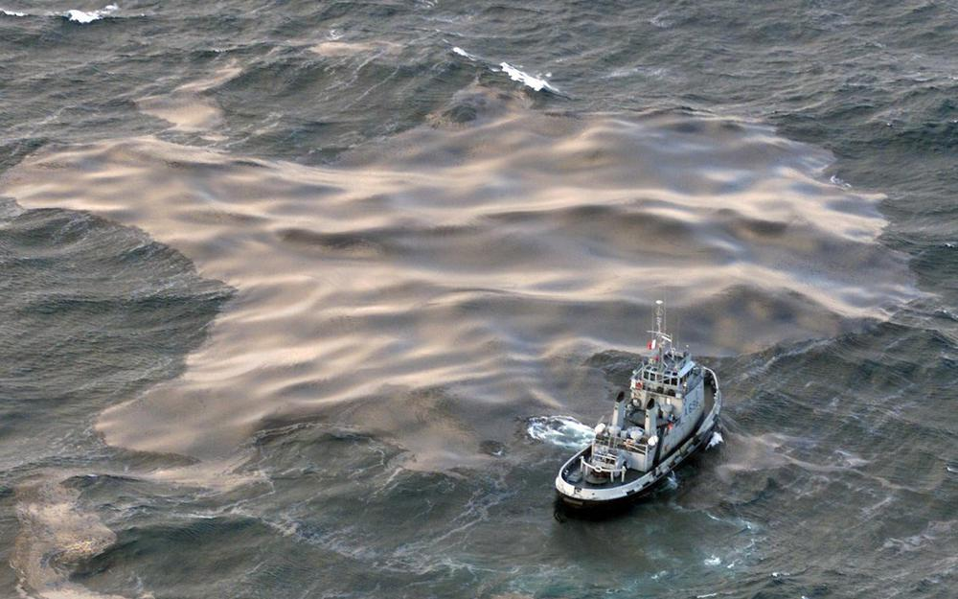
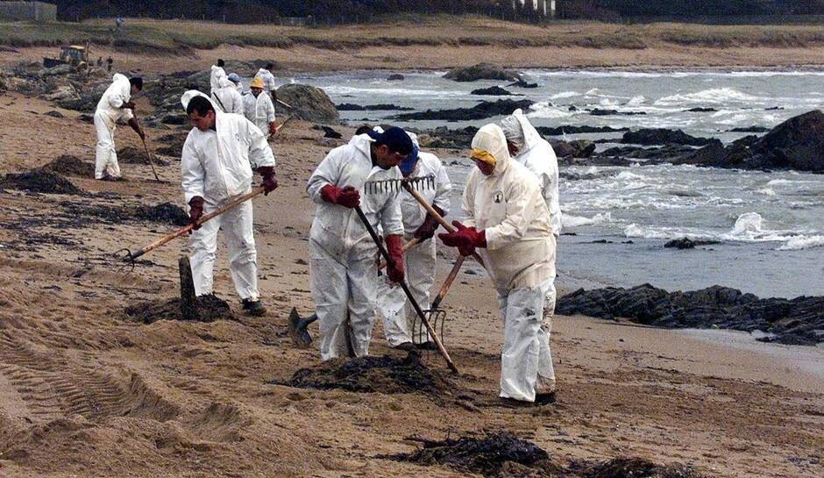
Environmental consequences
Pollution – oil spill:
  Oil slicks.
  400 km of coastline affected from Finistère to Charente-Maritime.
  270,000 tons of waste recovered (fuel oil, sand,...), treated at the Donges refinery.
  Thousands of oiled birds.
World Day for Safety 2024 – support for explanation - Erika

Slide 8
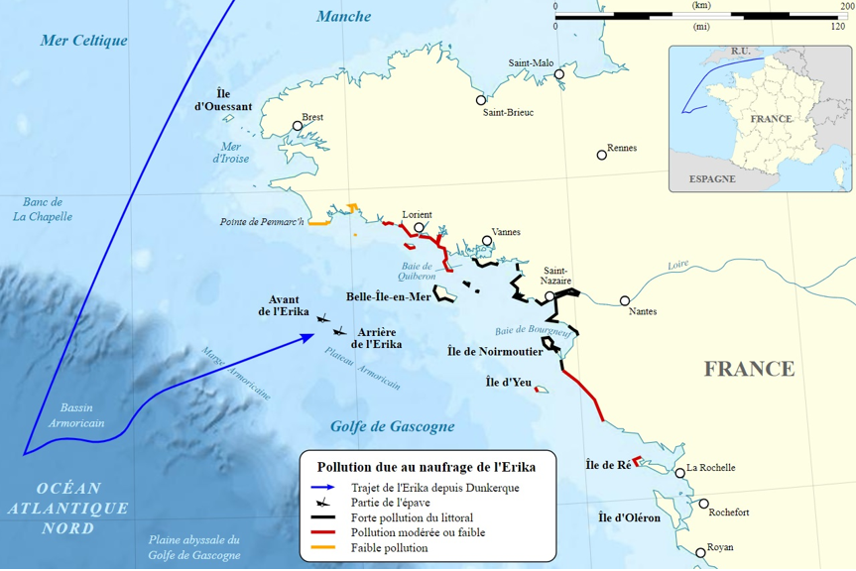
The Erika’s route and extent of the soiled coasts
Erika's route
Parts of the shipwreck
Heavy pollution of the coastline
Moderate or low pollution
Low pollution
World Day for Safety 2024 – support for explanation - Erika

Slide 9
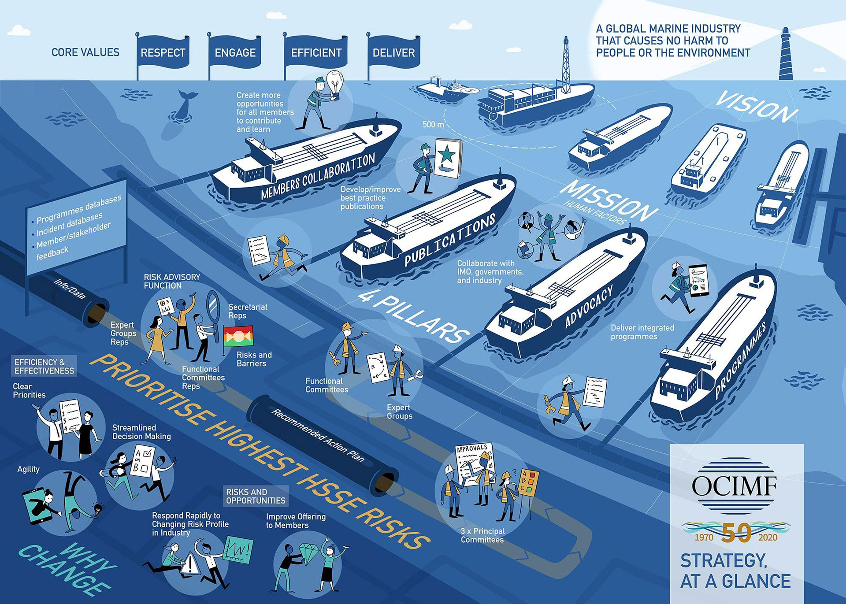
Regulatory and industry lessons learned
Implementation of the principle of environmental damage.
Increased accountability of vessel owners and operators.
Accelerated phasing-out of single-hull vessels, renewal of the fleet with double-hulled tankers.
Common classification society structural rules for oil tankers (Common Structural Rules - CSR).
Strengthening controls on the condition of the hull and structure of ships.
Revision of the evaluation conditions of ship classification societies.
Pooling of tanker vessels Inspection (OCIMF) and sharing inspection reports accessible to all oil companies.
Establishment of a list of ports of refuge.

Slide 10

Learnings for the Company
Review of the organisation of the Directorate of Maritime Transport
    Setting up a technical department with a naval architect
    An alert system and a strengthened crisis organisation
  Reinforcement of vetting (inspection of ships and evaluation of the vessel for its use):
    Each voyage of a ship is subject to an evaluation based on the most recent information concerning it.
Strengthening of charter criteria:
    Establishment of an age limit for oil and chemical tankers (20 years) and transport of heavy fuel oil (15 years)
    Use of double-hulled vessels only
    Lowering the average age of the charter tanker fleet (7 years on average)
    Minimum experience and presence in the company operating the vessel, required for senior crew members
  More substantial and quicker means of combating pollution to be implemented, in particular through the OSRL industry cooperative.

Slide 11


Enjoy your World Day for Safety 2024!

