Slide 1
World Environment Day (WED)
June 10, 2022
Protecting biodiversity is our collective responsibility.
Together we act daily to protect it.
Manager Kit

Slide 2
Reminder
01.

Slide 3
Reminder Previous WEDs
About World Environment Day (WED):
Celebrated since 1972, every year in June
A specific theme each year, chosen by the United Nations
Purpose: to prompt governments, businesses and citizens to tackle pressing environmental issues
WED 2022: EXCOM decision to make WED an event comparable to World Day for Safety or Business Ethics day
History of previous WED celebrated at TotalEnergies:
 | Theme | Events
2021 | Towards carbon neutrality | Yann-Arthus Bertrand & Patrick Pouyanné dialogue, question & answers from employees Quiz
2020 | Our successes in Co2 emission reduction | - HSE Conference: Climate Dept. CO₂ Fighters Squad; + Benoit Leguet (DG of I4CE - Institute for Climate Economics) - Videos «CO2 reduction good practices at our sites»
2019 | All committed to biodiversity | - Lecture by Bruno David (President of the French Museum of Natural History) - Biodiversity short videos produced by the sites and affiliates - Biodiversity photo contest
2018 | All acting for circular economy | Awareness campaign on waste management good practice

Slide 4
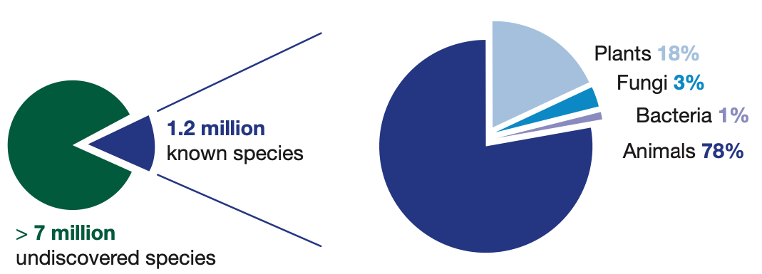
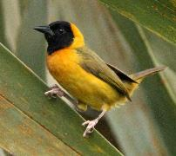
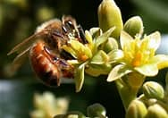
What is Biodiversity? All Life forms, « Nature »
Biodiversity and its componants
Services provided by Nature
There are three interrelated levels of biodiversity:
Specific diversity: animal or plant species
Genetic diversity within each species
The diversity of ecosystems
Also called « ecosystem services » there are 4 types:
Support for the development of life (oxygen production, soil formation, etc.)
Provisioning (water, food, etc.)
Regulation (climate, ecological balances)
Eco-cultural (spiritual life, amenities, etc.)
Notes:
Key messages:
When use the term Biodiversity we mean Nature essentially
Biodiversity includes species (like fauna and flora) but also means the Services and Benefits Nature provides people (for ex. POLLINATION, the air we breath, clean water supply, food like fishes and wood, but also soil fertility for growing our food

Slide 5
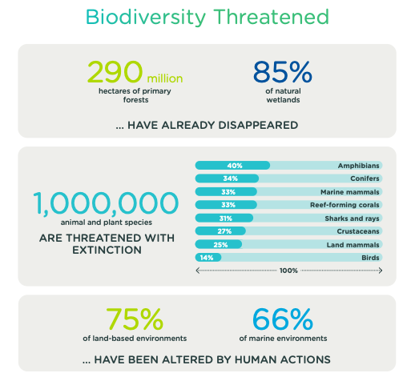
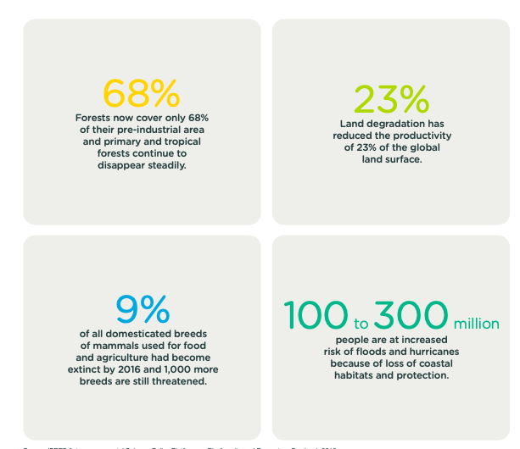
Global Biodiversity Crisis: Humanity directly under threat
Notes:
Key messages:
IPBES is the equivalent for Biodiversity of the IPCC for Climate (GIEC in French)
Losing biodiversity will destabilize natural ecosystems on which people depend

Slide 6
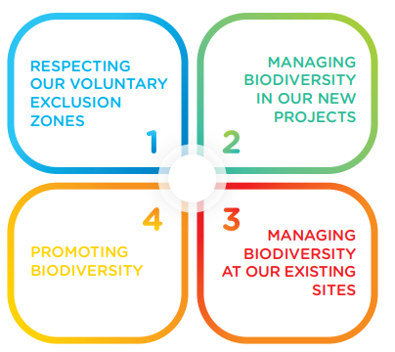
TotalEnergies Biodiversity Journey
1992
Creation of
2004
WCMC Proteus
Partnership
2005
Biodiversity
Policy
2007
Biodiversity
Guides
2016 Response SDG Advocates & SDG commitments
2012, 2013
Voluntary Avoidance Commitments
UNESCO World Heritage &
Arctic Sea IceAreas
2008
Iconic biodiversity Projetcs
June 2018
CBD COP 14
2018 July voluntary
commitments
CBD Cooperation Global Biodiversity Framework (GBF)
2020 update of
Biodiversity Ambition
with full EXCOM
Support

Slide 7
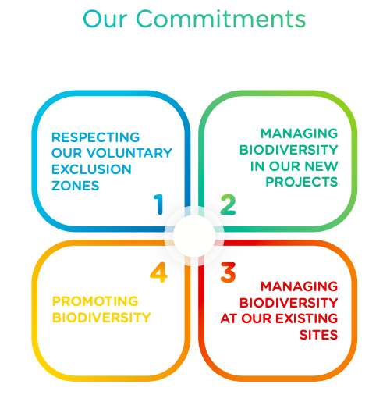
Biodiversity Ambition: 4 pillars
World Environment Day - June 10, 2022

Slide 8
Biodiversity Ambition: Booklet & Short Film

Slide 9
WED 2022 - Programme
02.

Slide 10
WED 2022 Activities Programme - Overview
Date: 10 June 2022
Theme: Biodiversity
Slogan: « Biodiversity, All in Action ! »
A key Event: a level of commitment comparable to that of the World Day for Safety : biodiversity is one of the 3 priority areas of action that the Company has set itself, to take care of the planet’s resources
Objective: demonstrate our commitment to support biodiversity
Executive level involvement: CEO and EXCOM members
Involvement and mobilization of all: Sites & HQs – set up of workshops to celebrate WED 2022
Raising awareness of all by providing biodiversity media (brochures, animated film, short films of site biodiversity actions, etc.)
World Environment Day - June 10, 2022

Slide 11
Tools and materials made available for WED 2022
To support your event, the following resources are available in HSE Toolbox (link):
A poster + kakemono
A WED 2022 Manager Kit + WED 2022 PowerPoint template
Company's Biodiversity Ambition short film
The Biodiversity booklet and the ”Company Ambition and commitments» document
To give visibility to your event:
The One HSE Yammer
(Access link)
A collection platform (photos and videos)
(available on June, 10)

Slide 12
Celebration ideas at sites
Suggestions for on-site celebrations
Workshops promoting biodiversity actions already in place at site and/or its surroundings.
Exchange and discussion workshops to identify actions that could be carried out by the site.
Round table for exchanges or debates with external biodiversity partners specializing in local biodiversity issues.
Biodiversity stands :
biodiversity educational trails,
biodiversity photo exhibition of the site and its surroundings,
display of management actions carried out on site,
partner interventions
…
Environment/biodiversity awards for team actions
Feel free to use your own ideas for celebrating WED 2022
Report on the actions carried out during WED
The sites share their achievements on Yammer One HSE (link) and on the dedicated WED 2022 collection platform (photos, videos, description of the celebrations).
Production of a WED 2022 retrospective film by HSE Communication (via HSE Toolbox, Yammer, WAT etc).

