Slide 1
Safety of Aviation Activities REGLE HSE GROUPE (CR-GR-HSE-415)
Executive Summary
This rule defines the minimum HSE requirements for aerial activities. It covers the use of airlines, charter flights, aerial work, infrastructure (helipads, ground equipment, etc.), the roles and responsibilities of the Group’s aeronautical technical center and those expected of the entities or affiliates. This rule does not cover non-chartered air transport of goods, commercial fuelling of aircraft and leisure travel including travel organized by company social committees.

Slide 2
Scope of Application: All Group entities and affiliates with risks associated with aerial activities.
Activities concerned:
Non-chartered flights (compagnies aériennes effectuant des vols réguliers).
Chartered flights (helicopter and airplanes): passenger transport and aerial work.
Infrastructure (helipads, air strips, ground equipment, etc.).
Excluded activities:
Non-chartered air transport of goods.
Commercial fuelling of aircraft
Leisure travel including travel organized by company social committees.
Takes into account the recommendations from the 2016 Group audit on crisis management regarding non chartered flights and effective communications throughout the network.
Takes into account REX (specifically concerning accidents in the North Sea).

Slide 3
Replaces 6 existing Group and Branch rules:
Reduction from 43 to 24 requirements.
Publication date in REFLEX : 14/06/2019
Effective date: 3 months following date of publication except for:
aerial work requirements for which a 12-month extension is given for the implementation of requirement 3.3.6, or at the end of the current contract if the length of contract is greater than 12 months. This extension does not apply to the E&P Branch.

Slide 4
PERIMETER
Currently covered at Group level: passenger transport
Airplanes Helicopters Infrastructure
NEW COMPANY RULE
REG-GR-HSE-415 :
Safety of Aerial Activities
Added to the scope:
Aerial work¹ New types of aerial means
Note ¹: For E&P, aerial work was already covered in CR-EP-LSO-100

Slide 5
EXISTING REFERENTIELS
EXISTING REFERENTIELS
DIR-EP-16 : Aviation Directive for E&P
New Company Rule
CR-EP-LSO-100 : Standards for Aerial Transport Operations
DIR-GR-SEC-015: Safety of Air Transport
REG-GR-HSE-415 :
Safety of Aerial Activities
24 requirements
CR-MS-HSEQ-630 Safety of Air Transport
REG-GR-SEC-015: Safety of Air Transport
13 existing or modified
02 taken into account in the new organisation
03 REX taken into account
01 recommended from the Group audit
05 Maestro
CR-GP-HSE-121: Safety of Air Transport
6 documents
43 requirements
1 single Group document
24 requirements
The number of requirements is reduced by 44%

Slide 6
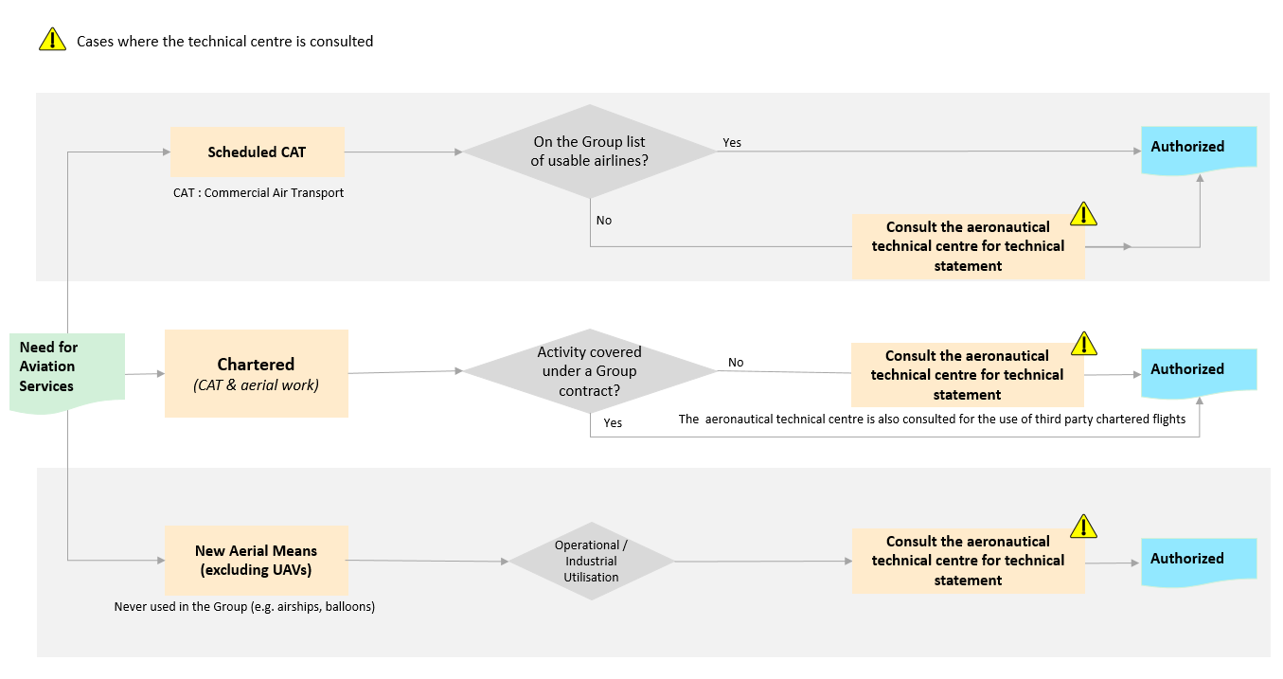
PLANNING PROCESS FOR AERIAL ACTIVITIES
The process for planning aerial activities follows the logic diagram below:

Slide 7
REQUIREMENT OVERVIEW: General Requirements
Operations Continuity (Requirement 3.1.1)
The maximum number of people allowed to travel on the same flight is included in the Business Continuity Plan of the entity or affiliate. Furthermore:
The Group's Chief Executive Officer and Chief Financial Officer do not travel together;
A maximum of one third of the Group Executive Committee members may travel together on the same aircraft;
A maximum of one third of the members of a Branch Codir may travel together on the same aircraft.
Comment:
Previous principle: Avoid using a single aircraft to transport several personnel from the same team.
Complying with Instructions (Requirement 3.1.2)
Operating instructions of the air operator and the safety instructions issued by the flight crew are respected.
New requirement
Aircraft for Passenger Transport (Requirement 3.1.3)
The aircraft used for the passenger transport are multi-engine, equipped with turbomachines.
No change

Slide 8
REQUIREMENT OVERVIEW: Non-Chartered Flights
Preselected Airlines for Non-Chartered Flights (Requirement 3.2.1)
Airlines companies that can be used are included on the Group list of air operators. In other cases, the aeronautical technical centre is consulted.
Comment:
E&P, M&S, R&C, GRP: Simplification of the previous requirement (DIR-GR-SEC-15 et REG-GR-SEC-15).
Documentation of the Technical Aeronautical Centre Statement (Requirement 3.2.2)
In the case of a request for advice under requirement 3.2.1, the statement is documented and provided to the requesting entity or affiliate after completion of a risk assessment.
Comment:
Previous principle: Carriers without IOSA certification or that are not monitored by an internationally recognised national public civil aviation authority must be the subject of a risk assessment prior to use.

Slide 9
REQUIREMENT OVERVIEW: Chartered Flights
Types of Aircrafts for Chartered Flights (Requirement 3.3.1)
Helicopters and airplanes that are authorised:
Are of a civil type, regardless of the activity;
For passenger transport are less than 25 years old for the duration of the charter contract.
Comment:
Reinforcement that aircraft are of a civil type.
Infrastructure for Chartered Flights (Requirement 3.3.2)
The minimum standards for airports, helipads and ground equipment are selected based on the most restrictive requirements between:
International Civil Aviation Organisation (ICAO) Annex 14, Vol I and II or ICAO Doc 9261, for all infrastructures;
National regulations.
New requirement
Adjustment of OACI definitions to the Group referential.

Slide 10
REQUIREMENT OVERVIEW: Chartered Flights
Risk Analysis for Chartered Flights (Requirement 3.3.3)
Before the establishment of a charter contract:
A risk analysis is conducted by the entity or affiliate taking into account the criteria of Appendix 2, and is then sent to the aeronautical technical centre for advice;
A statement of the advice from the aeronautical technical centre regarding the air operator considered for selection is provided back to the entity or affiliate. If necessary, risk controls are implemented by the entity or the affiliate before commencement of operations
Changes:
E&P, M&S, R&C, GRP: clarification on the risk analysis.
Prerequisite Documents for Chartered Flights (Requirement 3.3.4)
The verification of the following documents is a prerequisite for a positive statement from the technical aeronautical centre:
A certificate issued by a national civil aviation authority and corresponding to the type of activity carried out for the Group:
­ A valid Air Operator Certificate (AOC) for passenger transport or;
­ An Aerial Work Certificate (AWC) or equivalent for specialised operations.
A valid Aircraft Maintenance Organisation (AMO) certificate held by the air operator or by its subcontractors;
A valid insurance policy held by the air operator with civil liability coverage. The minimum amount of this insurance is as per the minimum Group Insurance requirements.
Changes:
E&P: Already in practice.
M&S, R&C, GRP: the perimeter of application is expanded for aerial work.
Insurance requirements are defined by the Group.

Slide 11
REQUIREMENT OVERVIEW: Chartered Flights
Verification of the Implementation Process of Airworthiness Directives by Aeronautical Technical Centre (Requirement 3.3.5)
The internal process of the chartered air operator ensures the implementation of the airworthiness directives regarding the state of registration and those regarding the state of certification of the aircraft.
No change
Reinforcement of the airworthiness directives.
Aeronautical Technical Centre Statement for the Selection of Chartered Air Operators (Requirement 3.3.6)
The technical statement of the aeronautical technical centre is issued on the basis of a documentation review and/or an aeronautical technical audit, which ensures that the air operator meets the Group's requirements.
The technical statement is communicated to the requesting entity or affiliate in the form of a written report, stating at minimum:
The results of the assessment;
For passenger transport, that the valid term of the technical statement is not to exceed a 2 year period;
In the case of aerial work, that the valid term of the technical statement is not to exceed a 3 year period;
The identified gaps with Group requirements, potential operational restrictions, and the need for derogation, if any;
If necessary, the action plan to be completed prior to issuance of the charter contract.
Changes:
E&P: Already in practice.
M&S, R&C, GRP: expansion of the scope of application for aerial work.
Reinforcement of validity period of the technical statement.

Slide 12
REQUIREMENT OVERVIEW: Chartered Flights
HSE Contractual Clauses for Charter Contracts (Requirement 3.3.7)
The charter contract with the air operator includes the following provisions:
The details of the derogations obtained vis-à-vis Group requirements, if any;
The obligation to declare any change in subcontractor or aircraft, and consequently the obligation to obtain a prior approval by the aeronautical technical centre;
The list of safety performance indicators and the quarterly reporting obligations (see Appendix 3);
A list of the incident types where reporting is mandatory, including the obligation to send an initial factual report within 24 hours;
The possibility that the Group may mandate the operator to apply optional service bulletins of the manufacturers
No change
Training (Requirement 3.3.8)
Ground personnel at the operated facilities involved in the landing/take-off operations of chartered aircraft receive appropriate training from organisations approved by the aeronautical technical centre.
Passengers transported by chartered helicopter to offshore facilities and/or vessels have up-to-date medical certificates and helicopter underwater emergency evacuation and sea survival (BOSIET, HUET) training certificates obtained from an organisation which is OPITO certified or internally approved by the Group.
No change

Slide 13
REQUIREMENT OVERVIEW: Chartered Flights
Management of Passengers of Chartered Flights (Requirement 3.3.9)
Passengers transported by helicopter to offshore installations and/or vessels carry an Emergency Breathing System (EBS) category A.
Passengers transported by helicopter to offshore installations and/or vessels and that are occupying seats at an emergency exit meet the compatibility requirements for shoulder width.
In the case of aerial work, no passenger shall be present on board the aircraft.
Changes:
To carry an EBS and passengers are compatible with the shoulder width for emergency exits:
E&P: already documented.
Note: Recommendation from aviation autorities following accidents in the North Sea.
For the restriction of passengers on board aircrafts used for aerial work:
E&P: already applied.
M&S, R&C, GRP: expansion of the perimiter of application for aerial work.

Slide 14
REQUIREMENT OVERVIEW: Chartered Flights
Restrictions for Chartered Flights (Requirement 3.3.10)
Flights to offshore installations and/or vessels, except for Search And Rescue (SAR) and medical evacuations, are prohibited when the sea state exceeds the certified limits of the helicopter emergency floatation system.
Chartered helicopter night flights are limited to medical evacuations and as necessary for pilots to maintain their qualifications. The only exceptions are flights with passengers at latitudes above 50° North or below 50° South when the daylight period is incompatible with operational requirements, and only:
Subject to the availability of appropriate SAR resources; and
After prior advice by the aeronautical technical centre.
No change
Note : Recommendation from aviation autorities following accidents in the North Sea.
Operational and Technical Flights Surveillance (Requirement 3.3.11)
For any long-term passenger transport, charter contract (> 1 year), and when the technology is available, the aircraft shall be equipped with the following:
Flight Data Monitoring (FDM);
Aircraft Health Usage Monitoring System (HUMS) or Unit/Engine Condition Trend Monitoring System (ECTMS).
The surveillance and analysis processes are implemented by the air operator using these technologies.
No change
Note : Recommendation from aviation autorities following accidents in the North Sea.

Slide 15
REQUIREMENT OVERVIEW: Chartered Flights
Third-Party Chartered Flights for Passenger Transport (Requirement 3.3.12)
The use of third-party charter flights for the passenger transport is subject to a prior approval by senior management of an entity or affiliate after advice from the aeronautical technical centre.
Changes:
E&P: good practices are formalised.
M&S, R&C, GRP: generalisation of existing good practices.
REQUIREMENT OVERVIEW: Aeronautical Experimentation
Use of New Aircraft Types (Excluding UAVs) (Requirement 3.4.1)
For the operational use of new aircraft types (excluding unmanned aerial vehicles (UAVs)), the aeronautical technical centre is consulted for a technical statement.
New Requirement
E&P, M&S, R&C, GRP: formalisation of existing practice.

Slide 16
REQUIREMENT OVERVIEW: Emergency Response
Elements to Include in the Emergency Response Plan (Requirement 3.5.1)
The emergency response plan of the entity or affiliate considers:
For charter flights:
­Accident scenarios and scenarios of overdue aircraft;
­Carrying capacity of chartered aircraft, the estimate of survival time, and the available means of rescue within the zone in the event of an accident.
For non-charter flights:
Accident scenarios.
Changes:
E&P, M&S, R&C, GRP: clarification on the content
Note: This requirement is following a 2016 Group audit and is aimed mainly at affiliates that have a contract in place with a travel agency other than CWT.
Emergency Response Plan Testing for Charter Flights (Requirement 3.5.2)
Charter flight scenarios in the entity or affiliate emergency response plans are integrated into the annual testing plan, or as soon as possible after the establishment of a long-term charter contract with an air operator.
No change

Slide 17
REQUIREMENT OVERVIEW: Inspections and Audits
Follow-up of Recommendations from Aeronautical Technical Audits (Requirement 3.6.1)
The close out of findings related to non-conformance level 1, made following a technical audit of an air operator, is subject to a technical statement from the aeronautical technical centre.
Note: Non-conformance Level 1: Safety is affected. Urgent action is required.
Comment:
Clarification of the rule

Slide 18
REQUIREMENT OVERVIEW: Communication and Reporting
Distribution and Archiving of Documentation (Requirement 3.7.1)
The technical statements are communicated to the Group HSE Aviation Activities function and archived according to the Group policy.
New Requirement
E&P, GRP, M&S & R&C: formalisation of an existing practice.
Reporting Accidents and Incidents (Requirement 3.7.2)
For charter flights the following events (as defined by ICAO) are reported:
Accidents;
Serious incidents;
Incidents that could have an impact on the airworthiness, the safety of the flight of the aircraft or the personnel on board.
New Requirement
Aviation Activity Report (Requirement 3.7.3)
For HSE performance monitoring, the activity of the chartered air operator report is transmitted quarterly to the Group HSE Aerial Activities function.
Comment:
E&P, GRP, M&S & R&C : formalisation of an existing practice.

