Slide 1

Safety moment
Golden Rule 7
Powered Systems
September 2022

Slide 2
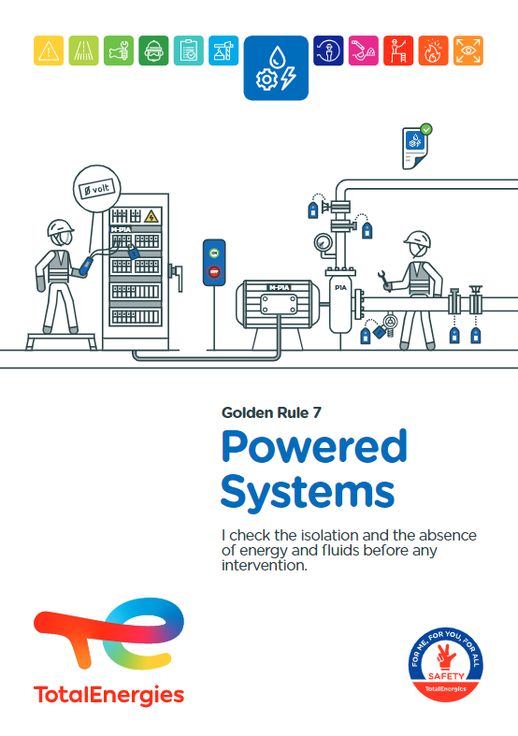
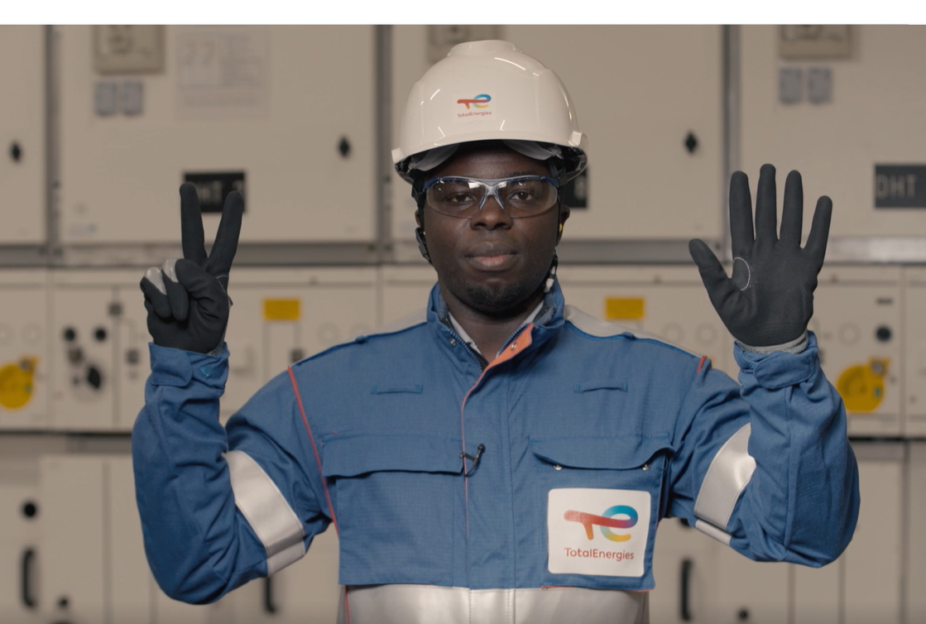

The Golden Rule Powered Systems
THE NEW GOLDEN RULES
Communication at the WDfS 2022
Evolution of Golden Rules 1 to 10 to strengthen personal commitment
→ Golden Rules written in "I "
2 new Golden Rules

Slide 3
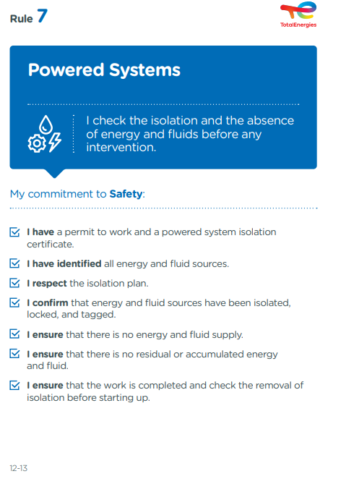
The essence of Golden Rule 7
POWERED SYSTEM
A powered system is any equipment, a circuit or an installation that has non-isolated energy source and/or contains hazardous substances.
3
Fatalities (2012-2021)
In the Company, where a requirement of Golden Rule 7 has been breached
77
Events with a high severity potential (2017-2021)
On industrial sites, in the office and at home, we are all implicated!

Slide 4
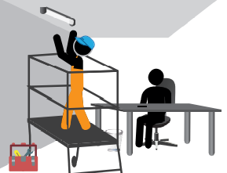
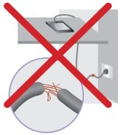
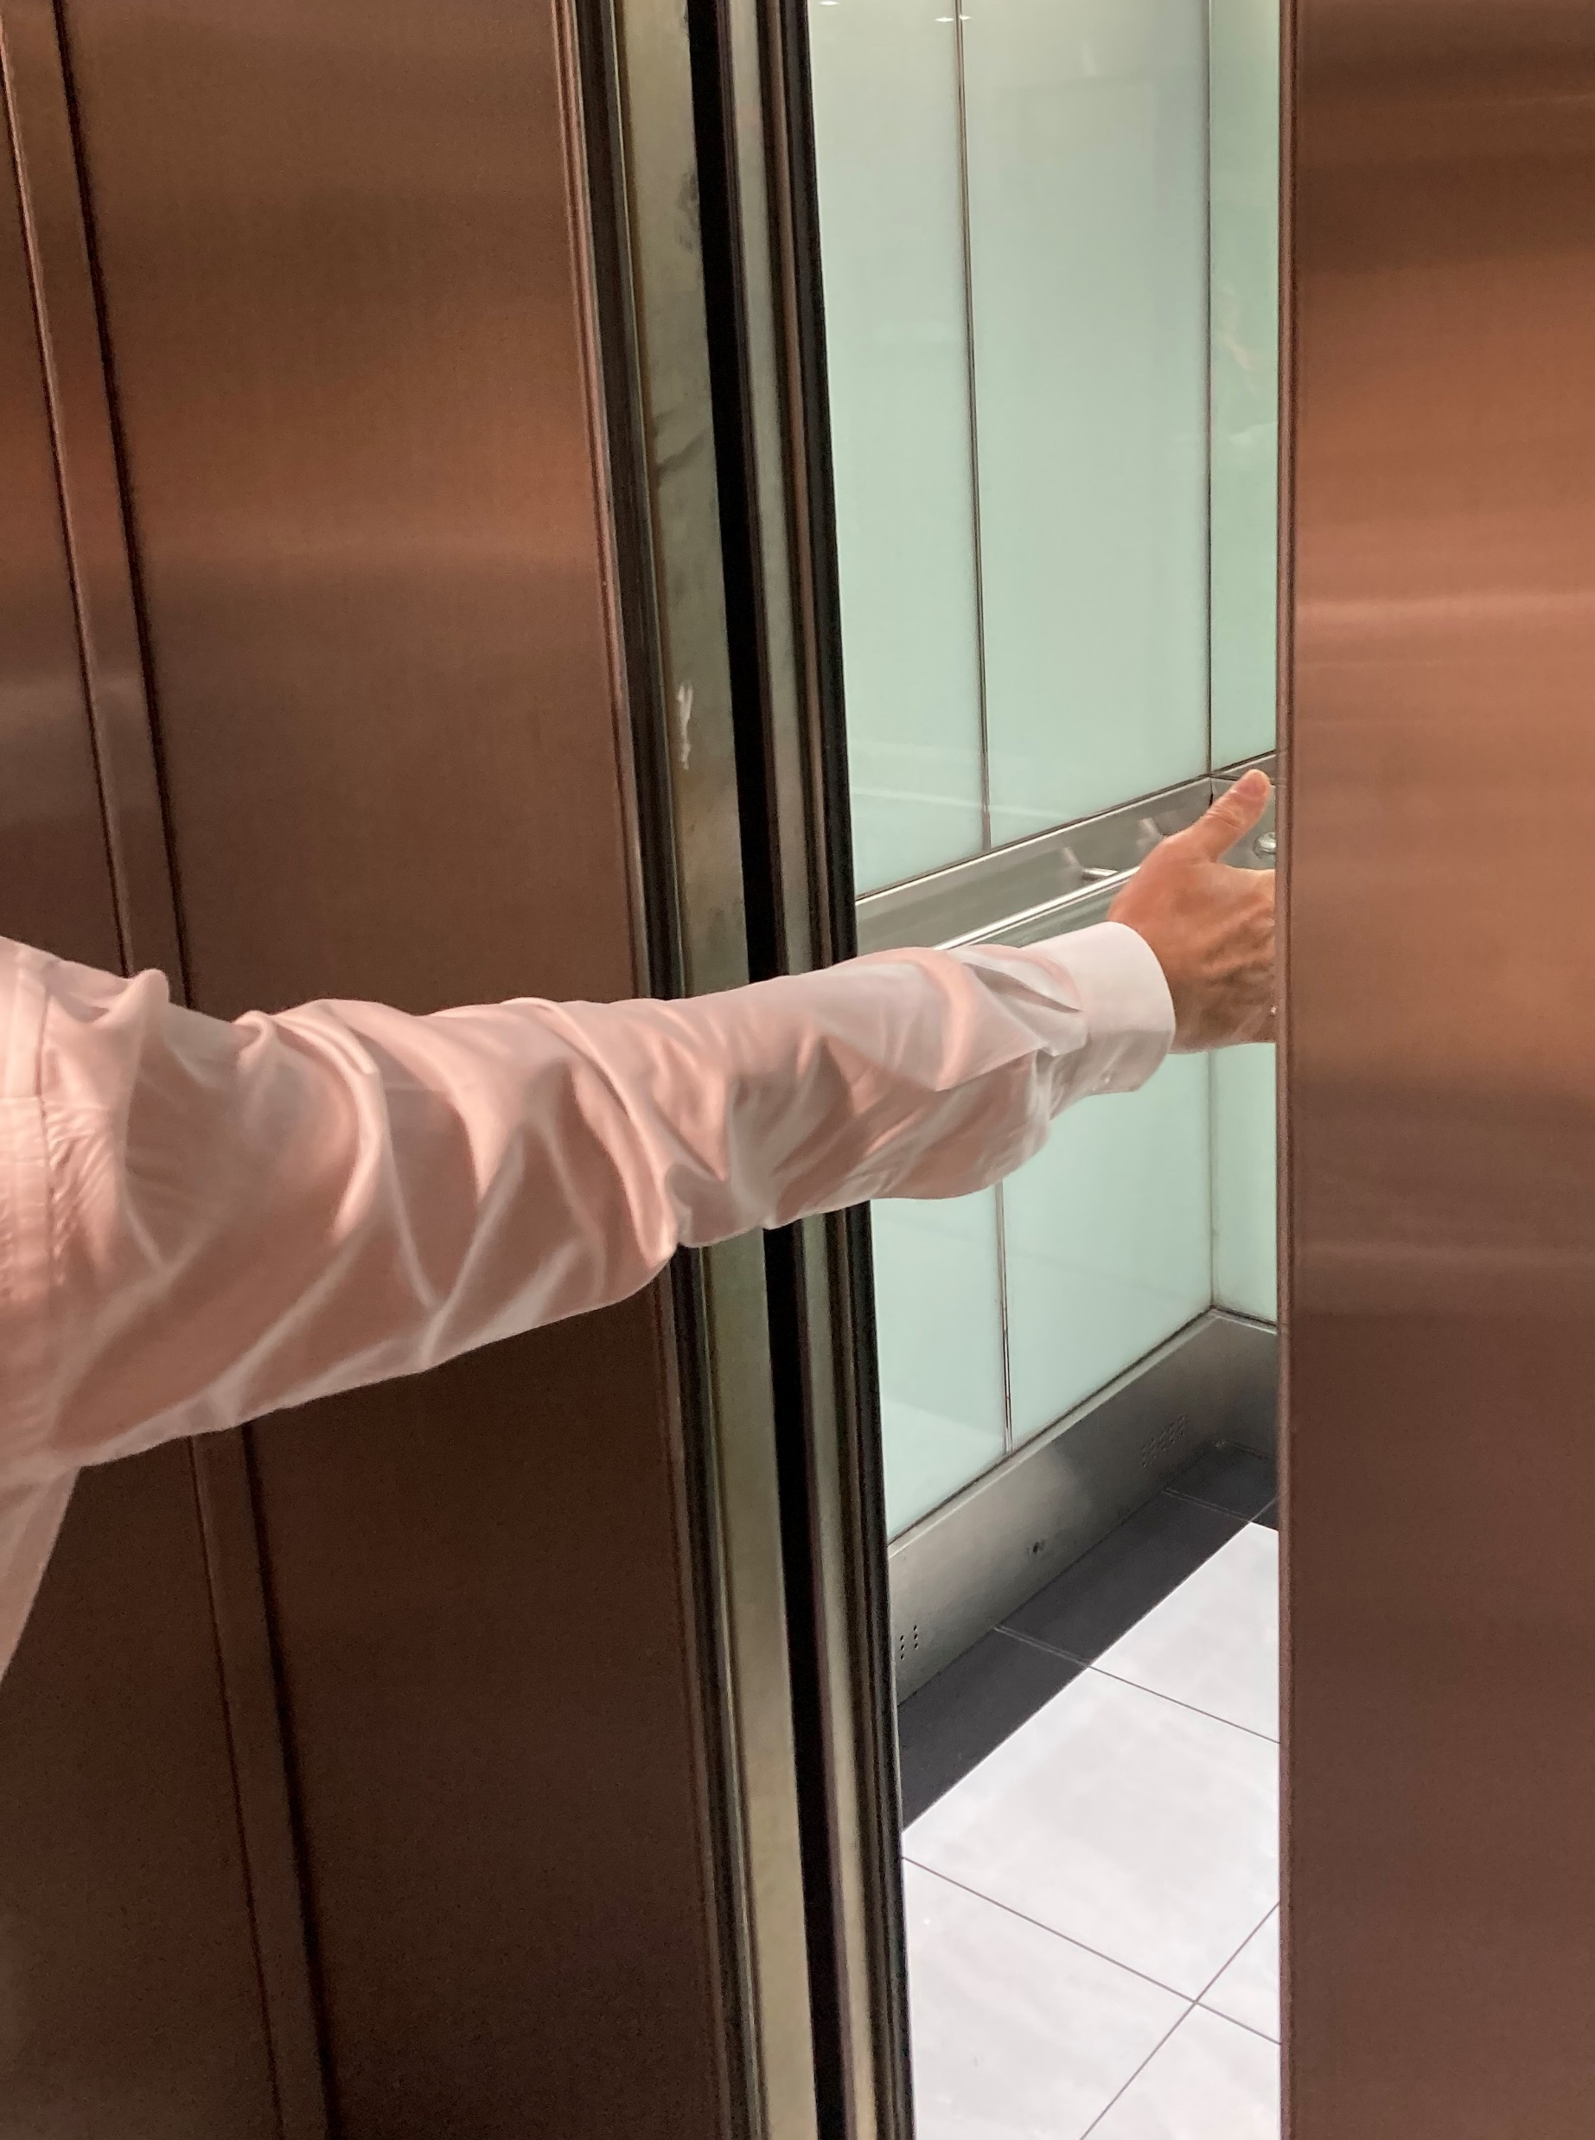
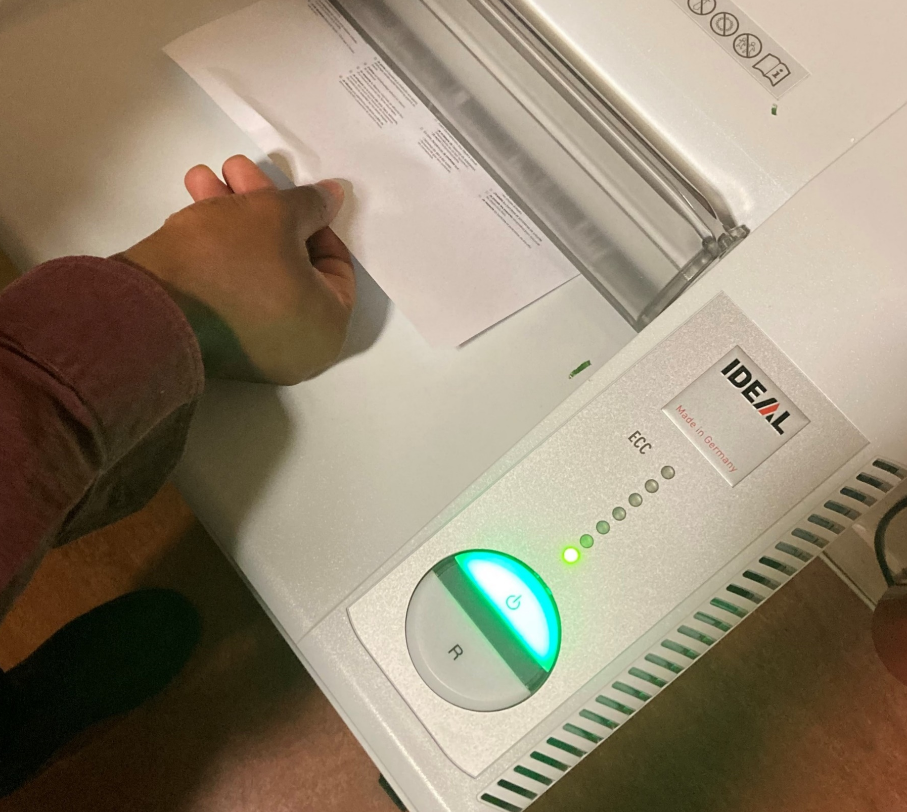
Examples of risks associated with powered systems in the offices
Electrification, electrocution
I do not carry out small jobs myself (changing light bulbs, etc.): I call on the service responsible for managing the building.
I do not use the equipment if the wire is stripped and dispose of it.
Crushing
I do not obstruct the closing of automatic doors.
Entrapment
I don't put my hand in the shredding machine.

