Slide 1
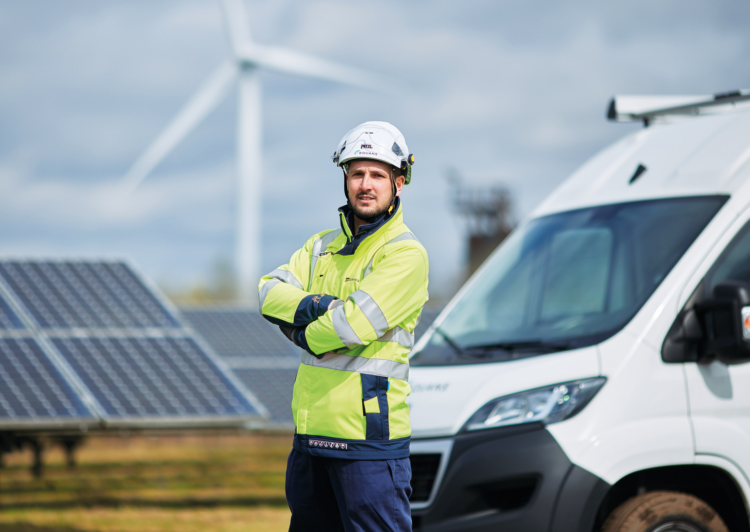
I'm a #SafeDriver
I don’t drive if I’m tired and I don’t allow distractions

