Slide 1
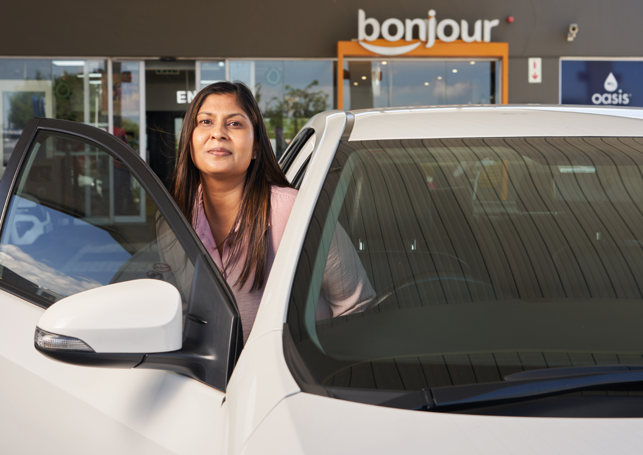
I'm a #SafeDriver
I keep control of my vehicle at all times

