Slide 1

Safety moment
Golden Rule 4
Personal Protective Equipment (PPE)
December 2022

Slide 2
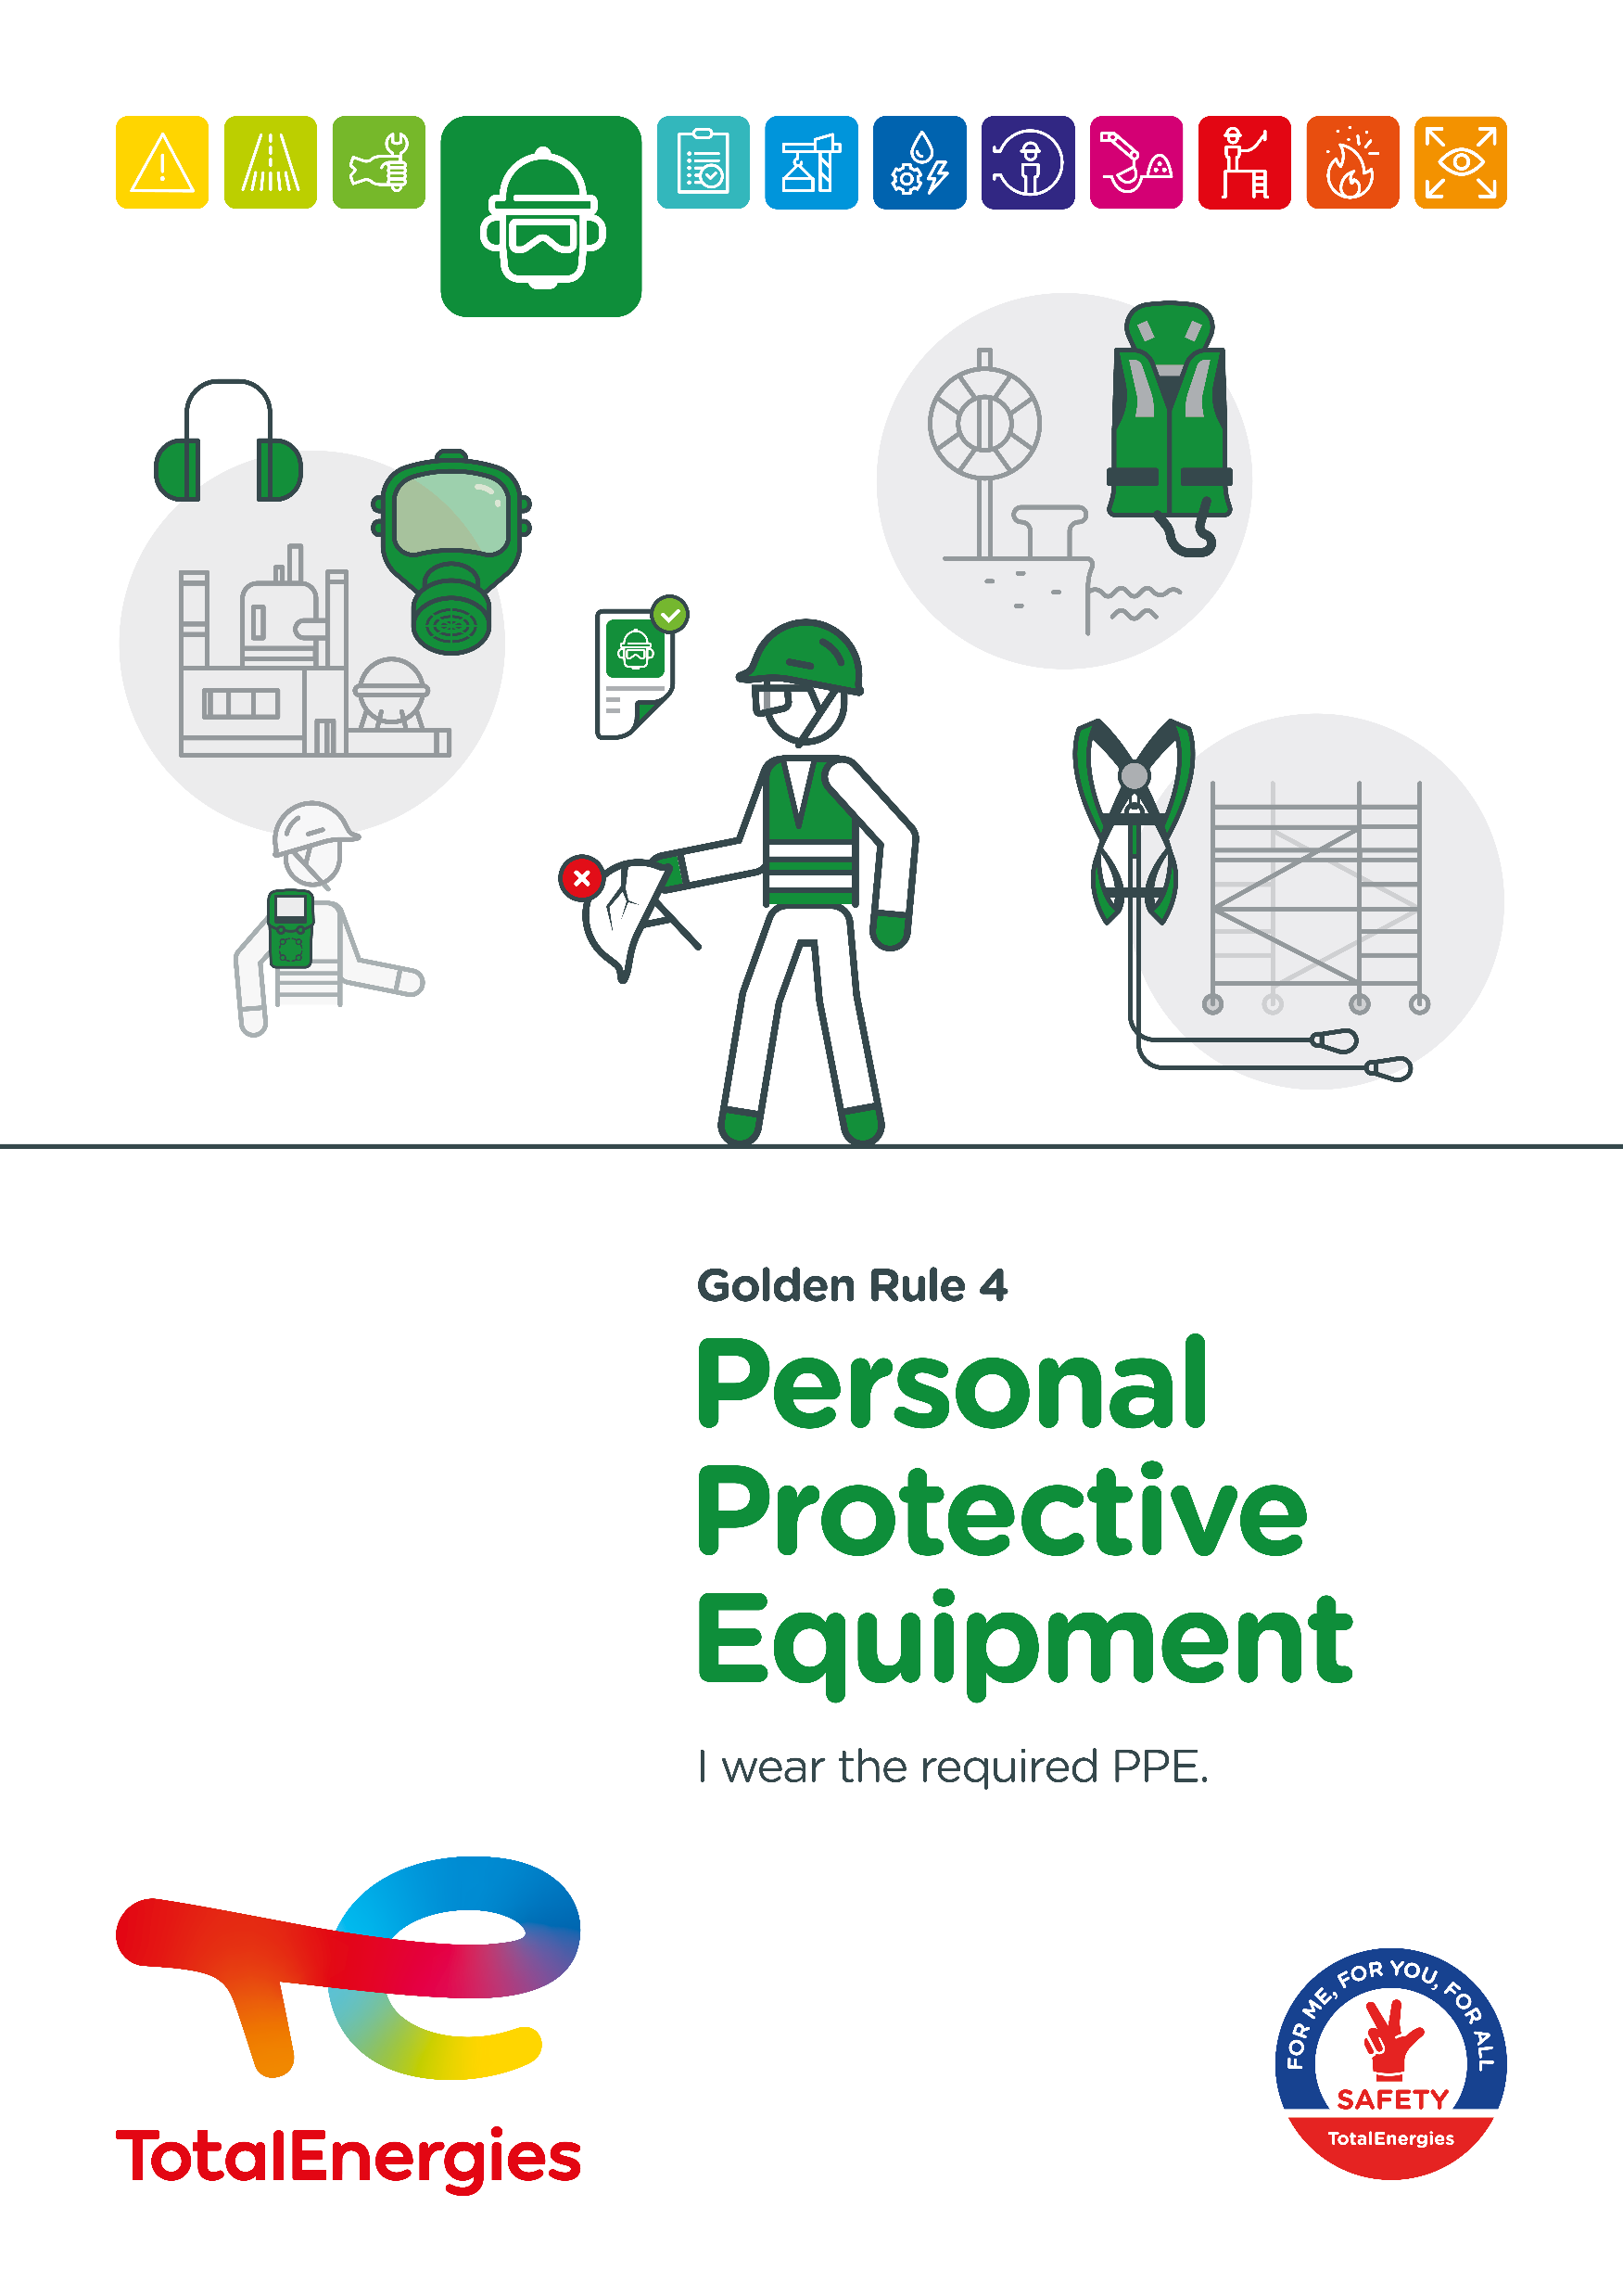
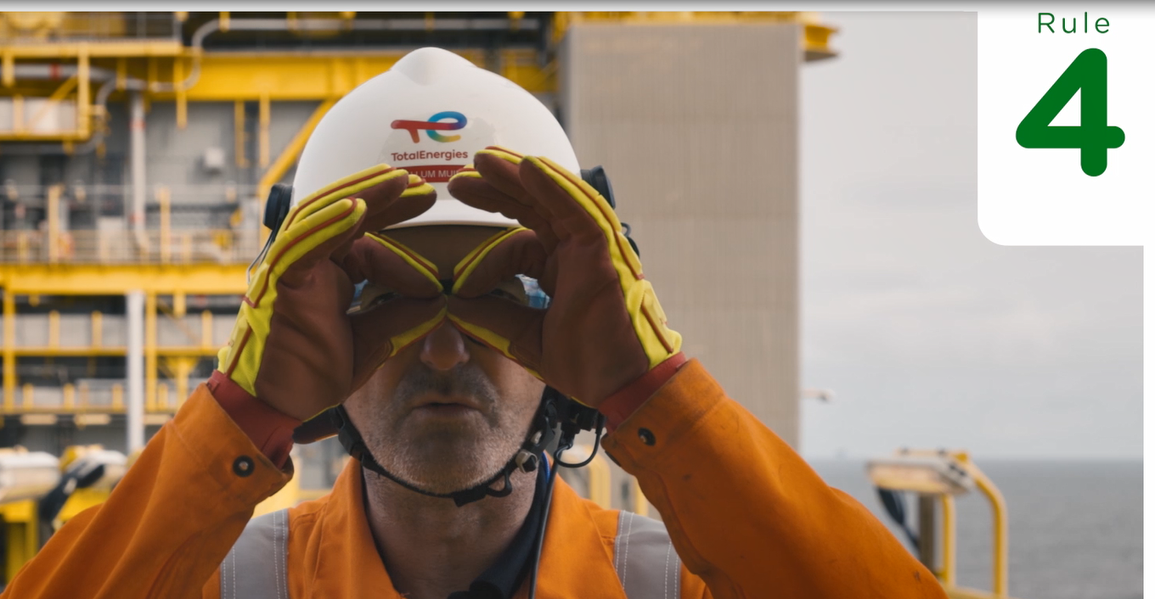

The Golden Rule Personal Protective Equipment (PPE)
THE NEW GOLDEN RULES
  Communication at the WDfS 2022
Evolution of Golden Rules 1 to 10 to strengthen personal commitment
→ Golden Rules written in "I "
  2 new Golden Rules

Slide 3
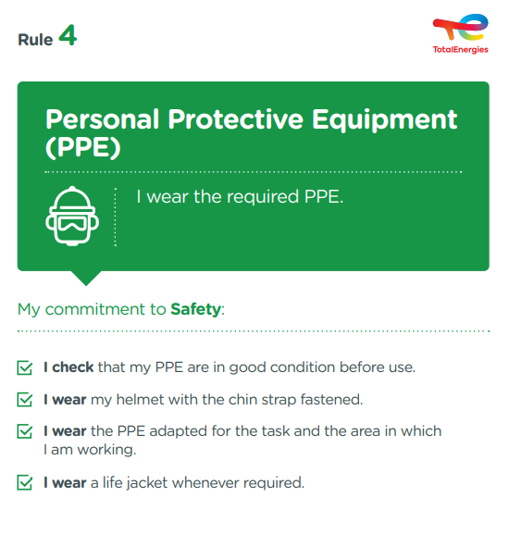
The essence of Golden Rule 4
PERSONAL PROTECTIVE EQUIPMENT (PPE)
Personal protective equipment is defined as "any equipment intended to be worn or held by personnel to protect them against one or more hazards likely to threaten their safety or health at work, as well as any complement or accessory intended for this purpose".
3
Fatalities (2012-2021)
In the Company, where a requirement of Golden Rule 4 has been breached
77
Lost time accidents
(2017-2021)
On industrial sites, in the office and at home, we are all implicated!

Slide 4
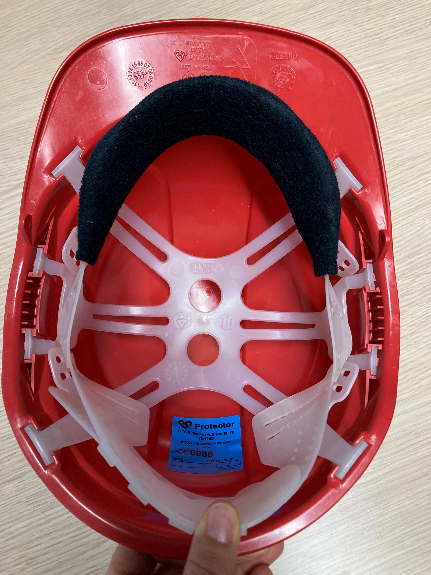

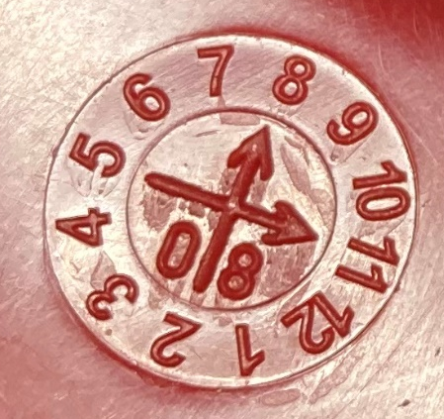

Personal protective equipment in offices
  As surgical masks are not personal protective equipment, do you think you are not concerned?
  I respect the markings and signs put in place; specific PPE is required in these areas.
  If I have PPE in my office so that I am equipped when I go on site:
  I check that my PPE is in good condition before use.
  I make sure that my helmet is equipped with a chin strap.
  I regularly check the expiration date of my PPE (helmet*, etc.) and dispose of it or recycle it if it has expired.
Manufacturing date*
11/2008
Month (11)
Year
(2008)
Chin strap
* A HDPE helmet is valid for 3 years.
At the office, I am also implicated!

