Slide 1
CR-GR-HSE-902 HSE Self-Assessments and HSE Audits
This rule defines the requirements for HSE self-assessments, the preparation, execution, validation and monitoring of HSE audits.
This rule does not cover other audits that may include an HSE component (e.g. operated by others), in which the Group HSE’s audit division participates but is not in charge of the process. These audits are not addressed within this rule.

Slide 2
HSE Self-Assessments and HSE Audits
Replaces the following existing Group and branches rules:
Groupe DIR-GR-SEC-011 (composante Audit)
E&P CR-EP-HSE-112
R&C CR-RC-HSE-120
M&S CR-MS-HSEQ-112 et CR-MS-HSEQ-141
GRP N/A
Defines 8 requirements concerning 5 subjects:
HSE self-assessments
HSE audits
HSE audit report
Action plans and monitoring
Documentation and archiving
REFLEX publication date: 24/09/2018.
Effective date: 3 months following date of publication, except for requirements 3.1.1 and 3.1.2 applicable within 6 months following the publication.
Notes:
Détails règles existantes
Groupe
DIR-GR-SEC-002 - Traitement des accidents, presqu’accidents et anomalies
DIR-GR-SEC-017 - Retour d’expérience (REX)
E&P
CR-EP-HSE-101 - Investigation des accidents majeurs
CR-EP-HSE-102 - Évènements HSE Définitions, déclaration et enregistrement
CR-EP-HSE-103 - Commission d'enquête
CR-EP-HSE-121 - Amélioration des performances HSE : indicateurs de performance clés et retour d'expérience
M&S
CR-MS-HSEQ-131 - Analyse des événements REX et des reportings HSE
R&C
CR-RC-HSE-001 - Information et Gestion de Crise
CR-RC-HSE-108 - Retour d’expérience
CR-RC-HSE-132 - Traitement des incidents et accidents
GRP
CR-GP-HSE-100 - Traitement des évènements REX et des reportings HSE
Pilotes
EP : TEP UK (Steve Rose)
TEP Qatar (Christophe Dubau)
M&S : TMFrance (Jean-Philippe Cabot)
TMCôte d’Ivoire (Eugène Krah avec 8 autres collègues)
RC : Raffinerie d’Anvers (Joris Plasmans)
Raffinerie de Donges (Thomas Gautherot)
GRP : n’a pas souhaité faire réaliser de test pilote
Commentaire de Donges : satisfait de la dernière exigence de la REGLE car cette exigence permettra de convaincre/contraindre certains metiers/zones de la raffineire de faire plus
Commentaire de TERP UK : sur communication si évènement médiatique niveau 3
Commentaire de TEP était déjà intégré dans le projet de règle
Aucune modification de la règle suite au feedback des pilotes

Slide 3
HSE Self-Assessments and HSE Audits
Applies to entities and affiliates in the Group’s operated domain.
HSE audits are conducted with a focus on management of major risks and not strictly on compliance with referentials.
HSE audits conducted in 2017 and 2018 are already in conpliance with the majority of the requirements within the new rule.
Evolution in the rule’s continuity.
No major difficulties to implement the requirements in the rule.
For affiliate’s or entitiy’s management, particular attention to be paid to ‟HSE Self-Assessments″.
Tools to support the implementation of ‟HSE Self-Assessments″.
Notes:
Détails règles existantes
Groupe
DIR-GR-SEC-002 - Traitement des accidents, presqu’accidents et anomalies
DIR-GR-SEC-017 - Retour d’expérience (REX)
E&P
CR-EP-HSE-101 - Investigation des accidents majeurs
CR-EP-HSE-102 - Évènements HSE Définitions, déclaration et enregistrement
CR-EP-HSE-103 - Commission d'enquête
CR-EP-HSE-121 - Amélioration des performances HSE : indicateurs de performance clés et retour d'expérience
M&S
CR-MS-HSEQ-131 - Analyse des événements REX et des reportings HSE
R&C
CR-RC-HSE-001 - Information et Gestion de Crise
CR-RC-HSE-108 - Retour d’expérience
CR-RC-HSE-132 - Traitement des incidents et accidents
GRP
CR-GP-HSE-100 - Traitement des évènements REX et des reportings HSE
Pilotes
EP : TEP UK (Steve Rose)
TEP Qatar (Christophe Dubau)
M&S : TMFrance (Jean-Philippe Cabot)
TMCôte d’Ivoire (Eugène Krah avec 8 autres collègues)
RC : Raffinerie d’Anvers (Joris Plasmans)
Raffinerie de Donges (Thomas Gautherot)
GRP : n’a pas souhaité faire réaliser de test pilote
Commentaire de Donges : satisfait de la dernière exigence de la REGLE car cette exigence permettra de convaincre/contraindre certains metiers/zones de la raffineire de faire plus
Commentaire de TERP UK : sur communication si évènement médiatique niveau 3
Commentaire de TEP était déjà intégré dans le projet de règle
Aucune modification de la règle suite au feedback des pilotes

Slide 4
REQUIREMENT OVERVIEW
Subject |  |  | Requirement
HSE Self-Assessments |  |  | Requirement 3.1.1 : Frequency of HSE self-assessment An HSE self-assessment is performed at minimum every 2 years, and following any significant change.
 |  |  | Requirement 3.1.2 : Action Plan Following the HSE Self-Assessment An action plan that sets out the prioritized corrective and improvement actions related to each gap identified during an HSE self-assessment is established, implemented and monitored through to closure by the entity or affiliate. Changes: The concept of an internal audit did not exist in the rule for E&P. The concept of an internal audit noted in the existing rules for the R&C and M&S branches is now assimilated into the SHE self-assessment exercise.
HSE Audit |  |  | Requirement 3.2.1 : Frequency of HSE Audits Each auditable unit is subject to an HSE audit every 3 to 5 years, according to the long-term plan drawn up by the Group HSE audit division. Requirement 3.2.2 : Information Provided to the HSE Audit Team The documents and any other information required for the HSE audit are made available to the HSE audit team in a timely manner. Change:
 |  |  | Previously defined frequencies: 3 years (recommendation based on the Group Directive), every 3 to 4 years (E&P), every 4 years (R&C) and between 3 to 5 years depending on the risks associated with activities (M&S).

Slide 5
REQUIREMENT OVERVIEW
Subject |  |  | Requirement
Audit Report |  |  | Requirement 3.2.3 : Comments Regarding the HSE Audit Report After completion of the HSE audit and upon receipt of the draft HSE audit report, comments are returned to the lead auditor within 15 working days. No change
Action Plan and Monitoring |  |  | Requirement 3.2.4 : Action Plan Following the HSE Audit Upon receipt of the final HSE audit report, a corrective and improvement action plan appropriate to the HSE audit findings is established, implemented and monitored through to closure. Progress of the action plan is periodically communicated to the auditable unit’s appropriate hierarchy level.
 |  |  | Requirement 3.2.5 : HSE Action Plan Status Report
 |  |  | Status report including details of actions taken for P1 and P2 audit findings is sent to branch management and the Group HSE division at the end of each semester. Change: This is a new requirement for all branches. Previously, the E&P branch rule provided for a ‟follow-up visit” by EP/HSEQ, 12 to 18 months after the audit.
Documentation and Archiving |  |  | Requirement 3.3.1 : Conservation of HSE Self-Assessment and HSE Audit Documents The following documents and records are conserved following the Group's document retention policy: HSE self-assessment reports, HSE audit reports, detailed evidence of actions taken to close findings. No change

Slide 6
REQUIREMENTS NOT RETAINED IN THE NEW RULE
Subject |  |  | Requirement
Third party acknowledgement of audit protocol Audit protocol used by approved contractors |  |  | Third party acknowledgement of audit protocol for entities exposed to technological risk is no longer required. (Group DIR-GR-SEC-011)
 |  |  | Approved contractor cannot use the audit protocol. (Group DIR-GR-SEC-011)
Maestro Review concept HSEQ Follow-up Visit |  |  | The concept of a MAESTRO Review no longer existis in the new rule. (Branch EP - CR-EP-HSE-112)
 |  |  | The concept of a follow-up visit by HSEQ no longer exists in the new rule. (Branch EP - CR-EP-HSE-112)
Protocol modularity concept Certification based on international standards |  |  | One Maestro protocol is no longer modular. (Branch MS - CR-MS-HSEQ-112)
 |  |  | Third parties* will no longer be allowed to conduct One-MAESTRO audits at the same time as an affiliate’s other desired certifications (ISO 14001, OHSAS 18001, ISO 50001). (Branch MS - CR-MS-HSEQ-112)
* Accredited certification organizations (e.g. DNV, SGS, BV, AFNOR, Lloyd’s)

Slide 7
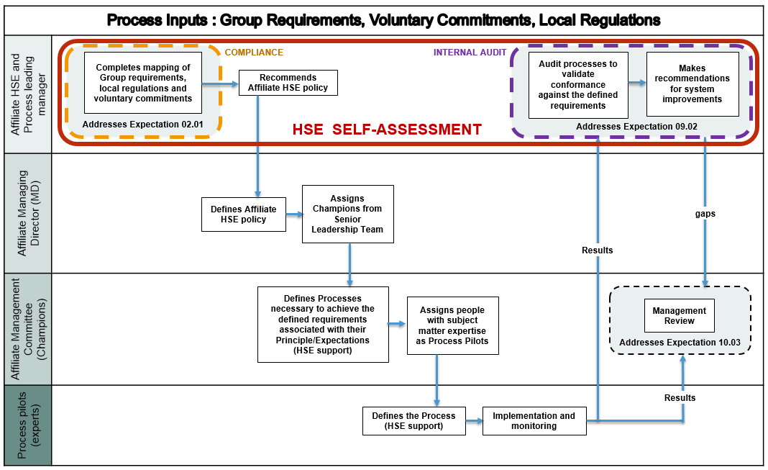
HSE SELF-ASSESSMENT (One-MAESTRO HSE Expectation 09.02)

