Slide 1

The new Golden Rules
My Commitment, our Safety
Golden Rule 4
Personal Protective Equipment (PPE)
Rev.0 – December 2022

Slide 2
01.
The essentials

Slide 3
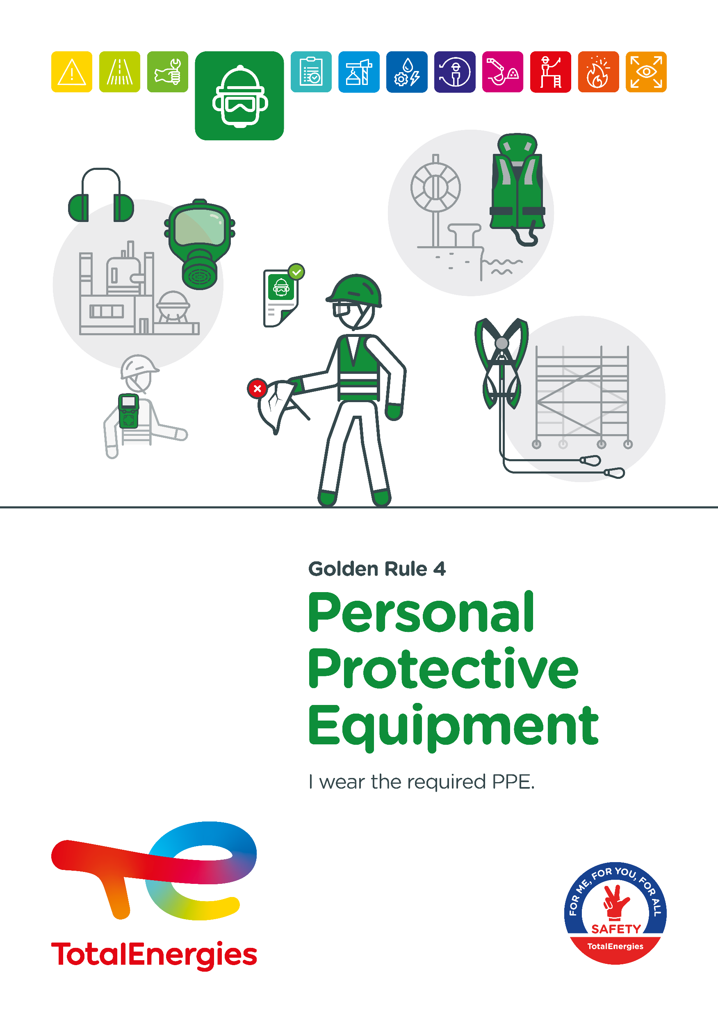
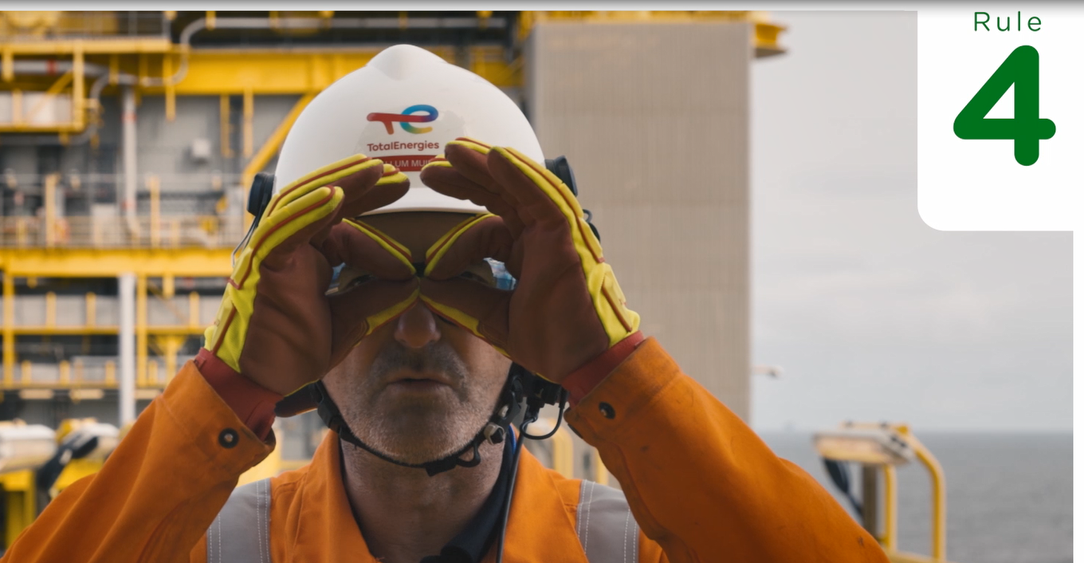
Poster & pictogram
The Golden Rule 4 pictogram "Personal Protective Equipment (PPE)" shows a person wearing safety glasses, a helmet with chin strap fastened and hearing protection. This symbolises the wearing of personal protective equipment.

Slide 4


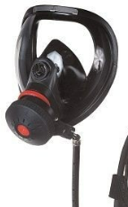
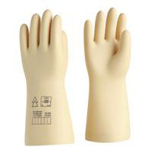
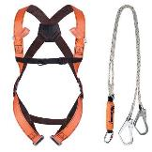
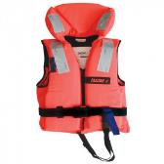

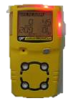
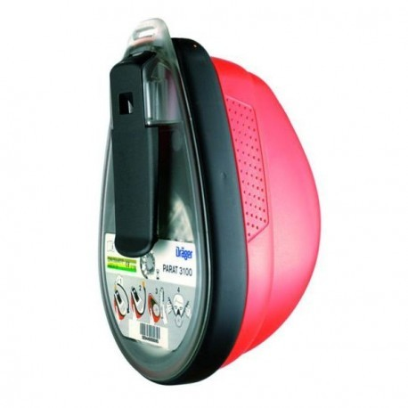
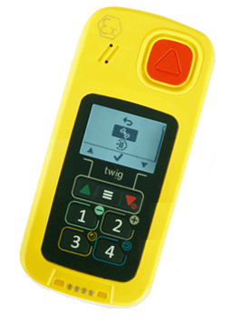
Some definitions
STANDARD PPE
PERSONAL PROTECTIVE EQUIPMENT (PPE)
Each site determines the standard PPE adapted to the risks present.
They are worn systematically in the areas concerned and according to the rules established locally.
Personal protective equipment is defined as "any equipment intended to be worn or held by personnel to protect them against one or more hazards likely to threaten their safety or health at work, as well as any complement or accessory intended for this purpose".
They are defined according to an analysis of the risks at the workplace.
EXAMPLES OF SPECIFIC PPE
They are worn for tasks involving specific risks not covered by standard PPE.
Specific gloves (e.g. electricity, chemicals, shocks, etc.)
Insulating mask
Face shield
Harness
Lifejacket
OTHER WARNING AND RESCUE DEVICES
Lone Worker Alert System
Gas detector
Escape mask

Slide 5
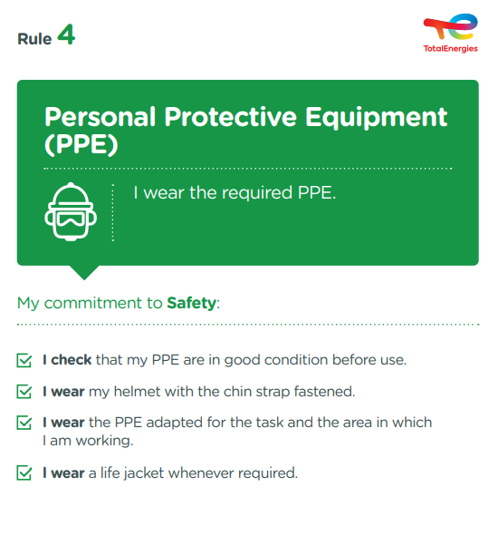
The essence of Golden Rule 4
What changes from the 2017 version of the Golden Rules:
    Refocusing on personal protective equipment, collective protective barriers are covered by other Golden Rules.
    Addition of a requirement to wear a helmet, with
    chin strap fastened, regardless of the activity and the work height.
Personal protective equipment is covered in CR-GR-HSE-406 - "Personal Protective Equipment "*.
* Company Rules (CR) are limited to internal use.

Slide 6
Incidents related to PPE
ACCIDENTS IN THE COMPANY WHERE A REQUIREMENT OF GOLDEN RULE 4 HAS BEEN BREACHED
EXAMPLES OF RISKS FOR WHICH PPE ARE REQUIRED
Splash/spray
Biological risk
3
Fatalities*
Cutting, impact, abrasion
Poisoning, chemical burns
77
Lost time accidents**
Electrification, electrocution
Noise
10
HIPO (High Potential)**
Falling object
Hot or cold burns
* 2012-2021
** 2017-2021
Fall of a person

Slide 7
02.
REX

Slide 8
Illustration of requirements
REQUIREMENT | EVENT | SLIDE
1. I check that my PPE are in good condition before use. | WHAT TO DO TO CHECK A PPE? | N°9
2. I wear my helmet with the chin strap fastened. | FALL FROM HEIGHT | N°10
3. I wear the PPE adapted for the task. | FATAL ELECTROCUTION WHEN PREPARING FOR MAINTENANCE ON A TRANSFORMER | N°11
3. I wear the PPE adapted for the area in which I am working. | CLEANING OF A BITUMEN PIPELINE | N°12
4. I wear a lifejacket whenever required. | DROWNING AT SEA | N°13
The descriptions of the circumstances and consequences have been simplified for a better understanding.
A link to each REX/Good practice is available for more information.

Slide 9
GOOD PRACTICE
1. I check that my PPE are in good condition before use.
WHAT TO DO TO PROPERLY CHECK A PPE?
GOOD PRACTICE
To be effective, PPE must be in good condition.
Because of its limited lifespan, frequent use and exposure to wear and tear, it is imperative to check its good condition.
I check that PPE is suitable for my body type (size, shape, etc.),
I check the condition and wear,
I check the validity date for PPE that has one,
I use the checklist of points to be checked if it exists.
WHO CHECKS THE PPE AND WHEN?
Each PPE must be checked by its user before each use.
In addition, PPE dedicated to the prevention of serious and fatal accidents must be checked periodically by competent personnel.
In the event of any anomaly or doubt, I do not use the PPE and request its immediate replacement before working.

Slide 10
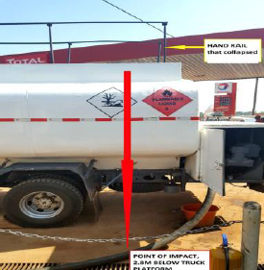
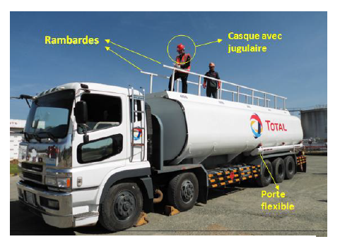
REX
2. I wear my helmet with the chin strap fastened.
> FALL FROM HEIGHT
CIRCUMSTANCES – FACTS
  A worker was positioned on the dome of his tanker in the unloading area of a service station.
  The guardrail of the tanker he was holding gave way at a weld.
  The worker then lost his balance and fell.
  He was wearing a helmet with a chin strap that was fastened.
CONSEQUENCES
Head injury with 4 stitches.
Potential death (HIPO).
LESSONS TO BE LEARNED
I wear my helmet, fitted and with the chin strap fastened, to protect my head in case of an impact or fall.
  Guardrail of the tanker that gave way.
  Guardrails
  Helmet with chin strap fastened
CAUSES
  Storage of hoses on the tank dome (no hose holder tubes on the tank).
  Dangerous operation on the tank dome (transmission of the hose downwards).
  Faulty guardrail.
  Hose holder
  Point of impact, 2.8m lower.
Click here to access the REX

Slide 11
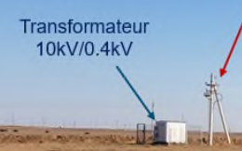
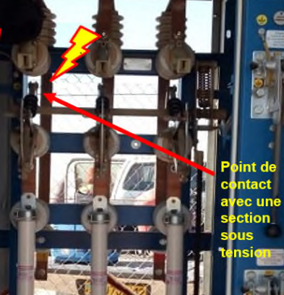
REX
3. I wear the PPE adapted for the task.
> FATAL ELECTROCUTION WHEN PREPARING FOR MAINTENANCE ON A TRANSFORMER
CIRCUMSTANCES – FACTS
  The intervention included an inspection of the internals of a transformer by two workers (electricians).
  The disconnecting devices on the pylon had been activated and locked, in order to cut off the power supply to the transformer.
  However, a faulty disconnector remained in its original position.
  In preparation for the zero-voltage and grounding tests, the team opened the front and rear access doors and panels of the poorly isolated transformer.
  Prior to carrying out the zero-voltage and grounding tests, one of the workers entered the transformer and touched the live section.
  He was not wearing isolating PPE and received a fatal electric shock.
CONSEQUENCES
Death of a worker, and a potential death (worker coming to their aid).
LESSONS TO BE LEARNED
When carrying out a task in the vicinity of a potentially live section, I wear the appropriate isolating protective equipment.
CAUSES
  Mechanical failure of the disconnecting device.
  Physical contact with the live part of the transformer.
  No Zero Voltage Test (ZVT) carried out.
  Unsuitable PPE.
  Transformer
  10 kV / 0.4kV
  Point of contact with a live section
Click here to access the REX

Slide 12
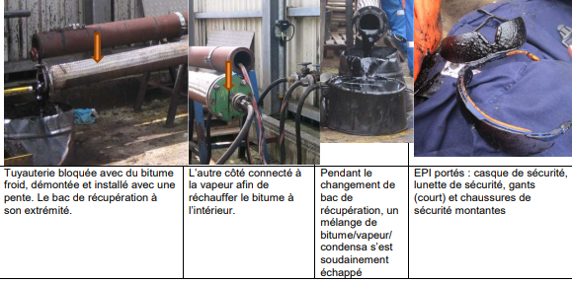
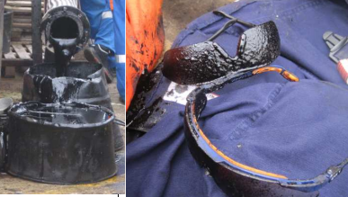
REX
3. I wear the PPE adapted for the area in which I am working.
> CLEANING OF A BITUMEN PIPELINE
CIRCUMSTANCES – FACTS
  A pipe was blocked with cold bitumen and was removed for cleaning.
  One side of the pipe was supplied with steam to heat the bitumen inside and facilitate its drainage.
  When replacing a bitumen drip tray at the other end, a plug of bitumen suddenly came loose.
  3 workers (one of whom was located a few meters away) were splashed with bitumen.
CONSEQUENCES
Burns caused by bitumen spray.
LESSONS TO BE LEARNED
1
In a risk area, I wear the defined PPE, even if I am not involved in the task (e.g. noise, splashing, falling objects, slippery surfaces, etc.).
2
CAUSES
  Pressure generated in the closed tube by the steam and sudden release when the bitumen plug gave way.
  Lack of face protection and gloves with cuffs.
1
Equipment concerned
2
3
3
Click here to access the REX

Slide 13
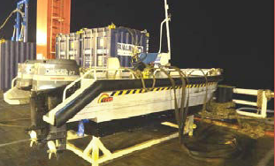
REX
4. I wear a life jacket whenever required.
> DROWNING AT SEA
CIRCUMSTANCES – FACTS
  A boat had broken its moorings.
  To retrieve it, a worker on a nearby floating barge jumped into the sea without a life jacket.
CONSEQUENCES
Death of the worker.
LESSONS TO BE LEARNED
I wear a life jacket or personal flotation device when required.
I make sure the life jacket fits properly.
CAUSES
  Failure to take risk into account.
  Insufficient preparation for a "man overboard" emergency.
  Not wearing PPE (including life jacket).
Click here to access the REX

Slide 14
03.
Further information

Slide 15

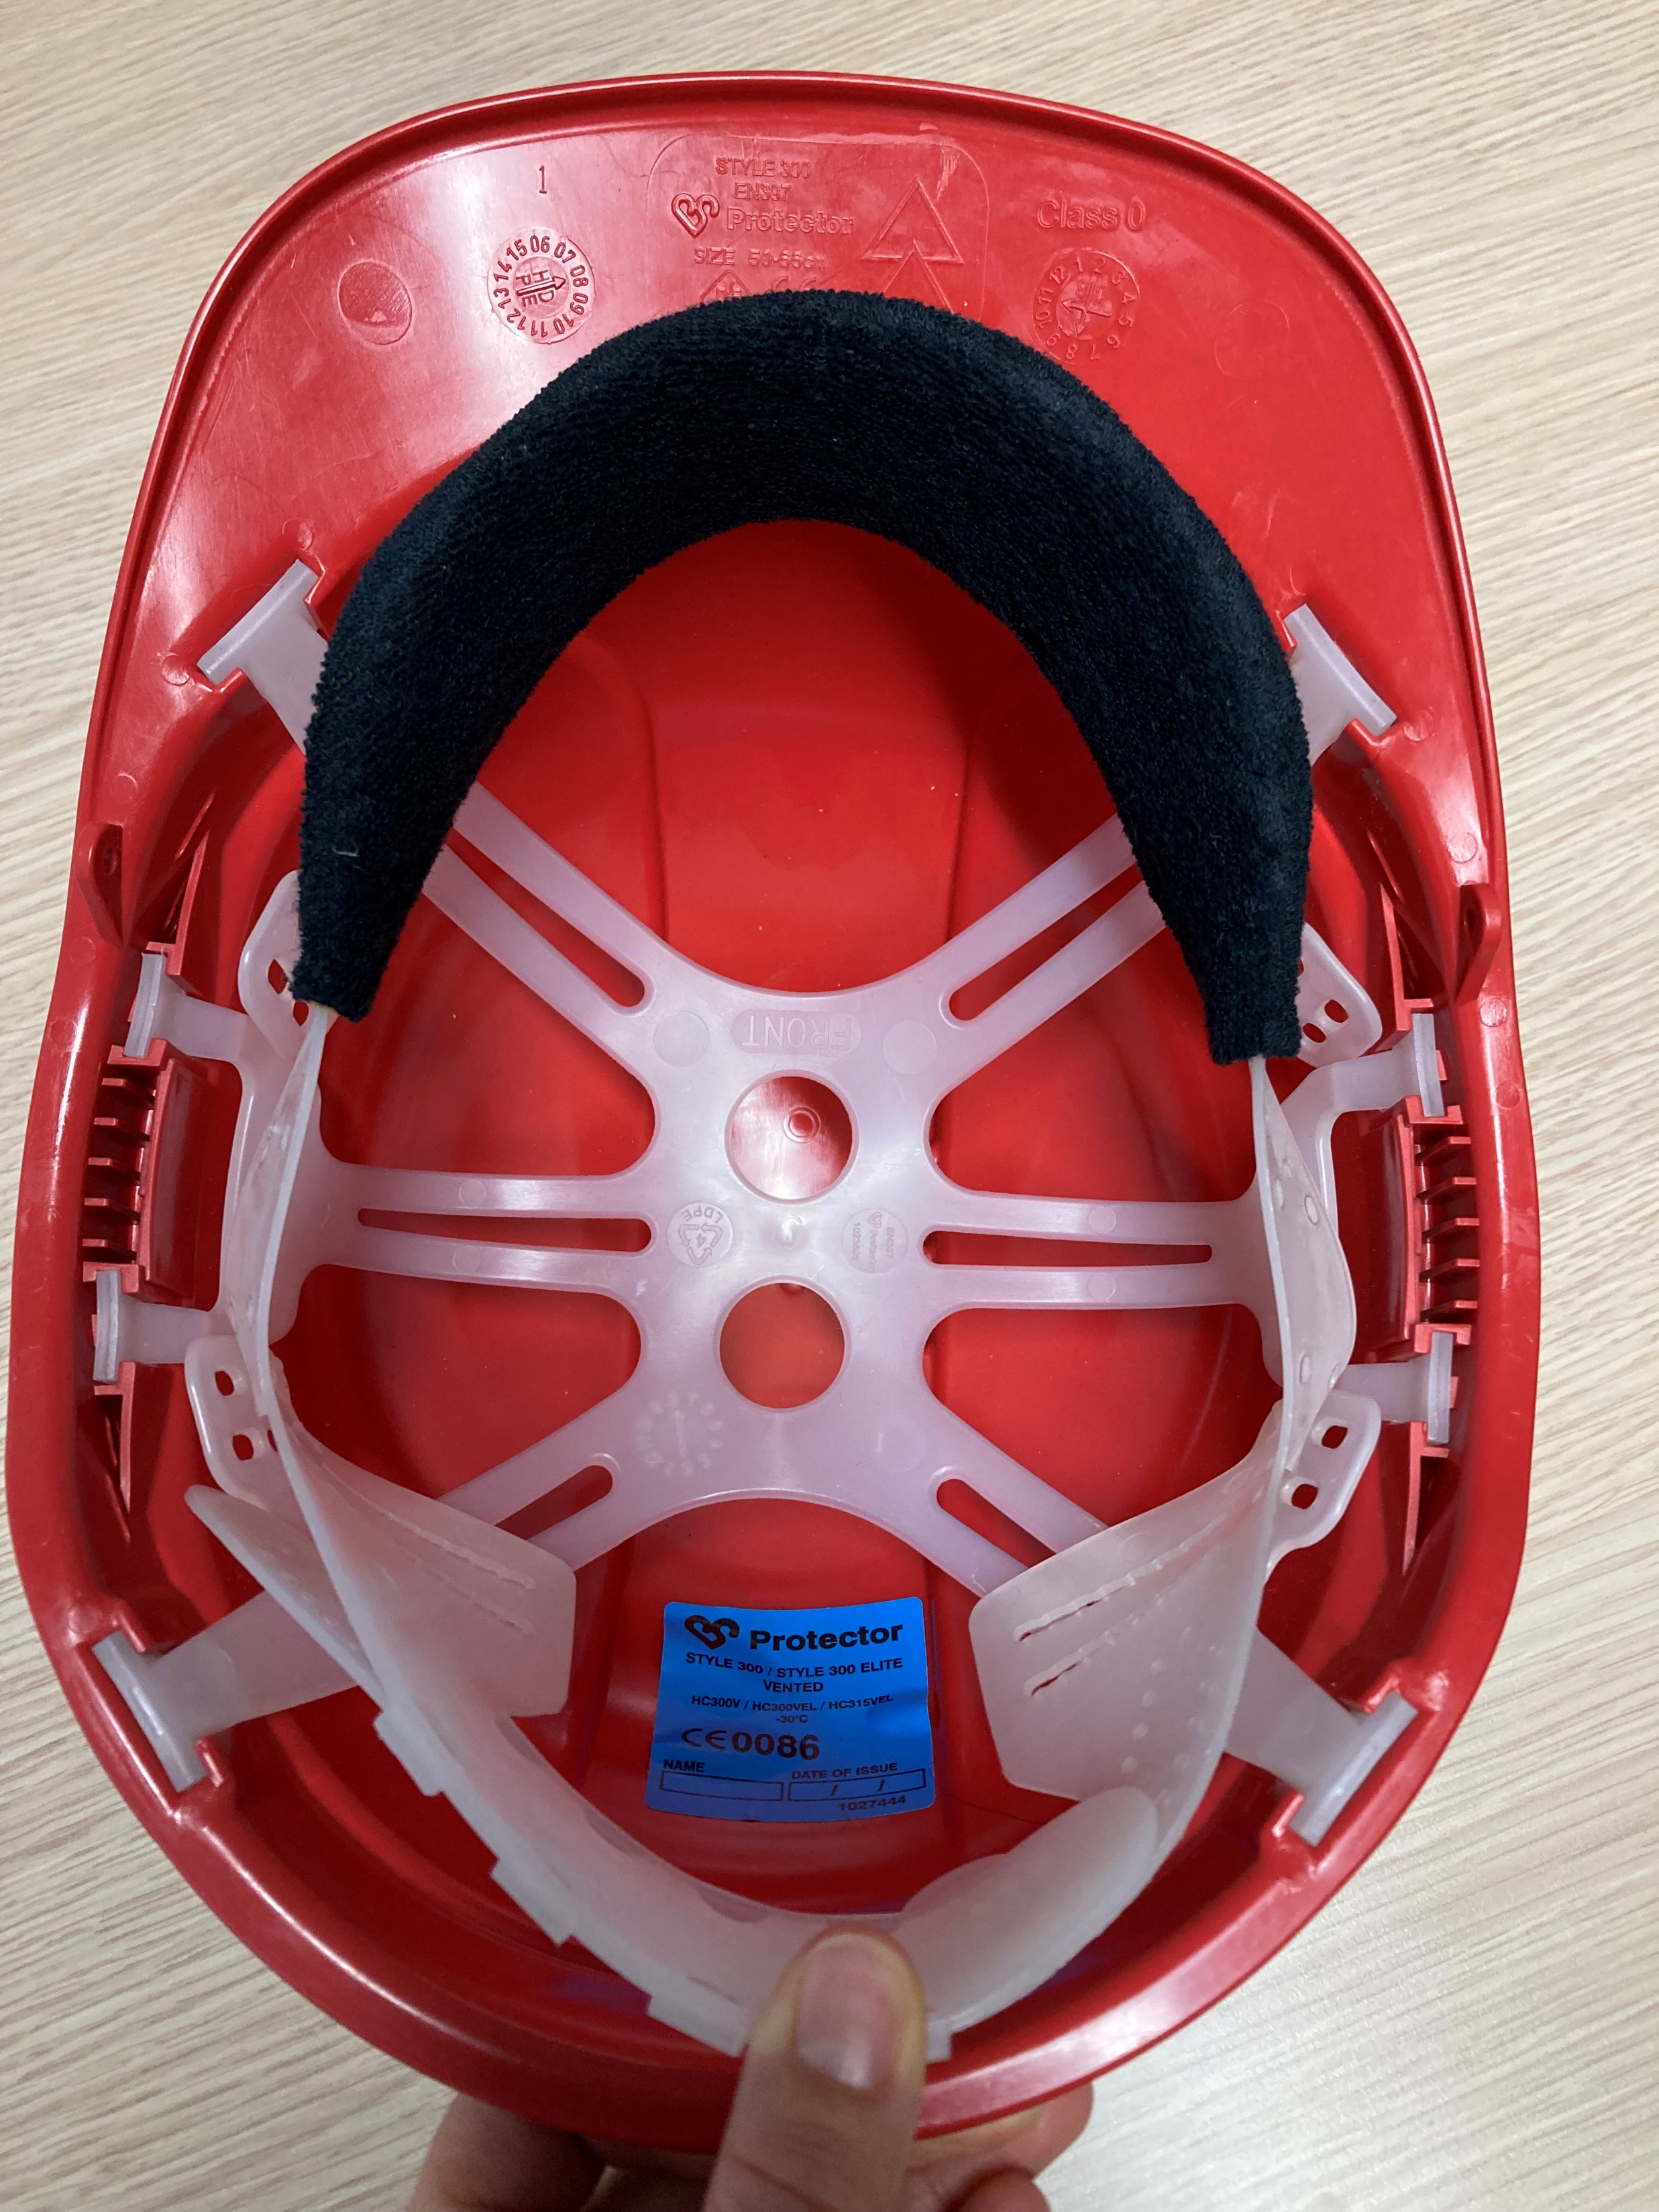
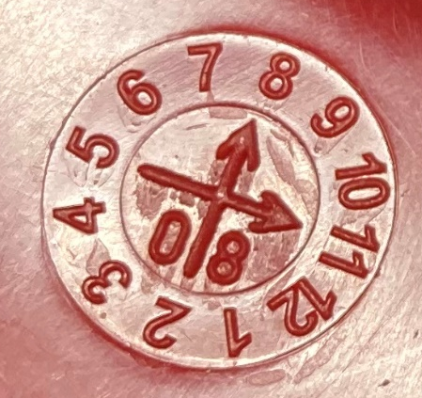

Personal protective equipment in offices
  I respect the markings and signs put in place; specific PPE is required in these areas.
  If I have PPE in my office so that I am equipped when I go on site:
  I check that my PPE is in good condition before use.
  I make sure that my helmet is equipped with a chin strap.
  I regularly check the expiration date of my PPE (helmet*, etc.) and dispose of it or recycle it if it has expired.
Manufacturing date*
11/2008
Month (11)
Year
(2008)
Chin strap
* A HDPE helmet is valid for 3 years.
At the office, I am also implicated!

Slide 16
Our tools and documents
CR-GR-HSE-406 – Personal Protective Equipment: HSE Company Rules
PPE e-learning: https://lizzy.totalenergies.com/
HSE Toolbox – the new Golden Rules:
    General material: Règles d’or TotalEnergies – Supports généraux
    Roll-out material: TotalEnergies Golden Rules – Roll-out material
REX database: https://totalworkplace.sharepoint.com/sites/GroupHSEREXDataBase/en-us/Pages/REX%20HSE%20Home.aspx
Safety+ (good practices by Golden Rule) : https://safetyplus.totalenergies.com/en
      Good practices:
        https://safetyplus.totalenergies.com/en/contribution/rjkbkt?p_route=wall&p_qs=
        https://safetyplus.totalenergies.com/en/contribution/89y1md?p_route=wall&p_qs=
        https://safetyplus.totalenergies.com/en/contribution/rpridz?p_route=wall&p_qs=rules%3D3

Slide 17
Lexicon
Hazard: An intrinsic property of a product, equipment, process, situation or action that can result in harm to people, the environment and/or assets.
Risk: The combination of the probability of occurrence of a hazardous event and the severity of the impact that may result from exposure to the hazard.
HSE events:
  Incident: Any sudden and undesirable HSE event on a given date, that causes injury or illness, damage to property or facilities, loss of production, environmental damage or damage to the Company's image.
  Near miss: Any sudden and undesirable HSE event on a given date which, in slightly different circumstances, could have had the same consequences as an incident. A near miss does not have an actual severity level but has a potential severity level.
  Anomaly: Any abnormal situation or behaviour, including deviations from a standard, specification, procedure or rule.
HIPO (High Potential) [slide 6]: Incident or near miss with an actual severity level ≤ 3* and a potential severity level ≥ 4** in one or more areas of the Company’s evaluation matrix of the actual and potential severity level of HSE events.
REX HSE: Document for sharing information on an internal or external HSE event, based on a detailed analysis and making recommendations.
* For example, physical consequences with an actual severity level = 3 correspond to a lost time accident.
** For example, physical consequences with a potential severity level of 4 correspond to a fatality.
Notes:
Définitions « risques » et « danger » (GM-GR-HSE-300 « Evaluation des risques professionnels au poste de travail »)
Définitions HIPO, Incident, presqu’accident, anomalie (CR-GR-HSE-100 « Reporting HSE »)

