Slide 1
Management of HSE Events and Return on Experience GROUP HSE RULE (CR-GR-HSE-801)
This rule describes the process and defines the minimum requirements for the management of HSE events within the Group’s operated domain.
It aims to promote HSE return on experience and embed lessons learned.

Slide 2
Management of HSE Events and Return on Experience
Replaces the following existing Group and branch rules (2 + 9 rules):
Group DIR-GR-SEC-002 et 017
E&P CR-EP-HSE-101, 103, 121 et 102*
R&C CR-RC-HSE-001, 108, 132
M&S CR-MS-HSEQ-131
GRP CR-GRP-HSE-100
Defines 9 requirements:
New requirements:
Tier 1 et Tier 2 analysed using the root cause analysis method (or an equivalent systematic method).
"Major HSE Event Analysis Committee" lead by the PSR/HSE team.
Local HSE Corex at all levels of the organisation (sites, affiliates, entities, branches and Group).
Return on experience concerning an entity or affiliate are known and explained to personnel. The action plan is monitored.
Retained exisiting branches’ requirements were harmonized.
Applicable to entities and affiliates in the Group’s operated domain.
REFLEX publication date: 24/09/2018
Effective date: 3 months following date of publication
* CR-EP-HSE 102 covered by this rule and the new HSE Reporting Group rule
Notes:
Détails règles existantes
Groupe
DIR-GR-SEC-002 - Traitement des accidents, presqu’accidents et anomalies
DIR-GR-SEC-017 - Retour d’expérience (REX)
E&P
CR-EP-HSE-101 - Investigation des accidents majeurs
CR-EP-HSE-102 - Évènements HSE Définitions, déclaration et enregistrement
CR-EP-HSE-103 - Commission d'enquête
CR-EP-HSE-121 - Amélioration des performances HSE : indicateurs de performance clés et retour d'expérience
M&S
CR-MS-HSEQ-131 - Analyse des événements REX et des reportings HSE
R&C
CR-RC-HSE-001 - Information et Gestion de Crise
CR-RC-HSE-108 - Retour d’expérience
CR-RC-HSE-132 - Traitement des incidents et accidents
GRP
CR-GP-HSE-100 - Traitement des évènements REX et des reportings HSE
Pilotes
EP : TEP UK (Steve Rose)
TEP Qatar (Christophe Dubau)
M&S : TMFrance (Jean-Philippe Cabot)
TMCôte d’Ivoire (Eugène Krah avec 8 autres collègues)
RC : Raffinerie d’Anvers (Joris Plasmans)
Raffinerie de Donges (Thomas Gautherot)
GRP : n’a pas souhaité faire réaliser de test pilote
Commentaire de Donges : satisfait de la dernière exigence de la REGLE car cette exigence permettra de convaincre/contraindre certains metiers/zones de la raffineire de faire plus
Commentaire de TERP UK : sur communication si évènement médiatique niveau 3
Commentaire de TEP était déjà intégré dans le projet de règle
Aucune modification de la règle suite au feedback des pilotes

Slide 3
STRUCTURE OF THE RULE
New Requirement
The management of HSE events (health, safety, environment, societal) follows 4 steps:
1. Evaluation of the severity level
The severity level of HSE events is evaluated.
Integration of the Group Evaluation Matrix (DIR-GR-SEC-002)
2. Communication
HSE events with actual severity level ≥ 4 (or media impact ≥ 3) or those likely to evolve rapidly to these levels are subject to an immediate alert.
Alert and communication schemes are defined in Group rules related to emergency response and communication.
3. Information gathering and analysis
Any HSE event is subject to a prompt information gathering.
Any HSE event is analysed:
Actual or potential severity level ≥ 4, the root cause analysis method is used (or an equivalent systematic method).
Fatal accidents or an HSE event with a real or potential severity level ≥ 5, a Major HSE Event Analysis Committee is set up.
Same requirement for Tier 1 or Tier 2 loss of primary containment events.
This committee is led by PSR/HSE/AUD/REX*.
4. HSE Return on Experience
HSE return on experience documents are published after validation by HSE Corex except for HSE alerts directly published by the entity.
Local HSE Corex.
HSE REX Documents related to the entity or affiliate.
Recommendations from HSE Major REX are implemented, monitored and their effeciency assesed at branch level.
Formalization of the validation process and rationalisation of the multiple documents in place in the branches.
Each entity establishes a monthly Local HSE Corex.
These documents are known and explained to personnel. The recommendations are monitored in an action plan if necessary.
* PSR/HSE/AUD/REX = deparment that analyses Major Incidents and Return on Experience
Notes:
Mise en œuvre / Déploiement
Date de publication : 01/09/2018
Date d’application : 3 mois après publication
Messages spécifiques pour l’implémentation :
La nouvelle règle est associée à la DIR-GR-SEC-020, DIR-GR-COM-003 et REG-GR-SEC-005 qui seront remplacées par des nouvelles règles.
Elle remplace la DIR-GR-SEC-002 et DIR-GR-SEC-017 et les règles Branches associées (CR-EP-HSE-101, 102*, 103 et 121; CR-RC-HSE-001**, 132 et 108; CR-MS-HSEQ-131 et CR-GP-HSE-100)
Point d’attention
* CR–EP–HSE-102 est couverte par la nouvelle CR-GR-HSE-801 et la nouvelle règle reporting HSE Groupe
** CR-RC-HSE-001 traite aussi de la gestion de crise qui sera couverte pour la nouvelle règle Groupe Gestion de Crise CR-GR-HSE-701
Supports à fournir pour la formation et/ou la communication
Présentation de la nouvelle règle avec identification des changements les plus significatifs
Explication des nouvelles exigences et écarts avec l’existant
Outil de support à la réalisation des analyses des événement HSE (Guide en préparation)
Personne de contact animateur des COREX
Accompagnement et coaching des filiales pour que l’usage des REX HSE soit efficient et devienne systématique et incontournable
Etat d’appropriation de la nouvelle règle
Exigences des étapes 1 et 2 inchangées et déjà appliquées
Exigences de l’étape 3 (Ref. COMEX) appliquées pour les cas pertinents.
Exigences de l’étape 4 en place au niveau Groupe, branches et dans certaines entités et filiales.

Slide 4
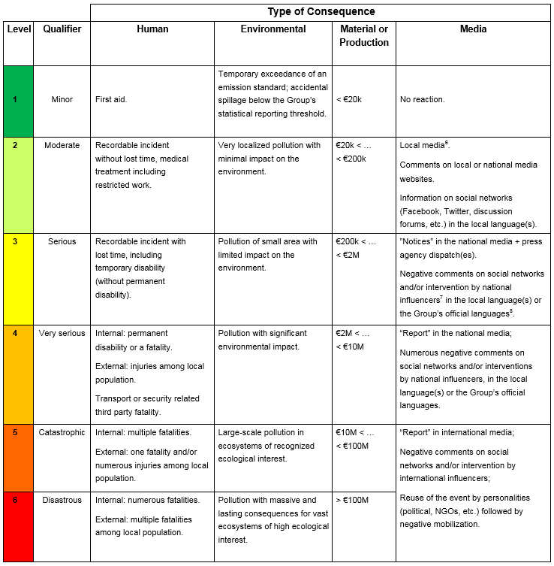
REQUIREMENT OVERVIEW
Steps to Manage HSE Events (Requirement 3.1.1)
In accordance with local regulations, all HSE events are managed according to the following four steps:
Note: For HSE events that occur within industries or professional organizations outside the Group's operated domain, lessons learned are shared with relevant entities, affiliates or métiers through the HSE Corex process (appendix 4).
Changes:
These 4 steps are the framework to manage HSE events.
The expected outcomes of these steps are contained in the existing branch rules.
Evaluation of the Severity Level (Requirement 3.2.1)
The severity level of HSE events are evaluated according to the Evaluation Matrix of Actual and Potential Severity
Level in appendix 1.
Note: For anomalies, only evaluations of potential severity level ≥ 4 are recorded.
The initial evaluation of an HSE event can be reviewed after analysis (e.g. considering new information, findings).
Changes:
This is an existing requirement. The evaluation matrix is from the existing rule DIR-GR-SEC-002.
The E&P branch have downgraded LTIs from a level 3 to a level 2.

Slide 5
REQUIREMENT OVERVIEW
Communication (Requirement 3.3.1)
HSE events with actual severity level ≥ 4 (or media impact ≥ 3), or those likely to evolve rapidly to these levels, are subject to:
Immediate alerts sent to the contact persons of the branch and the Group through two parallel channels:
the reporting line;
the duty function.
Alerts sent to local authorities;
Alerts sent to relevant stakeholders.
No change
Information Gathering (Requirement 3.4.1)
Any HSE event is subject to prompt information gathering (including relevant material elements) related to the event’s circumstances, facts and effects.
Considering locally applicable laws and regulations, the procedures to be followed during information gathering are defined while considering any separate analysis that may be carried out simultaneously, in particular requests and investigations by official authorities (e.g. emergency services, administrative or judicial authorities).
No change

Slide 6
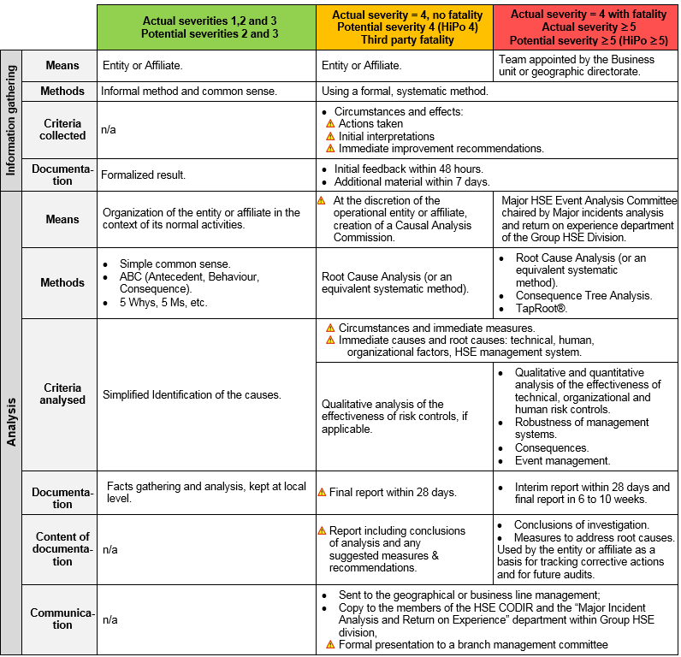
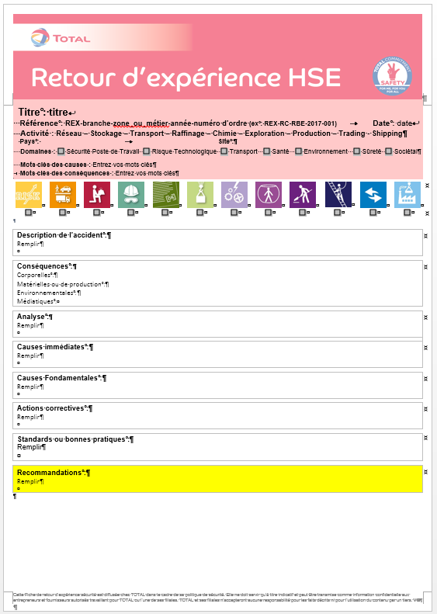
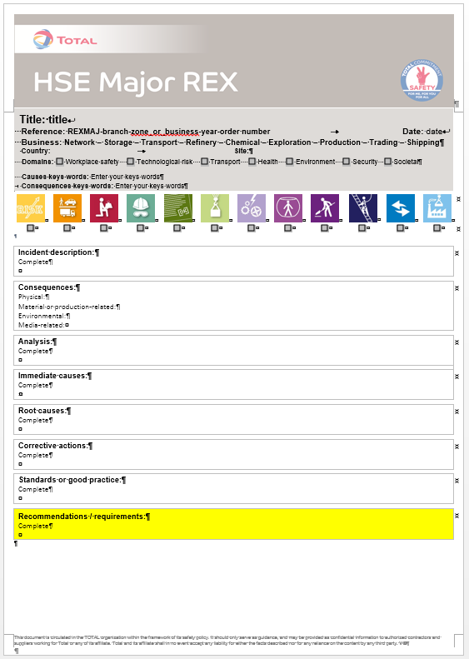
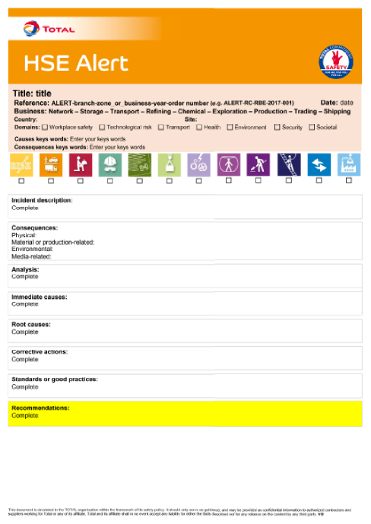
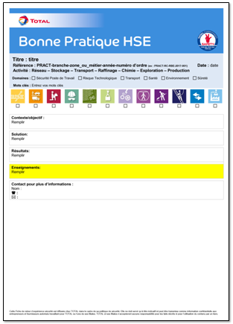
REQUIREMENT OVERVIEW
Analysis of HSE Events (Requirement 3.4.2)
All HSE events are analysed using a method that is appropriate to its actual or potential severity and re-evaluated as necessary. The requirements of the table "HSE Event Analysis Methods" (see appendix 2), which states the expected means, methods, analysed criteria, documentation, communication and deadlines, are applied.
For HSE events with actual or potential severity ≥ 4 or for Tier 1 or Tier 2 Loss of Primary Containment events, the root cause analysis method (or an equivalent systematic one) is used.
Requirement from the table « HSE Event Analysis Method»
In case of a fatal accident or any other HSE event with an actual or potential severity level ≥ 5, the Major Incident Analysis and Return on Experience department of the Group HSE division is mobilized and a Major HSE Event Analysis Committee is set up.
Changes:
Requirements concerning Tier 1 or Tier 2 previously only existed in E&P.
Only E&P had a requirement for a "Major HSE Event Analysis Committee" which was piloted by the branch.
HSE REX Documents (Requirement 3.5.1)
The HSE REX documents are written within the time set out in the table 1 "Types of HSE REX Documents" and are issued following the validation of the HSE Corex, excluding directly issued HSE alerts.
Changes:
Formalisation of the validation process.
Rationalisation of the multiple documents in place in the branches.

Slide 7
REQUIREMENT OVERVIEW
Local HSE Corex (Requirement 3.5.2)
A monthly local HSE Corex is set up to review:
HSE events of the entity or affiliate and to select those that will be detailed in HSE REX documents.
Recommendations from the branch or Group HSE Corex.
Follow up of action plans, if applicable.
At least once a year, the work of the local HSE Corex is reviewed to identify local HSE management system improvement opportunities.
Change:
This requirement did not previously exist even if certain entities or affilates had already established this practice.
Implementation of HSE REX Documents (Requirement 3.6.1)
HSE REX documents relevant to the entity or affiliate are known and explained to personnel. The learnings/recommendations are followed, as necessary, in an action plan. The entity or affiliate puts in place performance indicators and monitors performance in order to ensure the effectiveness of the HSE return on experience process.
Change:
The REX explanation at the site or affiliate level was not required.
Recommendations Issued from a Major HSE REX (Requirement 3.6.2)
In addition to requirement 3.6.1, each branch monitors the implementation and effectiveness of the applicable recommendations resulting from a Major HSE REX.
No change

Slide 8
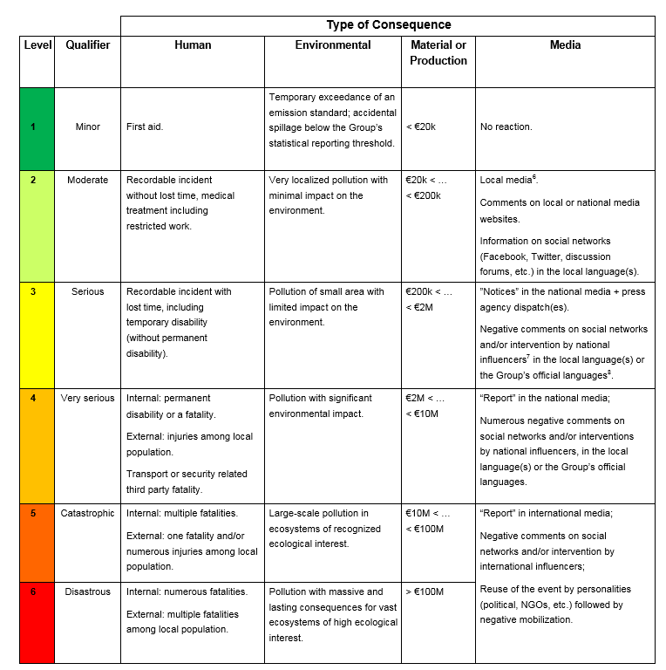
EVALUATION MATRIX OF ACTUAL AND POTENTIAL SEVERITY LEVELS OF HSE EVENTS

Slide 9
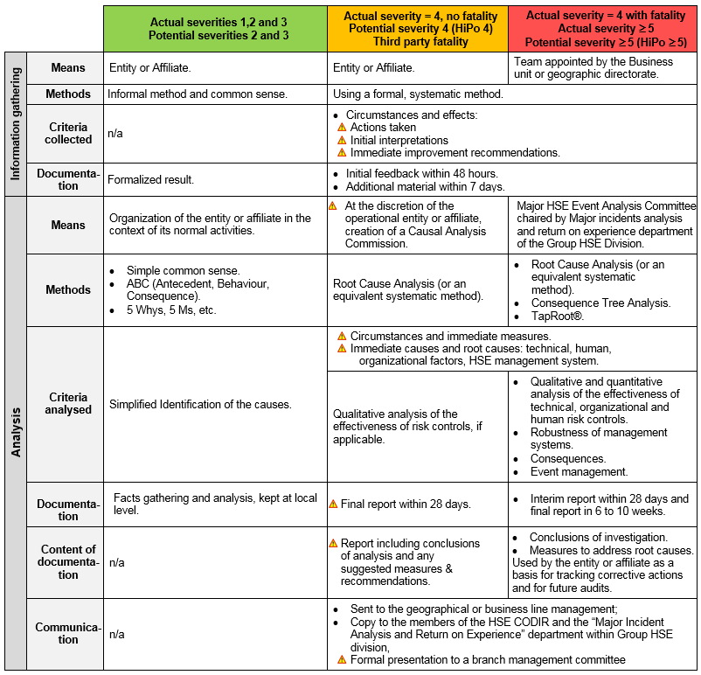
HSE EVENT ANALYSIS METHODS
For real severity 4 without death and HIPO = 4: done at the discretion of the entity or affiliate, but mandatory when the entity or the affiliate establishes an "HSE Event Analysis Commission".

Slide 10
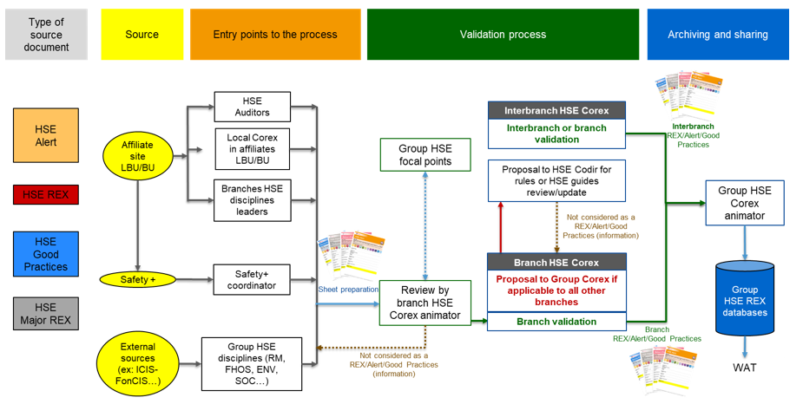
SCHEMATIC OF THE HSE REX VALIDATION PROCESS

Slide 11
DOCUMENTS USED FOR THE GAP ANALYSIS
Branch |  | Reference |  | Title
Group |  | DIR-GR-SEC-002 DIR-GR-SEC-017 |  | Treatment of Accidents, Near Misses and Anomalies Return on Experience (REX)
E&P |  | CR-EP-HSE-101 CR-EP-HSE-102 CR-EP-HSE-103 CR-EP-HSE-121 |  | Investigation of Major Accidents HSE Events – Definitions, Reporting and Recording Board of Enquiry Improving HSE Performance: Key Performance Indicators and Feedback
M&S |  | CR-MS-HSEQ-131 |  | H3SEQ Event Analysis and Return on Experience (REX)
R&C |  | CR-RC-HSE-001 CR-RC-HSE-132 CR-RC-HSE-108 |  | Treatment of Accidents and Incidents & Crisis Managment Incident and Accident Management Return on Experience
GRP |  | CR-GP-HSE-100 |  | HSE Reporting Accident Analysis REX

