Slide 1

The new Golden Rules
My Commitment, our Safety
Rev.1 – June 2022
Golden Rule 12
Line of Fire

Slide 2
01.
The essentials

Slide 3
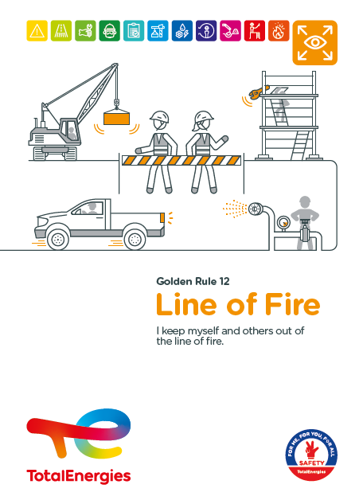
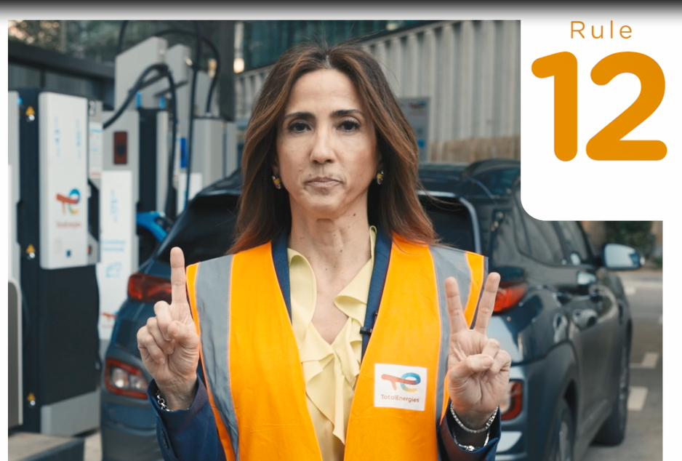

Poster & pictogram
The Golden Rule pictogram “Line of Fire"
represents an eye surrounded by 4 arrows pointing
in 4 opposing directions.
This pictogram symbolises constant vigilance
to the dangers around us, for ourselves and for
our colleagues.

Slide 4
Some definitions
CONCEPT OF « LINE OF FIRE »
EXAMPLES OF LINES OF FIRE
Being in the line of fire means being positioned in the path of a moving object or energy discharge.
Lines of fire are not always visible or previously identified. They can vary or be introduced by other activities in the area (co-activity, simultaneous operations).
Being positioned in the path of a falling object:
When falling, loose or unsecured objects can injure workers.
Being positioned in the path of a moving object:
A worker can be trapped, caught by a machine or hit by a moving object.
Being positioned in the path of a pressure release while working: Stored pressure can be released suddenly (compressed gas, vapour, liquid), causing projected parts or fluids to splash.
Being positioned in the path of a vehicle or machine:
A vehicle or machine may come into contact with a worker, pedestrian or cyclist, particularly in areas of co-activity.

Slide 5
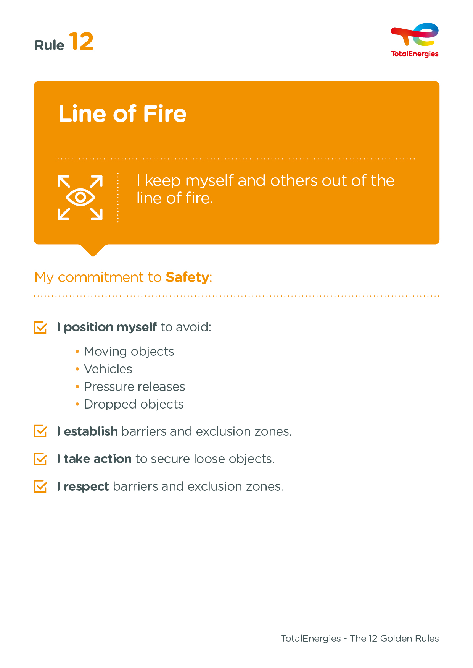
The essence of Golden Rule 12
The objectives of Golden Rule 12 include:
Raise awareness of the risks of being positioned in the "line of fire".
Ensure that everyone is aware of the environment in which they are operating and positions themselves to limit exposure to danger.
Remind people of the importance of shared vigilance.
Reinforce the installation of safety barriers and make the risk zones visible by taking into account the lines of fire.
Ensure that unsecured objects that may accidentally move or fall are secured.

Slide 6
Line of Fire incidents
ACCIDENTS IN THE COMPANY WHERE A REQUIREMENT OF GOLDEN RULE 12 HAS BEEN BREACHED (2012-2021)
EXAMPLES OF RISKS
ASSOCIATED WITH LINES OF FIRE
Despite the safety measures put in place, risks remain:
2
Injuries from
falling objects
Crushing, collision
with engines or vehicles
Fatalities
ND*
Mechanical risk (entanglement, crushing, jamming), ...
linked to stored energy
or to the starting of equipment
Projections
(fluids, objects) from pressurised systems
Lost time accidents
ND*
Collision, crushing, entanglement
with a moving object
or equipment
Burns, electrification
or electrocution from overhead or underground power lines
HIPO (High Potential)
* NA (not available): all the events of the period have not been reassessed according to this new Golden Rule.

Slide 7
02.
REX

Slide 8
Illustration of requirements
REQUIREMENT | EVENT | SLIDE
1. I position myself to avoid moving objects. | PERSONNEL CRUSHED DURING MAINTENANCE OF AN UNDERWATER ROBOT | N°9
1. I position myself to avoid vehicles. | FATAL ACCIDENT OF A DRIVER | N°10
1. I position myself to avoid pressure releases. | IMPACT ON VISOR BY A HIGH PRESSURE HOSE | N°11
1. I position myself to avoid dropped objects. | FALLING SCAFFOLDING MATERIAL | N°12
2. I establish barriers and exclusion zones. | DROWNING IN A SETTLING POND | N°13
3. I take action to secure loose objects. | 9 M FALL OF SCAFFOLD DECKING (23KG) ONTO A WELDER | N°14
4. I respect barriers and exclusion zones. | COLLAPSE OF A METAL STRUCTURE | N°15
The descriptions of the circumstances and consequences have been simplified for a better understanding
A link to each REX is available for more information

Slide 9

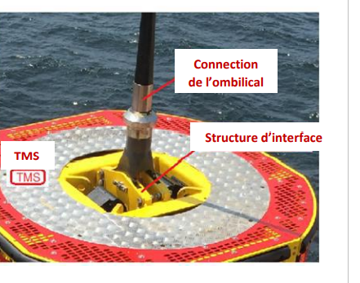
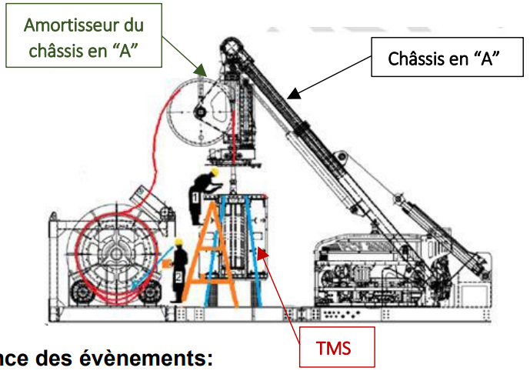
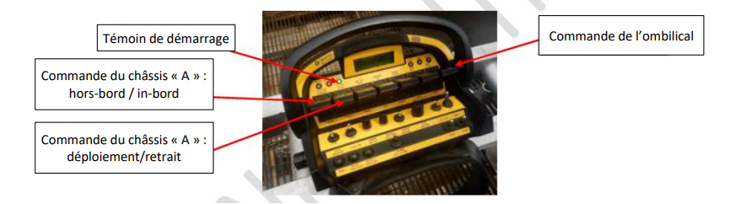
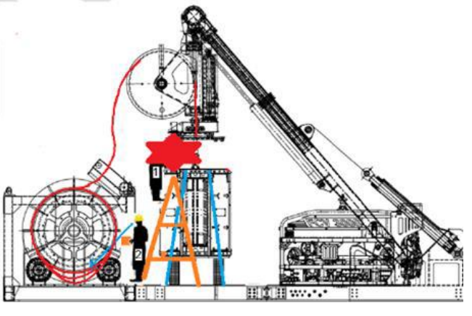
REX
1. I position myself to avoid moving objects.
> PERSONNEL CRUSHED DURING MAINTENANCE OF AN UNDERWATER ROBOT
CIRCUMSTANCES – FACTS
  2 workers were carrying out maintenance work on an uderwater robot.
  The operation in progress consisted of reconnecting the robot's attachment system (known as the TMS) to its power supply cable (known as the umbilical).
  The first worker was standing on a ladder, with his upper body engaged between the frame and the roof of the TMS.
  The second worker held the remote control console in his hands. His intention was to adjust the umbilical to facilitate the first worker’s intervention.
  However, the technician unintentionally lowered the chassis.
CONSEQUENCES
  Death of the worker.
LESSONS TO BE LEARNED
I identify equipment that can cut, trap or entrap me and position myself to avoid lines of fire (this applies to the positioning of all or part of the body, including the hands).
CAUSES
  Position of the operator between the TMS roof and the chassis.
  Accidental or incorrect handling of the system remote control.
  Lack of specific maintenance procedure/work instruction.
  Small team without supervisor.
1
2
Umbilical connection
Frame
Interface structure
2
3
1
4
Start indicator
Umbilical
remote control
Frame contro: outboard/inboard
4
Frame control: deploy/retreat
3
Click here to access the REX

Slide 10
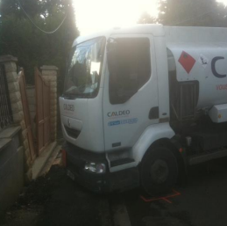
REX
1. I position myself to avoid vehicles.
> FATAL ACCIDENT OF A DRIVER
CIRCUMSTANCES – FACTS
  After a delivery to a private home,
  the driver tried to adapt the road access to avoid contact with the vehicle bumper.
  He got out, engine running, without applying the parking brake and without putting on a chock, to take a wooden board to raise the passage of his truck.
  The truck then started to move
  and crushed him against the pillar
  of the house.
CONSEQUENCES
Death of the driver.
LESSONS TO BE LEARNED
I identify the risk and eliminate it (if possible):
  In this case, I apply the parking brake before getting out of my vehicle.
I do not stand in the path of a vehicle that may start moving.
CAUSES
  brake not applied and chock not placed, although the road was sloped.
  No "park brake not applied" warning beep due to the age
  of the truck (pre-2007).
  The driver was positioned
  in the potential path
  of the truck.
Click here to access the REX
Caution: Office car parks
are also affected by this requirement

Slide 11
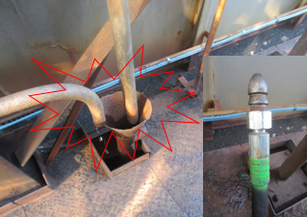
REX
1. I position myself to avoid pressure releases.
> IMPACT ON VISOR BY A HIGH PRESSURE HOSE
CIRCUMSTANCES – FACTS
  A worker proceeded to unblock a pipe with a high-pressure hose, passing through a funnel.
  The worker was kneeling over the funnel to guide the hose.
  When the pressure was applied, the hose came out of the pipe and hit him hard on his helmet.
CONSEQUENCES
Forehead wound (HIPO).
LESSONS TO BE LEARNED
  Accumulated pressure can be released suddenly.
To intervene safely:
I ensure that operating procedures are followed and report any downgraded situation.
I am trained in high-pressure operations and carry out
the necessary checks.
I do not position myself in the potential ejection path
of the hose, as far as possible.
CAUSES
  No anti-ejection device provided for in the operating procedure.
  The operator was in the path of the hose ejection during his intervention.
Click here to access the REX

Slide 12
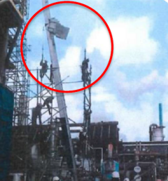
REX
1. I position myself to avoid dropped objects.
> FALLING SCAFFOLDING MATERIAL
CIRCUMSTANCES – FACTS
  A scaffolding company was using a furniture lift truck to transport scaffolding elements to a height of 31 m.
  The foreman performed the manoeuvres from the control at the base of the truck, in order to manage the speed, which
  was not possible with the remote control.
  After several trips back and forth,
  the loaded bin derailed during the ascent from a height of 10 metres.
  The bin remained attached, but the scaffolding elements it contained fell
  to the ground within the marked area.
  The foreman stepped aside just in time.
CONSEQUENCES
No actual consequences but potential serious injury (HIPO).
LESSONS TO BE LEARNED
I am aware of the environment in which I am operating and
I position myself in such a way as to limit exposure to danger.
To avoid putting myself in danger:
I take into account the risk of falling objects when preparing
any operation.
I implement the collective prevention measures defined in the
work permit.
I position myself so as to minimise the risk of falling objects.
If I am not safe, I stop my work.
CAUSES
  Incorrect distribution
  of the load in the bin
  of the lift.
  Using the control
  at the base of the truck required positioning
  in the line of fire.
Click here to access the REX
Safety perimeters during work or operations
in offices must also be respected.

Slide 13
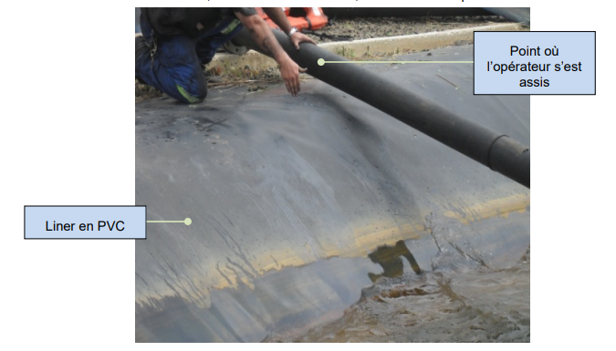
REX
2. I establish barriers and exclusion zones.
> DROWNING IN A SETTLING POND
CIRCUMSTANCES – FACTS
  Two workers were taking a lunch break
  at the edge of a settling pond.
  One of them sat on a 5" PVC pipe through which the water is conveyed
  to the pond.
  The cantilevered pipe bent under the weight of the worker, who slipped and fell into the water.
  Despite the rapid intervention of his colleagues, the worker was unable to climb back onto the bank and drowned.
CONSEQUENCES
Death of the worker.
LESSONS TO BE LEARNED
I stay out of the line of fire and I ensure that others
do the same.
Risks are identified and safety barriers and perimeters
are installed.
CAUSES
  Free access to the settling pond due to the absence of a collective protection barrier.
  Pipework sting on its flange, and without rigid attachment.
  No means for a person who has fallen into the water to climb back up onto the bank (pond equipped with a perfectly smooth and slippery liner - "slide" effect).
Point where the operator sat
PVC liner
Click here to access the REX

Slide 14
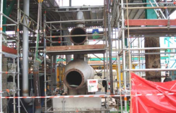
REX
3. I take action to secure loose objects.
> 9 M FALL OF SCAFFOLD DECKING (23KG) ONTO A WELDER
CIRCUMSTANCES – FACTS
  The day before the accident,
  an opening was made in two levels
  of existing scaffolding in preparation for lifting work. The openings were protected by guardrails but no toe boards were fitted. The removed scaffolding decks were stored on the floor near the opening.
  On the day of the accident, a pipe fitter, who was present on the floor of the second level, tried to grab some material from the basket in front of him. He then unintentionally kicked a deck stored near the opening. The deck slipped,
  fell through the hole, bounced off
  the structures, before falling on the neck of a welder working on the floor 9 metres below.
CONSEQUENCES
Neck pain and dizziness for the welder. Potential serious personal injury (HIPO).
LESSONS TO BE LEARNED
I secure loose objects and I put up safety barriers.
I analyse my environment, I identify and I assess
the associated risks.
I avoid exposure (my own and others) to potential lines of fire,
and I ensure that safety barriers are respected.
CAUSES
  No toe board around the floor opening.
  Equipment stored and not secured near an opening.
  Interference between the two activities (pipe fitting above a welding operation).
  Lack of floor markings during assembly work.
Do not store objects high up in the office (on a cupboard, etc.).
Click here to access the REX

Slide 15
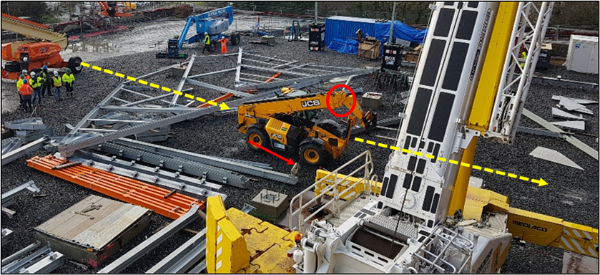
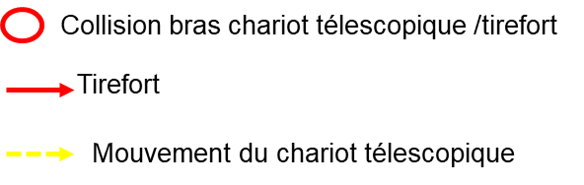
REX
4. I respect barriers and exclusion zones.
> COLLAPSE OF A METAL STRUCTURE
CIRCUMSTANCES – FACTS
  A worker was using a telescopic forklift to move a generator located in an assembly area of a metal structure.
  To do so, he removed the barrier-chain that defined the safety perimeter of the assembly area.
  While moving, the forklift caught a tensioned cable that was holding the steel structure. This structure then collapsed, damaging the rear of the machine.
  Another worker, who was under the structure, managed to quickly leave the impacted area. However, he slipped and fell on the ground, landing on his hands.
CONSEQUENCES
Potential physical consequences (HIPO).
LESSONS TO BE LEARNED
I am aware of the environment in which I am operating and
I position myself in such a way as to limit my exposure to danger.
I respect the barriers and safety perimeters, which make it possible to make risky areas visible.
CAUSES
  Removal of safety barriers.
  Lack of coordination
  of the different tasks and associated risk assessment.
Collision forklift telescopic arm / manual cable winch
Cable winch
Mouvement of the forklift
Location of the worker
Evacuation route of the worker
Safety perimeters during work
or operations in offices must also
be respected.
Click here to access the REX

Slide 16
03.
Further information

Slide 17
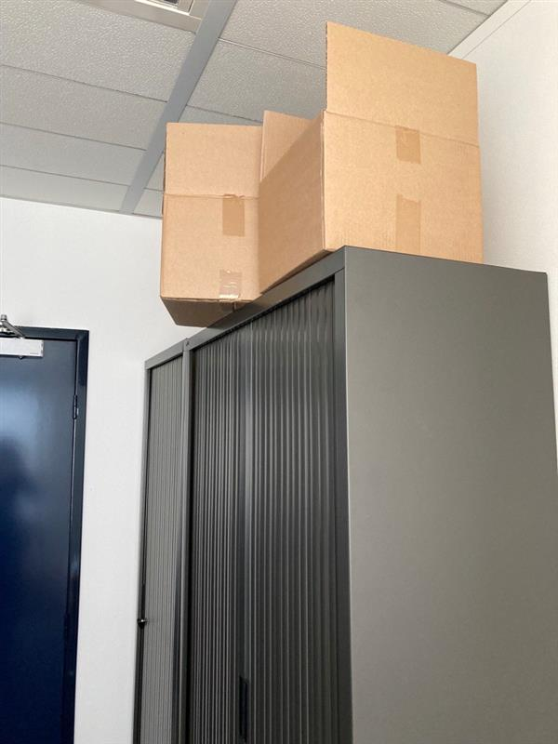
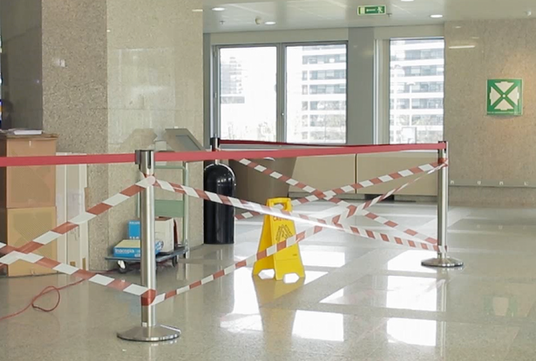
Examples of lines of fire in the office
I respect the safety barriers (work or cleaning).
I don't put things on top of cupboards, etc.
I am vigilant when opening doors or passing by doors.
I pay attention to the trajectories of vehicles manoeuvring in car parks.
I pay attention to the trajectories of scooters, bikes, etc.
At the office, I am also implicated!

Slide 18
Our tools and documents
HSE Toolbox (booklets and posters):
https://toolbox-hse.totalenergies.com/en
REX database:
https://totalworkplace.sharepoint.com/sites/GroupHSEREXDataBase/en-us/Pages/REX%20HSE%20Home.aspx
Safety + (good practices per Golden Rule):
https://safetyplus.totalenergies.com/en

Slide 19
Lexicon
Hazard: An intrinsic property of a product, equipment, process, situation or action that can result in harm to people, the environment and/or assets.
Risk: The combination of the probability of occurrence of a hazardous event and the severity of the impact that may result from exposure to the hazard.
HSE events:
  Incident: Any sudden and undesirable HSE event on a given date, that causes injury or illness, damage to property or facilities, loss of production, environmental damage or damage to the Company's image.
  Near miss : Any sudden and undesirable HSE event on a given date which, in slightly different circumstances, could have had the same consequences as an incident. A near miss does not have an actual severity level but has a potential severity level.
  Anomaly: Any abnormal situation or behaviour, including deviations from a standard, specification, procedure or rule.
HIPO (High Potential) [slide 6]: Incident or near miss with an actual severity level ≤ 3* and a potential severity level ≥ 4** in one or more areas of the Company’s evaluation matrix of the actual and potential severity level of HSE events.
REX HSE: Document for sharing information on an internal or external HSE event, based on a detailed analysis and making recommendations.
* For example, physical consequences with an actual severity level = 3 correspond to a lost time accident.
** For example, physical consequences with a potential severity level of 4 correspond to a fatality.

