Slide 1
Environmental Management and Protection in Operations HSE GROUP RULE (CR-GR-HSE-411)
SUMMARY
This rule defines the minimum HSE requirements to be observed for the management and protection of the environment during operations.

Slide 2
CR-GR-HSE-411
Context:
The environmental performance of our operations: a challenge for the Group's image
2010 - 2020: commitments on environmental indicators (air quality, water, waste, etc.)
2020: new biodiversity ambition for the Group
Scope: all entities of the operated domain
Defines 17 requirements, grouped into 3 themes:
Organization and management system
Environmental risk management
Environmental practices in operation
Replacing branch document :
CR MS HSEQ 416​, CR MS HSEQ 421
Date of publication in REFLEX: 26/10/2020
Effective date: 26/04/2020

Slide 3
REQUIREMENTS
→ No change
Requirement perimeter change witouth impacting MS sites
Only 2 sites within Lub&Spe are concerned

Slide 4
REQUIREMENTS
No change
MS sites not concerned. Voluntary step for certain sites.
NEW
→ New requirement for: EP, MS, GRP

Slide 5
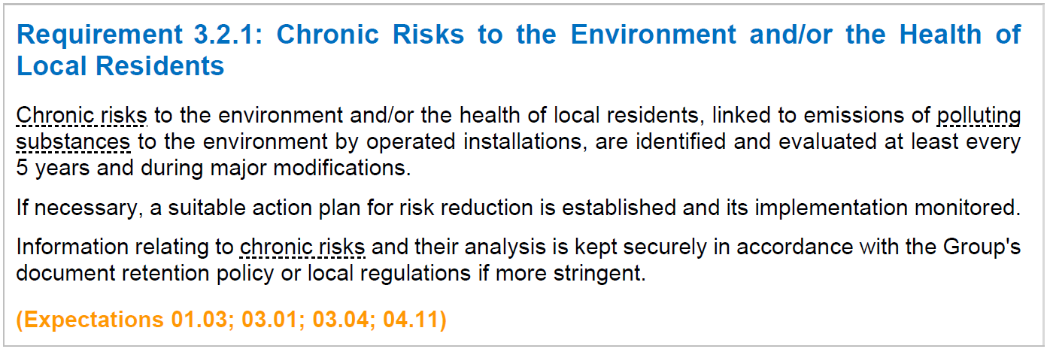
REQUIREMENTS
NEW
→ New requirement for: RC, MS, GRP
→ No change

Slide 6
REQUIREMENTS
New requirement for all branches: maximum quantities stored
Lub&Spe more concerned
→ No change

Slide 7
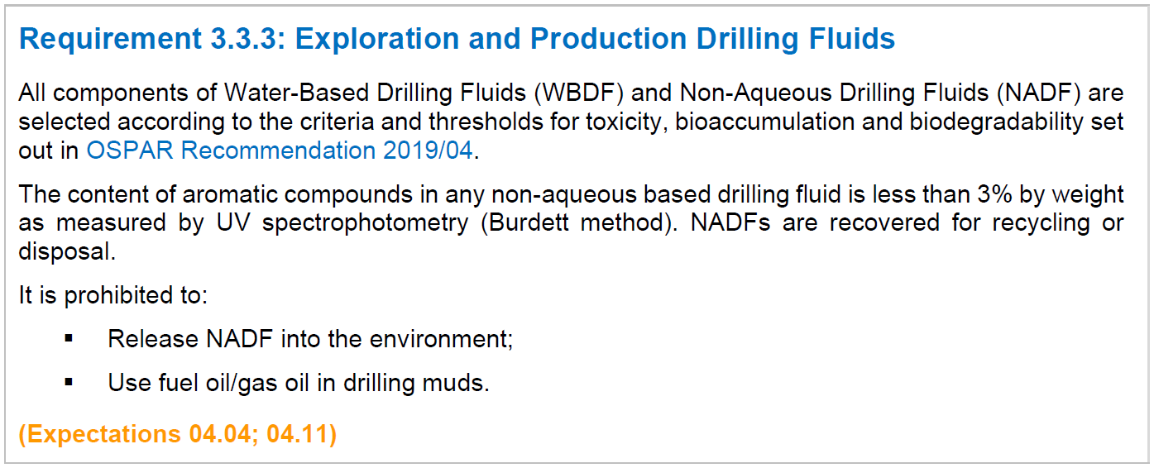
REQUIREMENTS
→ Not applicable to MS branch

Slide 8
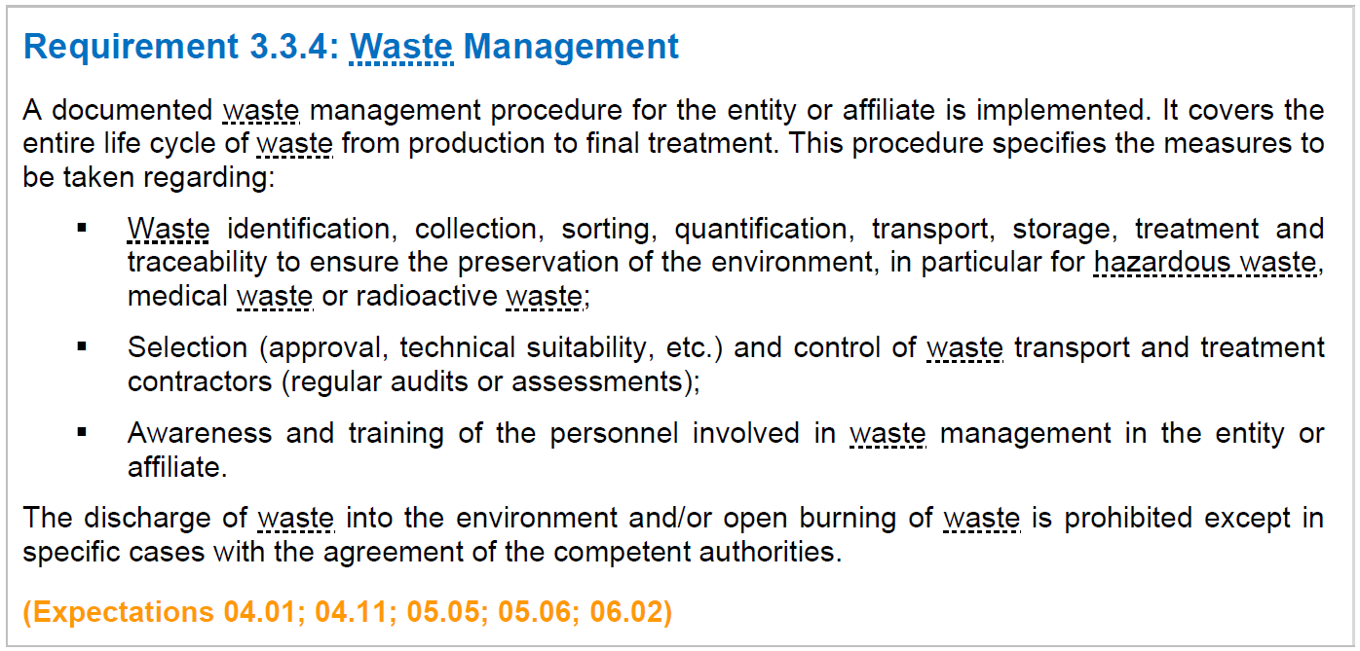
REQUIREMENTS
→ No change

Slide 9
REQUIREMENTS
→ Not applicable to MS branch

Slide 10
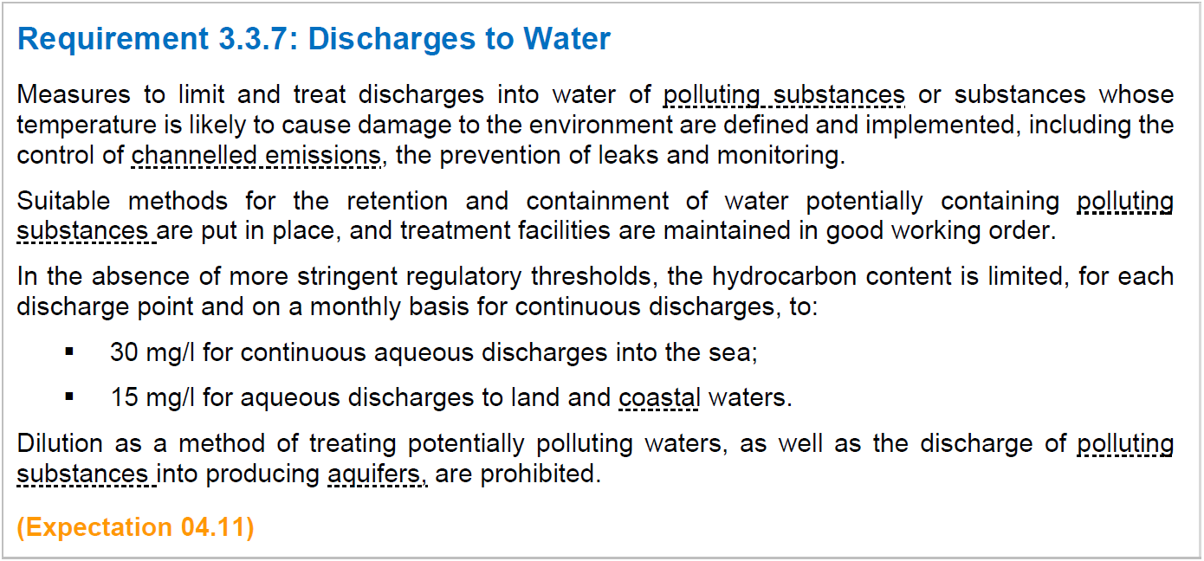
REQUIREMENTS
→ No change
→ No change. Process waters only generated at Oudalle and Brunsbuttel

Slide 11
REQUIREMENTS
No change
All MS sites are concerned
No change
Low risk. Possible causes: odour for bitumen sites, noise or odour for gas bottling sites.

Slide 12
REQUIREMENTS
NEW
New requirement for all the branches : ARM process reinforced
In 2020, around 100 stations and 10 sites are located in IUCN zones I to IV or in a RAMSAR site
NEW
New requirement for all the branches : obligation to study ways of optimising the freshwater consumption
MS sites not concerned

