Slide 1
Safety Stand Down Webinar
May 2021

Slide 2
Covid Context
We acknowledge the difficulty of the global pandemic context and its impact on our operations.
Despite this difficult context, the Safety Stand Down was decided by our CDMS with regards to the number of recent accidents.
It must be organised in the best conditions with due respect for local and Group sanitary precautions.
The Safety Stand Down is to take place on may 20th. Related operations can however be spread over 30 days so that the whole drivers population (dedicated contracted and owned fleet) can be covered.
TO PROTECT YOURSELF AND OTHERS FROM CORONAVIRUS
Wash your hands very often
When coughing or sneezing, cover your mouth and nozewith your arm or use a disposable tissue
Dispose of any tissues you have used
Avoid close contact with greeting people
1 m

Slide 3
SAFETY STAND DOWN FRAMEWORK
CONTEXT
OBJECTIVES
52 severe or potentially severe truck accidents including 31 rollovers (4 rollovers in april 2021) since january 2020.
After several years of decreasing accident rates, our results have stagnated.
Driver behaviour is considered as predominant immediate cause of serious road transport accidents.
Accidents categorized as « behaviour » are those where driver’s intentional or non-intentional actions are considered as main immediate accident cause.
Some of these accidents may find their deeper roots in weaknesses of our organization, or in the way our requirements are deployed (violation-based logic, sanction policy etc).
Understand situations encountered by the drivers without blaming them.
Highlight main truck accident scenarios ie their causes and their actual or potential consequences.
Share major accident examples.
Share important messages with our transporters and drivers.
Together with our transporters and drivers, identify and capture improvement insights.

Slide 4
SAFETY STAND DOWN FRAMEWORK
MAIN TOPICS
TYPICAL SEQUENCE
Causes and consequences of our road traffic accidents.
The way fatigue deteriorates driver safety performance.
How distractors can mobilize attention away from the road.
Necessity to adjust one’s speed based on road conditions.
Messages by Alexis VOVK.
Core presentation.
Participative workshop.
TARGET AUDIENCE
Transporters / drivers operating contracted dedicated vehicles & owned fleet drivers.
When possible, include transporters operating for Total on spot contracts.

Slide 5
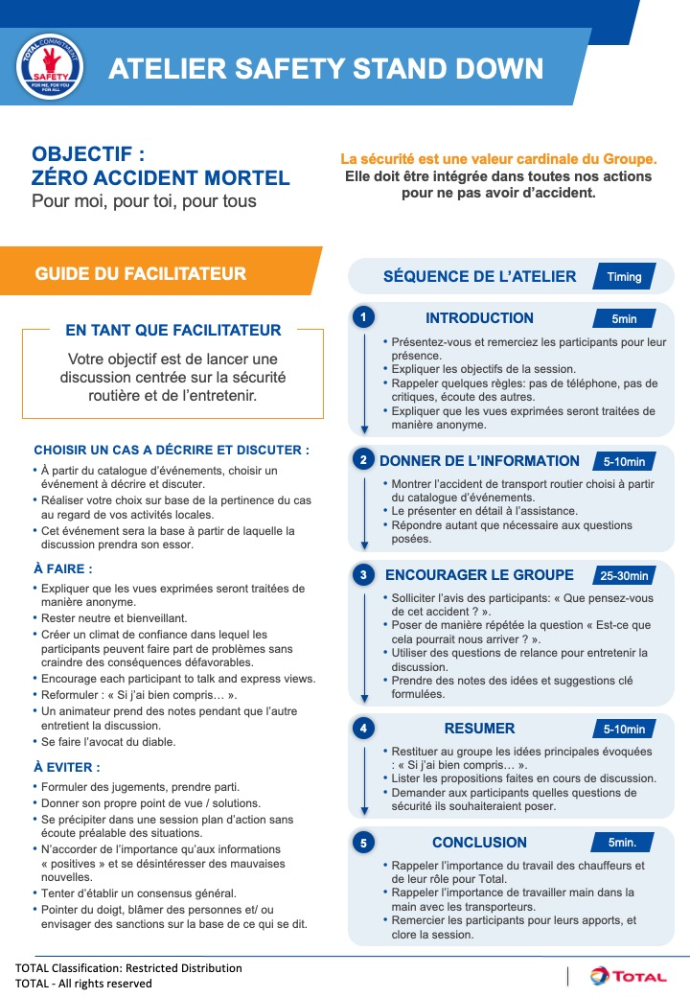
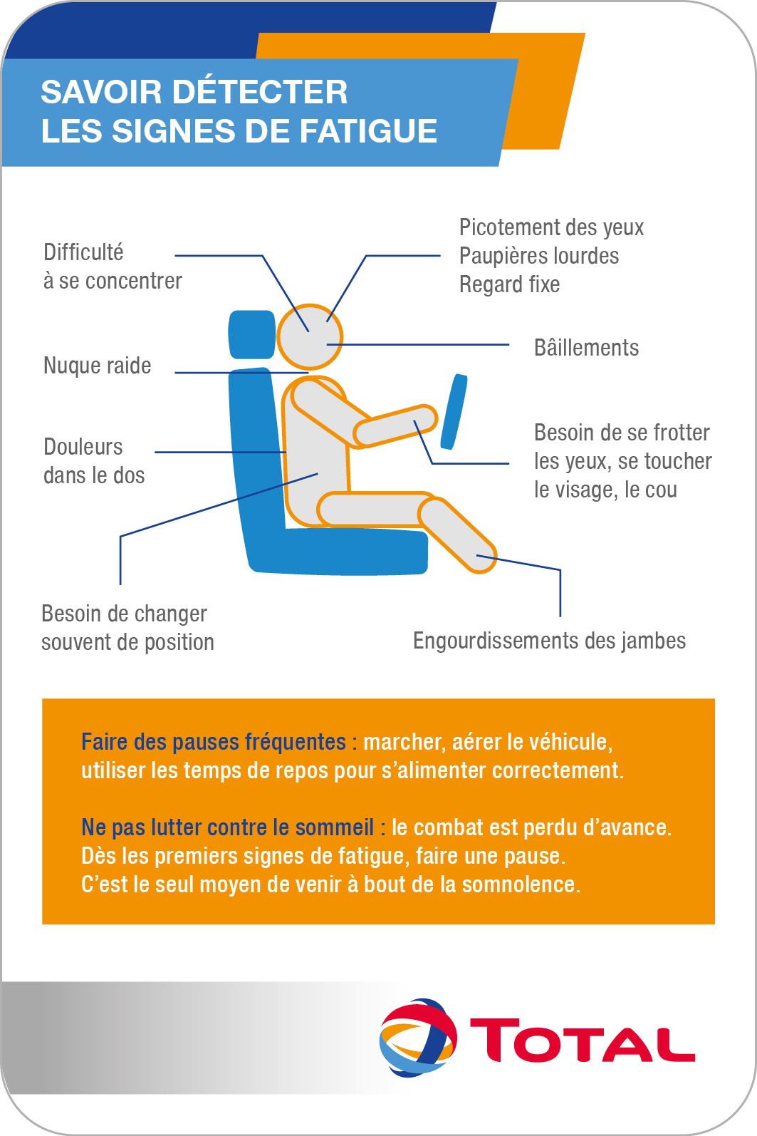
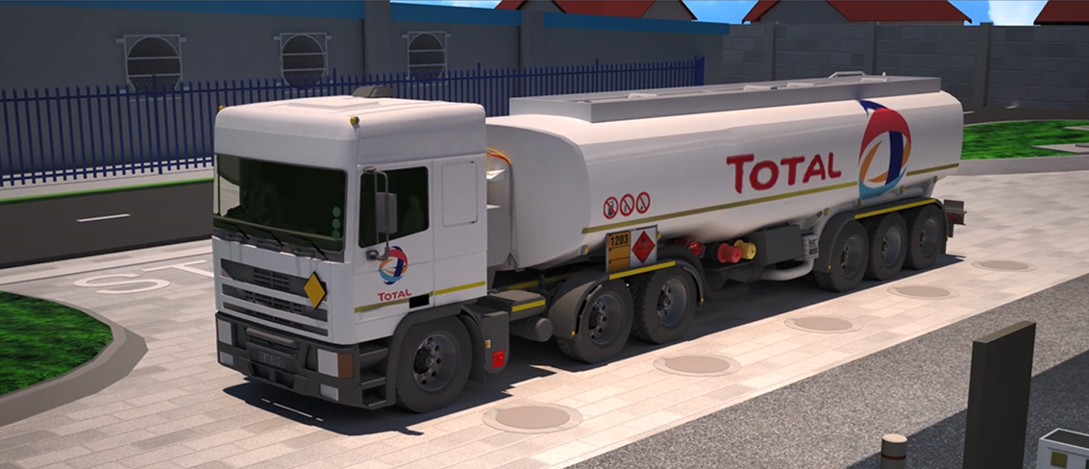
SSD SUPPORTING ELEMENTS
ALEXIS VOVK VIDEO
CORE PRESENTATION
EVENTS REPOSITORY
WORKSHOP GUIDELINES
TOPIC BASED ANIMATIONS
CARD & POSTER

Slide 6
KEY MESSAGES
We (Drivers, Transporters, Total) must do everything we can to further reduce our impact.
We are professionals, and not just random road users.
Despite difficulties, despite constraints, despite other road users, we must keep leading by example.
We must follow local driving rules as well as Total driving rules.
Safety rules are aimed at protecting ourselves as well as others.
Safety must take precedence over pure compliance with requirements.
Our behaviour is the key to our safety, that of other road users and of the public.
No journey is important enough to risk our life or the lives of others.

Slide 7
SSD WORKSHOPS
Create an opportunity to talk with our drivers about serious road traffic accidents.
Highlight and discuss potential accident root causes incl. weaknesses in our organisation.
Together with our transporters and drivers, identify improvement insights.
WHY
Understand how participants manage the risks associated with their journeys.
Launch a discussion focused on road safety and make sure it keeps running.
WHAT
Total leads the organization of the workshops, hand in hand with transporters.
Duets made of Total and transporter representatives facilitate the discussion.
WHO
During 45min-1hr, two facilitators debate with a group of 20 drivers.
With the help of a facilitator’s presentation and guide.
From the events repository, chose a case that will be used to start the discussion.
HOW
Notes:
REPLACE INTEGRATED CULTURE PICTURE

Slide 8
CALENDAR
20/05-20/06
03/05-07/05
20/05
Additional SSD sessions with remaining personnel.
Those sessions can be managed by transporters.
Zone by Zone webinars to present the initiative.
Safety Stand Down launched in all Affiliates
e
Before 07/05
Before 25/05
20/06-02/07
All supporting elements made available in the HSE Toolbox.
Communication of basic SSD information (est. nb of participants, nb of sessions conducted, pictures & movies) to the Zone.
Communication of further information (est. overall nb of participants, overall nb of sessions conducted). Workshop consolidations sharing, within the Affiliate and / or with the Zone if deemed necessary.

