Slide 1
Emergency & Crisis Management​ GROUP HSE RULE (CR-GR-HSE-701)
EXECUTIVE SUMMARY
This rule defines the minimum requirements related to maintaining an appropriate state of readiness to respond to an emergency or crisis situation and mitigate its consequences. This can include both HSE and non-HSE events.

Slide 2
Purpose: Requirements to maintain an appropriate state of readiness to respond to an emergency or crisis situation and mitigate its consequences. Covers the management of emergencies and crises at three levels: entities and affiliates, Branches and Group crisis support.
Scope of Application: Applicable to all operated Group entities and affiliates.
Replaces:
DIR-GR-SEC-020 Crisis Management
CR-MS-HSEQ-801 Crisis Management
CR-RC-HSE-001 Treatment of Accidents and Incidents & Crisis Management
CR-RC-HSE-125 Emergency Planning & Response
CR-EP-HSE-091 Managing emergencies/crises within affiliates
CR-EP-HSE-093 Large Scale Exercises (LSE)
CR-GRP-HSE-0702 Emergency Preparedness
REFLEX publication date: 30/09/2019.
Effective date: 3 months following date of publication.

Slide 3
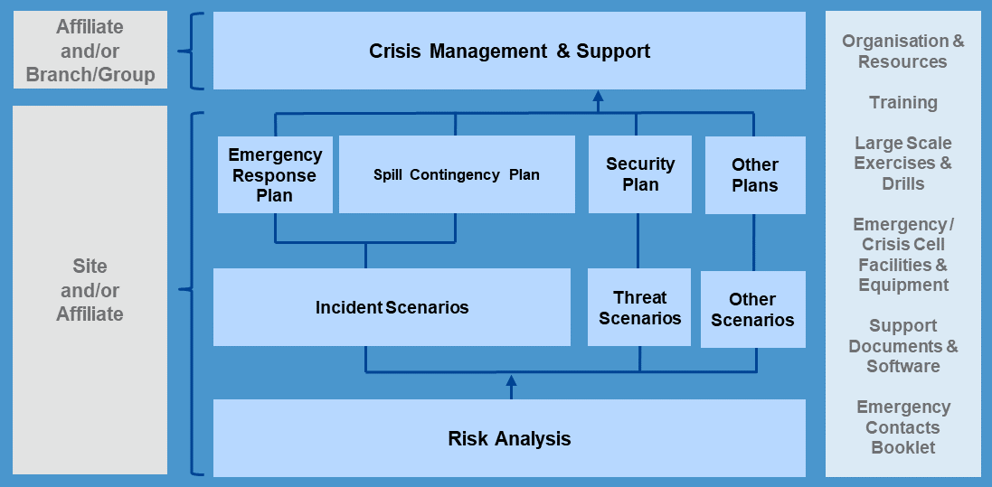
EMERGENCY AND CRISIS PREPAREDNESS COMPONENTS
Figure 1: Emergency and Crisis Preparedness Components

Slide 4
REQUIREMENT OVERVIEW: Emergency and Crisis Preparedness
Risk Analysis and Scenario Evaluation (Requirement 3.1.1)
Emergency and crisis scenarios and their consequences identified in the risk studies and/or assessments, are analysed to develop appropriate response strategies, organisation and resource requirements.
The analysis includes legal aspects and other applicable compliance obligations.
No change
Emergency Response Plans (Requirement 3.1.2)
Emergency response plans (ERP) are established according to the needs of each entity or affiliate as identified in 3.1.1.
ERPs are made available to the division in charge of crisis management and oil spill response and other support teams as identified by the relevant Branch to allow for crisis support according to this rule.
No change

Slide 5
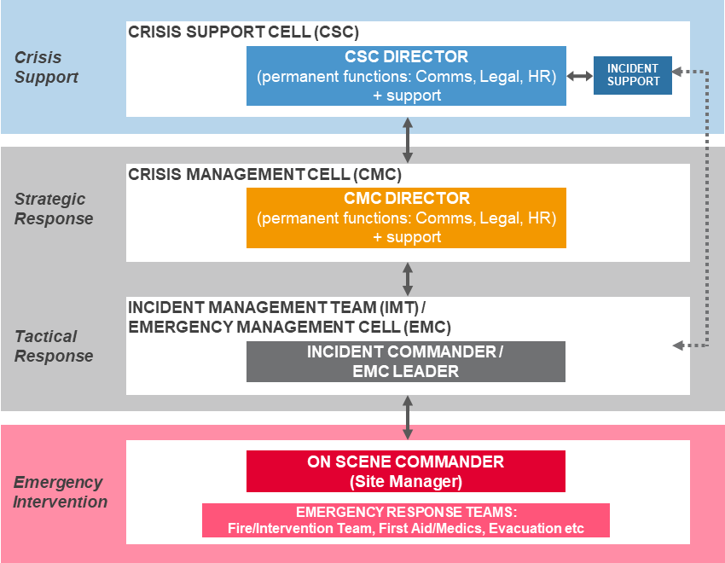
REQUIREMENT OVERVIEW: Emergency and Crisis Preparedness
Emergency and Crisis Management Organisation (Requirement 3.1.3)
The emergency and crisis management organisational structure is put in place.
The predefined organisational structure is scalable according to the nature, complexity, duration and potential development of the emergency or crisis situation.
In countries where multiple Group entities are present, the Country Chair facilitates coordination and mutual aid.
Roles and responsibilities are defined.
New requirement
Formalization of a new requirement already in practice since the memo "Country Chair Chair roadmap Implentation plan" (1 Oct 2017).
Figure 2: Emergency and Crisis Management Organisational Structure

Slide 6
REQUIREMENT OVERVIEW: Emergency and Crisis Preparedness
Emergency and Crisis Cell Facilities and Equipment (Requirement 3.1.4)
Facilities are appropriately designed, sized and pre-equipped to accommodate the emergency and crisis teams and associated functions.
The locations of facilities and associated equipment, including alternative rooms plus back-up equipment, are documented in the ERP and communicated to the emergency and crisis teams.
No change
Training (Requirement 3.1.5)
All personnel likely to take part in an emergency or crisis response undertake initial and refresher training based on the functions they would need to fulfil.
No change

Slide 7
REQUIREMENT OVERVIEW: Emergency and Crisis Preparedness
Exercises and Drills (Requirement 3.1.6)
The frequency and type of emergency and crisis response exercises and drills are defined in the respective ERP. The exercises and drills are based on analysed risks and/or incident scenarios.
Large Scale Exercises (LSE) are conducted for sites exposed to significant technological or environmental risks, as a minimum annually, including at least one site and the entity or affiliate’s headquarters.
Members of emergency and crisis teams participate in an exercise or drill as a minimum once every 3 years.
New requirement
Information and Communication Protocols (Requirement 3.1.7)
Means and procedures are put in place for information and communication during emergencies and crises, including:
On site (location of the emergency and crisis situation);
Between site and entity or affiliate emergency and crisis management teams;
Between an entity or affiliate and a Branch or Group (crisis support);
With surrounding communities and stakeholders, including internal staff, authorities, public and media.
No change

Slide 8
REQUIREMENT OVERVIEW: Emergency and Crisis Management
The process for managing emergencies and crises involves following 6 key phases.
ALERT
MOBILISATION
EMERGENCY / CRISIS RESPONSE
DE-BRIEFING
DE-MOBILISATION
REX
Figure 3: Emergency and Crisis Management Process

Slide 9
REQUIREMENT OVERVIEW: Emergency and Crisis Management
Alert Schemes (Requirement 3.2.1)
Alert schemes are documented in the ERP for both duty (on-call) and hierarchical channels.
They define the chain of alerts from the location of the emergency or crisis situation, through on-scene command, tactical and strategic response cells within the affiliate, to crisis support at Branch and/or Group levels.
The duty channel is accessible and operational 24 hours per day. The roles and instructions for concurrently alerting both the duty and hierarchical contacts are defined and communicated to relevant personnel.
No change
Mobilisation (Requirement 3.2.2)
Conditions and responsibilities for activating ERPs and mobilising appropriate emergency response and crisis management teams are defined in the ERP.
No change

Slide 10
REQUIREMENT OVERVIEW: Emergency and Crisis Management
Emergency and Crisis Response – Action Planning (Requirement 3.2.3)
FISA (Facts, Impacts, Stakeholders, Actions) methodology, including PEARL (People, Environment, Assets, Reputation, Liabilities), and a formal planning process are used to systematically develop, implement, follow-up, and document emergency and crisis response action plans.
New requirement
FISA methodology is new, but already in practice in some affiliates.
Emergency and Crisis Response - External Resource Mobilisation (Requirement 3.2.4)
Agreements are put in place for the mobilisation of specific local and/or regional resources in relation to the defined emergency and crisis scenarios.
Call-out Authorities are identified and nominated to mobilise Group contracted resources.
No change

Slide 11
REQUIREMENT OVERVIEW: Emergency and Crisis Management
Emergency and Crisis Response – Data Management (Requirement 3.2.5)
A robust record keeping system is put in place to capture all documentation (e.g. chronograms, action plans, activity logs, forms, written correspondence) and is made available for Return on Experience (REX), legal and investigative purposes during or following an emergency or crisis.
No change
Debriefing (Requirement 3.2.6)
Once the emergency or crisis situation is over, or following an exercise or drill, a debriefing is conducted and recorded.
No change

Slide 12
REQUIREMENT OVERVIEW: Emergency and Crisis Management
Demobilisation (Requirement 3.2.7)
The site On Scene Commander, tactical (IMT/EMC) leader, strategic (CMC) and support cell (CSC) Directors demobilise and stand-down their respective staff to return to their normal duties (see Figure 2).
For a large-scale and complex incident, a formal demobilisation plan is necessary for a controlled and phased demobilisation of resources and personnel.
Data, equipment or other evidential material are preserved for investigation purposes.
No change

Slide 13
REQUIREMENT OVERVIEW: Continual Improvement and REX
Continual Improvement (Requirement 3.3.1)
Following an exercise, drill, emergency or crisis situation, identified corrective and improvement actions, where relevant, are documented in a report.
An action plan is developed and all action items are recorded and tracked in respective reporting tools.
Where important lessons can be learned and shared, a REX or HSE Alert is developed.
No change
ERP Review (Requirement 3.3.2)
ERPs are reviewed at least once every 5 years, or when one of the following situations occur:
Change to facilities, operations, environment, process, or types and volumes of hazardous substances handled impacting emergency and/or crisis scenarios and consequences;
Organisational changes that could impact response capabilities;
Significant feedback from an exercise, drill or an incident;
Following recommendations from an internal REX, high potential (HIPO) event or HSE Alert, or external lessons learned;
Changes in applicable rules or regulations.
New requirement
For EP and MS branches (review frequency was not defined). Already an annual review for RC and every 2 years for GRP.

