Slide 1
Environmental Management and Protection in Operations HSE GROUP RULE (CR-GR-HSE-411)
SUMMARY
This rule defines the minimum HSE requirements to be observed for the management and protection of the environment during operations.

Slide 2
CR-GR-HSE-411
Context:
The environmental performance of our operations: a challenge for the Group's image
2010 - 2020: commitments on environmental indicators (air quality, water, waste, etc.)
2020: new biodiversity ambition for the Group
Scope: all entities of the operated domain
Defines 17 requirements, grouped into 3 themes:
Organization and management system
Environmental risk management
Environmental practices in operation
Replacing branch document :
DIR-GR-ENV-001, DIR-GR-ENV-003, DIR-GR-ENV-005, DIR GR HSE 007, CR EP HSE 052, CR-RC-HSE-126, CR-RC-HSE-056, CR-RC-HSE-130, CR MS HSEQ 416​, CR MS HSEQ 421
Partially: DIR-GR-ENV-004​, DIR GR HIS 002​, CR EP HSE 051​, GS EP ENV 001​, GS EP ENV 055
Date of publication in REFLEX: 26/10/2020
Effective date: 26/04/2021

Slide 3
REQUIREMENTS
No change
Requirement perimeter change

Slide 4
REQUIREMENTS
No change
New requirement for: EP, MS, GRP

Slide 5
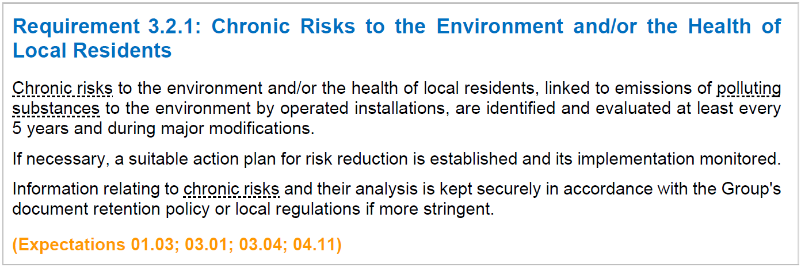
REQUIREMENTS
New requirement for: RC, MS, GRP
No change

Slide 6
REQUIREMENTS
NEW
New requirement for all branches: maximum quantities stored
No change

Slide 7
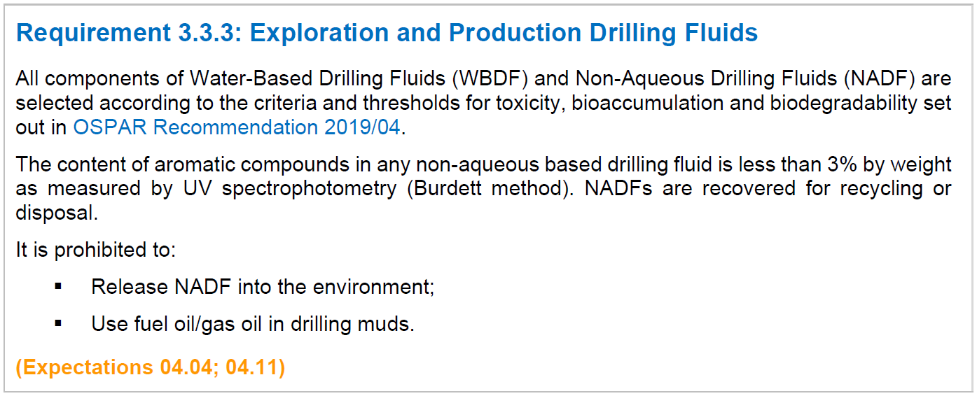
REQUIREMENTS
No change

Slide 8
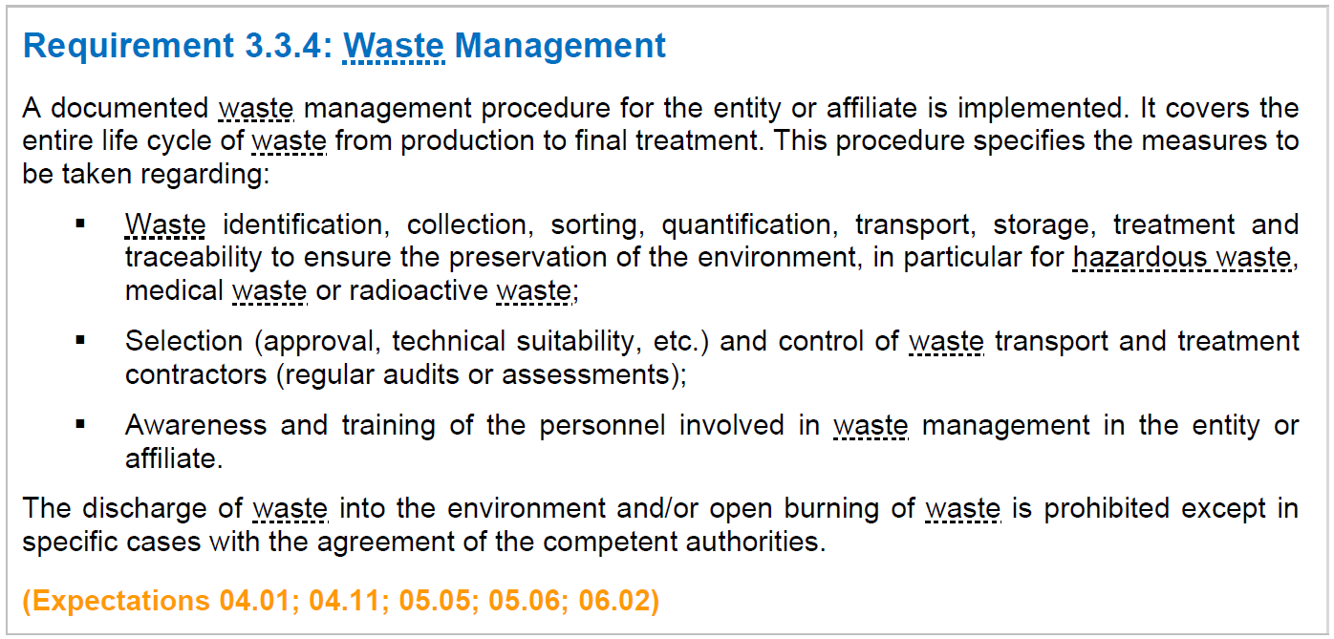
REQUIREMENTS
No change

Slide 9
REQUIREMENTS
No change

Slide 10
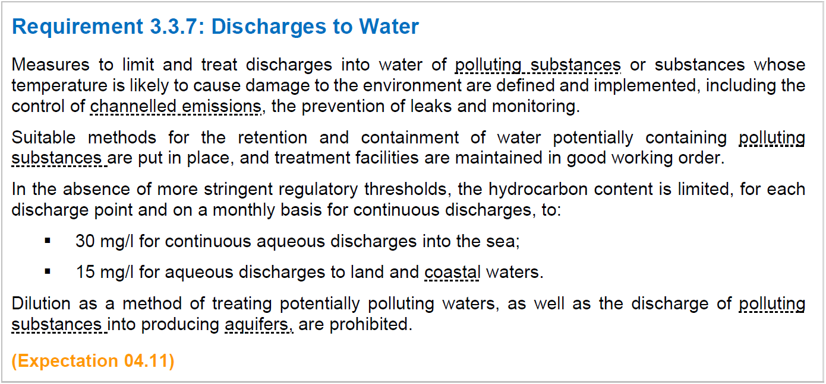
REQUIREMENTS
No change
No change

Slide 11
REQUIREMENTS
No change
No change

Slide 12
REQUIREMENTS
NEW
New for all branches: reinforcing the ARM process
NEW
New for all branches: obligation to optimize fresh water consumption

