Slide 1
World Day for Safety April 22, 2024
2013 Fire on Windmill at Ooltgensplaat
Netherlands – 2 fatalities
Notes:
Afin de respecter la dénomination de la Marque, merci de veiller à la bonne orthographe de TotalEnergies.
TotalEnergies s’écrit en un seul mot, sans espace, avec un « s » à la fin, avec le T et le E en majuscules, les autres lettres en minuscules, et pas d’accent sur le E majuscule.
Elle s’écrit bien TotalEnergies et non :
Total Energies (avec un espace)
totalenergies
total energies
Totalenergies
Total energies
totalEnergies
total Energies
TOTALENERGIES
TOTAL ENERGIES

Slide 2
Let's share 9 accidents that have marked the history of the Industry and of the Company
The Branches have selected 9 “historic” accidents of our industry or of the Company which are printed in our collective mind.
These incidents have been specifically chosen because they have led, through their analysis, to modify and improve our ways of operating and therefore to enhance the safety of our operations.
In the Manager Kit, each accident is summarized on a slide.
In addition to that, an additional media (PPT or video) will be provided in the HSE Toolbox for further explanation:
This PPT deals with the fire that occurred in 2013 on a windmill at Ooltgensplaat and that led to fatalities for the first time
We recommend that you use these media as part of your workshops to discuss these accidents and their lessons for the Company with all the participants.

Slide 3
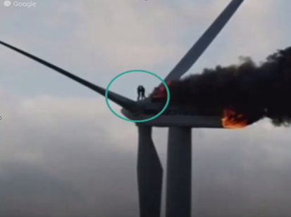
2013 Ooltgensplaat Windmill Fire (GRP) Netherlands – 2 fatalities
Summary of the facts
Deltawind’s Piet de Wit wind farm – first fatal accident due to a wind turbine fire.
Repairs were carried out in the nacelle by 4 technicians.​
A fire started in the afternoon, but it took until evening for a special team of firefighters to arrive and ascend with a large crane.
Only 2 mechanics managed to evacuate.
One fell to his death from the full height.
One died from burns inside the nacelle.
What has this accident changed in the safety of our operations?
Focus on inherently safe design to reduce risk of fire: electrical architecture design.
Focus on improved design for safety: safety venting, escape routes.
Evolve O&M philosophy towards more automation. For example:
Condition Monitoring System to determine the optimum point between corrective and scheduled maintenance through vibration/acoustic-controlled O&M techniques for the wind turbine and optical strain gauges for the blades.
IoT : Mobile Video Supportive System (MVSS), to send the information and direct the operator at the site location to selectively perform necessary operations.
Utilization of drones to perform inspection.
Global industry rethinking of operator training, focusing on the enclosed environment (development of immersive training).
Escape / Evacuation philosophy and associated operational procedure (to ensure safe evacuation), including specific training of firefighters and rethinking of fire-fighting techniques.
Rope based descent (RBD) Emergency Evacuation System.
Causes
Electrical short-circuit.
Dangerous phenomenon
Blast, fire.

Slide 4
2013 Ooltgensplaat Windmill Fire (GRP) Netherlands – 2 fatalities
This accident was the first turbine fire to result in fatalities. It shocked the industry globally, in Europe and USA in particular. It caused a real awakening, very strongly pushed by this photo that went around the world, of the 2 operators holding each other's arms and whose horrible end we know. This accident led to a revision in terms of the design of the wind turbines, not only intrinsically in terms of the electrical architecture, but also in terms of the vents, the layout of the interior space, the escape routes But above all, this accident has clearly changed the philosophy of operation and maintenance, with a great deal of work on automation and selectivity, always with a view to exposing humans as little as possible, for example by using drones for external inspection It has also changed the training, not only of operators but also of firefighters.
"Before", fires were attacked mainly from the outside via cranes.
"After", the firefighters were trained to reuse and improve their fire attack techniques in confined and vertical spaces.

Slide 5
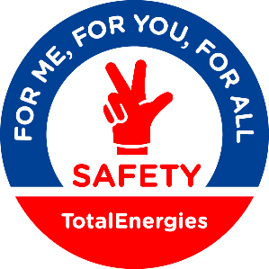
Enjoy your World Day for Safety 2024!

